Slide 1
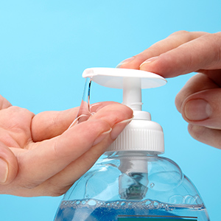
Infection control
Presented by- Naren Sharma
Pg IInd Yr

Slide 2
Contents
INTRODUCTION
INFECTION
TRANSMISSION OF INFECTION
MODE OF TRANSMISSION
MODE OF INFECTION CONTROL
INFECTION CONCERN IN DENTISTRY
OBJECTIVES OF INFECTION CONTROL
PERSONAL BARRIER PROTECTION

Slide 3
EMERGENCY & EXPOSURE INCIDENT PLAN
OPERATORY ASEPSIS
DISINFECTION
INSTRUMENT HANDLING & CLEANING
STERILIZATION
MONITORS OF STERILIZATON
CLINICAL WASTE DISPOSAL
STORAGE OF STERILIZED ITEMS
HANDPIECE ASEPSIS
CONCLUSION

Slide 4
INTRODUCTION
Microorganisms are ubiquitous
Since pathogenic microorganisms cause contamination, infection and decay, it becomes necessary to remove or destroy them

Slide 5
DEFINITIONS
INFECTION CONTROL – Also called “exposure control plan” by OSHA is a required office program that is designed to protect personnel against risks of exposure to infection
STERILIZATION: Use of a physical or chemical procedure to destroy all microorganisms including substantial numbers of resistant bacterial spores

Slide 6
STERILE: Free from all living microorganisms; usually described as a probability
DISINFECTION: Destruction of pathogenic and other kinds of microorganisms by physical or chemical means.
Disinfection is a process of removing or killing most, but not all, viable organisms.

Slide 7
DISINFECTANT: A chemical agent used on inanimate objects to destroy all recognized pathogenic microorganisms, but not necessarily all microbial forms
ASEPSIS: Prevention of microbial contamination of living tissues or sterile materials by excluding, removing or killing microorganisms.

Slide 8
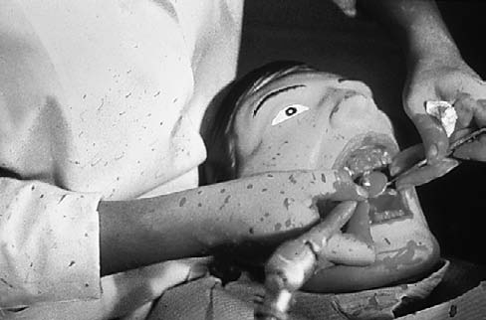
AEROSOLS :Invisible particles ranging from 50 mm to approximately 5 mm
MISTS: Visible in a beam of light consist of droplets estimated to approach or exceed 50 mm
SPATTER: Particles generally larger than 50 mm and are even visible splashes

Slide 9
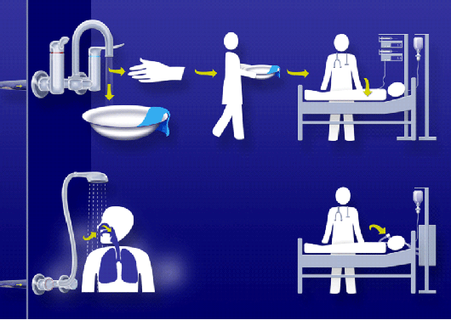
Transmission of infection

Slide 10
MODES OF TRANSMISSION:
Chain of infection
Infectious agent
Reservoirs
Means of transmission
Susceptible host
Portal of exit
Portal of entry

Slide 11
OBJECTIVES OF INFECTION CONTROL
Reduce
Implement
Simplify
Protect

Slide 12
STRATEGY TO ACHIEVE INFECTION CONTROL
Screening
PPE
Aseptic techniques
Sterilization & disinfection
disposal
Laboratory asepsis

Slide 13
HAND HYGIENE

Slide 14
Achieved using either a plain or antimicrobial soap and water.
Purpose- Eliminate transient flora and reduce resident flora to prevent introduction of organisms in the operative wound, if gloves become punctured or torn.
Hands must be lathered for at least 10 seconds, rubbing all surfaces and rinsed.
Clean brushes can be used to scrub under and around the nails.

Slide 15
Hand cleansers
CHLORHEXIDINE – Contain 2- 4% chlorhexidine gluconate with 4% isopropyl alcohol in a detergent solution with a pH of 5.0 to 6.5
POVIDONE IODINE – 7.5-10% povidone iodine, used as a surgical hand scrub
ALCOHOL HAND RUBS- Ethyl alcohol and isopropyl alcohol are widely used at 70% concentration.

Slide 16
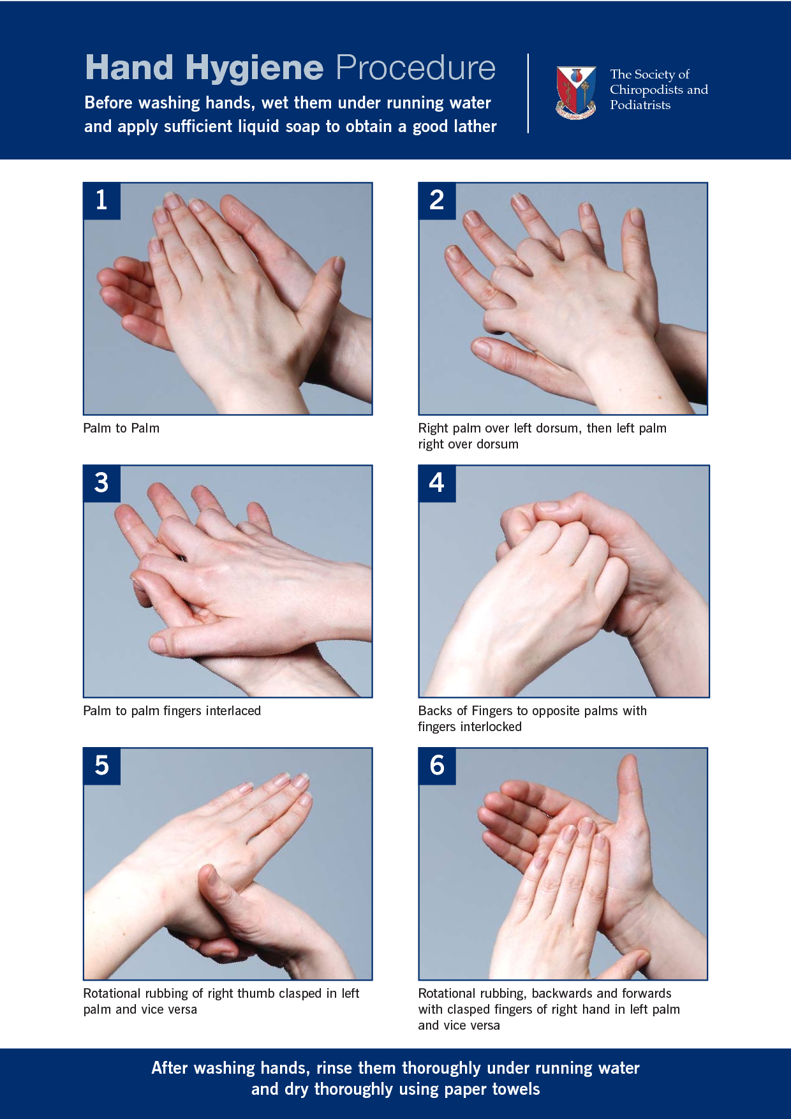

Slide 17
OSHA Guidelines
HBV immunization
standard precautions
Implement engineering controls
Implement work practice control
Instruction for washing hands
safe handling of needles
Prohibit eating, drinking in contaminated environment
PPE , universal barrier protection

Slide 18
Correctly use and discard PPE
Attend to housekeeping requirements
Laundering of protective garments used for universal precautions

Slide 19
PERSONAL BARRIER PROTECTION
PPE is essential to protect the skin and the mucous membranes of personnel from exposure to infectious or potentially infectious materials
The various barriers are gloves, masks, protective eye wear, surgical head cap & overgarments

Slide 20
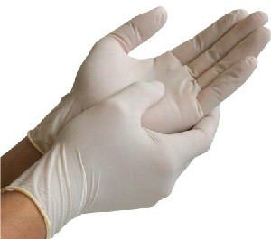
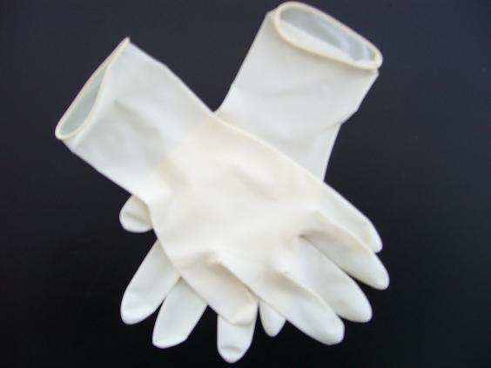
Gloves
Types:
Latex gloves

Slide 21
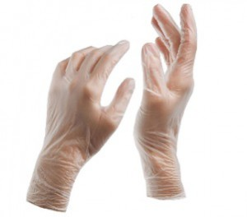
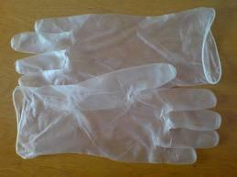
Vinyl Gloves

Slide 22
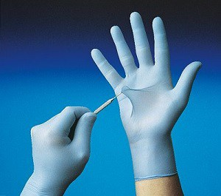
Nitrile Gloves

Slide 23
Steps

Slide 24
CONTACT DERMATITIS AND LATEX HYPERSENSITIVITY
Contact dermatitis is classified as
Irritant
Allergic.
Latex hypersensitivity

Slide 25
PRECAUTIONS TAKEN FOR LATEX ALLERGIC PATIENTS
Be aware that latent allergens in the ambient air can cause respiratory or anaphylactic symptoms among persons with latex hypersensitivity
Patients with latex allergy can be scheduled for the first appointment of the day to minimize their inadvertent exposure to airborne latex particles
Have emergency treatment kits with latex free products available at all times.

Slide 26
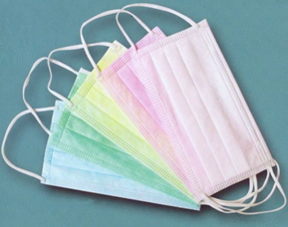
Masks
Types:
Surgical masks
Procedure/isolation masks
Layers
Outer layer
Microfiber middle layer - filter large wearer-generated particles
Soft, absorbent inner layer - absorbs moisture.
Available in 2 sizes: regular and petite.

Slide 27
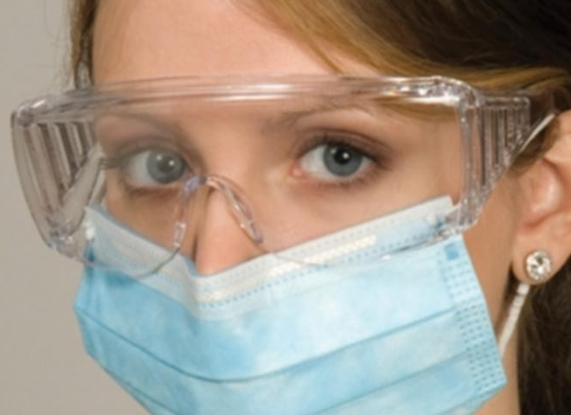
Eye wear
CAUSES OF EYE DAMAGE
Aerosols and spatter may transmit infection
Sharp debris projected from mouth while using air turbine handpiece, ultrasonic scaler may cause eye injury
Injuries to eyes of patients caused by sharp instruments especially in supine position

Slide 28
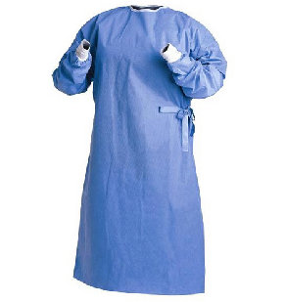
Over garments

Slide 29
Gown type | Situation and Rationale
Cotton/linen, reusable or disposable, long-sleeved isolation gowns | Use if contamination of uniform or clothing is likely or anticipated
Fluid resistant isolation gown or plastic apron | Use if contamination of uniform or clothing from significant volumes of blood or body fluids is likely or anticipated
Fluid impervious gowns e.g., Gortex® | Use if extended contact or large volume exposure (e.g., large volume blood loss during resuscitation or surgical assist)

Slide 30
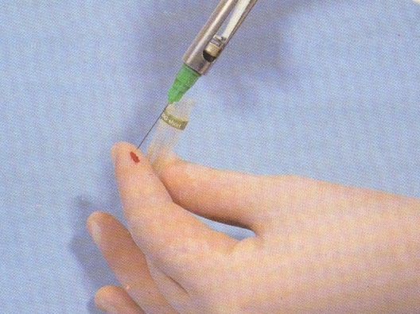
PRECAUTIONS TO AVOID INJURY EXPOSURE
Engineering controls are the primary method to reduce exposures to blood from sharp instruments and needles
Work-practice controls establish practices to protect personnel whose responsibilities include handling, using, or processing sharp devices.

Slide 31
Sharp end of instruments must be pointed away from the hand
Avoid handling large number of sharp devices.

Slide 32
EMERGENCY & EXPOSURE INCIDENT PLAN
General wound care and cleaning.
Counseling of the exposed worker regarding blood borne pathogens.
Source patient testing for HBV,HCV and HIV (consent required).
Documentation of the incident and review.
Post exposure assessment and prophylaxis for the health care worker.

Slide 33
OPERATORY ASEPSIS
In the dental operatory, environmental surfaces can become contaminated during patient care
Certain surfaces, especially ones touched frequently can serve as reservoirs of microbial contamination
Transfer of microorganisms from contaminated environmental surfaces to patients occurs primarily through personnel hand contact

Slide 34
Cdc classification
Category | Dental instrument or item
Critical | Surgical instruments, periodontal scalers, scalpel blades, surgical dental burs
Semicritical | Dental mouth mirror, amalgam condenser, reusable dental impression trays, dental handpieces
Noncritical | Radiograph head/cone, pulse oximeter

Slide 35
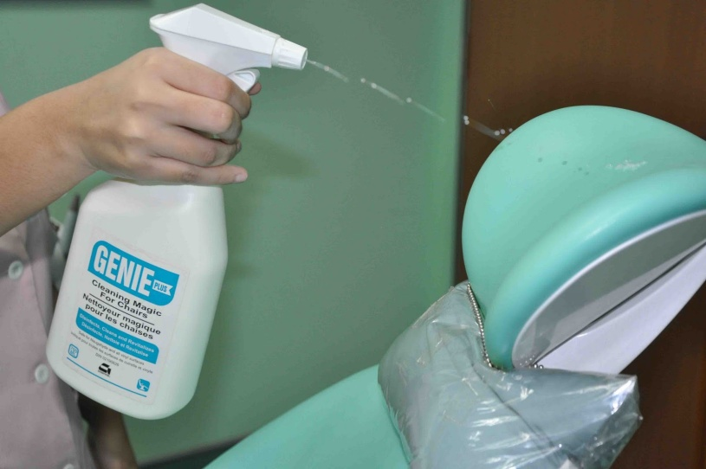
DISINFECTION
Disinfection is always at least a two-step procedure
Initial step
Second step

Slide 36
The ideal disinfectant has the following properties
Broad spectrum of activity
Acts rapidly
Non corrosive
Environment friendly
Free of volatile organic compounds
Nontoxic & nonstaining

Slide 37
High-level disinfection: Disinfection process that inactivates vegetative bacteria, mycobacteria, fungi, and viruses but not necessarily high numbers of bacterial spores
Intermediate-level disinfection: Disinfection process that inactivates vegetative bacteria, the majority of fungi, mycobacteria, and the majority of viruses
Low-level disinfectant: Liquid chemical germicide.

Slide 38
CLEANING AND DISINFECTION STRATEGIES FOR BLOOD SPILLS
Visible organic material should be removed with absorbent material
Nonporous surfaces should be cleaned and then decontaminated with either an hospital disinfectant effective against HBV and HIV

Slide 39
However, if such products are unavailable, a 1:100 dilution of sodium hypochlorite is an inexpensive and effective disinfecting agent.

Slide 40
PRINCIPLES AND PROCEDURES FOR HANDLING AND CLEANING INSTRUMENTS AFTER TREATMENT
Safest and most efficient procedures involve ultrasonic cleaning of used instruments kept in a perforated basket or cassette throughout the cleaning procedure
Used instruments are commonly placed in an anti microbial solution
Next, move the or basket of instruments into an ultrasonic cleaning device, rinse them
Dip instruments likely to rust into a rust inhibitor solution.

Slide 41
STERILIZATION
Stages for instrument sterilization
Presoaking
Cleaning
Corrosion control and lubrication
Packaging
Sterilization
Handling sterile instruments
Storage
Distribution

Slide 42
Agents used in sterilization
Physical agents
Sunlight
Dryheat
Moist heat
Filtration
Radiation
Ultrasonic and sonic vibrations
Chemical agents
Alcohols
Aldehydes
Dyes
Halogens
Phenols
Surface-active agents

Slide 43
The four accepted methods of sterilization are :
Steam pressure sterilization (autoclave)
Chemical vapor pressure sterilization- (chemiclave)
Dry heat sterilization (dryclave)
Ethylene oxide sterilization

Slide 44
STEAM PRESSURE STERILIZATION (AUTOCLAVING)

Slide 45
Advantages
Rapid and effective method for sterilizing
Dependable and economical
verifiable.
Disadvantages
Items sensitive to the elevated temperature
Rust carbon steel instruments and burs.
Instrument air dried at completion of cycle

Slide 46
CHEMICAL VAPOR PRESSURE STERILIZATION (chemiclaving)

Slide 47
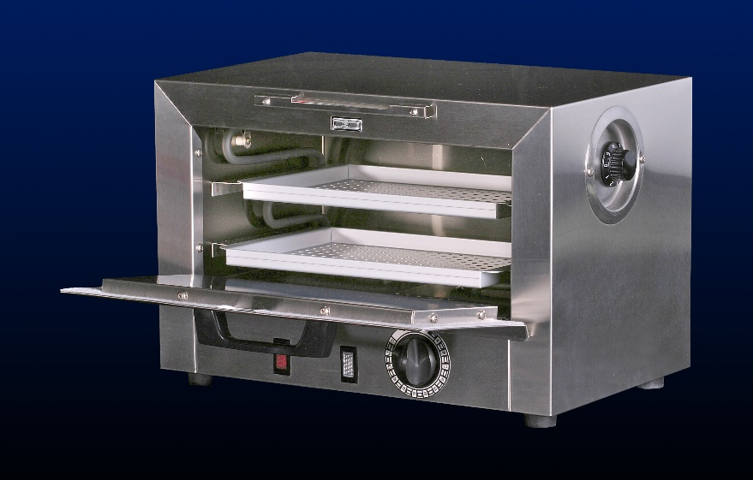
DRY HEAT STERILIZATION
Conventional Dry Heat Ovens
Short-Cycle, High-Temperature

Slide 48
Advantages
Carbon steel instruments and burs do not rust, corrode
Rapid cycles are possible at high temperatures.
Low initial cost and sterilization is verifiable.
Disadvantages
High temperatures may damage more heat-sensitive items
Sterilization cycles are prolonged at the lower temperatures.
Must be calibrated and monitored

Slide 49
ETHYLENE OXIDE STERILIZATION (ETO)
MOBILE FUMIGATOR

Slide 50
Advantages:
Operates effectively at low temperatures
Gas is extremely penetrative
Can be used for sensitive equipment like handpieces.
Sterilization is verifiable
Disadvantages:
Potentially mutagenic and carcinogenic.
Requires aeration chamber ,cycle time lasts hours
Usually only hospital based.

Slide 51
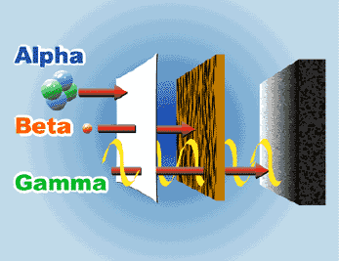
Gamma radiation
Benefits:
Precise dosing
Rapid processing
Uniform dose distribution
Penetrating sterlization
Decrease organism survival

Slide 52
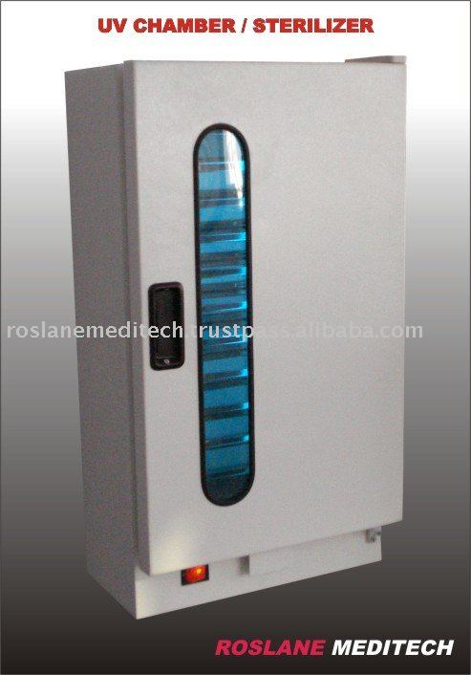
Uv radiation
Wavelength ranges from 328 nm to 210 nm (3280 A to 2100 A). Its maximum bactericidal effect occurs at 240–280 nm
Inactivation of microorganisms results from destruction of nucleic acid through induction of thymine dimers.
Employed in the disinfection of drinking water , air, titanium implants, and contact lenses.

Slide 53
OTHER STERILIZATION METHODS
Microwave
Glass Bead “Sterilizer”
Vaporized Hydrogen Peroxide
Formaldehyde Steam
Gaseous Chlorine Dioxide
Vaporized Peracetic Acid
Infrared radiation

Slide 54
STORAGE AND CARE OF STERILE INSTRUMENTS
Storage areas should be dust proof, dry, well ventilated and easily accessible for routine dental use
Stored atleast 8-10 inches from the floor, atleast 18 inches from the ceiling, and atleast 2 inches from the outside walls
Positioned so that packaged items are not crushed, bent, crushed, compressed or punctured.

Slide 55
Items are not stored in any location where they can become wet
Outside shipping containers and corrugated cartons should not be used as containers in sterile storage areas
Ultra violet chambers and formalin chambers are now commonly used for storage of instruments.

Slide 56
HANDPIECE ASEPSIS
Oral fluid contamination problems of rotary equipment and especially the high-speed handpiece involve:
Contamination of hand-piece external surfaces and crevices,
Turbine chamber contamination that enters the mouth,
Water spray retraction and aspiration of oral fluids into the water lines of older dental units
Growth of environmental aquatic bacteria in water lines
Exposure of personnel to spatter and aerosols generated by intraoral use of rotary equipment.

Slide 57
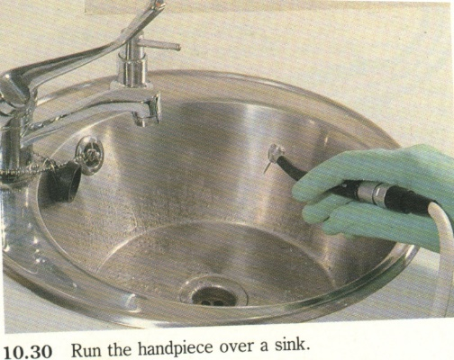
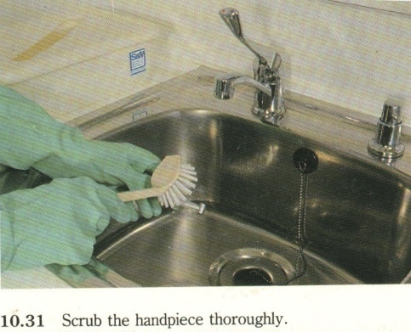
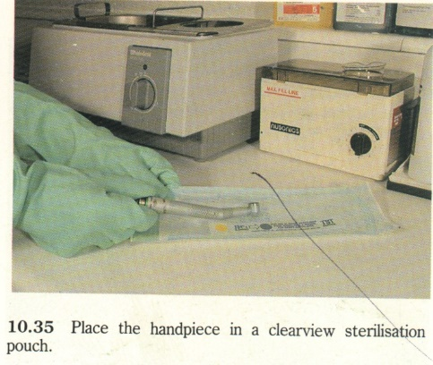
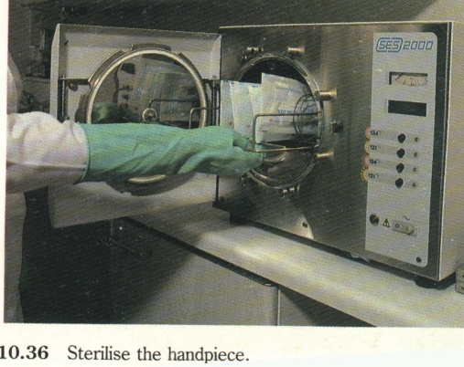
HANDPIECE SURFACE CONTAMINATION CONTROL

Slide 58
ULTRASONIC SCALERS
Soak inserts in a container containing 70% isopropyl alcohol for removal of organic debris
Rinse cleaned inserts thoroughly in warm water to remove all chemicals
As a final rinse, replace the insert into the scaler handpiece and operate the scaler for 10 seconds at the maximum water flow setting to flush out any retained chemicals

Slide 59
Dry inserts completely with air syringe
Package in proper wrap, bags, pouches, trays, or cassettes. Add spore tests and chemical indicators.
Ethylene Oxide is the preferred method of choice
Dry heat and chemical vapor methods of sterilization are considered ineffective methods with risk of damage to materials

Slide 60
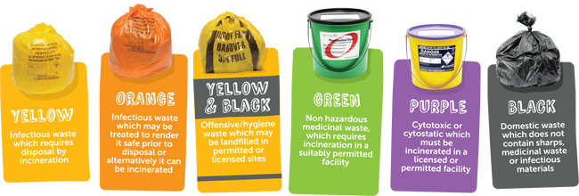
CLINICAL WASTE DISPOSAL
Red: Anatomical waste
Yellow: waste which requires disposal by incineration only
Black: Domestic waste minimum treatment/disposal required is landfill, municipal incineration.
Blue: medicinal waste for incineration
White: amalgam waste for recovery.

Slide 61
Pervasive increases in serious transmissible diseases over the last few decades have created global concern and impacted the treatment mode of all health care practitioners.
Emphasis has now expanded to assuring and demonstrating to patients that they are well protected from risks of infectious disease.
Infection control has helped to allay concerns of the health care personnel and instill confidence and in providing a safe environment for both patient and personnel.

