Slide 1
Department Of Conservative Dentistry And Endodontics
BDS IV YEAR
CLASS III, IV & V CAVITY PREPARATION FOR COMPOSITE RESIN
Dr. Manju
Professor
Date: 14/01/17

Slide 2
OBJECTIVES
Students must answer
What is class III, IV & V cavity ?
Types of tooth preparation
Techniques of restoration

Slide 3
CONTENTS
Introduction (Definition)
Indications for composite restoration in class III, IV & V.
Contraindications for composite restoration in class I & class II
Advantages for composite restoration in class III, IV & V.
Disadvantages for composite restoration in class III, IV & V.
Types of class III, IV & V tooth preparation
Technique of restoration
Summary
References

Slide 4
Introduction to class III, IV& V composite restoration
Classes III and IV restorations involve only anterior teeth, an esthetic material such as composite is indicated almost always.
Likewise, Class V restorations on anterior teeth usually require esthetic restorations.
Although esthetic considerations also are valid for posterior restorations, many patients are not as concerned with esthetics in posterior teeth as they are in anterior teeth. However, the use of composite for any restoration provides benefits other than improved esthetics.
This lecture will discuss in detail class III, IV & V tooth preparation for composite restoration.

Slide 5
INDICATIONS
Almost all Class III and Class IV restorations are appropriately restored with composite.
Most Class V restorations that are in esthetic prominent areas are also appropriately restored with composite or other tooth-colored materials.
However, in all of these instances, the operating area must be able to be adequately isolated to attain an effective bond and tooth preparation should have all-enamel margin.

Slide 6
CONTRAINDICATIONS
An operating area that cannot be adequately isolated,
Some Class V restorations in areas that are not esthetically critical, and
Some restorations that extend onto the root surface.

Slide 7
ADVANTAGES
a. Esthetic.
b. Conservative tooth structure removal.
c. Easier, less complex tooth preparation.
d. Used almost universally
e. Insulative (having low thermal conductivity)
f. Bonding benefits
↓ microleakage.
↓ recurrent caries.
↓ post operative sensitivity
↑ retention.
↑ strength of the remaining tooth structure.
g. Repairable
h. Economics

Slide 8
DISADVANTAGES
a. Material related
  Greater localized wear.
  Polymerization shrinkage (causes gap formation)
  LCTE (28 – 45 ppm/°c) ( causes marginal percolation)
  Biocompatibility of some component.
b. require more time to place.
c. More technique sensitive .
d. More expensive than amalgam restoration.

Slide 9
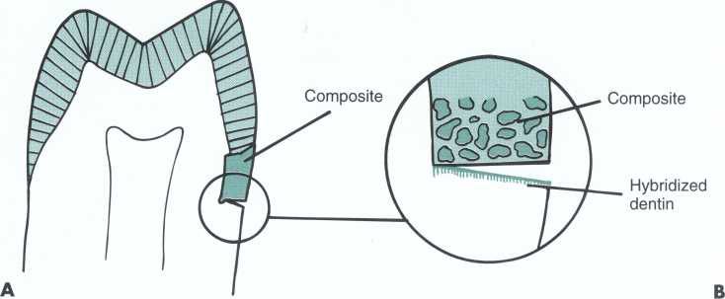
Contraction gap. A, V-shaped gap on root surface. B, Restoration-side vector is composite; root-side vector is hybridized dentin.

Slide 10
CLASS III CAVITY PREPARATION FOR COMPOSITE RESIN

Slide 11
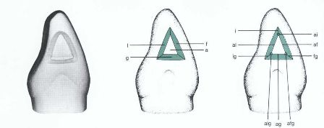
DEFINITION
Restorations on the proximal surfaces of anterior teeth that do not involve the incisal angle are Class III.

Slide 12
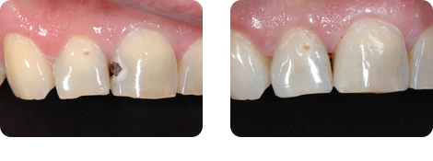
Figure A showing Class III caries and Figure B showing restored tooth
A
B

Slide 13
CLINICAL TECHNIQUE FOR DIRECT CLASS III COMPOSITE
RESTORATIONS
INITIAL CLINICAL PROCEDURES
Anesthesia may be necessary for patient comfort, and if used, will help decrease the salivary flow during the procedure.
Occlusal assessments should be made to help in properly adjusting the restoration's function and in determining the tooth preparation design.
The shade must be selected before the tooth dehydrates and
experiences concomitant lightening.
The area must be isolated to permit effective bonding.
If the restoration will be large (including all of the proximal contact), prewedging the area will assist in the reestablishment of the proximal contact with composite.

Slide 14
TOOTH PREPARATION
Class III tooth preparations, by definition, are located on the proximal surfaces of anterior teeth.
When a proximal surface of an anterior tooth is to be
restored and there is a choice between facial or lingual
entry into the tooth, the lingual approach is preferable.
A small carious lesion should be treated from the lingual approach unless such an approach would necessitate excessive cutting of tooth structure, such as in instances of irregular alignment of the teeth or facial positioning of the lesion.

Slide 15
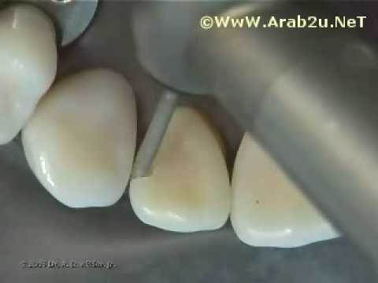
The advantages of restoring the proximal lesion from
the lingual approach include:
1. The facial enamel is conserved for enhanced esthetics.
2. Some unsupported, but not friable, enamel may be left
on the facial wall of a Class III or Class IV preparation.
3. Color matching of the composite is not as critical.
4. Discoloration or deterioration of the restoration is
less visible.

Slide 16
The indications for a facial approach include:
1. The carious lesion is positioned facially such that
facial access would significantly conserve tooth
structure.
2. The teeth are irregularly aligned, making lingual access undesirable.
3. Extensive caries extend onto the facial surface.
4. A faulty restoration that was originally placed from
facial approach needs to be replaced.

Slide 17
conventional
Modified
Beveled conventional
Types of tooth preparation

Slide 18
Conventional Class III Tooth Preparation
The primary indication for this type of Class III preparation is for the restoration of root surfaces.
When preparing the conventional portion of a preparation (on the root surface), the form of the preparation walls is the same as that of an amalgam preparation.

Slide 19
The cavosurface margins exhibit a 90-degree cavosurface angle and provide butt joint between the tooth and the composite material. Thus the external walls are prepared perpendicular to the root surface.

Slide 20
In this conventionally prepared area of the tooth, which is apical of the cervical line, the external walls will be entirely of dentin and cementum.
These walls must be prepared to a sufficient depth pulpally to provide for the following:
adequate removal of the caries, old restorative material, or fault
the placement of retention grooves, if deemed necessary.

Slide 21
This wall depth (depth to axial line angles) usually will be approximately 0.75 mm into dentin, assuming no additional caries excavation is required.
Groove retention form may be necessary in nonenamel, root-surface preparations to both increase the retention of the material in the tooth and to optimize the seal of the composite to the root surface.

Slide 22
The retention groove created also may help in minimizing the potential negative effects of polymerization shrinkage (the composite pulling away from the margin) when inserting the composite incrementally.
Additionally, this groove will enhance the marginal seal by resisting flexural forces (from tooth flexure) placed on the cervical portion of the restoration.

Slide 23
Using a No. ½, 1, or 2 round bur or diamond, prepare the outline form on the root surface, extending the external walls to sound tooth structure while extending pulpally to an initial depth of 0.75 mm, if, in a subsequent step, the preparation of retention grooves will be necessary.

Slide 24
However, if no retention groove is anticipated, the initial depth will be only that which removes the caries or fault, although still no deeper at this stage than 0.75 mm.

Slide 25
The boxlike design may be considered a part of retention form
however, at this stage in tooth preparation the external walls may be retentive because of opposing wall parallelism or slight undercuts, or nonretentive because of slight divergence outwardly.
If prepared with a diamond, the prepared walls also will be roughened.

Slide 26
The groove is located 0.25 mm (half the diameter of the No. 1 /4 round bur) from the root surface and is prepared to a depth of 0.25 mm (half the diameter of the No. 1 / 4 round bur).
This groove is directed as the bisector of the angle formed by the junction of the axial wall and the external wall.
For its entire length the groove should be parallel to the root surface.
When less retention need exists, the retention grooves may be omitted or placed only in the gingivoaxial and/or incisoaxial line angles.

Slide 27
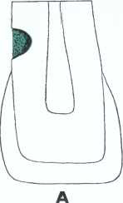
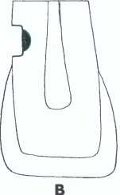
Class III conventional tooth preparation for a lesion
entirely on root surface.
A, Mesiodistal longitudinal section illustrating carious lesion. B, Initial tooth preparation.

Slide 28
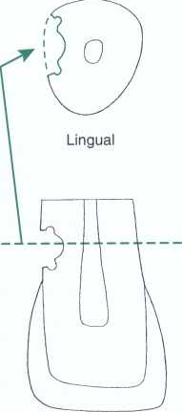
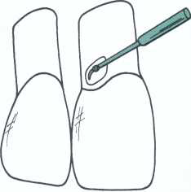
D, Retention grooves shown in longitudinal section, and transverse section through plane cd illustrates contour of axial wall and direction of facial and lingual walls. E, Preparing retention form to complete tooth preparation.

Slide 29
Beveled Conventional Class III Tooth Preparation
Indicated primarily for replacing an existing defective restoration in the crown portion of the tooth.
However, it also may be used when restoring a large carious lesion for which the need for increased retention and/or resistance form is anticipated.
The tooth preparation takes the shape of the existing restoration along with any extensions necessary to include recurrent caries, friable tooth structure, or defects.

Slide 30
The beveled conventional preparation is characterized by external walls that are perpendicular to the enamel surface, with the enamel margin beveled.
The axial line angles may or may not be of uniform pulpal depth, varying as the thickness of the enamel portion of the external walls varies.

Slide 31
If part of the tooth to be restored is located on the root surface, a conventional cavosurface configuration should be used in this area as described earlier, resulting in a combination of two tooth preparation designs, a conventional type in the root portion, and a beveled conventional type in the crown portion.

Slide 32
Usually retention is obtained by bonding to the enamel and dentin and no groove retention is necessary.
However, when replacing a large restoration or restoring a large Class III lesion, the operator may decide that retention form should be enhanced by placing groove (at gingival) or (at incisal) retention features in addition to the bonded tooth structure.

Slide 33
Lingual Access
Use a round carbide bur (No. 1/2, 1, or 2) or diamond stone, the size depending on the extent of the caries or defective restoration, to prepare the outline form.
The point of entry is within the incisogingival dimension of the carious lesion or defective restoration and as close to the adjacent tooth as possible, without contacting it.
Direct the cutting instrument perpendicular to the enamel surface, but at an entry angle that places the neck portion of the bur as far into the embrasure (next to the adjacent tooth) as possible; use light pressure and intermittent cutting (brush stroke) to gain access into the lesion.

Slide 34
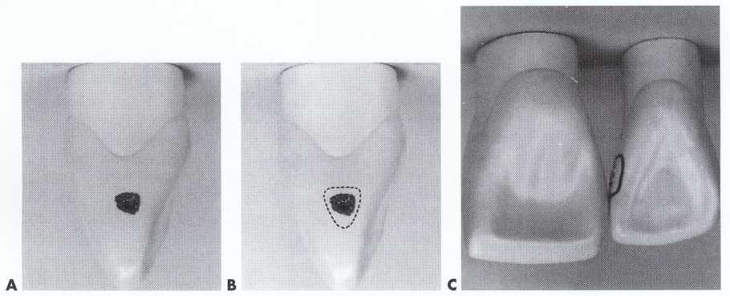
A, Small proximal carious lesion on mesial surface of maxillary lateral incisor. B, Dotted line indicates normal outline form dictated by shape of carious lesion. C, Extension (convenience form) required for preparing and restoring preparation from lingual approach when teeth are in normal alignment.

Slide 35
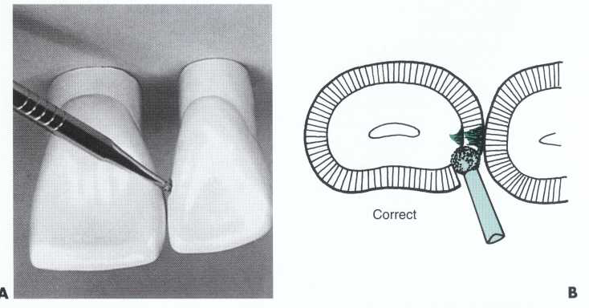
Beginning Class III conventional tooth preparation (lingual approach
A, Bur or diamond is held perpendicular to enamel surface, and initial opening is made close to adjacent tooth at incisogingival level of caries. B, Correct angle of entry is parallel to enamel rods on mesiolingual angle of tooth.

Slide 36
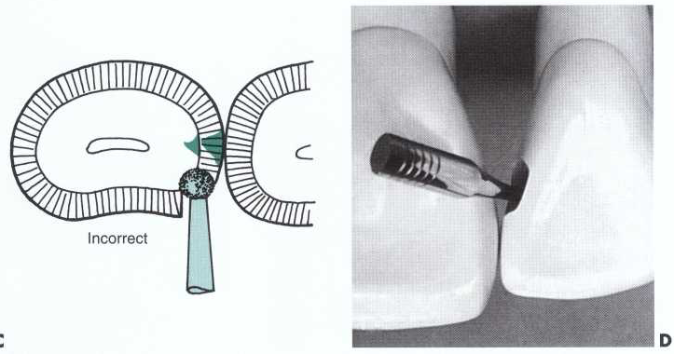
C, Incorrect entry overextends lingual outline. D, Same bur or diamond is used to enlarge opening for caries removal and convenience form while establishing initial axial wall depth.

Slide 37
Incorrect entry overextends the lingual outline into potential stress areas (marginal ridges) and unnecessarily weakens the tooth
The same instrument may be used to enlarge the opening sufficiently to allow for caries removal, completion of the preparation, and insertion of the restorative material

Slide 38
Extend the external walls to sound tooth structure during preparation of the outline form, but only to the initial limited prescribed depth. This extension should be as minimal as possible, dictated by the extent of caries and/or old restorative material on these walls.
  Unless absolutely necessary, do not:
  (1) include the proximal contact area,
  (2) extend onto the facial surface, or
  (3) extend subgingivally.

Slide 39
The axial wall depth at this initial stage of tooth preparation is limited to 0.2 mm inside the dentinoenamel junction (DEJ) (if no retention groove will be used), which means it will be approximately 0.75 to 1.25 mm deep (the larger being incisally where enamel is thicker).
The axial wall will be outwardly convex, following normal external tooth contour.

Slide 40
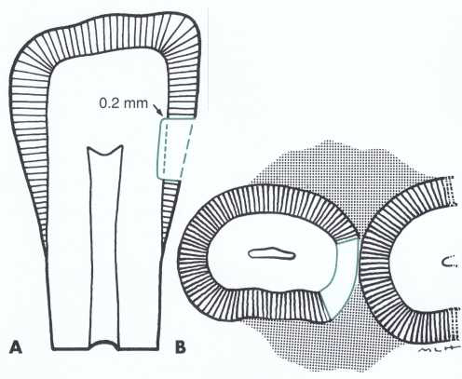
Ideal initial axial wall preparation depth. A, Incisogingival section showing axial wall 0.2 mm into dentin.
B, Faciolingual section showing facial extension and axial wall following contour of tooth.

Slide 41
Usually the axial line angles should be positioned at an initial depth of 0.2 mm into dentin. However, if a retention groove is to be placed, the axial wall should be 0.5 mm into dentin at retention locations to prevent undermining enamel where the retention form is prepared.
when the preparation outline extends gingivally onto the root surface, the depth of the axial wall at the gingivoaxial line angle should be 0.75 mm, thus providing adequate dimension for composite strength, placement of a retention groove, and maintenance of strength of the gingival wall and margin.

Slide 42
If retention features (grooves or coves) are indicated (and usually they are not), prepare them along the gingivoaxial line angle and, sometimes, the incisoaxial line angle with a No. 1/4 bur.
Particular care must be exercised not to weaken the walls or incisal angles that are subject to masticatory forces.

Slide 43
If deemed necessary, prepare a gingival retention groove along the gingivoaxial line angle. Care should be exercised to prepare this groove approximately 0.2 mm inside the DEJ to a depth of 0.25 mm (half the diameter of the No. 1/4 bur) so as not to undermine the enamel portion of the gingival wall.
Start the gingival groove at the faciogingivoaxial point angle and extend along the gingivoaxial line angle to the linguogingivoaxial point angle.

Slide 44
Class III beveled conventional tooth preparations are prepared as conventional preparations with the addition of a cavosurface bevel or flare of the enamel rather than a butt joint margin.
The cavosurface bevel or flare is best prepared with either a flame-shaped or round diamond instrument, resulting in an angle approximately 45 degrees to the external tooth surface.

Slide 45
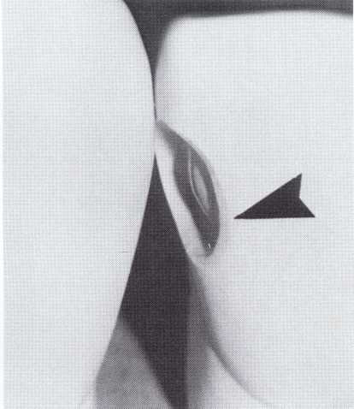
Large Class III beveled conventional tooth preparation.
Note cavosurface bevel (arrow).

Slide 46
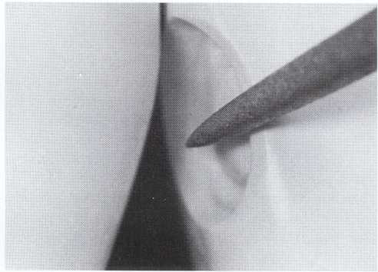
Beveling. Cavosurface bevel is prepared with flame shaped or round diamond resulting in an angle approximately 45 degrees to the external tooth surface.

Slide 47
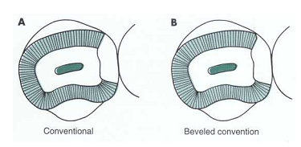
A, Cross-section of facial approach Class III conventional tooth preparation with 90-degree cavosurface angle. B, Beveled conventional tooth preparation showing 45-degree cavosurface bevel on facial margin.

Slide 48
A bevel width of 0.25 to 0.5 mm is considered sufficient unless the operator elects to increase the retention form by preparing a wider bevel, which will increase the surface area to be etched and therefore the retention form.
For moderate and large Class III beveled conventional preparations, all accessible enamel margins usually are beveled, with the exception of the gingival margin. This margin is usually not beveled if little or no enamel is present or access is difficult for finishing procedures.

Slide 49
If the preparation extends gingivally onto root structure, no bevel is placed on cementum, and the area is prepared as a conventional preparation.
In addition, bevels may not be recommended on lingual surface margins that are in areas of centric contact or subjected to heavy masticatory forces because composite has less wear resistance than enamel for withstanding heavy attritional forces.

Slide 50
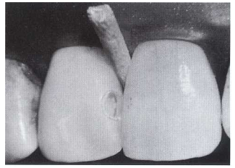
Facial Access
With a few exceptions, the same stages and steps of tooth preparation are followed as with lingual access. The procedure is simplified because direct vision is used and the lesion or faulty restoration is usually larger.
Completed Class III beveled conventional tooth
preparation (facial approach).

Slide 51
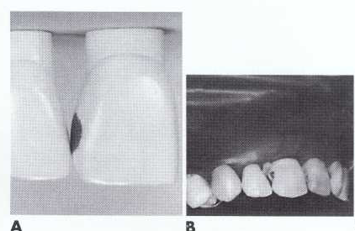
Class III initial preparation (facial approach)
A, Large proximal caries with facial involvement.
B, Isolated area of operation.

Slide 52
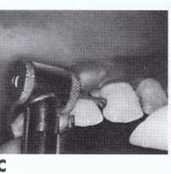
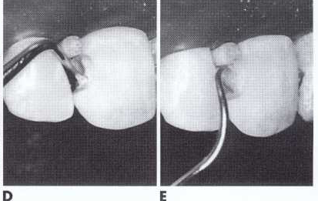
C, Entry and extension with No. 2 bur or diamond.
D, Caries removal with spoon excavator.
E, Explorer point removes caries at DEJ. This is a beveled conventional preparation if accessible margins are beveled

Slide 53
Modified Class III Tooth Preparation
INDICATION:
For small and moderate lesions or faults and is designed to be as conservative as possible.
The preparation design is dictated by the extent of the fault or defect and is prepared from a lingual approach when possible, with an appropriate size round bur or diamond instrument.
No effort is made to produce preparation walls that have specific shapes or forms other than external angles of 90 degrees or greater.
The extension axially also is dictated by the extent of the fault or carious lesion and usually will not be uniform in depth.

Slide 54
Weakened, friable enamel is removed while preparing the cavosurface margins in a beveled or flared configuration with the round diamond.
the preparation design appears to be "scooped" or concave.

Slide 55
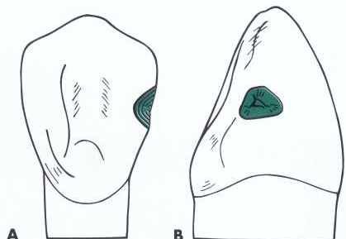
Modified preparation designs for Class III (A and B)

Slide 56
Most initial composite restorations utilize the modified preparation design. Because a carious lesion that requires a restoration usually extends into dentin, many modified preparations will be prepared to an initial axial wall depth of 0.2 mm into dentin.

Slide 57
Begin the preparation from a lingual approach (if possible) by making an opening using a round carbide bur (No. 1/2 1, or 2) or diamond instrument, the size depending on the extent of the lesion.

Slide 58
RESTORATIVE TECHNIQUE

Slide 59
Etching, Priming, and Placing Adhesive
First, the proximal surface of the adjacent unprepared tooth should be protected from inadvertent etching by placing a polyester strip. Then a gel etchant is applied to all of the prepared tooth structure, approximately 0.5 mm beyond the prepared margins onto the adjacent unprepared tooth .
The etchant is typically left undisturbed for 15 to 30 seconds (30 seconds for enamel-only preparations and 15 seconds when dentin is involved). The area is then washed to remove the etchant.

Slide 60
If dentin is exposed, rather than air-dry the rinsed area, it is better to use a damp cotton pellet, a disposable brush, or a paper tissue to remove the excess water.

Slide 61
The dentin surface should remain moist, as evidenced by a glistening appearance. Neither areas of overdrying or pooling of excess water should be allowed
The primer is applied to all of the prepared tooth structure with a microbrush or other suitable applicator

Slide 62
2. Matrix Application.
The matrix is usually applied and stabilized by a wedge (and compound if necessary) before application of the enamel/ dentin etchant, primer, and bonding adhesive (the bonding system).
A matrix for the proximal surface of an anterior tooth should be made of a thin material, such as polyester or metal, that can be easily contoured.

Slide 63
There are two main types of matrices:
  (1) a clear polyester strip matrix and
  (2) a compound-supported metal matrix.
  A properly contoured polyester strip matrix is used for most Class III and Class IV preparations.

Slide 64
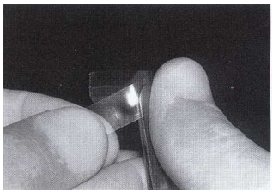
Because the proximal surface of a tooth is usually convex incisogingivally and the strip may be flat, it is necessary to shape the strip to conform with the desired tooth contour.
One way to contour a polyester strip is by drawing it across a hard, round object such as the rounded, back end of operating pliers.

Slide 65
A wedge is needed at the gingival margin to:
  (1) help hold the strip in position,
  (2) provide slight separation of the teeth,
  (3) help prevent a gingival overhang of the composite material.
  A wedge is required when all of the proximal contact is involved because the wedge must separate the teeth sufficiently to compensate for the thickness of the matrix if the completed restoration is to properly contact the adjacent tooth.

Slide 66
3.Inserting and Curing the Composite
4. Contouring and Polishing the Composite

Slide 67
SUMMARY
Keynote points
Definition of class III cavity preparation
Types of cavity preparation
Restoration technique

Slide 68
REFERENCES
Sturdevant’s Art & Science of Operative Dentistry

