Slide 1
Cavity Preparation for Composites
Dr Suhrab Singh
Assistant Professor
Dept. Of Endodontics

Slide 2
DEFINITION OF CAVITY PREPARATION
Cavity preparation is the mechanical alternation of a tooth to receive a restorative material, which will return the tooth to proper anatomical form, function, and esthetics. The procedure of the preparing the tooth is the removal of the defective or friable tooth structure. Any remaining infected or friable tooth structure may result of further carious progression, sensitivity or pain or fracture of the tooth and / restoration.

Slide 3
Cavity preparation is the mechanical alternation of defective, injured or diseased tooth in order to best receive a restorative material that will reestablish a healthy state for the tooth including esthetic correction when indicated, along with normal form and function.
The reason of the need for restoration as follow:
• To restore the integrity of the tooth surface.
• To restore the function of the tooth.
• To restore the appearance of the tooth.
• To remove the diseased tissue from the tooth.

Slide 4
CLASSIFICATION
(G.V. BLACK CLASSIFICATION)
Black suggested that it was necessary to
Remove additional tooth structure to gain access and visibility .
Remove all trace of demineralized enamel and dentin from the floor, walls and margins of the cavity.
Make room for the insertion of the restorative material in sufficient bulk to provide strength.
Provide mechanical interlocking retentive designs.
Extend the cavity to self-cleansing areas to avoid recurrent caries.

Slide 5
CLASS I
The lesions involving the occlusal surfaces of molars and premolars, the occlusal 2/3 of buccal and lingual surfaces of molars, and the palatal pits in anterior teeth.
CLASS II
The lesions involving the proximal surfaces of the posterior teeth with access established from the occlusal surface.
CLASS III
The lesions involving the proximal surfaces of anterior teeth which may or may not involve a labial or a lingual extension & not involving incisal edge.

Slide 6
CLASS IV
The lesions involving all proximal surfaces of anterior teeth which involves the incisal edge.
CLASS V
The lesions involving the cervical third of all teeth, including the proximal surface of posterior teeth where the marginal ridge is not included in the cavity preparation.
CLASS VI
The lesions involving the incisal edges or the cusp tips.

Slide 7
ACCORDING TO SITE INVOLVED
Site 1 . Pits, fissures and enamel defects on occlusal surfaces of posterior teeth or other smooth surfaces.
Site 2 . Approximal enamel in relation to areas in contact with adjacent teeth.
Site 3 . The cervical one third of the crown or, following gingival recession, the exposed root surface.

Slide 8
ACCORDING TO THE SIZE AND EXTENT OF THE LESION AT THE TIME OF IDENTIFICATION
Size 0 . The earliest lesion that can be identified as the initial stages of demineralisation. This needs to be recorded but will be treated by eliminating the cause and should therefore not require further treatment,
Size 1 . Minimal surface cavitation with involvement of dentine just beyond treatment by remineralisation alone. Some form of restoration is required to restore the smooth surface and prevent further plaque accumulation,
Size 2 . Moderate involvement of dentine following cavity preparation. Remaining enamel is sound, well supported by dentine and not likely to fail under normal occlusal load. The remaining tooth is sufficiently strong to support the restoration,

Slide 9
Size 3 . The lesion is enlarged beyond moderate. Remaining tooth structure is weakened to the extent that cusps or incisal edges are split, or are likely to fail if left exposed to occlusal load. The cavity needs to be further enlarged so that the restoration can be designed to provide support to the remaining tooth structure,
Size 4 . Extensive caries or bulk loss of tooth structure e.g. loss of a complete cusp or incisal edge has already occurred.

Slide 10
OBJECTIVES OF CAVITY PREPARATION
• To remove diseased tissue as necessary and at the same time provides the protection to the pulp.
• To locate the margins of the restoration as conservative as possible.
• To ensure the cavity form, it should not be under the force of mastication of the tooth.
• To allow the functional placement of the restorative material.

Slide 11
PRINCIPLES OF CAVITY PREPARATION
Gain access to caries.
Removal of all carious lesions.
Cut away all significantly unsupported enamel.
Extended margins so that they are accessible for instrumentation and Cleaning.

Slide 12
DESIGN AND PREPARATION OF CAVITIES
The design and preparation of cavities are based on Black’s principles
Each diseased tooth has an individual cavity form determined by caries involvement, morphology of tooth and its location in oral cavity – leading to new conservative cavity designs.

Slide 13
STEPS IN THE CAVITY PREPARATION
(Given by G V Black)
Obtaining Outline Form
Obtaining Primary Resistance Form
Obtaining Primary Retention Form
Obtaining Convenience Form
Removal of Remaining Carious Dentin
Obtaining Secondary Resistance & Retention Form
Providing Pulp Protection
Finishing of Enamel Walls & Margins
Performing the Toilet of the Cavity

Slide 14
ARMAMENTARIUM
Basic Instruments – mouth mirror, explorer, tweezer, etc.
Hand Instruments – Excavators, enamel hatchet, monoangle or biangle chisels, Gingival Marginal Trimmer.
Rotary Instruments –
Burs No.-carbide burs 55, 56, 57.
Ultraspeed and conventional speed contrangle handpiece.
Safety glasses.

Slide 15
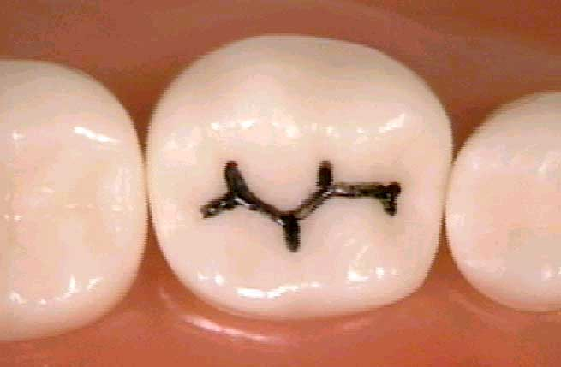
Simple occlusal cavities
Designing the Outline Form
The outline form of a routine class I cavity should describe a symmetrical design running in sweeping curves along all pits, fissures, and angular grooves between the cusps and with a minimum width.

Slide 16
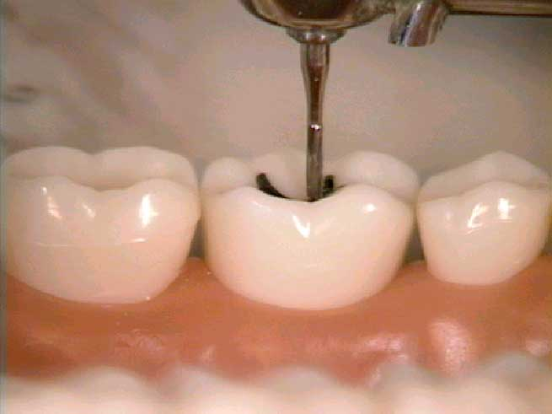
PERPENDICULAR IN MESIAL-DISTAL DIRECTION

Slide 17
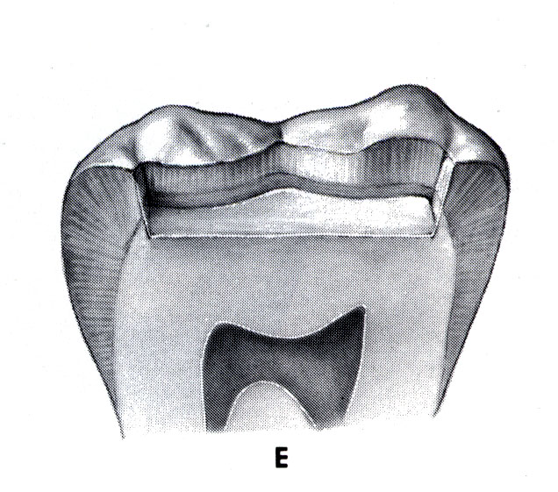
Pulpal Floor mesio-distally is flat and perpendicular to the long axis of the tooth

Slide 18
In a bucco-lingual direction, the cavity is extended just sufficient to eliminate the defective and susceptible tissues. The lingual and the buccal wall should be parallel to the respective tooth surface.

Slide 19
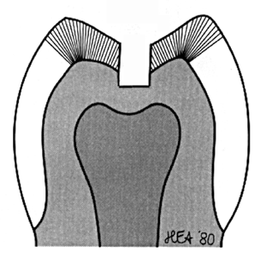
INTERNAL FORM
Buccal and Lingual Walls are Parallel to each other and to the Long Axis of the Crown (Provides retention)
Buccal, Lingual, and Proximal Walls meet Pulpal Floor at sharp angle
Buccal and Lingual Walls meet Proximal in smooth, rounded form.
BUCCO-LINGUAL VIEW

Slide 20
It must be reemphasized that the outline form for class 1 cavities should be very conservative since they involve cleansable areas.
It is governed only by the extent of caries in both enamel and dentin and the amount of extension or need to eliminate pits and fissures to secure smooth margins.

Slide 21
OBTAINING THE RETENTION FORM
“It is the shape given to the cavity that best permits the restoration resist
displacement through tipping or lifting forces”.
Primary retention form
a. Occlusal dovetail
b. Convergent wall
Secondary Retention Form
a. Grooves/Cove
b.Slotes
c. Pot Holes
d. Acid Etching

Slide 22
OBTAINING THE RESISTANCE FORM
“Shape given to the cavity that best enable both the restoration and the
tooth to withstand occlusal forces”.
a. Flat pulpal floor and gingival floor
b. Line angles and point angles should be rounded
c. Cusp and ridges should have sufficient dentin support
d. Restorative material should have enough thickness to prevent its
fracture under load

Slide 23
OBTAINING THE CONVENIENCE FORM
“It is that shape or form of the cavity that allows adequate observation ,
accessibility and ease of operation in preparing and restoring the cavity”.
Line angles and point angles should be rounded
Cavo surface margin should be 90 degree.
(80-110 degree –Amalgam-acceptable)
REMOVING REMAINING CARIOUS DENTIN
-If caries is not deep can be removed at the same visit, but if its deep,
I.P.C. is done.
-Infected or affected dentin

Slide 24
FINISHING THE ENAMEL WALLS
To assure sound, supported enamel
To obtain smooth, well defined surface and angle.
To facilitate placement and finishing of particular restorative material.
TOILET OF THE CAVITY (Isolation)
a. Rubber dam
b. Cotton rolls
c. High volume evacuation suction

Slide 25
CAVITY STERILIZATION OR DISINFECTION
a. Precipitated AgNO3
b. Phenol
c. Thymol
d. Alcohol
e. Sodium and Stannous Fluoride

Slide 26
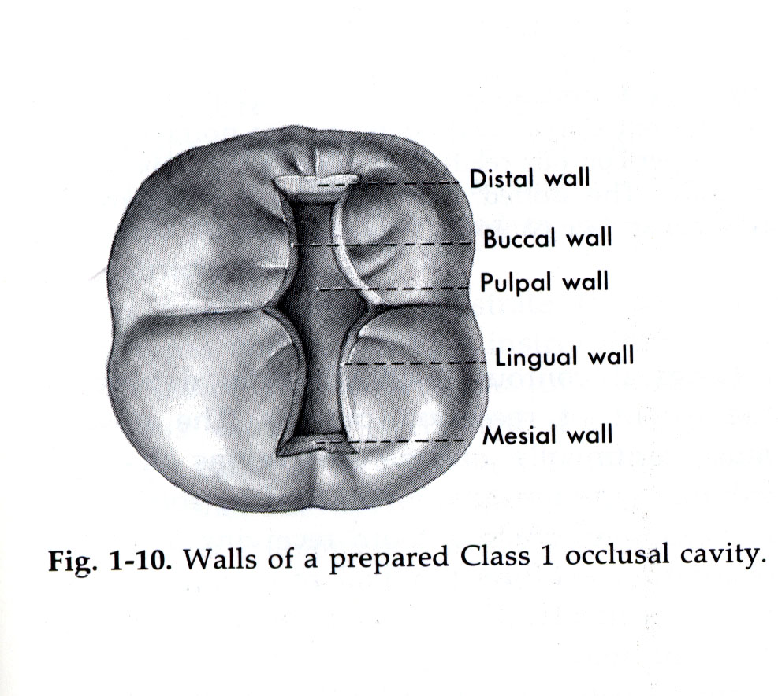

Slide 27
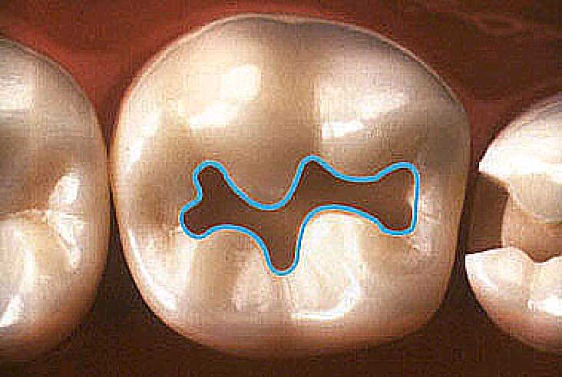
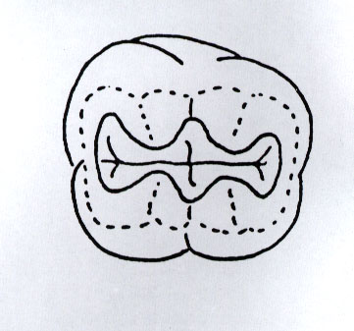
CORRECT OUTLINE FORM

Slide 28
Composite Cavity Preparation
Conventional
Conventional beveled
Modified/ scooped

Slide 29
Conventional cavity preparation
Features as described earlier
Bur is kept parallel to the long axis of the tooth
Use flat fissure bur to maintain uniform depth
The depth can be kept in enamel only, but for better retention it is advisable to extend into dentin. Total depth should be 1.5mm.
The isthmus as small as possible , usual width 1/4th intercuspal distance.

Slide 30
The cavity walls may NOT be kept perpendicular and parallel as in amalgam restorations.
The cavosurface margins are kept at right angle to the cavity walls.
No Bevels are given
The butt joint margin prevents composite marginal breakdown and ditching.
But staining at the margins can be caused.

Slide 31
In moderate to large sized class I and class II composite restorations we need more retention form, which can be provided only by conventional methods of cavity preparation.
An inverted cone bur is used which gives same preparation as with the amalgam restoration.
The cavosurface angles can be kept as butt joints or can also be slightly flared (obtuse).
Since conversion of tooth structure is important therefore class I and II should have minimum facio-lingual extensions (conservative)

Slide 32
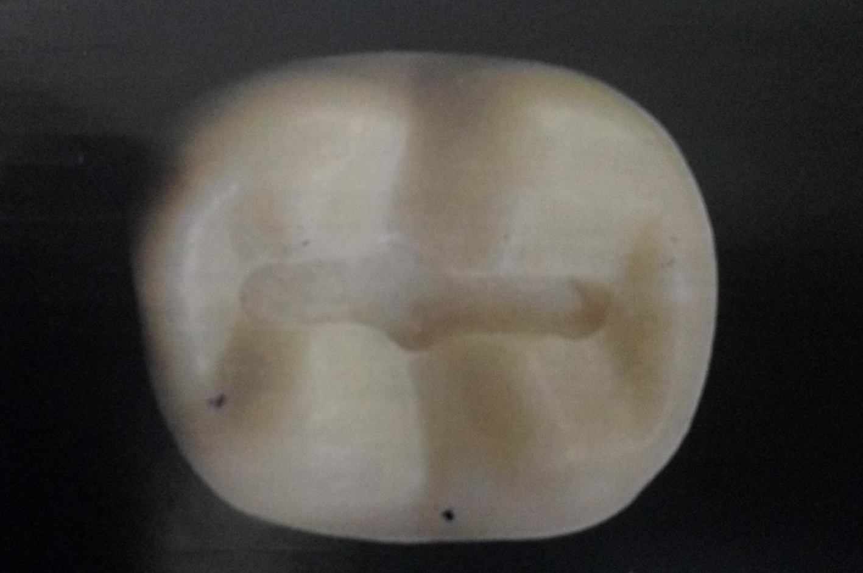
Sealants can be used where minor extensions are to be done.

Slide 33
Conventional Bevelled
Bevelled conventional preparations are similar to conventional type except that the enamel margins are beveled.
It is recommended when composite restoration is being done to replace an old restoration (usually Amalgam) exhibiting a conventional tooth preparation design.
It is mostly used for Class III, IV and V restorations
The advantage of an enamel bevel for a composite tooth preparation is that the ends of enamel rods (exposed by beveling) are more appropriately etched.

Slide 34
Also there is an increase in the etched enamel surface area which enhances the bonding to the composite.
Bevelling also allows the restoration to blend more esthetically with the coloration of the surrounding tooth structure.
The beveled conventional design is rarely or never used for the posterior teeth (Class I and Class II)
Its is majorly used in areas where esthetics is of concern.

Slide 35
Conventional Bevelled

Slide 36
White Lines
There are a number of potential causes for white lines at the margins, which can be gaps, discontinuous voids, or micro fractures in the tooth substance or the restorative material. White lines at placement frequently become black lines later, so it is certainly preferable to correct them immediately.
In general, white opacity is created by differences in the refractive index. Everyone has noticed the ‘bleaching effect’ when teeth are dried, this is the effect of replacing the water with air. One can see the same effect when a light curing composite is spatulated, the incorporated air lightens the shade.

Slide 37
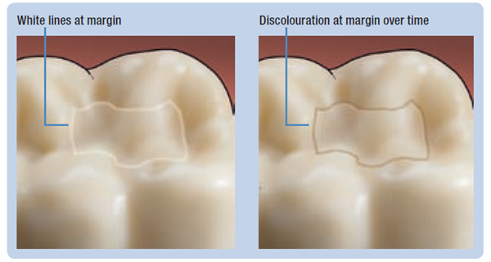
For reference, the clinically relevent refractive indices are approximately: enamel = 1.7; water = 1.4; air = 1.0; and composites are in the range of 1.5 -1.6. White lines are therefore most visible when the tooth is dry, since the difference in refractive index between air and enamel is larger than the difference between water and enamel.

Slide 38
Bevels
Bevels are the angulation which is made by 2 surfaces of a prepared tooth which is other than 90 degrees. Bevels are given at various angles depending on the type of material used for restoration.
Definition: Any abrupt incline between the 2 surfaces of a prepared tooth or between the cavity wall and the cavosurface margins in the prepared cavity.

Slide 39
Partial Bevel- beveling which involves less than 2/3rd of the enamel thickness. This is used only to trim unsupported enamel rods from the cavity borders.
Short Bevel- Entire enamel wall is included in this type of bevel without involving the dentin. This bevel is used mostly with cast restorations
Long Bevel- Entire enamel and ½ dentin is included in the bevel preparation. This is also used for cast restorations.
Full Bevel- Complete enamel and dentinal walls of the cavity wall or floor are included in this bevel. It is not used very often.
Counter Bevel- Used when cusp capping is to be done.

Slide 40
Hollow bevel- hollow ground bevel allows more space for bulk of cast metal , a design feature needed in special preparations to improve resistance form.

Slide 42
Modified
Modified or the scooped techniques have neither specified wall configurations nor specified pulpal or axial depths, preferably they have enamel margins, so to preserve as much tooth structure as possible
In contrast to conventional preparations, modified preparations are not prepared to a uniform dentinal depth.
The cavity preparation is solely designed according to the extent of the carious lesion.
The lesion is removed as conservatively as possible.

Slide 43
Modified tooth prep. Preserves more tooth structure and relies more on the bonding of the composite which is dependent upon micro-mechanical adhesion.
Round burs or diamond stones may be used.
The preparation often looks “Scooped Out” rather than having any distinct internal line angles.
Modified preparations are indicated for the restoration of smaller, cavitated, carious lesions usually surrounded by enamel and for correcting the enamel defects.

Slide 44
Modified or scooped technique

Slide 45
Modified or scooped technique

Slide 46
Box Only Prep
Another modified design is the box only tooth preparation. This design is indicated when only the proximal surface is faulty, with no lesions present on the occlusal surface.
A round or inverted cone bur is used.

Slide 47
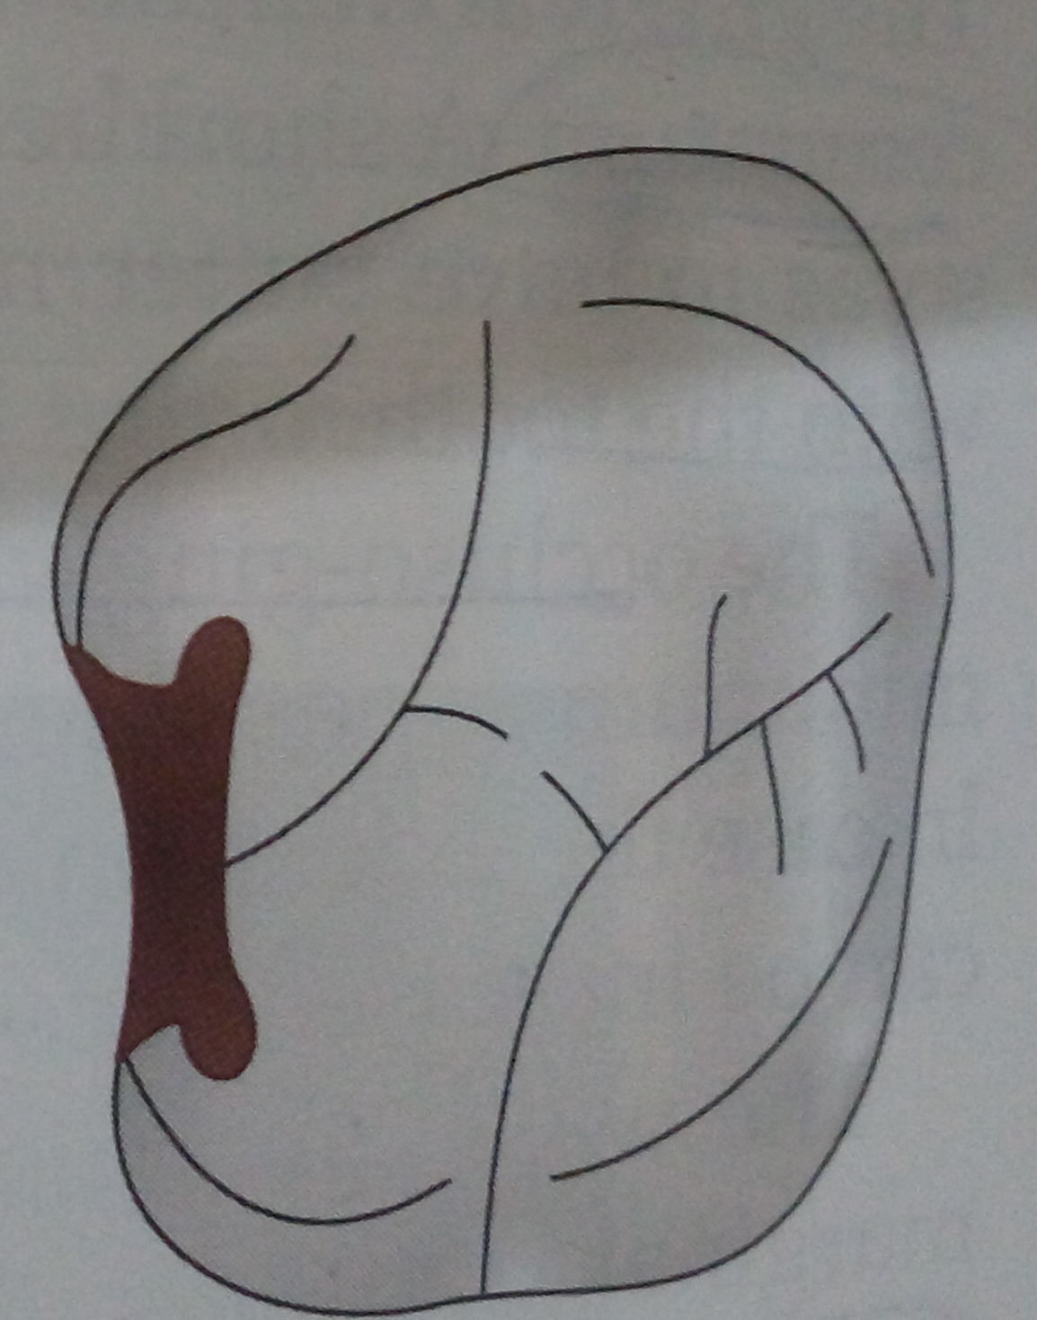

Slide 48
Facial or Lingual Slot Preparation
The 3rd design to prepare the proximal surfaces with a modified technique is having facial or the lingual slot
The lesion is approached either through the facial or the lingual direction rather than through the marginal ridge from the occlusal direction.
The prep. Is extended occluso-gingivally and facio-lingually enough to remove the lesion.

Slide 50
Thank you

