Slide 1
Department Of Conservative Dentistry And Endodontics
CLASS V CAVITY PREPARATION FOR COMPOSITE RESIN
BDS IV YEAR
Dr. Manju
Professor
Date: 20/01/17

Slide 2
OBJECTIVES
Students must answer
DEFINITION
DIAGNOSIS
TYPES OF PREPARATIONS
ARMAMENTARIUM AND MATERIAL USED

Slide 3
CONTENTS
Introduction
Types of class v tooth preparation
Armamentarium used
Materials used

Slide 4
INTRODUCTION
Definition (Black’s classification)
Restorations on the gingival third of the facial or lingual surfaces of all teeth (except pit-and-fissure lesions) are Class V.

Slide 5
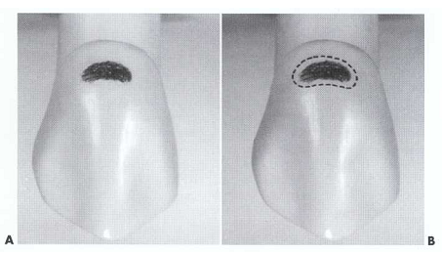

Slide 6
CLINICAL TECHNIQUE FOR CLASS V COMPOSITE RESTORATIONS
Anesthesia is usually necessary when restoring a Class V lesion.
Shade selection is done.
Isolation using rubber dam and No. 212 retainer or with a cotton roll(s) and retraction cord.

Slide 7
CLASS V LESIONS
carious
Non-carious

Slide 8
TYPES OF CLASS V TOOTH PREPARATION
Conventional
Modified
Beveled Conventional

Slide 9
Conventional class V tooth Preparation
Indicated for that portion of a carious lesion or defect entirely or partially on the facial or lingual root surface of a tooth.
The features of the preparation includes a 90-degree cavosurface angle; uniform depth of the axial line angles; and, sometimes, groove retention form.

Slide 10
A tapered fissure carbide bur (No. 700, 701, or 271) or similarly shaped diamond is used at high speed with air-water spray.
If access interproximally or gingivally is limited, a No. 1 or No. 2 round bur or diamond may be used to prepare the tooth.

Slide 11
When a tapered fissure bur or diamond is used, make entry at a 45-degree angle to the tooth surface by tilting the handpiece distally; however, as the cutting progresses distally, maneuver the handpiece to thereafter maintain the bur's long axis perpendicular to the external surface of the tooth during preparation of the outline form, which should result in 90-degree cavosurface margins.

Slide 12
0.75 mm
Axial depth
Strength of the preparation walls
Strength of the composite;
Placement of a retention groove, if necessary

Slide 13
When the desired distal extension is obtained, move the bur mesially, incisally (occlusally), and gingivally for indicated extensions, while maintaining the proper initial depth and keeping the bur's long axis perpendicular to the root surface.

Slide 14
The axial wall should follow the original contour of the facial surface, which is convex outward mesiodistally and sometimes occlusogingivally The outline form extension of the mesial, distal, occlusal (incisal), and gingival walls is dictated by the extent of the caries, defect, or old restorative material indicated for replacement.

Slide 15
All of the external preparation walls of a Class V conventional tooth preparation are visible when viewed from a facial position (outwardly divergent walls).

Slide 16
Retention grooves
No. ¼ bur
0.25 mm depth
Along the full length of the gingivoaxial and incisoaxial (occlusoaxial) line angles

Slide 17
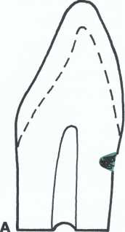
Conventional Class V tooth preparation.
A, Lesion entirely on root surface.

Slide 18
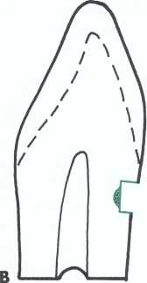
B, Initial tooth preparation with 90-degree cavosurface margins and axial wall depth of 0.75 mm.

Slide 19
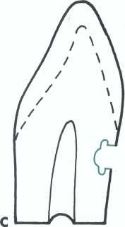
C, Remaining infected dentin excavated and incisal and gingival retention form prepared.

Slide 20
BEVELED CONVENTIONAL CLASS V TOOTH PREPARATION
The beveled conventional Class V tooth preparation has beveled enamel margins and is indicated either for:
Replacement of an existing, defective Class V restoration that initially used a conventional preparation
A large, new carious lesion.

Slide 21
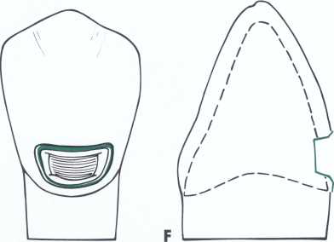
The beveled conventional Class V preparation initially will exhibit 90- degree cavosurface margins (that subsequently will be beveled) and an axial wall that is uniform in depth

Slide 22
The axial depth into dentin is only 0.2 mm when groove retention is judged unnecessary and 0.5 mm when a retention groove is planned and the margin is still in enamel.

Slide 23
The advantages of the beveled conventional tooth preparation as compared to the conventional tooth preparation are:
increased retention due to the greater surface
area of etched enamel afforded by the bevel
decreased
microleakage due to the enhanced bond between
the composite and the tooth

Slide 24
decreased need for
groove retention form therefore less removal of tooth structure

Slide 25
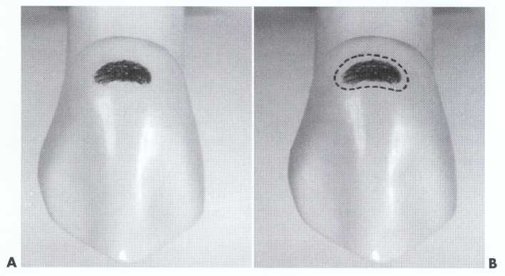
Prepare the outline form as described in the preceding section with the initial axial wall depth only 0.2 mm into dentin when groove retention is unnecessary
A, Class V caries. B, Typical outline form

Slide 26
The bevel on the enamel margin is accomplished with a flame-shaped or round diamond instrument, resulting in an angle approximately 45 degrees to the external tooth surface and prepared to a width of 0.25 to 0.5 mm.
DEPTH 0.75 TO 1.25 mm

Slide 27
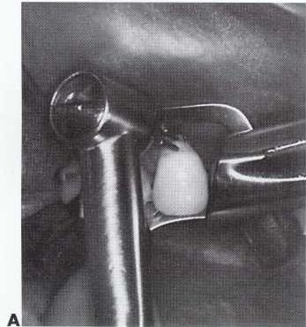
Initiating a beveled conventional Class V tooth preparation
A, Operating position and equipment. Entry with No. 701 bur or tapered diamond held at 45-degree angle to tooth surface.

Slide 28
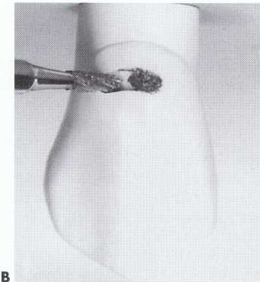
B, As cutting proceeds distally (0.2 mm into dentin), bur shank is held perpendicular to enamel surface.

Slide 29
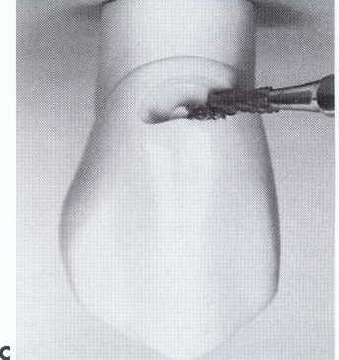
C, Mesial extension, keeping bur shank perpendicular to surface and maintaining initial depth.

Slide 30
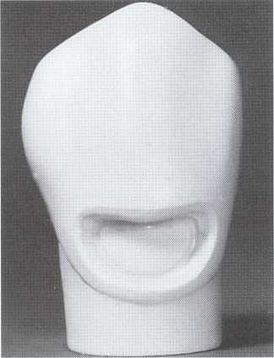
Completed large beveled conventional Class V preparation.

Slide 31
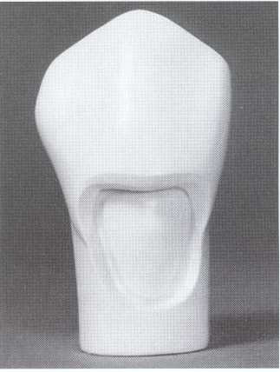
Completed Class V tooth preparation extending onto the root; crown portion beveled conventional design; root portion conventional design

Slide 32
MODIFIED PREPARATION
Indicated for the restoration of small and moderate Class V lesions or defects
The objective is to restore the lesion or defect as conservatively as possible.
The lesion or defect is "scooped" out,
no effort to prepare the walls as butt joints
no uniform depth
For e.g. in Decalcified and hypoplastic areas

Slide 33
prepare initial tooth preparation with a round or elliptical diamond instrument, eliminating all of the enamel lesion or defect.
The preparation is only extended into dentin when the defect warrants such extension, and at this initial stage is prepared no deeper than 0.2 mm into dentin (because no groove retention form will be used).
No effort is made to prepare 90-degree cavosurface margins.

Slide 34
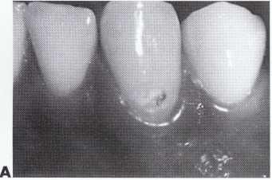
Modified Class V tooth preparation.
A, Small cavitated Class V lesion.

Slide 35
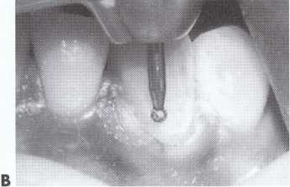
B, Surrounding enamel defect is prepared with round diamond instrument.

Slide 36
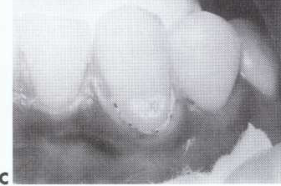
C, Completed modified tooth preparation after acid-etching.

Slide 37
Class V Tooth Preparation for Abrasion/Erosion Lesions.
The tooth preparation for a Class V abrasion or erosion area usually requires only roughening of the internal walls with a diamond instrument; beveling or flaring all enamel margins; and, sometimes, placing a retention groove in nonenamel areas

Slide 38
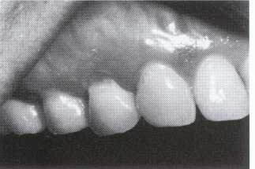
Class V Tooth Preparation for Abrasion/Erosion Lesions.

Slide 39
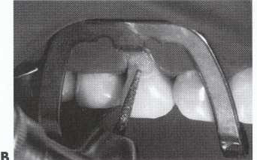
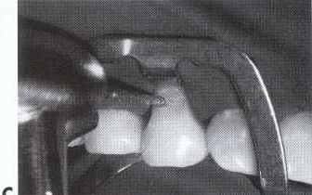
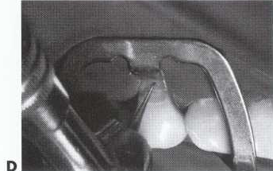
Beveling the enamel margin, roughening the internal walls, and placing retention groove.

Slide 40
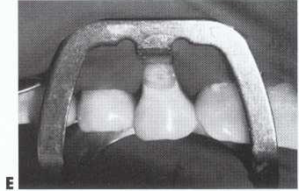
Completed preparation with etched enamel.

Slide 41
MATERIAL USED
1. Microfill composites may be selected for restoring class V defects because their composition results in:
Increased restoration smoothness, and
restoration flexibility when the tooth undergoes cervical flexure. It is thought the microfill composite restoration can flex, rather than debond, when the tooth flexes under heavy occlusal forces
2. GIC on the root surface

Slide 42
SUMMARY
This lecture presents techniques and rationales for the use of composite and other tooth-colored materials for
Classes III, IV, and V restorations.
It should be apparent that composite is the material of choice for most Class III and Class IV restorations and most esthetically demanding Class V restorations.
When done correctly, composite restorations provide excellent dental treatment in those clinical situations.

Slide 43
REFERENCES
Sturdevant’s Art & Science of Operative Dentistry

