Slide 1
Dental material, basic equipment and management

Slide 2
Introduction
The science of dental materials must include a knowledge and appreciation of certain biological considerations that are associated with selection and use of materials designed for the oral cavity.
Strength and resistance to corrosion are unimportant if the material injures the pulp or soft tissue.

Slide 3
Biological requirements of dental material
A dental material should
Be non toxic to the body.
Be non irritant to the oral or other tissues
Not produce allergic reactions
Not be mutagenic or carcinogenic

Slide 4
Classification of material from a biological perspective
Those which contact the soft tissue within the mouth
Those which could affect the health of the dental pulp
Those which are used as root canal filling materials
Those which affect the hard tissues of the teeth
Those used in the dental laboratory which though not used in the mouth, are handled and may be accidentally ingested or inhaled.

Slide 5
Basic equipments
BASES AND DENTIN BONDING AGENTS
Function and purpose
Placed in tooth after cavity preparation and just before placement of restorative material.
Function to reduce microscopic gap between surface of dentin and restorative material.

Slide 6
Reduce microleakage.
Reduce senstivity of restoration.
Helps living tissue inside the tooth recovers from stress of preparation and restoration.
Reducing the microscopic gap can –
Serve to bond or tie restoration to tooth chemically and micromechanically.
Assist retention of restoration.

Slide 7
BASES
GLASS IONOMER CEMENTS
Glass ionomer cements are adhesive tooth colored anticariogenic restorative materials which were originally used for restorations of eroded areas. Now it is modified to allow its use in other areas.
Unlike other restorative materials, this cement requires minimal cavity prepartion as it bonds adhesively to tooth structure.

Slide 8
Applications
Anterior esthetic restorative material for class III cavities.
For eroded areas and class V restorations.
As a luting agent
As liners and bases
For core build up
To a limited extent as pit and fissure sealants.
Not recommended for class II and class V restorations, since they lack fracture toughness and are suspectible to wear.

Slide 9
classification
1. Type I - Luting
2. Type II - Restorative
3. Type III - Fast setting lining
4. Type IV - Fissure sealants
5. Type V - Orthodontic cements

Slide 10
6. Type VI - Core build up material
7. Type VII - High fluoride releasing command set GIC
8. Type VIII - GIC for Atraumatic Restorative Treatment (ART)
9. Type IX - Geriatric and Paediatric GIC

Slide 11
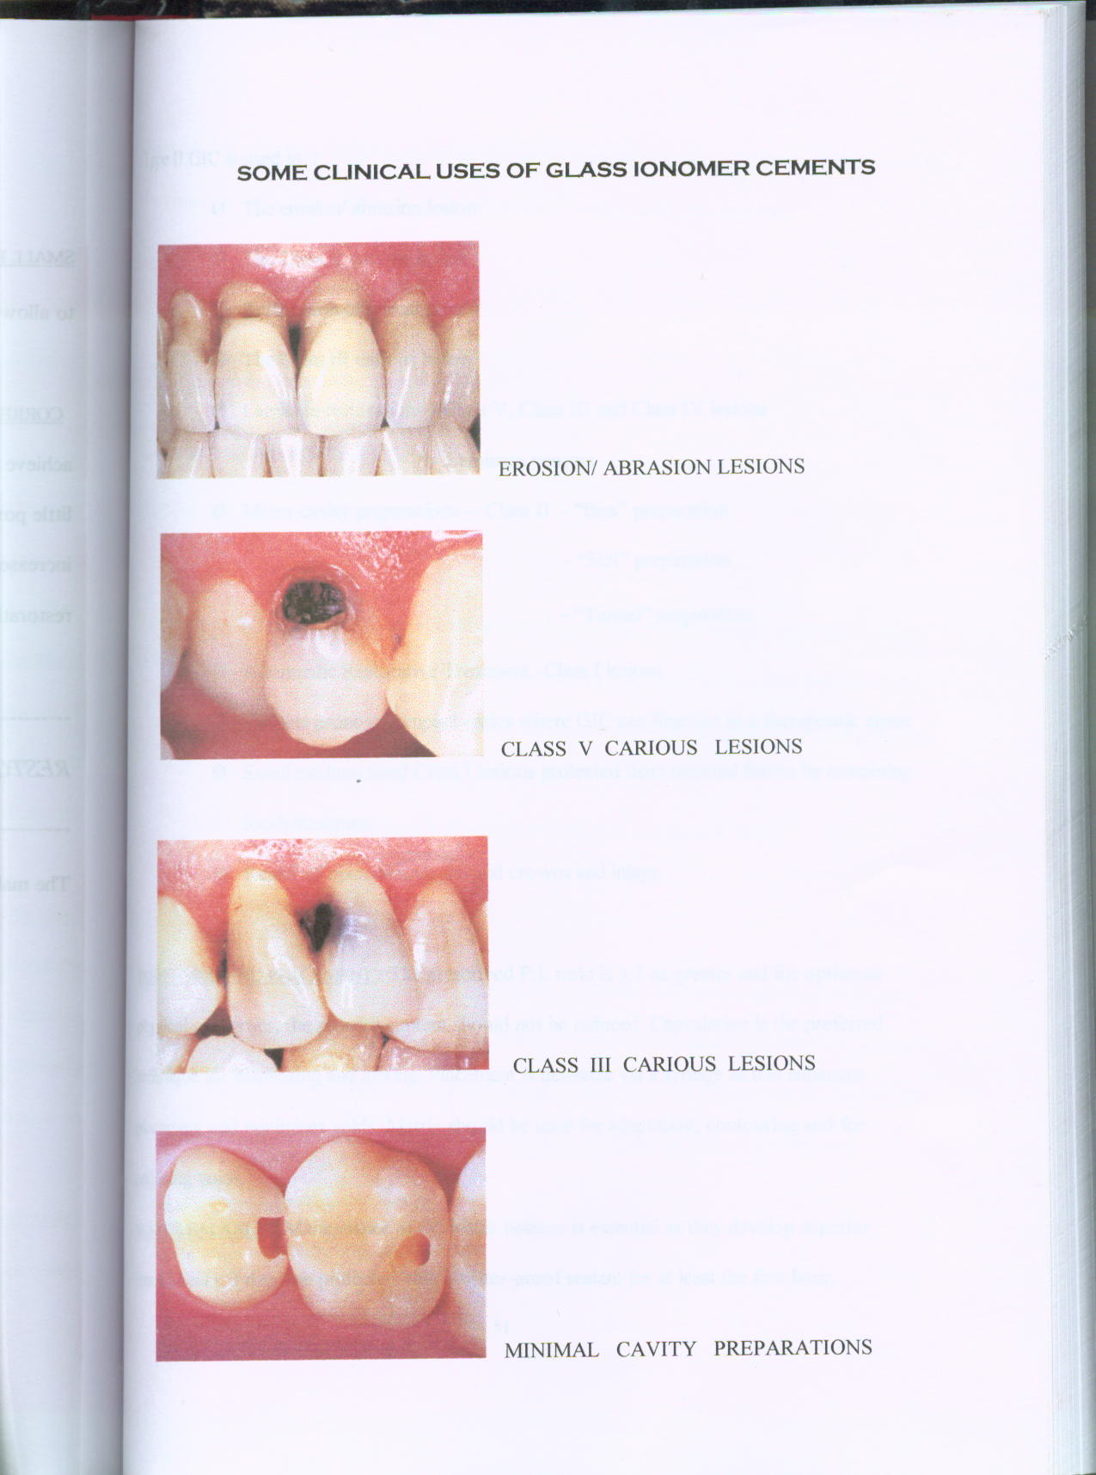
INDICATIONS:
RESTORATIVE MATERIALS:
Restoring of erosion/ abrasion lesions without cavity preparation.
Sealing and filling of occlusal pits and fissures
Restoration of deciduous teeth.
Restoration of class III lesions, preferably using a lingual approach with labial plate intact.

Slide 12
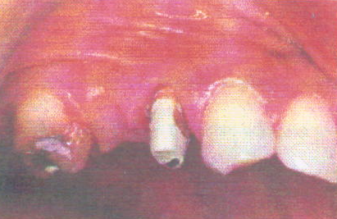
Repair of defective margins in restorations
‘Minimal cavity preparations’ – proximal lesions –buccal and
occlusal approach (tunnel preparation)
Core build-up
Sealing of root surfaces for over dentures.

Slide 13
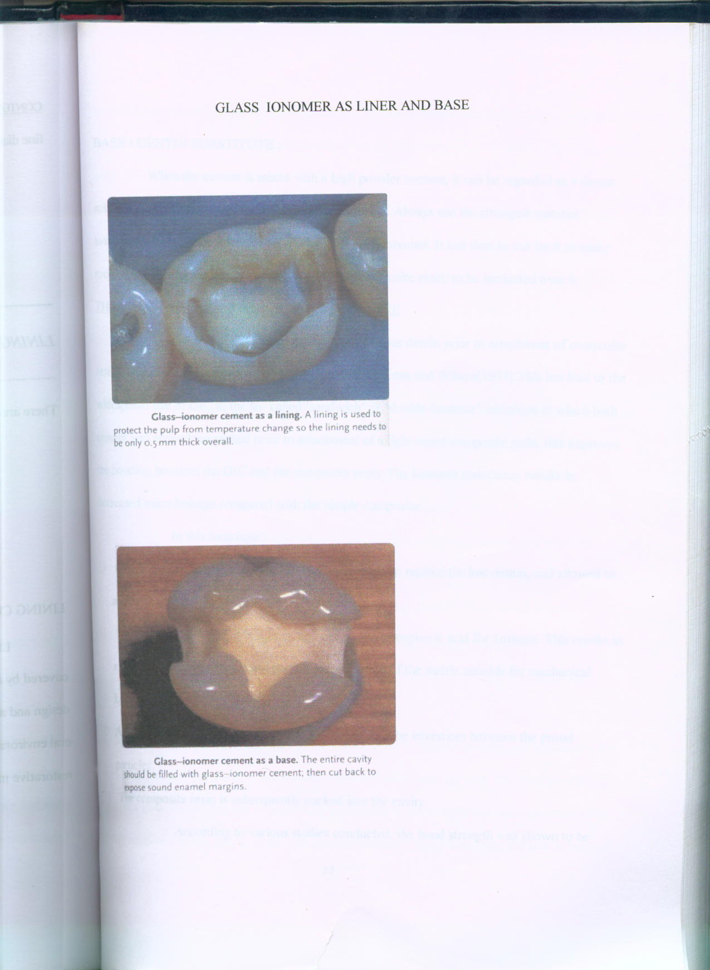
GLASS IONOMER AS LINER AND BASE
Glass-ionomer cement as a lining. A lining is used to protect the pulp from temperature change so the lining needs to be only 0.5mm thick overall.
Glass-ionomer cement as a base.

Slide 14
CONTRAINDICATIONS:
Class IV carious lesions of fractured incisors.
Lesions involving large areas of labial enamel where esthetics is of major importance
Class II carious lesions where conventional cavities are prepared; replacement of existing amalgam restorations.
Lost cusp areas.

Slide 15
Mixing
P/L ratio: 3:1 by wt
Low P/L ratio reduces mechanical properties and increases the chances of cement degradation.
Moisture contamination alters the acid water balance.
Manufacture provides a plastic scoop which is useful for measure.
Spatula used: Agate or plastic

Slide 16
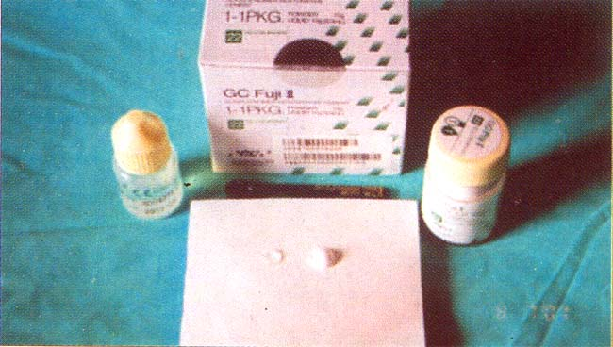
Manual mixing :
the powder and liquid is dispensed just prior to mixing.
A cool dry glass slab is preferred

Slide 17
Powder is divided into 2 equal increments. The first increment is incorporated into the liquid rapidly with stiff bladed spatula to produce a homogenous milky consistency.
The remainder of powder is then added. The mixing is done in a folding method in order to preserve the gel structure.
Mixing time : 45 sec
Insertion: mix is immediately packed into the cavity with a plastic instrument

Slide 18
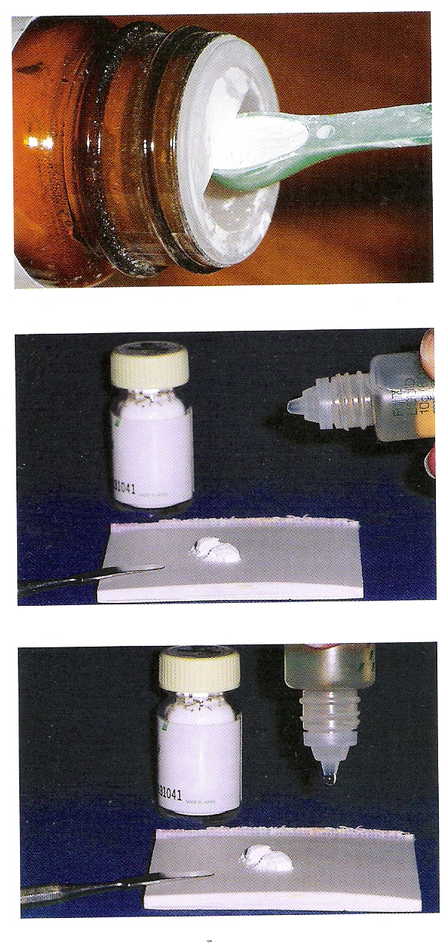
CLINICAL PROCEDURE (DISPENSING)
STANDARDIZE POWDER IN SPOON
DISPENSE LIQUID TO AVOID AIR BUBBLES

Slide 19
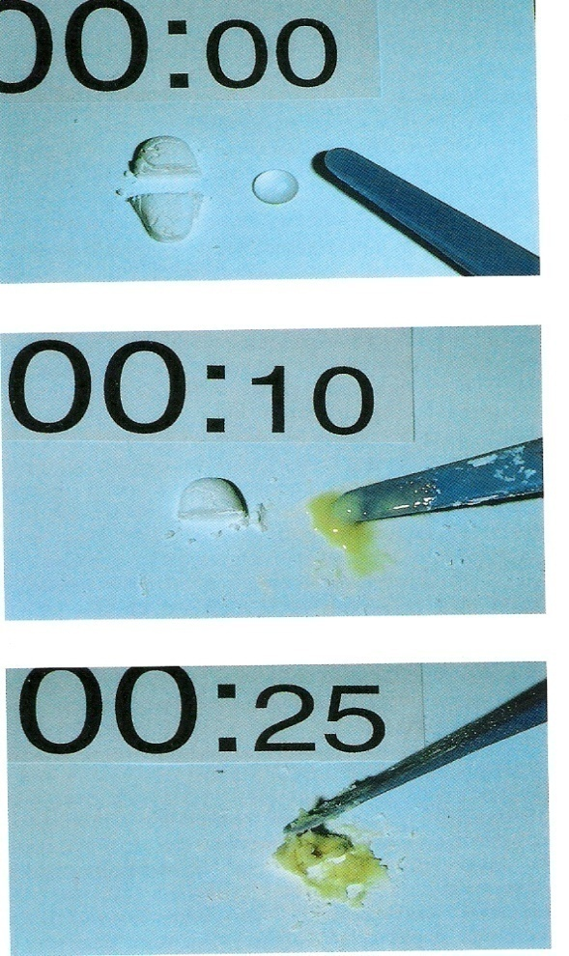
MIXING
MIXING POWDER AND LIQUID USING PLASTIC SPATULA
FOLDING TECHNIQUE FOR MIXING

Slide 20
Metal modified GIC
The metal modified GIC’s were introduced to improve the strength, fracture toughness and resistance to wear and yet maintain the potential for adhesion and anticariogenic property.
Types :
Silver alloy admix - amalgam alloys are interpreted into the glass powder. (miracle mix)

Slide 21
Cermet : silver particles are bonded to glass particles. This is done by sintering of a mixture of the two powders at a high temperature.
Uses:
Restoration of small class I cavities as an alterative to amalgam or composite.
For core build up of grossly destructed teeth.
Drawbacks of miracle mix:
Poor esthetics
Cannot be burnished
Poor resistance to abrasion

Slide 22
Advantages of cermets
Burnishable surface
Improved abrasion resistance
Sintered metal powder lowers the coefficient of friction .
Silver has a lubricating effect on the surface.
Slightly better flexural strength than conventional GICs

Slide 23
Calcium hydroxide (dycal)
Light cured and self curing
Uses and characteristics:
Pulp protector – used when pulp exposure expected.
Used under any restorative material
Dentist will apply dycal only to relatively dry cavity preparation.

Slide 24
Once dycal is mixed, their is a need to dry cavity preparation before it is placed.
Preparation
Dispense equal amounts of base and catalyst.
Mixing time is 10 sec.
Mix it untill uniform in color.

Slide 25
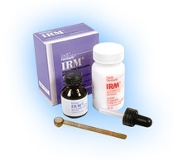
ZINC OXIDE EUGENOL CEMENT(Tempec/Tempbond)

Slide 26
Temporary sedative filling material and cements
Intermediate restorative material(IRM)
A reinforced eugenol composition
Zinc oxide eugenol cement have been used extensively in dentistry since 1890,s
Cements of low strength

Slide 27
Least irritating af all dental cements(Biocompatible)
OBTUNDENT (sedative)&anti-inflammatory effect on exposed dentin

Slide 28
APPLICATIONS
Thermal insulating base
Temporary restoration
Permanent cementation
Provisional restorations
Soft tissue packs in oral surgery & periodontics(obtunds surgerized tissue,promotes epi growth)
Root canal sealers(viscosity,radiopacity,dimensional change)

Slide 29
Classification
TYPE I – FOR TEMPORARY RESTORATION
TYPE II – FOR PERMANENT CEMENTATION OF FIXED PROSTHESIS
TYPE III – TEMPORARY FILLING & THERMAL INSULATING BASES
TYPE IV - USED AS CAVITY LINERS(INTERMEDIATE RESTORATIONS)

Slide 30
AVAILABLE AS-
POWDER & LIQUID
TWO PASTE SYSTEM
Zinc oxide eugenol cements differ from zinc oxide eugenol paste in that the latter contains plastisizer like linseed oil,olive oil,mineral oil etc which increases its flow
SETTING TIME – 4-10 minutes

Slide 31
MANIPULATION
P/L RATIO – 4:1 by wt
Measured quantity of P & L dispensed on paper mixing pad
Bulk of powder incorporated into liquid
Spatulated in circular motion with stiff stainless steel spatula
Small increments added to complete mix(putty like &non sticky)

Slide 32
Advantages
Obtundent effect on the pulp Good short-term sealing
Bacteriostatic
Disadvantages
weak, soluble

Slide 33
POLYMER REINFORCED ZOE(IRM)
USES
Intermediate direct filling restorative material
LUTING AGENT
AS BASE
TEMPORARY FILLING MATERIAL
AS CAVITY LINER

Slide 34
SETTING TIME – 6-10 MIN
FACTORS AFFECTING ST
Low P/L ratio increases ST
Moisture- accelerates ST

Slide 35
MANIPULATION
Proper P/L is dispensed on dry glass slab
Powder mixed into liquid in small portions with vigorous spatulations
Working time: These cements have a long working time.

Slide 36
NON-EUGENOL ZINC OXIDE
CAVIT-Premixed non-eugenol paste
Available for temporary restoration & cavity base
Suitable for patients sensitive to eugenol
Composition:
Zinc oxide
Zinc sulhate-1 hydrate
Calcium sulphate-hemihydrate
glycol acetate,polyvinyl acetate & red pigments

Slide 37
Setting reaction
The material sets by chemical reaction.
It sets by reacting with water which it absorbs from the mouth or from the cavity.
The setting occurs slowly.It expands on setting.
Setting time
20 – 30 min. complete hardness takes place in 2 – 3 hrs.

Slide 38
Properties:
It is white or pink colored. It has good initial sealing.
Since it expands on setting, the marginal seal is further improved. The seal gradually decreases with time.
The strength is low and its life is short. The material should be used for not more than 1 to 2 weeks.
It slowly disintegrates with time and is therefore not indicated for any long term temporary restoration.

Slide 39
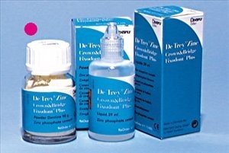
Zinc phosphate cement

Slide 40
zinc phosphate dental cement is one of the oldest and widely used cements, and is commonly used for luting & Base purposes.
‘CROWN & BRIDGE’ AND ‘ZINC OXYPHOSPHATE’
Developed 100 yrs ago and was extremely popular during 20th century
‘Gold standard’ for all dental cements

Slide 41
APPLICATIONS
LUTING Restorations
Base (high strength)
Luting of Orthodontic bands & brackets
Temporary Restorations

Slide 42
CLASSIFICATION
TYPE I - LUTING (fine grained)
TYPE II – LUTING & BASE(medium grained)

Slide 43
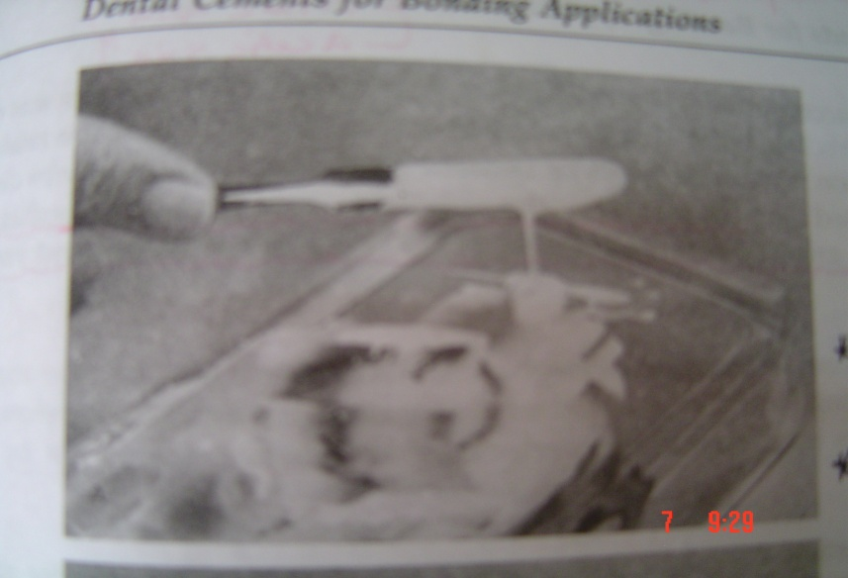
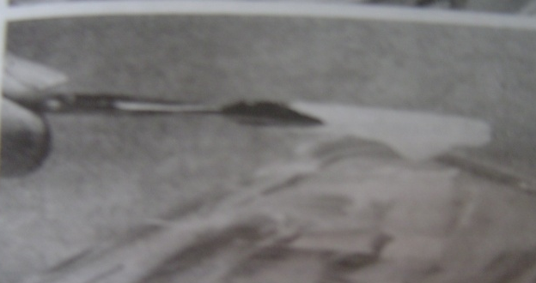
CONSISTENCY
Luting –for cementation of crown, inlays and orthodontic bands.
Base –under metallic restorations(Amalgum)
- thermal and chemical insulation.
Restorative
LUTING BASE

Slide 44
AVAILABLE AS
POWDER & LIQUID
(supplied in two separate bottles)
Capsules of pre-proportioned powder & liquid
Zinc Phosphate

Slide 45
MIXING TIME:-60-90sec or 1min. 15 sec
Working time is approximately 4 to 5 minutes
SETTING TIME – 2.5 -8 min(ADA SPEC. NO.96)
MIXING AND SETTING TIME

Slide 46
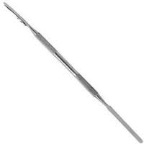
MANIPULATION
P/L RATIO – 1.4gm powder to 0.5ml liquid
STAINLESS STEEL SPATULA
MIXING TIME – 1 min 15 sec
A COOL MIXING GLASS SLAB
DRY FIELD

Slide 47
PROCEDURE
Powder divided into portions
mixing initiated by adding small amount of powder using BRISK SPATULATION over a larger surface area
completion of mix requires around 1.5 – 2 min
Prosthesis seated immediately before matrix formation occurs and held under pressure until the cement sets
Excessive cement removed after it has set

Slide 48
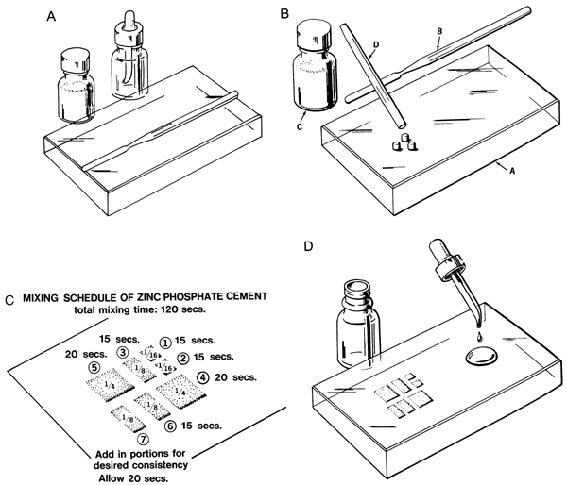
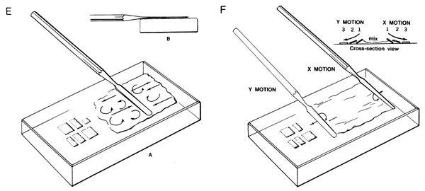
MIXING PROCEDURES
Chilled glass slab
and dispensing P.
Dividing P portions
and dispensing L.
Incremental additions
and stropping.

Slide 49
When using zinc phosphate cement,dentin is routinely protected with varnish or dentin sealer
Advantages
Long record of clinical acceptability
High compressive strength

Slide 50
Disadvantages
Low initial pH which may lead to post cementation sensitivity
Lack of an ability to bond chemically to tooth structure
Lack of an anticariogenic effect

Slide 51
IMPRESSION MATERIALS
ALGINATE impression material
Uses and characteristics
Preliminary impressions for study casts (seldom used for final impressions)
Irreversible hydrocolloid

Slide 52
Types:
Regular set – working time - 2 min;
setting time - 41/2 minutes
Fast set – working time - 1 min
Set time – 1 to 2 min
Setting time is reduced by warmer water.

Slide 53
Preparation:
Measure water and place in rubber mixing bowl
Tumble alginate container
Measure powder and add to water
Stir in middle of bowl; then spatulate against sides of bowl.
Mix must have a smooth, creamy texture
Complete mix within 60 sec
Place mix into impression tray.

Slide 54
Vinyl polysiloxane impression material
Reprosil
Uses and characteristics
Extremely accurate impression material
Crown and bridge impressions
Precise duplication of models (diagnostic casts) in the dental laboratory.

Slide 55
Four types:
Light body(low viscosity): used in syringe or tray
Medium body: used in syringe or tray
Heavy body (high viscosity): used in tray
Putty – used in tray
Supplied as: the base and catalyst paste come in equal sized tubes.
Putty jars: two equal sized plastic jars- one containing the base and other catalyst.

Slide 56
Preparation
Dispense equal lengths(4”) of materials from each tube on to a parchment pad.
Dispense in middle of pad close together, but not touching
Use two tongue blades to incorporate the two materials.
Use first tongue blade to begin the mix, at 30 sec, turn the mix with second tongue blade and complete the mix.

Slide 57
Mix must be complete within 60 sec.
Mix must be uniform in color, no streaks.

Slide 58
Restorative resin materials
Acid etch- (37% solution of phosphoric acid)
Purpose: increase bond between enamel and resin.
Provides added source of retention and marginal seal.

Slide 59
Acid etching
Acid used and its concentration:
37% concentration of phosphoric acid is preferred.
Etching time: originally the etching time was 60 sec. currently this has been reduced to 15 sec as it produces the same roughness as a 60 sec etching time.
Form of the acid: the acid may be available as a liquid or gel etchent.

Slide 60
Liquid etchant are free flowing and cannot be confined to the area where they are applied.
Gel etchant have colloidal silica or polymer beads incorporated in them to make more viscous. They can be localized to the area where they are applied.
Gel etchants are therefore preferred due to controlled placement.
Acid placement: it may be applied by means of syringe or brush. Syringe placement is easy and precise.

Slide 61
Mechanism of etching: Acid etching converts smooth enamel into a very irregular surface with high surface energy.
It removes 10 µm of surface enamel and creates a microporous layer which is 5 to 50µ deep.
Rinsing:
After etching the enamel surface should be thoroughly rinsed with a continuous stream of water spray for 5 to 10 sec so that acid is completely washed off.

Slide 62
Drying:
This should be followed by proper drying which will produce a frosty, white appearance.
Contamination of the etched and dried enamel surface by saliva, moisture or blood can prevent proper bonding.

Slide 63
Enamel bonding agents
Originally enamel bonding agents consisted of BISGMA or UDMA resin with a diluent TEGDMA to lower their viscosity.
These agents flow easily into the microporosities of enamel surface and when polymerized by light activation form resin tags which lock them into the enamel surface.

Slide 64
Mechanism of enamel bonding:
Bonding to enamel is micromechanical in nature brought about by the formation of resin tags within the etched enamel.
Bond strength:
The bond strength of composite resins to etched enamel is 15 to 25 Mpa.
This is adequate to resist shrinkage stresses produced during the polymerization of composite resins.

Slide 65
RESTORATIVE RESINS
These are tooth colored material used in the restoration of natural teeth. They are of two types:
Unfilled, eg. acrylic resins
Filled, eg. composite resins

Slide 66
Restorative acrylic resins
These were first introduced, they created quite a stir, because of their superior esthetics. Slowly many restorations began to fail, through microleakage and staining.
The type I unfilled direct resins have been largely replaced by the composite resins.

Slide 67
Composite resins
It is a tooth colored restorative system developed in the late 1950’s and early 1960’s by bowen. It is basically a resin which has been strengthened by adding silica particles.
A composite is a system composed of a mixture of two or more macromolecules which are essentially insoluble in each other and differ in form.

Slide 68
The composite material properties are superior to those of its individual components, eg. Fiberglass has a resin matrix which is reinforced by glass fibers. The resulting composite is harder and stiffer than the resin matrix material, but less brittle than glass. Matrix is made of collagen, with hydroxyapatite crystals acting as fillers.
Uses: restoration of anterior and posterior teeth
To veneer crowns and bridges
To build up cores (post core)
Cementation of orthodontic brackets and ceramic crowns, inlay, onlay and laminates.
Pit and fissure sealant

Slide 69
Types: based on curing mechanism
Chemically activated
Light activated
Based on mean particle size of the major filler
Conventional 8-12 µm
Small particle 1 - 5 µm
Microfilled 0.04 – 0.4 µm
Hybrid 0.6 - 1 µm

Slide 70
Based on the filler particle size and distribution
Megafilled composite very large fillers
Macrofilled composites 10- 100 µm
Midfilled composites 1- 10 µm
Minifilled composites 0.1- 1 µm
Microfilled composite 0.01 – 0.1 µm
Nanofilled composite 0.005 – 0.01 µm
Based on the method of polymerization
Self cured or chemically cured composite
Light cured composite
Dual cured composite

Slide 71
procedure
Etch tooth
Apply bonding agent, light cure
Placement filling material and light cure(20-40sec).
Finish /polish the restoration.

Slide 72
Dental Amalgam
Amalgam is one of the oldest of all materials used for restoring the carious lesion. It has been used more than any other materials in restorative dentistry.
Thus on the basis of frequency of use, one might say that dental amalgam is the most important restorative material used by the dentist

Slide 73
Amalgam technically means an alloy of mercury with any other metal
Dental amalgam is an alloy made by mixing mercury with a silver tin alloy.
Dental amalgam alloy is a silver tin alloy to which varying amount of copper and small amount of zinc has been added.

Slide 74
According to Skinner’s, amalgam is a special type of alloy in which one of its constituent is mercury.
According to Sturdevant, dental amalgam is an alloy made by mixing mercury with a silver-tin dental amalgam alloy (Ag-Sn).

Slide 75
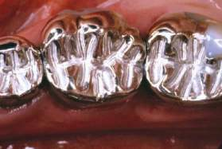
Why Amalgam?
Inexpensive
Easy to insert
Not overly technique sensitive
Maintain anatomic form
Have adequate resistance
to fracture
Prevent marginal leakage after a
Period of time
Ease of use
Proven track record
  >100 years
Familiarity
Have a long service life
Resin-free

Slide 76
Physical characteristics of mercury:
Liquid at room temperature
Vaporizes with increased heat
Provides plasticity to amalgam restoration
Highly poisonous- symptoms are nausea, headache and vomiting

Slide 77
INDICATION FOR USE OF AMALGAM:
Pit and fissure caries
In Class I, Class II, Class V, and Class III on distal of cuspids
Cemental caries: used as treatment restoration for root caries.
Short life expectancy of tooth:
Preventive procedure: Hyatt had recommended a preventive or prophylactic procedure, in which pits and fissures may be minimally prepared and restored with amalgam before visible attack by caries. He referred to this procedure as ""prophylactic odontomy""

Slide 78
Core build-up:
Complex restoration:
Control restoration: Amalgam can be used as control restoration in teeth which are either symptomatic preoperatively and are poor periodontally. These restoration help to (1) Isolate pulp from oral fluids, (2) Provide an anatomic contour against which gingival tissue may heal, (3) Facilitate control of caries and plaque.
Retrograde filling:
Economic: inexpensive

Slide 79
Limitations of Dental Amalgam:
Poor aesthetics:
Mercury toxicity:
High thermal conductivity:
Galvanic effects:
Lack of adhesion:
Secondary caries:
Marginal integrity: Marginal breakdown of amalgam restoration ranging from ditching to complete break down of marginal restoration can also result in many secondary discrepancies.

Slide 80
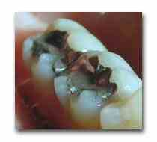
Mercury absorption
Mercury is ubiquitous in the environment and taken into the body in one form or another via water, air food on a daily basis. As long as the levels are low, there is no threat for mercury toxicity. And mercury is biochemically processed and excreted.

Slide 81
Absorption, bio-transformation, distribution and elimination of mercury
The metabolism of mercury is dependent on the chemical form of mercury and the route of exposure.
There is evidence that elemental mercury can penetrate skin, but quantitative data are lacking Ingested elemental mercury vapor readily crosses cell membranes because of its high diffusibility and lipid solubility.
About 80% of inhaled mercury is absorbed across alveolar membranes into blood stream and then transported to other tissues.
Accumulation occurs in spleen, muscle, glands such as thyroid gland, salivary gland and testis.
The accumulation of mercury, after exposure is dependent on the close, frequency and duration of exposure as well as a number of metabolic factors related to the exposed individual

Slide 82
The retention time of mercury in organs varies considerably, with biologic half-life ranging from a few days to months. On an average biologic half-life of inorganic mercury is 50-60 days.
The organs with the longest retention times are the brain, kidneys and testicles. The kidney especially renal cortex is the main organ of accumulation.
In cases of chronic low level exposure, the critical organ is the brain.
In contrast, nonionized mercury (Hg°) is capable of crossing through lipid layers at these barriers and, if subsequently oxidized within these tissues, is only slowly removed

Slide 83
Mercury ions (H⁺²) circulate readily in the blood but pass the membrane barriers of the brain and placenta only with difficulty.
The elimination of mercury from the body occurs primarily by the excretion of Hg⁺⁺ via
1) Urine
2) feces.
3) Exhalation of mercury vapor accounts for only a small portion of 7%.
4) Perspiration may also have a role under certain conditions.
All forms of mercury cross the placenta to varying degrees.

Slide 84
Toxicity of mercury
The elemental mercury gets oxidized into mercuric ion, which has a strong affinity for the sulfydryl groups of proteins. It also combines with other ligands, such as the phosphoryl, carboxyl, amide and amine groups.
Hg may alter membrane permeability and increase cell volume without any loss in cell viability.
Mercury is a potent metabolic poison; within cells it act as potent nonspecific enzyme inhibitors and denaturants of proteins, thus interfering with cellular metabolism and function.
The mercuric ion has also been shown to alter membrane function and transport, including the release and uptake of neurotransmitters in the brain.

Slide 85
The possible harmful effects from amalgam could be
Neurotoxicity
kidney dysfunction
Reduced immunocompetence
Birth defects
General health
But several studies have demonstrated no relationship between the presence of amalgam fillings and the above mentioned harmful effects.

Slide 86
Sources of mercury in dental office
Mercury spills.
Expression of excess mercury from amalgam.
Leakage from dispensers.
Leakage from amalgam capsules during trituration.
Mercury vaporization from contaminated instruments placed in sterilizers.
Grinding of amalgam during removal of restorations.
Amalgam condensation with ultrasonic condensers.
Contaminated furnishings of the office.
Contaminated amalgamators, cabinets, drains, drapes.
Waste containers .

Slide 87
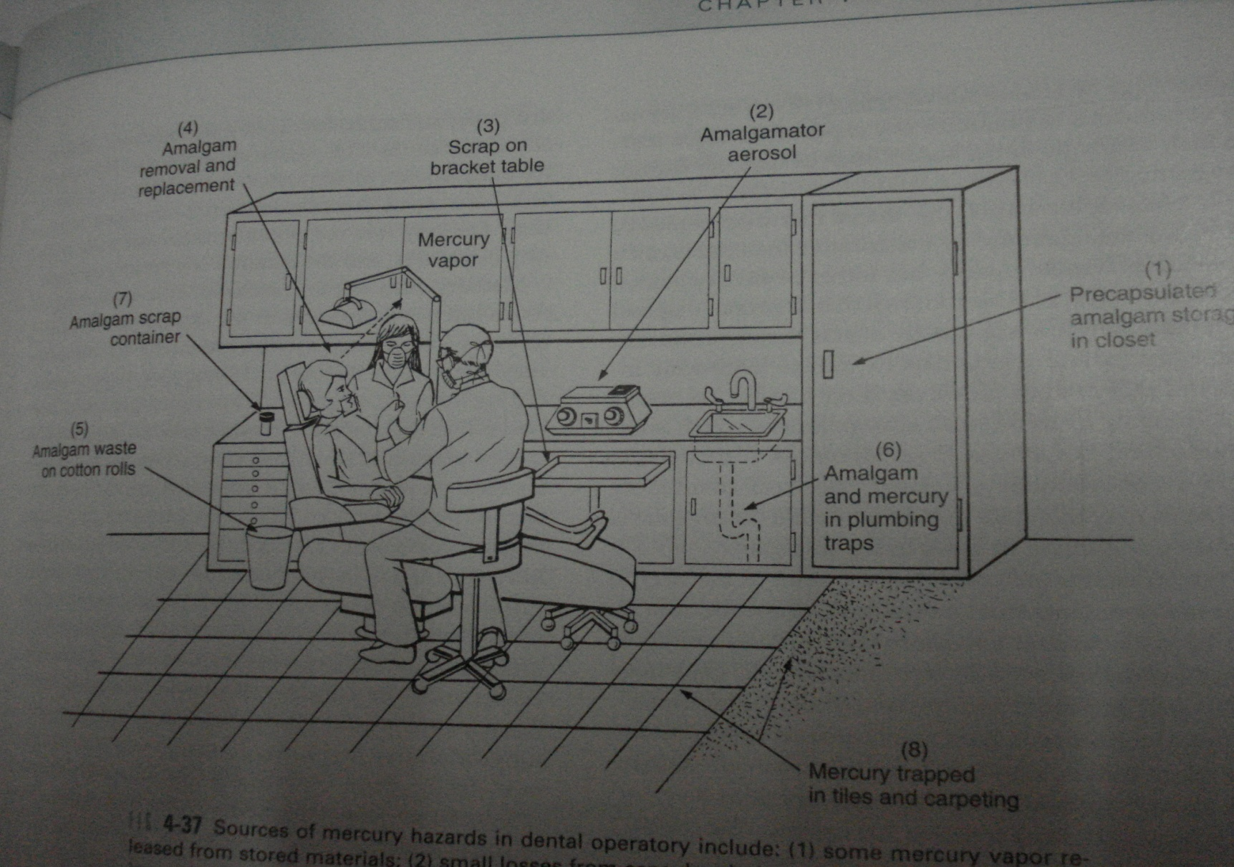
Sources of Hg hardard in dental operatory : 1. Some mercury vapor released from stored materials; 2. Small losses from capsules during trituration; 3. Spillage during manipulation for tooth restorations; 4. Some vapor exposed to dentist, assistant n patient during removal, placement or finishing 5. contamination of cotton rolls 6. collection of debris via vaccum sucton into plumbing system and sewer system 7. collection of remnants in jar for recycling 8. mercury trapped in small cracks between floor tiles

Slide 88
TREATMENT OF MERCURY POISONING
TREATMENT OF MERCURY POISOINING
a. Acute Exposure: Treatment of acute mercury poisoning consists of removal from exposure and chelation treatment with dimercaprol, usually in dosage of 3-5 mg/kg intramuscularly every 4 hours for 48 hours and then every12 hours for 10 days. If renal damage occurs, hemodialysis will be required.(Br Dent J, 1969).
b. Chronic Exposure: With chronic mercury poisoning,oral penicillamine or N-acetylpenicillamine (250-500 mgorally 4 times a day for 10 days) is usually required. Urinary mercury levels should be monitored to observe enhanced removal Dimercaprol and penicillamine promote excretion of mercury into the urine (J Am Dent Assoc, 1976).

Slide 89
Mercury hygiene
Train all personal involved in the handlingof mercury or dental amalgam regarding the potential hazard of mercury vapour and the necessity of observing good mercury hygiene practices.
Make the personal aware of the potentail sources of mercury vapour in the operatory.
Provide proper ventilation in the work place by having fresh air exchanges and periodic replacement of air-conditioning filters, which may act as traps for mercury.
Periodically check the dental operatory atmosphere for mercury vapour.

Slide 90
Use proper work area design to facilitate spill containment and cleanup.
Use pre-capsulated alloys ;discontinue the use of bulk alloy and mercury.
Use an amalgamator with a completely enclosed arm.
Use care in handling amalgam. Avoid skin contact with mercury or freshly mixed amalgam.
If possible, recap single-use capsules from precapsulated alloy after use.
Use high volume evacuation when finishing or removing amalgam. Evacuation system have traps or filters. Check, clean or replace traps and filters periodically.

Slide 91
Salvage and store all scrap amalgam in a tightly closed container, either dry or under radiographic fixer solution.
When feasible, recycle amalgam scrap and waste amalgam. Otherwise, dispose of amalgam scrap and waste amalgam in accordance with applicable laws.
Dispose of mercury –contaminated items in sealed bags according to applicable regulations.
Clean up spilled mercury properly using trap bottles, tape or freshly mixed amalgam to pick up droplets, and commercial cleanup kits. Do not use a household vacuum cleaner.
Remove professional clothing before leaving the workplace.
( J Am Dent Assoc , 1999)

