Slide 1
Department Of Conservative Dentistry And Endodontics BDS II YEAR
Class I cavity preparation for silver amalgam – Part II
DR. MANJU
PROFESSOR
Date: 17/02/17

Slide 2
EXTENSIVE CLASS I AMALGAM RESTORATIONS
Initial Clinical Procedures
RUBBER DAM ISOLATION
PREOPERATIVE OCCLUSAL ASSESSMENT AND ANESTHETIC ADMINISTRATION

Slide 3
EXTENSIVE CLASS I AMALGAM RESTORATIONS
Caries is considered extensive if the distance between
infected dentin and the pulp is judged to be less than
1 mm or when the faciolingual extent of the defect is up
the cuspal inclines.

Slide 4
Tooth Preparation
Initial Tooth Preparation
Using a No. 245 bur at high speed with air-water spray and oriented with its long axis parallel to the long axis of the tooth crown, prepare the outline, primary resistance, and primary retention forms.
An initial depth of 1.5 to 2 mm should be maintained.
The preparation is extended laterally to remove all enamel undermined by caries by alternately cutting and examining the lateral extension of the caries.
For caries extending up the cuspal inclines, it may be necessary to alter the bur's long axis to prepare a 90- to 100-degree cavosurface angle while maintaining the initial depth.

Slide 5
When extending the outline form, enameloplasty should be used when possible. When the defect extends to one half the distance between the primary groove and a cusp tip, capping the cusp (i.e., reducing the cuspal tooth structure and restoring it with amalgam) may be indicated.
When that distance is two thirds, cusp capping is usually required because of the risk of cusp fracture postoperatively. A Class I restoration that has either a wide faciolingual extension or a capped cusp may also be considered for adhesive bonding.

Slide 6
Initial tooth preparation with extensive caries. When extending laterally to remove enamel undermined by caries, alter the bur's long axis to prepare a 90- to 100-degree cavosurface angle. A 100-degree cavosurface angle on the cuspal incline will result in an 80-degree marginal amalgam angle.

Slide 7
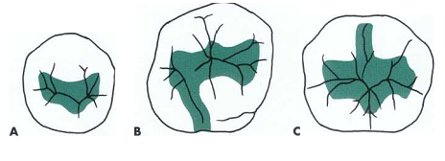
Some examples of large Class I amalgam preparation outlines
A, Occlusal outline form in the mandibular second premolar
B,Occlusolingual
outline form in the maxillary
first molar.
C, Occlusofacial outline
form in the mandibular first
molar.

Slide 8
For pulpal protection in very deep carious excavations (where the remaining dentin thickness is judged to be less than 0.5 mm), a thin layer (i.e., 0.5 to 0.75 mm) of a calcium hydroxide liner may be placed.
The calcium hydroxide liner may stimulate secondary dentin formation in an area where a microexposure is suspected.
The calcium hydroxide liner should be placed only over the deepest portion of the excavation (nearest the pulp). A thin base of RMGI should then be used to cover the calcium hydroxide. As before, the entire dentin surface should not be covered.

Slide 9
Placement of Ca(OH) 2 liner and RMGI base.

Slide 10
Primary resistance form was obtained by extending the outline of the tooth preparation to include only under- mined and defective tooth structure, while preparing strong enamel walls and allowing strong cuspal areas to remain.
If the excavation of caries has removed most (or all) of the flat pulpal floor that was initially prepared, secondary resistance form may be indicated.
If so, establish flat seats in dentin (0.2 mm inside the DEJ, at the pulpal wall level) that are somewhat equally spaced around the periphery of the excavation.
Primary retention was obtained by the occlusal convergence of the enamel walls; secondary retention form may result from undercut areas that are occasionally left in dentin (and that are not covered by a liner) after removal of infected dentin.

Slide 11
Restorative Technique
After any indicated liner or base is placed, regardless of the depth of the excavation, either a dentin desensitizer or adhesive system is used.
The objective of the use of a dentin desensitizer is to better seal the prepared dentin. As described previously, it is used instead of varnish. It is rubbed into the dentin surface with an applicator tip for 30 seconds and dried.
Amalgam adhesives may be used with all amalgam restorations, but they are generally reserved for foundations and large amalgam restorations, particularly those with deep excavations, remaining weakened tooth structure, and capped cusps.
Amalgam adhesives seal the dentin with an acid-resistant layer of resin-reinforced dentin called the hybrid layer.

Slide 12
When amalgam adhesives are used, varnish should not be used and dentin desensitizers are usually unnecessary. The adhesive itself serves as a desensitizer, reducing dentin permeability.
Adhesives used with amalgam must be self-curing or dual curing, because it is impossible to light-cure an adhesive through the amalgam.
The primer and adhesive components should not be dispensed in advance because the primer will volatilize (especially those containing acetone solvents) and the adhesive will set (because most are dual cured).
The preparation side of the matrix band should be waxed (i.e., lubricated) before placement to ensure that the bonded amalgam does not adhere to the band itself.

Slide 13
Bonding technique. A, Etchant application. B, Moist preparation surface.

Slide 14
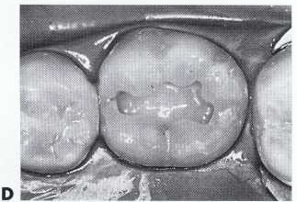
C, Primer application. D, Primed preparation surface.

Slide 15
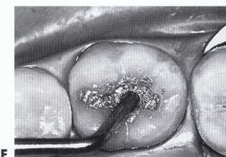
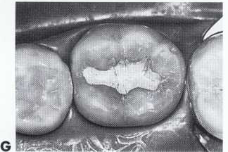
E, Adhesive application. F, Amalgam condensation.
G, Carved restoration

Slide 16
The timing of amalgam condensation is critical if the restoration is being bonded (i.e., if the insertion of the adhesive resin is immediately followed by the amalgam condensation).
The use of spherical amalgams is occasionally advocated
with amalgam adhesives because they are more quickly condensed than admixed amalgams.
Extensive Class I restoration is often more complex, because more cuspal inclines are included in the preparation. Appropriate contours, occlusal contacts, and groove and fossa anatomy must be provided.

Slide 17
CLASS I OCCLUSOLINGUAL AMALGAM RESTORATIONS
Outline of margins for OL tooth preparation.

Slide 18
Tooth Preparation
The initial tooth preparation involves the establishment of the outline, primary resistance, primary retention forms, and initial preparation depth.
The tooth preparation should be no wider than necessary; ideally the mesiodistal width of the lingual extension should not exceed 1 mm, except for extension necessary to remove carious or undermined enamel or to include unusual fissuring.
When indicated, the tooth preparation should be cut more at the expense of the oblique ridge rather than centering over the fissure (weakening the small distolingual cusp).

Slide 19
The margins should extend as little as possible onto the oblique ridge, distolingual cusp, and distal marginal ridge.
These objectives help to conserve the dentinal support and strength of the tooth, and they aid in establishing an enamel cavosurface angle as close as possible to 90 degrees. They also help to minimize marginal deterioration of the restoration by locating the margins away from enamel eminencies where occlusal forces may be concentrated.

Slide 20
Using the mirror for indirect vision and the high- speed handpiece with air-water spray, enter the distal pit with the end of the No. 245 bur.
The long axis of the bur usually should be parallel to the long axis of the tooth crown. Penetrate to a depth of 1.5 to 2 mm.
Once the entry cut is made, move the bur (maintaining the initial established depth) to include any remaining fissures facial to the point of entry. However, remember to use enameloplasty, if indicated.
Next, at the same depth, move the bur along the fissure toward the lingual surface.

Slide 21
The pulpal floor should follow the contour of the occlusal surface and DEJ, which usually rises occlusally as the bur moves lingually.
The mesial and distal walls of the occlusal portion of the preparation should converge occlusally because of the shape of the bur. This convergence provides sufficient retention form to the occlusal portion of the preparation.

Slide 22
Next, prepare the lingual portion. This may be accomplished by two techniques. In one technique the lingual surface is prepared with the bur's long axis parallel with the lingual surface.
The tip of the bur should be located at the gingival extent of the lingual fissure. Be careful to control the bur and not allow it to "roll out" onto the lingual surface, because this could "round over" or damage the cavosurface margin.

Slide 23
The axial wall should follow the contour of the lingual surface of the tooth. An axial depth of 0.5 mm inside the DEJ is indicated if retentive locks are required; an axial depth of 0.2 inside the DEJ is permissible if retentive locks are not required.
The No. 245 bur may be used with its long axis perpendicular to the axial wall to accentuate (i.e., refine) the mesioaxial and distoaxial line angles. This will also result in the mesial and distal walls converging lingually because of the shape of the bur. During this step the axial wall depth is not altered.

Slide 24
The occlusal and lingual convergences usually provide sufficient preparation retention form; thus no retention locks are needed. Keeping the bur perpendicular to the tooth surface, round the axiopulpal line angle.
Leaving a sharp line angle increases the possibility of fracture of the amalgam because of stress concentration. It also helps to ensure adequate preparation depth and amalgam thickness.

Slide 25
The second technique is more difficult. In this case, the No. 245 bur is held perpendicular to the cusp ridge and lingual surface as it extends the preparation from the occlusal surface gingivally (to include the entire fault).
Initiate final tooth preparation by removal of remaining caries on the pulpal and axial walls with a suitably sized round bur, a discoid-type spoon excavator, or both.

Slide 26
Additional retention in the lingual extension may be required if the extension is wide mesiodistally or if it was prepared without a lingual convergence.
If additional retention is required, the No. 1/4 or 169 bur can be used to prepare locks into the mesioaxial and distoaxial line angles.
If these angles are in enamel, the axial wall must be deepened to 0.5 mm axially of the DEJ (because the locks must be in dentin to not undermine enamel).

Slide 27
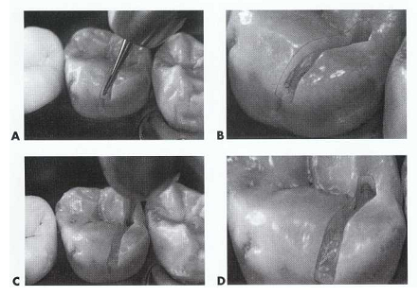
OL tooth preparation. A, No. 245 bur positioned for entry. B, Penetrate to minimal depth of 1.5 to 2 mm. C, Entry cut. D,

Slide 28
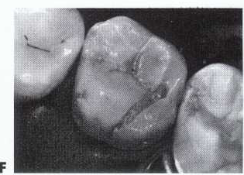
E and F, Cut lingually along fissure until bur has extended the preparation onto lingual surface.

Slide 29
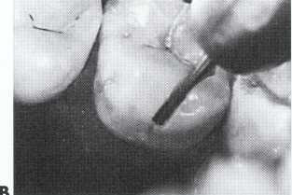
OL tooth preparation. A, Position of bur to cut lingual portion. B, Initial entry of bur for cutting lingual portion.

Slide 30
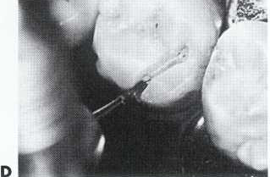
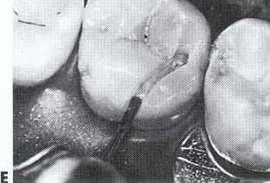
C, Alter inclination of bur to establish correct axial wall depth. D and E, Direct bur perpendicular to axial wall to accentuate mesioaxial and distoaxial line angles.

Slide 31
F, Axial wall depth should be 0.2 to 0.5 mm inside the DEJ.

Slide 32
The locks should diminish in depth toward the occlusal surface, terminating midway along the axial wall.
Extension of a facial occlusal fissure may have required a slight divergence occlusally to the facial wall to conserve support of the facial ridge. If so and if deemed necessary, prepare a retention cove in the faciopulpal line angle.
The tip of the No. 245 bur held parallel to the long axis of the tooth crown also might be used to prepare this cove. Be careful not to undermine the occlusal enamel (this retentive cove is recommended only if occlusal convergence of the mesial and distal walls of the occlusal portion is absent or inadequate).
Any irregularities at the margins may indicate weak enamel that may be smoothed by the side of the No. 245 bur rotating at slow speed.

Slide 33
Restorative Technique
Placing a Sealer or Adhesive System. As presented previously, after any indicated liner or base or both is placed, regardless of the depth of the excavation, either a dentin desensitizer or dentin-bonding system is placed.
A desensitizer is usually indicated in conservative preparations. A dentin-bonding system may be indicated in more extensive preparations. Either is used instead of varnish.
Placing a Matrix (if Necessary). Using a rigid matrix to support the lingual portion of the restoration during condensation is occasionally necessary.

Slide 34
A matrix is helpful to prevent "land-sliding" during condensation and to ensure marginal adaptation and strength of the restoration. The Tofflemire matrix retainer is used to secure a matrix band to the tooth. Because this type of matrix band does not intimately adapt to the lingual groove area of the tooth, an additional step may be necessary to provide a matrix that is rigid on the lingual portion of the tooth preparation.
If so, cut a piece of stainless steel matrix material (0.002 inch [0.05 mm] thick, 5/16 inch [8 mm] wide) that will fit between the lingual surface of the tooth and the band already in place. Place the gingival edge of this segment of matrix material slightly gingival to the gingival edge of the band to help secure the band segment.

Slide 35
Break off approximately 1/2 inch (12.7 mm) of a round toothpick, while holding it with pliers. Heat the end of a stick of green compound and cover the end of the tooth-pick wedge. Immediately insert the compound-coated wedge between the Tofflemire band and the cut piece of matrix material.
While the compound is still soft, use a suitable burnisher to press the compound gingivally, thereby securing the matrix tightly against the gingival cavosurface margin and the lingual surface of the tooth to provide a rigid, lingual matrix.

Slide 36
A unique property of the lingual matrix is its ability to respond to needed change in contour by pressing a warmed, metal instrument against the band from the preparation side. The heat is transferred through the matrix material to the compound, which may then be reshaped to provide the proper contour. This matrix for the OL amalgam restoration is referred to as the Barton matrix. Occasionally the piece of strip matrix can be positioned appropriately by using only the wedge (not the compound).

Slide 37
Inserting the Amalgam
Insertion of the amalgam is accomplished as previously described for the Class I occlusal tooth preparation.
Begin condensation at the gingival wall. If a matrix is not used, care must be taken to ensure that "landsliding" of the amalgam does not occur because two adjoining surfaces of the tooth are being restored.

Slide 38
For this technique, the last increments of amalgam may be condensed on the lingual surface with the side of a large condenser. Its long, broadly rounded contour conforms to the rectangular shape for the lingual groove preparation. However, the operator must still be careful (when condensing the occlusal surface) not to fracture out the lingual amalgam.
Another technique is to have the assistant secure the condensed lingual surface with a broad condenser nib while the operator completes the condensation of the occlusal surface. Neither technique is as fail-safe as using a Barton matrix. Regardless of the technique used, the amalgam must be well condensed.

Slide 39
Contouring and Finishing the Restoration.
When the preparation is sufficiently overfilled, carving of the occlusal surface may begin immediately with a suitable size, sharp discoid-cleoid instrument.
All carving should be done with the edge of the blade perpendicular to the margin and with the blade moving parallel to the margin.
To prevent overcarving, the blade edge should be guided by the unprepared tooth surface adjacent to the margin. Use an explorer to remove excess amalgam adjacent to the lingual matrix before matrix removal).

Slide 40
After the occlusal carving is complete, loosen the Tofflemire retainer from the band and remove the retainer with No. 110 pliers.
Push the free ends of the band one at a time, lingually and occlusally, through the proximal contacts. As the band is freed from the tooth, the compound, wedge, and the cut segment of steel matrix material may be lifted away from the tooth.
Complete the carving on the lingual surface. Only slight excess should remain to carve away. With carving completed, remove the rubber dam and adjust the restoration for proper occlusion.

Slide 41
References
Sturdevant’s Art & Science of Operative Dentistry

