Slide 1
TERMINOLOGY AND NOMENCLATURE

Slide 2
INTRODUCTION
The human dentition includes a total of 52 teeth, that is 20 primary and 32 permanent teeth.
While performing conservative dental procedure it is necessary to employ an easy means of identifying individual teeth.
For this it is necessary to combine the name of the tooth with its quadrant, arch as well as the dentition that it belongs.

Slide 3
Eg. Mandibular left permanent first molar, maxillary right primary central incisor, etc.
Since naming teeth in this manner is cumbersome and difficult for communication purpose, tooth numbering systems were developed.

Slide 4
Tooth numbering systems
There are several systems of numbering teeth. Of these, 3 system are currently popular. They are :
Zsigmondy/ Palmer system
American Dental Association (ADA system)
Federation Dentaire International (FDI) system

Slide 5
1. Zsigmondy’s & Palmer method
It is the oldest method of recording teeth. The oral cavity is divided into four quadrants
Upper Right Upper Left
Lower Right Lower Left
It is also called as the angular or grid system.
Each deciduous tooth is assigned an alphabet from A-E starting from deciduous central incisor to second deciduous molar.

Slide 6
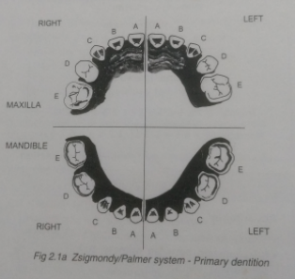
For the deciduous teeth the nomenclature is :

Slide 7
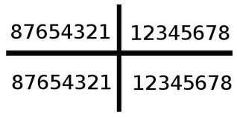
Each permanent tooth is assigned a number from 1-8 starting from the permanent central incisor to the third permanent molar.
For permanent dentition the nomenclature
Right
Left

Slide 9
In order to denote the specific tooth, the quadrant grid is combined with the tooth number in reference to the midline
Eg.1 represent maxillary right permanent central incisor
D represent mandibular left first primary molar
.

Slide 10
DISADVANTAGES :
Oral communication is difficult
Opposing and contralateral teeth are indicated by the same number or alphabet which can be confusing
ADVANTAGES :
Simple to use
No confusion between primary and permanent teeth

Slide 11
AMERICAN DENTAL ASSOCIATION (ADA ) system
It is also known as the Universal system.
The numbering begins from the patient’s maxillary right posterior most tooth, proceeds around the arch to maxillary left posterior most tooth, then to mandibular left posterior most tooth and around the mandibular arch to the mandibular right posterior most tooth.

Slide 12
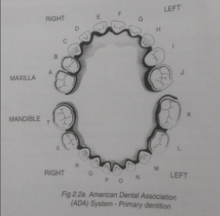
The primary teeth in the maxillary arch are designated by letters A to J, beginning with deciduous right second molar which is designated as ‘A’ to maxillary left second molar which is denoted by the letter ‘J’.

Slide 13
The teeth in the mandibular arch are designated by letters K to T beginning with the deciduous left second molar which is designated as ‘K’ and proceeding around the arch till the mandibular right second molar which is denoted by letter ‘T’
A B C D E F G H I J
T S R Q P O N M L K

Slide 14
The permanent teeth are indicated by numbers 1 to 32.
The maxillary right third molar is denoted by the number ‘1’ and proceeding around the arch till the maxillary left third molar which is denoted by the number ‘16’.
The mandibular left third molar is denoted by the number ‘17’ and around the arch till the mandibular right third molar ‘32’
Eg ‘D’ represents the maxillary right primary lateral incisor

Slide 15
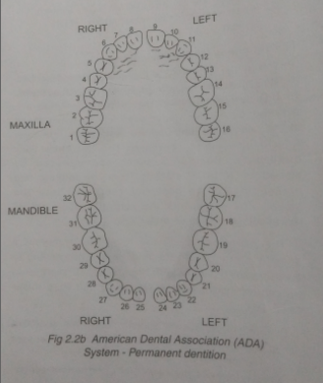

Slide 16
‘15’ represents the maxillary left permanent second molar.
1 2 3 4 5 6 7 8 9 10 11 12 13 14 15 16
32 31 30 29 28 27 26 25 24 23 22 21 20 19 18 17
ADVANTAGES :
Each tooth has a seperate unique letter or number to denote it.
DISADVANTAGE :
Difficult to remember the letters or numbers of individual teeth

Slide 17
FEDERATION DENTAIRE INTERNATIONAL (FDI) system
It is also referred as the two digit system.
Two digits are used to identify each tooth. The first digit identifies the quadrant to which the tooth belongs and the second digit denotes the tooth.
Both digits have to be pronounced separately.

Slide 18
For permanent dentition, the quadrant are numbered ‘1’ to ‘4’
Maxillary right quadrant is number 1
Maxillary left quadrant is number 2
Mandibular left quadrant is number 3
Mandibular right quadrant is number 4
The teeth in permanent dentition are numbered ‘1’ to ‘8’ from the midline to the third molar

Slide 19
Federation Dentaire International (FDI) System –Permanent dentition

Slide 20
For the primary dentition, the quadrants are numbered ‘5’ to ‘8’
Maxillary right quadrant is number ‘5’
Maxillary left quadrant is number ‘6’
Mandibular left quadrant is number ‘7’
Mandibular right quadrant is number ‘8’
The teeth in primary dentition are numbered ‘1’ to ‘5’ from the midline to the second molar

Slide 21
Federation Dentaire International (FDI) System – Primary dentition

Slide 22
ADVANTAGE :
Each tooth has a seperate number
Simple to understand and teach
Easy to pronounce in conversation
DISADVANTAGE :
May be confused with the ADA numbers.

Slide 23
Terminology related to various tooth surfaces

Slide 24
The coronal portion of each tooth is divided into surfaces. These are named according to the related anatomic structures :
Mesial : the surface of the tooth closest to the anterior midline
Distal : the surface of the tooth away from the anterior midline
Labial : the surface of tooth towards the lip
Buccal : the tooth surface that is towards the cheek (both labial and buccal can be reffered to as facial)

Slide 26
5. Facial : the surface of the tooth towards the patient’s face
6. Lingual : the tooth surface that is towards the tongue
7. Incisal : the functional edge of an anterior teeth
8. Occlusal : the masticatory surface of a posterior teeth
9. Cervical : the surface of the tooth close to the neck or cervix of the tooth
10. Gingival : the surface of the tooth close to the gingiva

Slide 27
Terminology related to dental caries
Dental caries is an infectious and microbiological disease that results in localized dissolution and destruction of the calcified tissues of the tooth.
According to the location, caries can be:
Primary caries :
Pit and fissure caries
Smooth surface caries
Root surface caries
Residual caries

Slide 28
Secondary/ recurrent caries :
According to the amount of tooth involvement caries can be :
Incipient caries
Advanced/ cavitated caries
According to the rate of progression caries can be :
Acute caries
Chronic caries

Slide 29
Primary caries : This refers to the first attack of caries on a tooth.
Depending upon its location on the tooth, the pattern of caries progression varies and also influences the cavity prepartion.
Caries can be located in the pits and fissures, on the smooth surfaces and root surfaces.

Slide 31
Pit and fissure caries
Caries beginning in the pits and fissure of the teeth is referred as pit and fissure caries.
Pits and fissure are those areas of the teeth where there is imperfect union of development enamel lobes.
Because of incomplete fusion of enamel, these areas are suspectible to food impaction and hence caries.

Slide 32
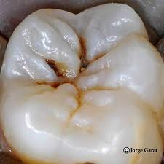
Pit and fissure caries

Slide 33
Pit and fissure caries usually begins as a small point penetration at the bottom of the pit and fissure.
From here, it fans along the enamel rods to the dentino-enamel junction.
On reaching the dentino-enamel junction, caries spreads laterally at the junction and then spread penetrate towards the pulp through the dentinal tubules

Slide 34
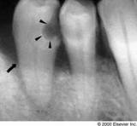
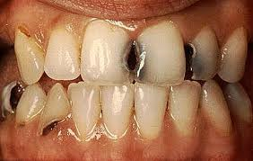
Smooth surface caries
Smooth surface caries involves the smooth areas of the teeth that are covered by plaque for prolonged period of time.
These include the proximal surfaces of teeth, the gingival one-third of the facial and lingual surfaces of teeth.

Slide 35
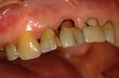
Root surface caries
This is the caries that is seen on the exposed root surfaces following gingival recession. Since it is generally seen in elderly patients it is also called “senile caries”.
Root surface caries spreads more rapidly when compared to caries on other surfaces and therefore it has to be treated soon after detection.

Slide 36
Residual caries
Caries that remains after the cavity prepartion has been complete is referred to as residual caries, which may have been left behind either intentionally by the operator or by accident.
Residual caries at the dentino-enamel junction or the enamel walls is not acceptable

Slide 37
Secondary caries
Secondary caries : This is the subsequent attack of caries on a tooth that has already been restored.
Secondary caries is usually seen at the junction between the tooth and the restoration. It is also called “ recurrent caries”

Slide 38
incipient caries
Incipient caries is also referred as initial caries or reversible caries.
It is just the beginning of the caries activity and the lesion is evident as a white opaque area on the surface of the enamel.
Surfaces inflicted by incipient caries are fairly hard and only minor surface roughening may be present.

Slide 39
The lesion is in a reversible state i.e can be remineralized provided oral hygiene measures are followed and the plaque removed and controlled.
A remineralized lesion may continue to be white or turn brownish black because of external staining.
Such dark areas are referred to as arrested caries, are hard to touch and appear even when the tooth surface is dry or wet.

Slide 40
Cavitated caries
This represents the carious lesion that has cavitated the enamel and progressed into dentin. It is no longer reversible.
At this stage, the lesion cannot be remineralized and requires cavity prepartion and restoration for treatment.

Slide 41
Acute caries
Caries of a rapid onset and spread is referred to as acute caries
e.g nursing bottle caries or rampant caries.
Lesion are light yellow in colour, soft and highly infectious.

Slide 42
Chronic caries
Caries of a slower onset and spread is referred to as chronic caries.
Lesions may be present in only few locations in the mouth.
They are hard and dark brown to black in colour. Their dark colour is because of enough time for external staining to occur.

Slide 43
Affected and infected dentin
Carious dentin can be grossly divided into 2 zones
Infected dentin or the outer zone
Affected dentin or the inner zone
Infected dentin is characterized by irreversibly denatured collagen which is infiltrated with bacteria and is not remineralizable.

Slide 44
Affected dentin is characterized by reversibly denatured collegen which is not infiltrated with bacteria and is remineralizable.
Infected dentin should be removed while affected dentin can be left behind during cavity prepartion.
Affected dentin either remineralizes or become sterile once the cavity is thoroughly restored.

Slide 45
Clinically it may be difficult to precisely distinguish between the two zones of dentin caries but still a guide that helps in distinguishing between them is :
Infected dentin is darker than affected dentin
Infected is softer to touch than the affected dentin.
This guide may prove to be of little use in acute caries where the discolouration is very slight and not distinguishable.
A more accurate guide to distinguish between the two is the application of 1.0% solution of acid red in propylene glycol.

Slide 46
Nomenclature related to cavity prepartion
Cavity : A cavity refers to a defect in enamel or in both enamel and dentin, subsequent to the destruction caused by dental caries.
Cavity prepartion/ tooth prepartion : this refers to the mechanical alteration of a defective, injured or diseased tooth to best receive a restorative material which will re- establish the normal form, function and esthetics of the tooth.

Slide 47
Intracoronal cavity prepartion : Cavity that is prepared in the interior of the tooth is referred to as intracoronal cavity prepartion.
Extracoronal cavity prepartion : Cavity prepartion that involves the external surface of the tooth which requires removal of most or all of the enamel.

Slide 48
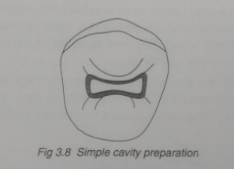
Simple cavity prepartion : This refers to a cavity preparation that involves only one surface of a tooth. Eg. Occlusal cavity preparation

Slide 49
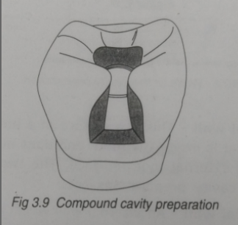
Compound cavity preparartion: This refers to a cavity preparation that involves two surfaces of a tooth. Eg. Mesial and occlusal cavity preparation.

Slide 50
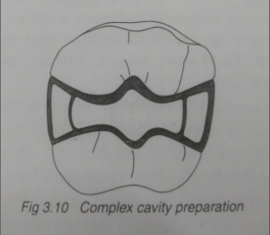
Complex cavity preparation: this refers to a cavity preparation that involves three or more surfaces of a tooth. Eg. Mesial, occlusal and distal cavity preparation.

Slide 51
For ease of communication these may be abbreviated and expressed as follow:
Occlusal cavity preparation – O
Mesial and Occlusal cavity preparation – MO
Mesial, Occlusal and Distal cavity preparation- MOD.
Walls of the cavity preparation: Any surface of a prepared cavity is referred to as a wall
The various walls in a cavity preparation are:
Internal wall- This is a surface of a prepared cavity that is inside the tooth and does not extend onto the external tooth surface. The two internal walls in cavity preparation are:

Slide 52
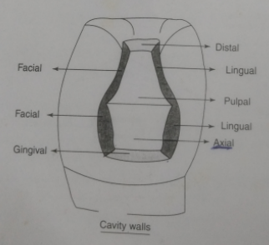
Axial wall: An internal wall which is parellel with the long axis of the tooth.
Pulpal wall: An internal wall which is perpendicular to the long axis of the tooth. This wall is occlusal to the dental pulp.

Slide 53
External wall: This is a prepared surface that extends to the external tooth surface. It takes the name of the tooth surface that the wall is toward. Eg. Mesial, Distal, Lingual and gingival walls.
Floor or seat: This term refers to a prepared wall that is relatively flat and perpendicular to the occlusal forces which are directed along the long axis of the tooth. Eg. Pulpal and gingival walls.

Slide 54
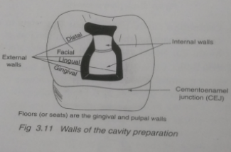

Slide 55
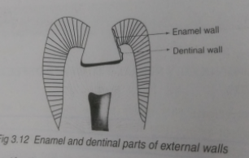
Enamel wall: This is that portion of the prepared external wall which is composed of enamel.
Dentinal wall: This is that portion of the prepared external wall which is composed of dentin. This wall usually incorporates mechanical retentive features.

Slide 56
Angles in a cavity preparation:
The term angle refers to the junction of two or more surfaces of a cavity preparation.
There are many angles in a prepared cavity such as:
Line angles: This is the junction of two walls in a cavity preparation along a definite line.
Point angle: This refers to the junction of three walls in a cavity preparation at a point.

Slide 57
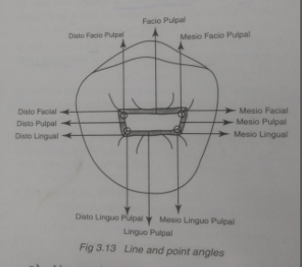

Slide 58
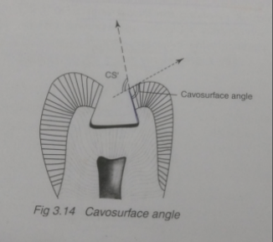
Cavosurface angles: This refers to the angle of the tooth structure formed by the junction of a prepared wall and the external tooth surface.

Slide 59
It varies according to the location of the cavity preparation on the tooth, the type of the restorative material to be used and the direction of the enamel rods on the prepared wall.
The actual junction of the prepared wall and the external tooth surface is called cavosurface margin.
Junction:
Dentinoenamel junction: This is the junction of the enamel and dentin.

Slide 60
Cementoenamel junction: This is the junction of the enamel and cementum. It is also called the cervical line.

Slide 61
Classification of cavity preparation
The first comprehensive classification of cavity preparation was proposed by Dr. G.V. Black, based on the frequency of occurrence of caries on different areas of teeth.
Class I cavity preparation: This includes cavity preparation involving pit and fissures areas of teeth.
It involves the following areas:

Slide 62
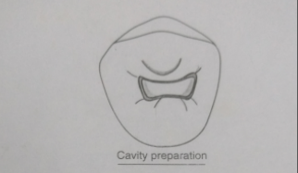
Occlusal pit and fissures in posterior teeth (molars and premolars)
Occlusal two thirds of the facial and lingual surfaces of molars.
Lingual pits of maxillary incisors.

Slide 63
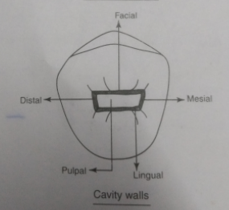
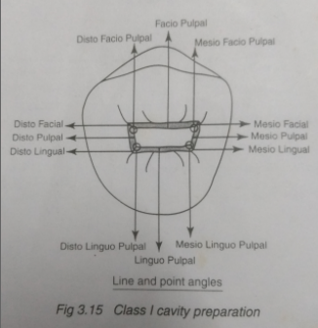

Slide 64
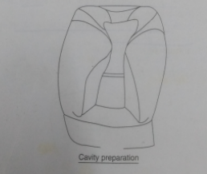
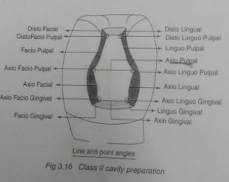
Class II cavity preparation: This involves one or both the proximal surfaces of posterior teeth.

Slide 65
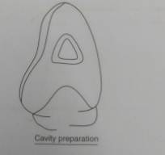
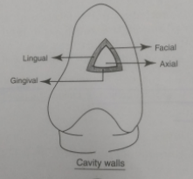
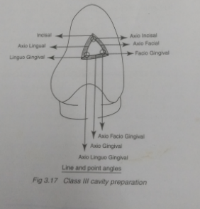
Class III cavity preparation: This includes cavity preparation on the proximal surfaces of anterior teeth without involving the incisal angle.

Slide 66
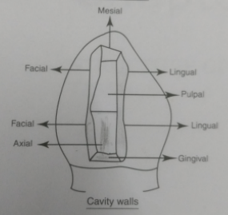
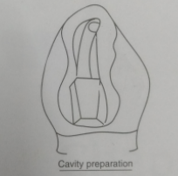
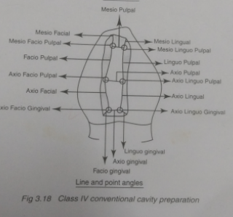
Class IV cavity preparation: this includes cavity preparation on the proximal surfaces of anterior teeth with involvement of incisal angle.

Slide 67
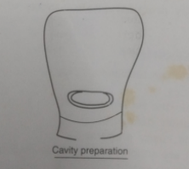
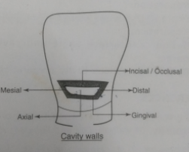
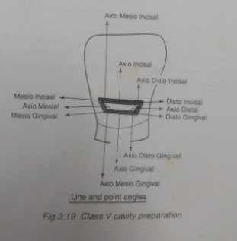
Class V cavity preparation: This involves cavity preparation on the gingival one third of the facial and lingual surfaces of all teeth.

Slide 68
Class VI cavity preparation: This involves cavity preparation on the incisal edge of anterior teeth or the occlusal cusp heights of posterior teeth.

