Slide 1
Department of Conservative Dentistry & Endodontics
CLASS IV CAVITY PREPARATION FOR COMPOSITE RESIN
Dr. Manju
Professor
Date: 20/01/17

Slide 2
OBJECTIVES
Students must answer
What is class IV cavity ?
Types of tooth preparation
Techniques of restoration

Slide 3
CONTENTS
Introduction (Definition)
Types of class IV tooth preparation
Conventional
Beveled conventional
modified
Technique of restoration
Summary
References

Slide 4
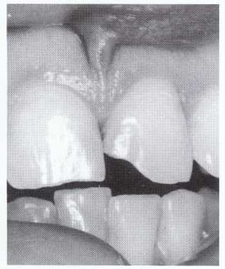
Definition:
Restorations on the proximal surfaces of anterior teeth that do involve the incisal edge are Class IV.

Slide 5
CLINICAL TECHNIQUE FOR DIRECT CLASS IV COMPOSITE RESTORATIONS
INITIAL CLINICAL PROCEDURES
The same initial procedure considerations presented earlier for class I, II & III are appropriate for Class IV restorations.
The preoperative assessment of the occlusion is even more important for Class IV restorations because it may influence the tooth preparation extension (placing margins in noncontact areas) and retention and resistance form features (heavy occlusion requires increased retention and resistance form). Thus, occlusal factors may dictate a more conventional tooth preparation form, with more resistance form features (boxlike, flat floors, and walls and floors parallel to the long axis and perpendicular to the occlusal forces) and secondary retention form features (grooves and wider bevels).

Slide 6
Also, proper shade selection may be more difficult for large Class IV restorations that do not have normal dentin colorations. Use of separate translucent or opaque shades of composite may be necessary.
Because it is likely that the proximal contact must be restored, prewedging before tooth preparation will benefit the effort to restore the contact.

Slide 7
TOOTH PREPARATION

Slide 8
Conventional Class IV Tooth Preparation.
Any portion of Class IV restoration that extends onto the root requires a 90-degree cavosurface margin and possible groove retention form, regardless of whether either a beveled conventional or modified preparation design is used for the portion of the preparation in the crown of the tooth.

Slide 9
Beveled Conventional Class IV Tooth Preparation.
The beveled conventional Class IV tooth preparation is indicated for restoring large proximal areas that also include the incisal surface of an anterior tooth.
In addition to the etched enamel margin, retention of the composite restorative material in beveled conventional Class IV tooth preparations may be obtained by groove or other shaped undercuts, dovetail extensions, threaded pins, or a combination of these. All of these features would be part of the final stage of tooth preparation.

Slide 10
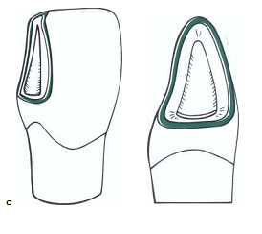
Gingival and incisal retentive undercuts may be indicated in large Class IV preparations and are similar to those used in the Class III preparation in which rounded undercuts are placed in the dentin along line angles and into point angles wherever possible, without undermining the enamel

Slide 11
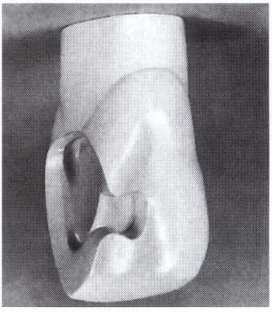
An arbitrary dovetail extension onto the lingual surface of the tooth may enhance both the restorations strength and retention, but it is less conservative and therefore not used often.
Incisal and gingival retention grooves and dovetail
extension in a large Class IV beveled conventional tooth preparation before beveling.

Slide 12
Although pin retention is sometimes necessary, the use of pins in composite restorations is discouraged for several reasons:
the placement of pins in anterior teeth involves the risk of perforation either into the pulp or through the external surface;
pins do not enhance the strength of the restorative material; and

Slide 13
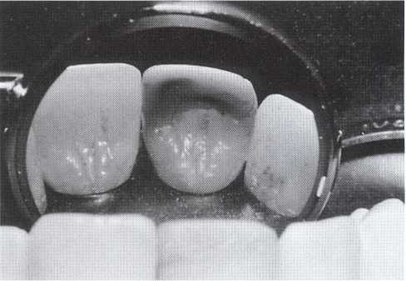
Some pins may corrode because of microleakage of the restoration, resulting in significant discoloration of the tooth and restoration.
Despite these disadvantages, when a large amount of tooth structure is missing, pin retention may be necessary to retain the composite restoration.
Tooth and restoration discoloration caused by microleakage and subsequent corrosion of pin.

Slide 14
A maxillary right central incisor having large defective Class III restoration and a fractured mesioincisal corner, which upon removal necessitates a Class IV restoration.
Class IV beveled conventional tooth preparations are characterized by an outline form that occurs when the preparation walls are prepared as much as possible perpendicular or parallel to the long axis of the tooth. This results in a design that provides greater resistance to biting forces that could cause fracture of the tooth or restorative material.

Slide 15
Using an appropriate size round carbide bur or diamond instrument at high speed with air-water coolant, prepare the outline form.
Remove all weakened enamel and establish the initial axial wall depth at 0.5 mm into dentin (because groove retention form will likely be utilized).
Prepare the walls as much as possible parallel and perpendicular to the long axis of the tooth.

Slide 16
Bevel the cavosurface margin of all accessible enamel margins of the preparation. The bevel is prepared at a 45-degree angle to the external tooth surface with a flame-shaped or round diamond instrument.
The width of the bevel should be 0.25 to 2 mm, depending on the amount of tooth structure missing and the retention perceived necessary.
Retention form is provided primarily by the micromechanical bonding of the composite to the enamel and dentin. Additional retention may be obtained by increasing the width of the enamel bevels or placing retention undercuts.

Slide 17
If retention undercuts are deemed necessary, prepare a gingival retention groove using a No. 1/4 round bur. It is prepared 0.2 mm inside the DEJ at a depth of 0.25mm (half the diameter of the No. 1/4 bur) and at an angle bisecting the junction of the axial wall and gingival wall.
This groove should extend the length of the gingival floor and slightly up the facioaxial and linguoaxial line angles.
No retentive undercut is usually needed at the incisal area, where mostly enamel exists.

Slide 18
Class IV beveled conventional tooth preparation
A, Large defective Class III restoration with resulting fractured incisal angle.

Slide 19
B, Beveling cavosurface

Slide 20
C, Gingival retention groove

Slide 21
D, Completed Class IV beveled conventional tooth preparation

Slide 22
Modified Class IV Tooth Preparation.
The modified Class IV preparation for composite is indicated for small or moderate Class IV lesions or traumatic defects.
The objective of the tooth preparation is to remove as little tooth structure as possible, while removing the fault and providing for appropriate retention and resistance forms.
Usually little or no initial tooth preparation is indicated for fractured incisal corners, other than roughening the fractured tooth structure.
The axial depth is dependent on the extent of the lesion, previous restoration, or fracture, but initially no deeper than 0.2 mm inside the DEJ.

Slide 23
Usually no groove or cove retention form is indicated. The treatment of teeth with minor traumatic fractures requires less preparation than the beveled conventional example.
If the fracture is confined to enamel, adequate retention usually can be attained by simply beveling sharp cavosurface margins in the fractured area with a flame-shaped diamond instrument followed by bonding.

Slide 24
Class IV modified tooth preparation
A, Minor traumatic fracture.

Slide 25
B, Fractured enamel is roughened with flame-shaped diamond instrument.

Slide 26
C, Completed Class IV modified tooth preparation.

Slide 27
RESTORATIVE TECHNIQUE
Etching, Priming, and Placing Adhesive
Matrix Application
Inserting and Curing the Composite
Contouring and Polishing the Composite
SAME AS CLASS III

Slide 28
SUMMARY
Keynote points
Definition of class IV cavity preparation
Types of cavity preparation
Restoration technique

Slide 29
REFERENCES
Sturdevant’s Art & Science of Operative Dentistry

