Slide 1
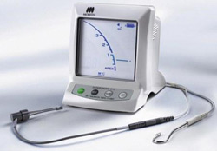
IV) ELECTRONIC APEX LOCATOR
In addition to radiography,tactile sensation has been used with questionable success , plus the drawbacks cited about radiographic length determination along with increasing concern about radiation exposure ,the introduction & development of apex locators was received with enthusiasm
These devices do not assess the position of the root apex and the name “electronic apex locator” is not appropriate ; “electronic apical foramen locator” or “electronic root canal length measurement device” as a generic name would be more appropriate.

Slide 2
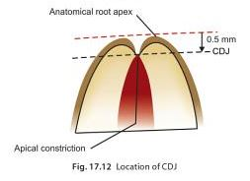
The ability to distinguish between minor & major diameter of apical terminus is the most important for creation of APICAL CONTROL ZONE.
The apical control zone is the mechanical alteration of the apical terminus of root canal space that provides resistance & retension form to the obturating material against the condensation pressure of obturation

Slide 3
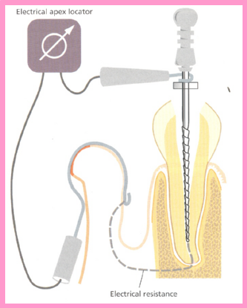
How does it work??

Slide 4
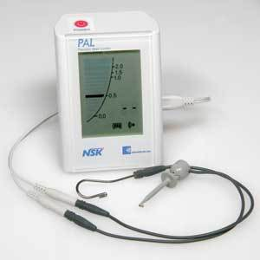
PARTS OF APEX LOCATOR :
has four parts :-
the lip clip
the file clip
Electronic device
Cord which connects the above three parts

Slide 5
USES OF APEX LOCATORS :
Provide objective information with high degree of accuracy
Used when apical portion of canal is constricted :
Impacted teeth
Zygomatic arch
Overlapping roots
Excessive bone density
Used in patients with gag refles and cannot tolerate x-ray films
In pregnant ladies to reduce radiation exposure
Useful in children,disabled patients,heavily sedated patients,etc

Slide 6
6. Can be used in teeth with incomplete root formation ,requiring apexification & to determine WL in primary teeth
7. Valuable tool for :
Detecting site of root perforations
Testing pulp vitality
Determination of perforations caused during post preparation
Detecting horizontal or vertical root fractures
Detecting internal or external resorption

Slide 7
Basic conditions for accuracy of eals :
Canal should be relatively dry
Canal should be free from debris
No cervical leakage
No blockage or calcification of canals
Proper contact of file with canal walls & periapex

Slide 8
CLASSIFICATION :
TYPES OF APEX LOCATORS
BASED ON DIRECT CURRENT
BASED ON ALTERNATING CURRENT
ORIGINAL OHM METER USED BY SUZUKI & SUNANDA
RESISTANCE TYPE
Root canal meter
Endometric meter
IMPEDENCE TYPE
sonoexplorer
FREQUENCY TYPE
SUBTRACTION TYPE
Endex
Neosono ultima EZ
RATIO TYPE
2 FREQUENCIES
Root ZX
5 FREQUENCIES
AFA
Apex finder

Slide 9
FIRST GENERATION APEX LOCATOR
Resistance apex locators
Measures opposition to flow of direct current (ie resistance)
Eg : - root canal meter (Onuki Medical co.,japan)
- endometric meter
- endometric meter S II (Onuki Medical Co.)

Slide 10
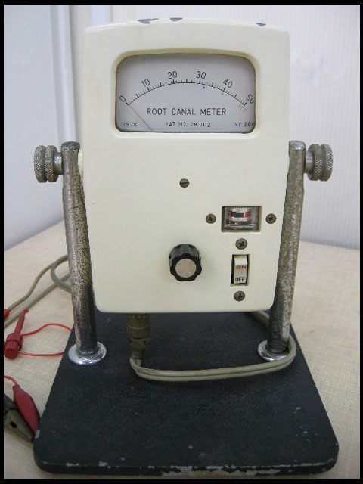
ADVANTAGES :
Easily operated
Digital readout
Audible indication
Detect perforation
Can be used with K-file
DISADVANTAGES :
Requires a dry field
Patient sensitivity
Requires calibration
Requires good contact with lip clip
Cannot estimate beyond 2mm

Slide 11
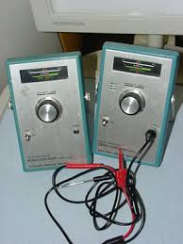
SECOND GENERATION APEX LOCATOR
Inoue introduced the concept of impedance based AL
PRINCIPLE :measures opposition to flow of alternating current or impedence
egs : -Sonoexplorer
-Apex finder
-endo analyzer
-Digipex
-Digipex II
-Exact-A-Pex

Slide 12
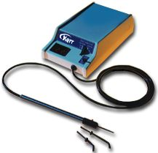
ADVANTAGES :
Does not require lip clip
No patient sensitvity
Analog meter
Detects perforations
DISADVANTAGES :
No digital readout
Difficult to operate
Requires coated probes

Slide 13
THIRD GENERATION APEX LOCATORS
Based on the fact that different sites in the canal give difference in impedance b/w high (8 KHz) & low(400 Hz) frequencies
Difference in impedance is least in the CORONAL part & greatest at the CDJ
As impedance is influenced by frequency of current flow these are also known as frequency dependent
They should be called comparative impedance because they measure magnitudes of impedance which is converted to length information

Slide 14
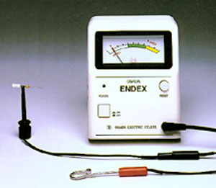
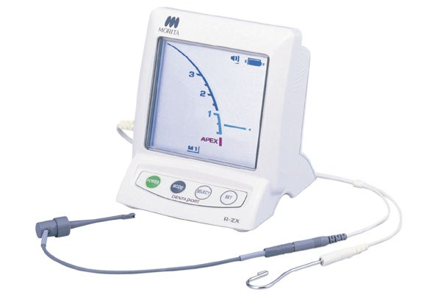
Egs :
Endex (original 3rd gen AL)
Root ZX (shaping & cleaning of canals with simultaneous monitoring of WL)
Mark V plus
Co-pilot
Endo analyser 8005

Slide 15
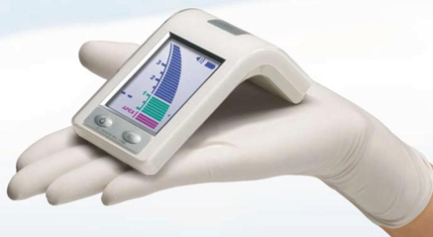
ADVANTAGES :
Easy to operate
Audible indication
Can operate in presence of fluids
Analogue readout
Uses K-file
DISADVANTAGES :
Requires lip clip
Chances of short circuit
Needs fully charged battery
Must calibrate each canal

Slide 16
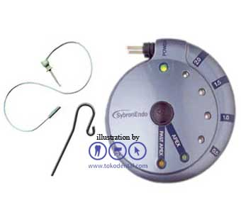
FOURTH GENERATION APEX LOCATORS
Measures resistance & capacitance separately
There can be different combination of values of capacitance and resistance that provides the same foraminal reading
This is broken down into primary components and measured separately for better accuracy and thus less chances of occurrence of errors
Eg :neosono ultima ZX
sybronendo

Slide 17
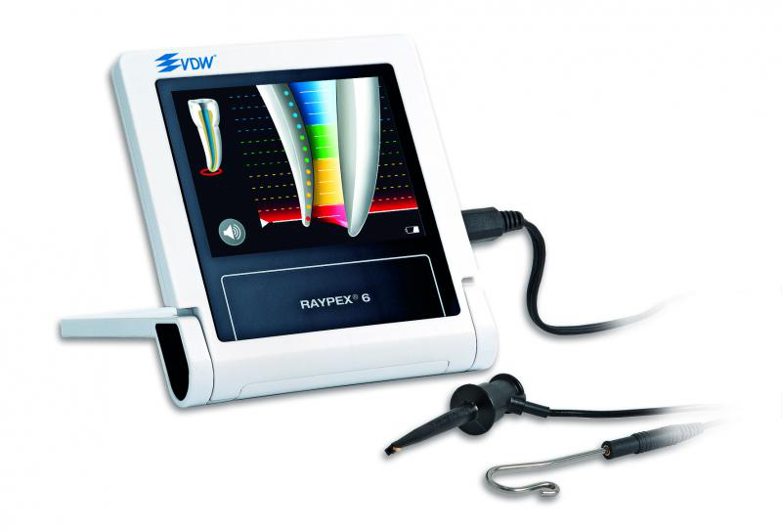
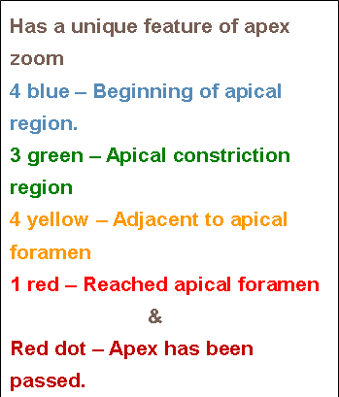
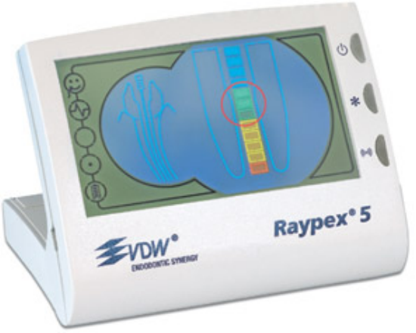
FIFTH GENERATION APEX LOCATORS
It uses multiple frequencies rather than the dual frequencies of the third and fourth generations of apex locators, so it works in dry or wet canals and requires no calibration. Eg :RAYPEX

Slide 18
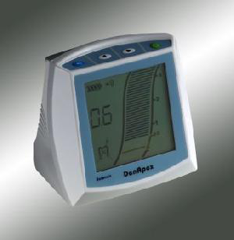
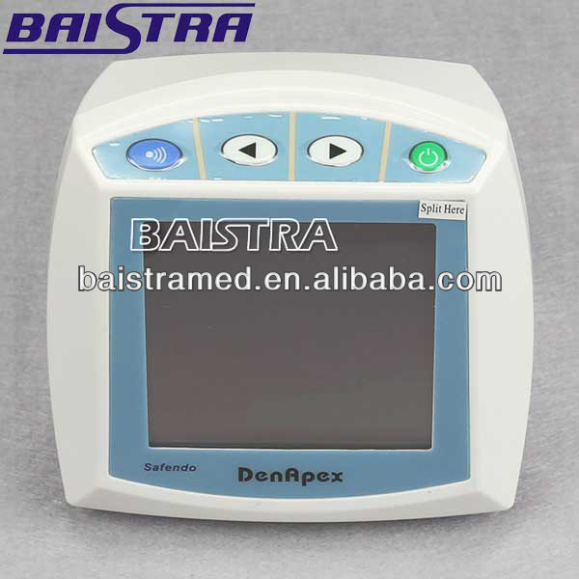
SIXTH GENERATION APEX LOCATORS
Also called adaptive apex locators
Multi-frequency Operating System
Sound operated switching device can produce different kinds of sound to indicate the different positions of file in the root canal. Dry and wet condition are also available for accurate reading

Slide 19
COMBINATION OF A.L & ENDODONTIC HANDPIECES
Tri auto ZX
Safy ZX
Endy 7000

Slide 20
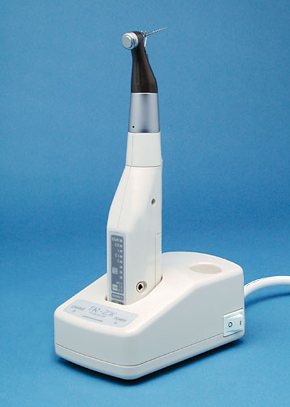
TRIAUTO ZX
Is cordless electric endodontic handpiece with built in RootZx apex locator. The handpiece uses Ni-Ti rotary instruments that rotate at 280±50 rpm.
Auto start-stop mechanism
Auto torque reverse mechanism
Autoapical reverse mechanism
The Root ZX is not capable of detecting the '0.5 mm from the foramen' position and thus, should
only be used to detect the major diameter. (i.e. Contrary to manufacturer claims,
Apex Locators can only reliably determine when the file is actually touching the PDL at the
apex. Set your working length 1 to 1.5 mm back from this length to avoid over-instrumentation).
Ounsi HF, Naaman A. In vitro evaluation of the reliability of the Root ZX electronic apex
locator. Int Endod J 1999;32:120-23.

Slide 21
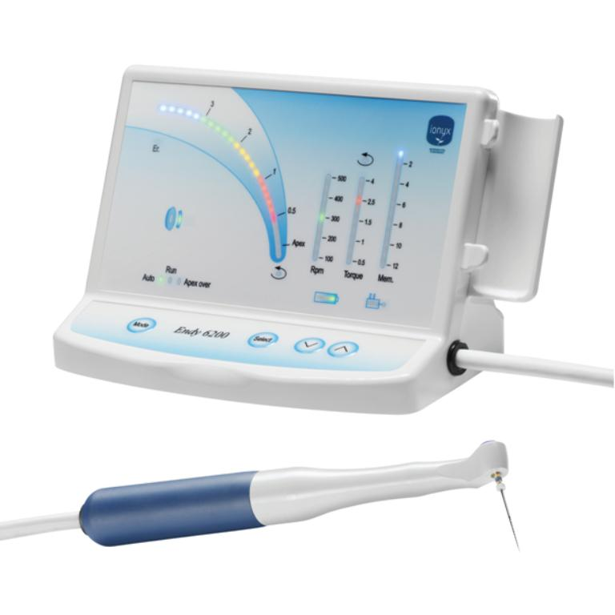
ENDY 7000
Endodontic handpiece connected to an endy apex locator
Reverses the rotation of the instrument when it reaches a point in the apical region preset by the clinician

Slide 22
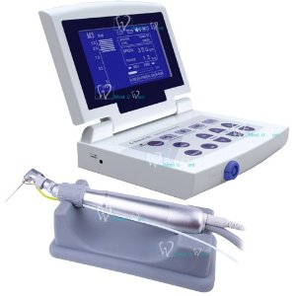
SAFY ZX
New development of ultrasonic systems
Handpiece + apex locator
Uses Root ZX to monitor location of file during instrumentation
Minimizes danger of over instrumentation

