Slide 1
ITS DENTAL COLLEGE, GREATER NOIDA
SUBJECT : GENERAL PATHOLOGY
SESSION TOPIC : ACUTE INFLAMMATION-THE CELLULAR RESPONSE
PROGRAM, YEAR: BDS, SECOND YEAR
FACULTY : Dr VERTIKA GUPTA (PROFESSOR & HOD)

Slide 2
Learning Objectives & Specific Learning Outcomes
General Objectives: To describe cellular response seen in acute inflammation.
Specific Learning Outcomes: At the end of the lecture, the learner should have the knowledge about cellular response seen in acute inflammation with respect to
1) Exudation of leucocytes
2) Phagocytosis

Slide 3
CELLULAR EVENTS

Slide 4
The cells & molecules of host defense normally circulate in bld, & the goal of inflammatory rxn is to bring them to the site of infection or tissue damage
2 PROCESSES
EXUDATION OF LEUCOCYTES
PHAGOCYTOSIS

Slide 5
EXUDATION OF LEUCOCYTES
Escape of leucocytes from lumen of microvasculature to interstitial tissue
1)Changes in formed elements of bld
2)Rolling & adhesion
3)Emigration
4)Chemotaxis

Slide 6
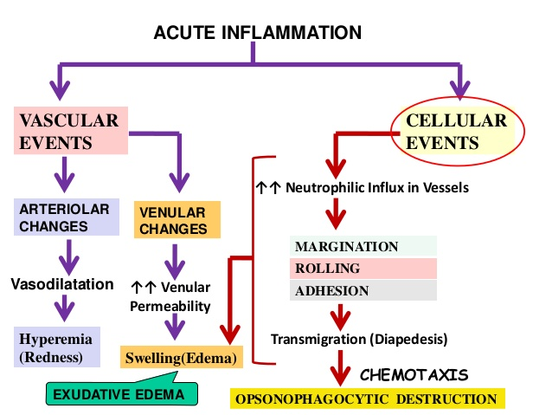

Slide 7
1) CHANGES IN FORMED ELEMENTS OF BLOOD
CHANGE IN NORMAL AXIAL FLOW (central stream of cells , peripheral layer of plasma)
vasodilation
↓
↑ bld flow (↑HP)+ ↑ vascular permeability
(fluid moves into extravascular space)
↓
Slowing or stasis of bld flow
↓
“MARGINATION” of PMNs ↓
“PAVEMENTING” (PMNs come close to vessel wall)

Slide 8
2) ROLLING & ADHESION
PMNs slowly roll over the endothelial cells lining the vessel wall, transiently sticking along the way ( rolling phase) followed by transient bond between leucocytes & endothelial cells becoming firmer (adhesion phase)
Following adhesion molecule bring about rolling & adhesion
-Selectins (rolling)
-Integrins (adhesion)
-Immunoglobulin superfamily adhesion molecule

Slide 9
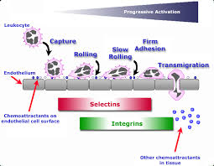

Slide 10
3) EMIGRATION
After being arrested on endothelial surface PMNs throw out cytoplasmic pseudopods at intercellular junctions.
↓
Subsequently the PMNs lodged between endothelial cells & basement membrane(BM) , cross the BM by damaging it locally with secreted collagenase & escape out in the extravascular space ; k/a emigration
↓

Slide 11
↓
PMNs 1st cells to emigrate (within 6-24 hrs in acute inflammation)
replaced by Monocytes & macrophages in next 24-48 hrs
↓
Escape of RBC thru gaps between endothelial cells
↓
Gives hemorrhagic appearance to exudate

Slide 12
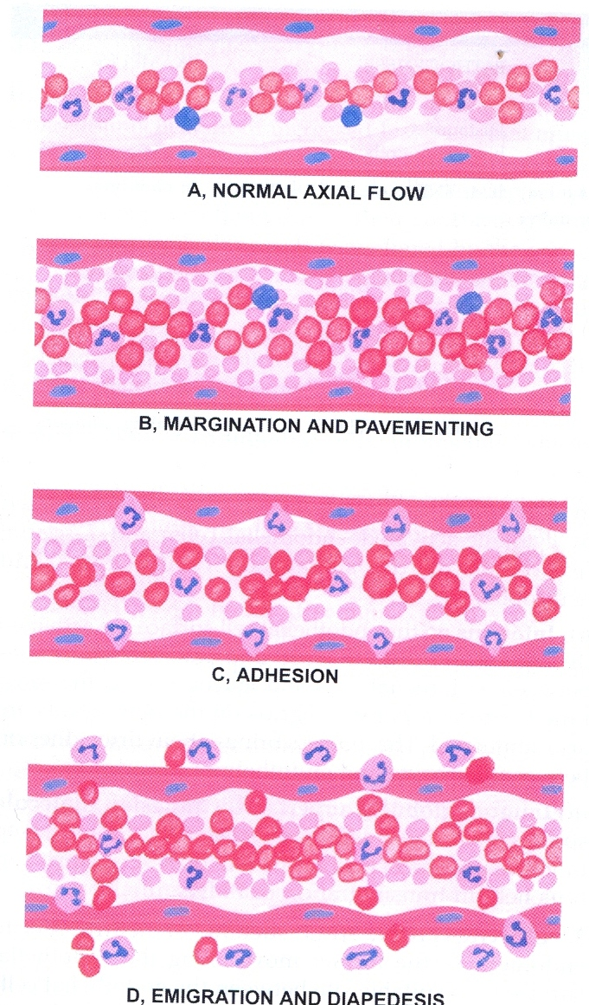

Slide 13
4) CHEMOTAXIS
After extravasation , the chemotactic factor mediated transmigration of leucocytes to reach the site of injury is k/a CHEMOTAXIS (also defined as locomotion oriented along a chemical gradient)
The agents acting as potent chemotactic substances for different leucocytes are k/a CHEMOKINES

Slide 14
Leukotriene B4 (LT-B4)
Platelet factor4 (PF4)
Components of complement system(C3 ,C5a)
Cytokines (IL-1, IL-5 , IL-6 )
Soluble bacterial products eg peptides with N-formylmethionine
Monocyte chemoattractant protein (MCP1)
Chemotactic factor for CD4+Tcells
Eotaxin for eosinophils

Slide 15
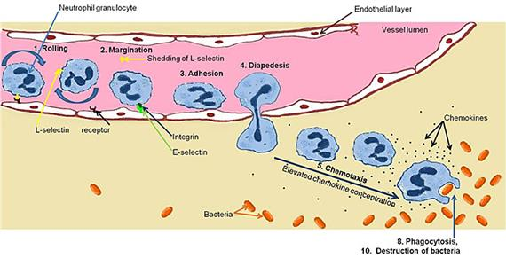

Slide 16
2 - PHAGOCYTOSIS
DEF - process of engulfment of solid particulate material by the cells (cell eating)
2 main types of phagocytic cells
- PMNs – also k/a microphages
- circulating monocytes & fixed tissue mononuclear phagocytes k/a macrophages

Slide 17
Process of phagocytosis is similar & involves 3 steps
1) Recognition & attachment stage
2) Engulfment stage
3) Killing or degradation stage

Slide 18
1)RECOGNITION & ATTACHMENT STAGE(OPSONISATION)
Phagocytosis is initiated by the expression of surface receptors on macrophages. This process is further enhanced when microrganisms are coated with opsonins
1) Fc fragments of IgG (Ab in serum)
2) C3b opsonin (fragment of complement)
3) Lectins (carbohydrate binding proteins in the plasma which bind to bacterial cell wall)

Slide 19
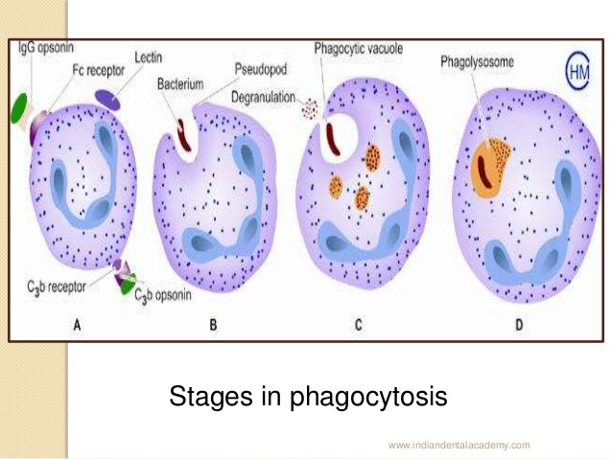

Slide 20
2) ENGULFMENT STAGE
Phagocytic cells form cytoplasmic pseudopod around the opsonised particle → phagocytic vacuole
Membrane of lysosomal granule fuses with membrane of phagocytic vacuole resulting in discharge of the granules content (degranulation) into phagolysosome/phagosome

Slide 21
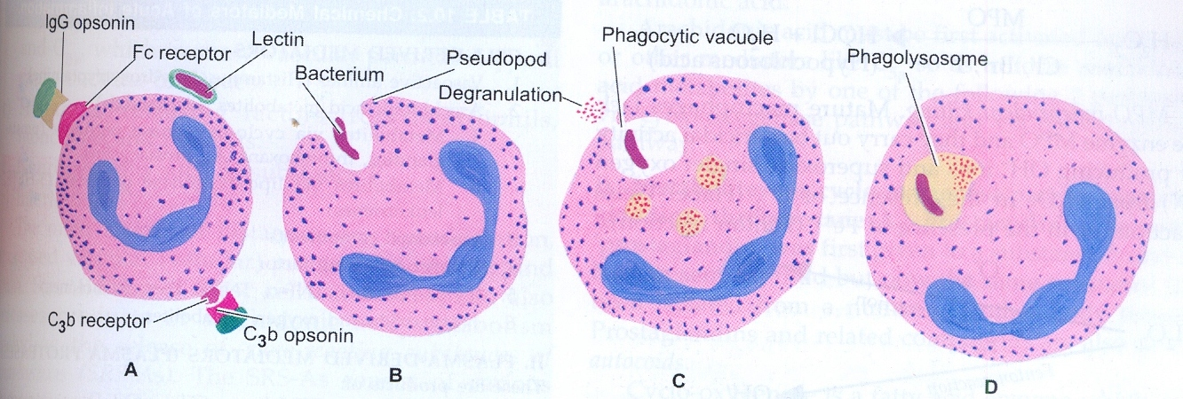

Slide 22
3)KILLING /DEGRADATION STAGE
The microrganism after being killed by antimicrobial agents are degraded by hydrolytic enzymes
INTRACELLULAR MECHANISMS
1) Oxidative bactericidal mechanism by oxygen free radicals.
-MPO(myeloperoxidase) dependent killing
-MPO independent killing
2) Oxidative bactericidal mechanism by lysosomal granules
3)Non oxidative bactericidal mechanism
B) EXTRACELLULAR MECHANISM

Slide 23
INTRACELLULAR MECHANISMS 1) Oxidative bactericidal mechanism by oxygen free radicals
Oxidative damage is caused by the production of reactive O₂ metabolites (O¯₂ , H₂O₂ , OH¯, HOCl, HOI, HOBr).
NADPH oxidase
2 O₂ 2O⁻₂
NADPH NADP + H¯
2 O¯₂ + 2H⁺+ → H₂O₂ (bactericidal)

Slide 24
A) MPO dependent killing(H₂O₂-MPO halide system)
Most efficient bactericidal system
Lysosomes of neutrophils & monocytes contain the enzyme MPO
MPO
H₂O₂ HOCl· ,HOI· ,HOBr· + H₂O
Cl ¯, Br ¯,I¯ (hypohalus acid)
HOCl – more potent antibacterial agent than H₂O₂

Slide 25
B) MPO independent killing
Mature macrophage lack MPO & they carry bactericidal activity by producing OH¯ ions & O¯ (superoxide singlet O₂) from H₂O₂ → useful in eliminating organism that grow within phagocyte eg M.tuberculosis & H.capsulatum

Slide 26
2) Oxidative bactericidal mechanism by lysosomal granules
In this mechanism, the preformed granule stored products of neutrophil & macrophages are discharged or secreted into the phagosome & the extracellular environment.

Slide 27
3)Non oxidative bactericidal mechanism
Some substances released from granules of phagocytic cells do not require oxygen for killing infectious pathogen.
Granules
Nitric oxide

Slide 28
B) EXTRACELLULAR MECHANISM
Granules
Immune mechanisms

Slide 29
Frequently asked Questions
Define inflammation and describe cardinal signs and cellular response seen in acute inflammation.
Short notes on
Cellular response seen in acute inflammation.
Phagocytosis
Chemotaxis

Slide 30
Reading List/Reference List
Robbins Basic Pathology: Kumar, Abbas, Aster, 9th Edition
Essential Pathology for Dental Students: Harsh Mohan, Sugandha Mohan, 5th Edition

