Slide 1
ITS DENTAL COLLEGE, GREATER NOIDA
SUBJECT : GENERAL PATHOLOGY
LECTURE TOPIC : AIDS
PROGRAM, YEAR: BDS, SECOND YEAR
FACULTY : Dr VERTIKA GUPTA (PROFESSOR & HOD)

Slide 2
Learning Objectives & Specific Learning Outcomes
Learning Objectives: To explain AIDS with emphasis on its pathogenesis & clinical stages.
Specific Learning Outcomes: At the end of the lecture, the learner should have the knowledge about the following with respect to AIDS.
Structure of HIV
Routes of transmission
Pathogenesis
Clinical stages
Opportunistic infections seen in AIDS

Slide 3
AIDS

Slide 4
Retroviral disease caused by HIV & characterized by infection & depletion of CD4+T lymphocytes and by profound immunosupression, primarily affecting cell-mediated immunity, that leads to neurologic manifestations, opportunistic infections, and neoplasms.
Epidemiology
AIDS has been reported from more than 190 countries worldwide
In India – Maharashtra, TN , NE state of Manipur

Slide 5
ROUTES OF TRANSMISSION
Sexual contact – predominant mode (75%)
Parentral transmission
Passage of virus from infected mothers to their newborns

Slide 6
Etiologic agent
AIDS is caused by HIV, a human retrovirus belonging to the lentivirus family
Two genetically different but antigenically related forms of virus have been isolated.
HIV-1
- HIV-2

Slide 7
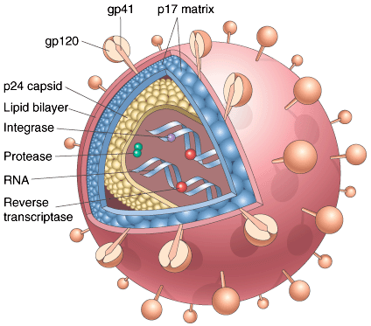

Slide 8
PATHOGENESIS OF HIV INFECTION AND AIDS
Immune system and CNS are two major targets of HIV infection.
Profound immunosuppression, primarily affecting CMI, is the hallmark of AIDS.
HIV enters body thru mucosal tissues and blood and infects T-cells, dendritic cells & macrophages

Slide 9
Selective tropism and internalisation.
CD4 acts as high affinity receptor for HIV hence the selective tropism of the virus for CD4+ T cells & other CD4 + cells esp monocytes , macrophages and dendritic cells.

Slide 10
2) Uncoating and proviral DNA integration.
Once internalised, RNA genome of the virus undergoes reverse transcription (with the help of enzyme reverse transcriptase), leading to formation of cDNA (proviral DNA)
Initially proviral DNA remains in cytoplasm in linear form
Later on - DNA circularizes, enters the nucleus and is then integrated into the host genome.

Slide 11
3) Budding and syncytia formation
On activation, proviral DNA may be transcribed with formation of complete viral particles that bud from cell membranes. These infected cells may fuse with uninfected cells, forming giant cells.

Slide 12
PATHOGENESIS
ATTACHMENT BUDDING

Slide 13
PATHOGENESIS
EARLY BUDDING

Slide 14
PATHOGENESIS
LATE BUDDING

Slide 15
PATHOGENESIS
MATURE NEW VIRIONS

Slide 16
Cytopathic effects (cell lysis)
Completion of viral life cycle in latently infected cells occurs only after cell activation and in case of most CD4+ T cells, virus activation results in viral budding & in cell lysis.

Slide 17
5) HIV infection of non T cells (monocytes, macrophages and dendritic cells)
In contrast to CD4 +T cells, although these cells are infected with HIV, but they are resistant to cytopathic effect of HIV. Thus HIV can multiply in these cells.

Slide 18
6) Effect on B Lymphocytes- abnormal B cell function.
Patients have hypergammaglobulinemia & circulating immune complexes owing to polyclonal B cell activation.
Despite activated B cells, patients with AIDS are unable to mount antibody response to new antigens.

Slide 19
7) Pathogenesis of CNS involvement
-Macrophages & microglia- predominantly infected with HIV. HIV is carried into brain by infected monocytes.

Slide 20
Major abnormalities of immune func in AIDS
T-cell abnormalities
1.Lymphopenia with depletion of CD4+ T-cells ( inversion of CD4:CD8 ratio)
2.Preferential loss of memory T-cells
3.Suceptibility to neoplasms
4.↓ delayed type HS
5.↓ response to Antigens

Slide 21
B) B-cell abnormalities
1. Polyclonal B-cell activation
2. Hyper gammaglobulinemia
3. Circulating immune complexes
4. Inability to mount response to new Ag’s
C) Altered monocyte- macrophage function
1. Decreased chemotaxis & phagocytosis
2. Decreased capacity to present Ag to T-cells
D) NK cell abnormalities
1. Decreased cytotoxicity

Slide 22
Natural History & C/F of HIV infection
Acute retroviral syndrome( 3-6 wks after inf & resolve spontaneously in 2-4 wks)
- High level of virus production
- Viremia (high levels of HIV p24 Ag in serum)
- Abrupt reduction of CD4+ T-cells→ later return to near normal
- Development of virus-specific immune response (“seroconversion”) which controls initial infection

Slide 23
Clinical features
Self limited acute illness with nonspecific symptoms - flu like syndrome
Sore throat, rash, myalgias, cervical adenopathy, fever, diarrhea, wt. Loss, vomiting, fatigue
Both latent & replicating HIV can be found in CD4+T cells & macrophages

Slide 24
2. Middle, chronic phase(10-12 yrs)
Stage of relative containment of virus i.e reflects the equilibrium reached b/w virus & host after initial battle between HIV and the host immune system
May last for several years
Largely intact immune system, but gradual erosion of CD4+ T-cells

Slide 25
Clinical features:
Asymptomatic
Persistent generalized Lymphadenopathy
Minor opportunistic infections (thrush, Herpes Zoster)
Thrombocytopenia

Slide 26
3. Final, crisis phase( Full blown AIDS)
i. Breakdown of host defenses
ii. Dramatic increase in plasma virus
iii. CD4+ T-cells<200 cells/ul & this phase culminates in death of the patient
iv. Clinical disease
Long lasting fever (>1month)
Fatigue
Weight loss
Diarrhoea( > 1 mth)

Slide 27
v. Multiple opportunistic infections(most common cause of death)
Helminthic & protozoal inf
- Crypto/ isosporidiosis ( enteritis)
- Pneumocystosis – by P. carnni (pneumonia/ disseminated infection)
- Toxoplasmosis (pneumonia/ CNS infection)
B. Fungal inf
- candidiasis- MC fungal inf (oesophageal, tracheal, pulmonary)
- cryptococcosis (CNS inf)
- coccidioidomycosis, histoplasmosis (disseminated)

Slide 28
candidiasis

Slide 29
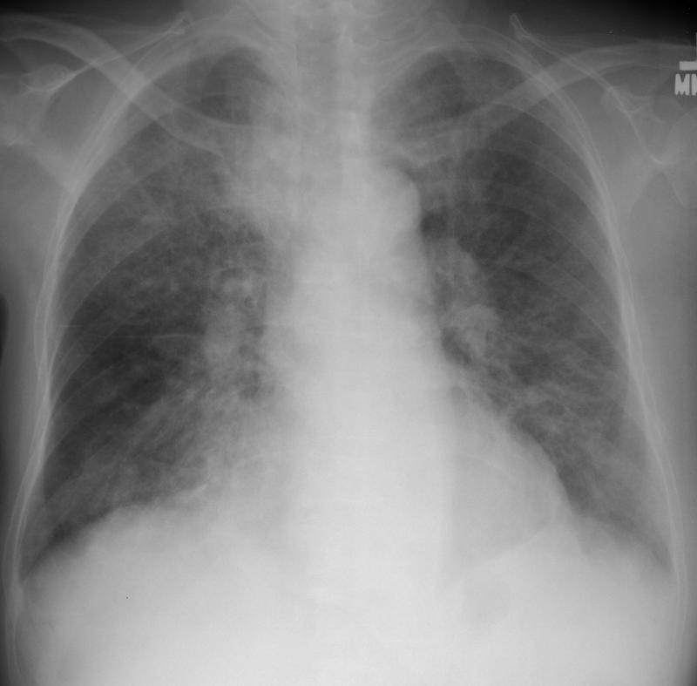
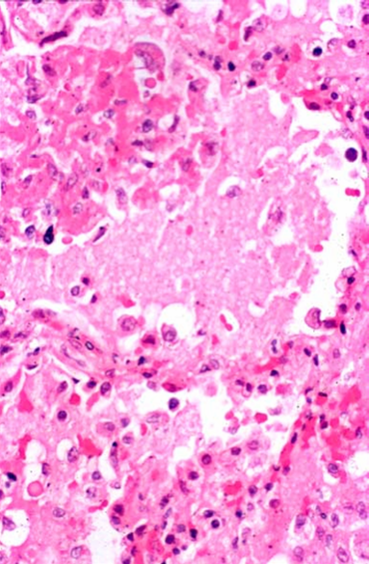
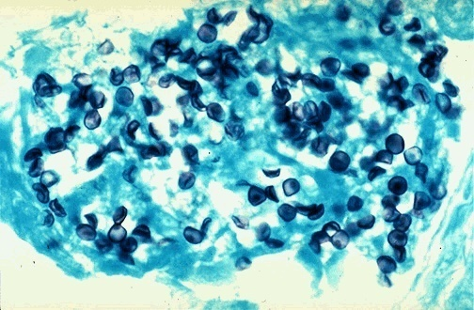
PCP

Slide 30
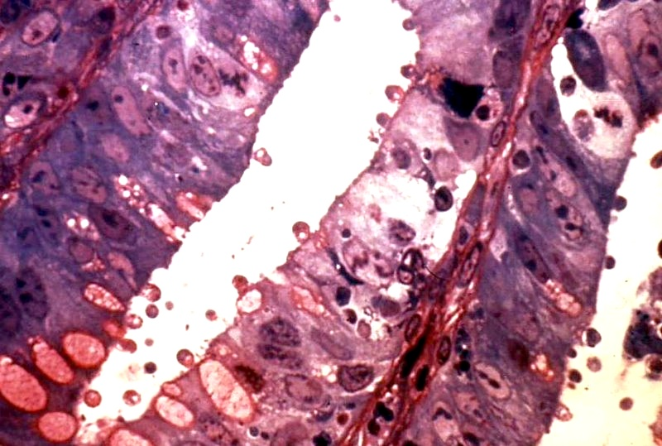
CRYPTOSPORIDIUM
Notes:
We are all exposed to the protozoan, and can tolerate it. AIDS patients have a much harder time.

Slide 31
C. Bacterial infections
- Mycobacteriosis (M. avium intracellulare, M.tuberculosis)
- Nocardiosis ( pneumonia, meningitis, disseminated)
- salmonella inf ( disseminated)
D. Viral infections
- CMV (pulm, intestinal, CNS)
- HSV
- varicella zoster inf

Slide 32
Herpes simplex virus

Slide 33
Cytomegalovirus

Slide 34
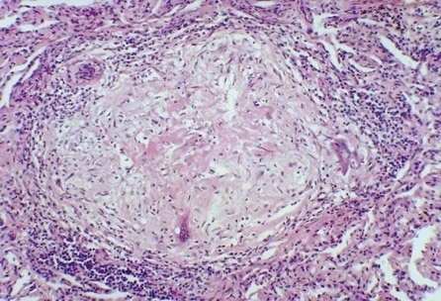
CASEATING GRANULOMA
Notes:
What is the mother of all caseating granulomatous diseases? Ans: TB

Slide 35
vi.Seconday neoplasms
Kaposi’s sarcoma
B-cell Non-Hodgkin lymphomas
Primary lymphoma of brain
cervix cancer, anal CA

Slide 36
vii. Clinical neurologic disease
Meningoencephalitis
Aseptic meningitis
Vascular myelopathy
AIDS-dementia complex
opportunistic infections
neoplasms
peripheral neuropathies

Slide 37
MORPHOLOGY
Changes are more prominent in lymphoid organs
Biopsy specimens from enlarged LN in early stages show
Marked follicular hyperplasia. Enlarged follicles have irregular borders & are present both in cortex & medulla.
Activated monocytoid cells are present in & around sinusoids & trabecular bld vessels.
Medulla contains abundant plasma cells

Slide 38
With disease progression (late phase)
Follicular involution i.e follicles are depleted of cells & organized network of follicular dendritic cells is disrupted.
The germinal centres may even become hyalinized : burnt out LN ( atrophic & small).

Slide 39
Frequently asked Questions
Pathogenesis of AIDS
Opportunistic infections in AIDS
Oral cavity lesions in AIDS

Slide 40
Reading List/Reference List
Robbins Basic Pathology: Kumar, Abbas, Aster, 9th Edition
Essential Pathology for Dental Students: Harsh Mohan, Sugandha Mohan, 5th Edition

