Slide 1
ITS DENTAL COLLEGE, GREATER NOIDA
SUBJECT : GENERAL PATHOLOGY
SESSION TOPIC : AMYLOIDOSIS
BATCH : BDS 2nd year
FACULTY : DR. CHARU SINGH (ASST PROFESSOR)

Slide 2
Learning Objectives & Specific Learning Outcomes
Learning Objectives: To explain Amyloidosis in detail.
Specific Learning Outcomes: At the end of the lecture, the learner should have knowledge of Amyloidosis with respect to-
Definition
Nature of Amyloid
Types
Classification
Staining Characteristics
Morphology in various organs
Diagnosis

Slide 3
AMYLOIDOSIS
Definition- Amyloidosis is a disorder of protein metabolism, which may be either acquired or hereditary, characterized by extracellular deposition of abnormal protein fibrils.

Slide 4
Nature of Amyloid
1- Physical Nature/Properties
2- Chemical Nature/Properties

Slide 5
1-Physical Nature/Properties
consisting of cross-β-pleated sheets which are straight, rigid, non-branching, 10 to 15nm in diameter; indeterminate length; regular fibrillar structure
These aggregates are insoluble in physiological solutions
relatively resistant to proteolysis

Slide 6
The “Beta-Sheet” Rigid Folding Pattern

Slide 7
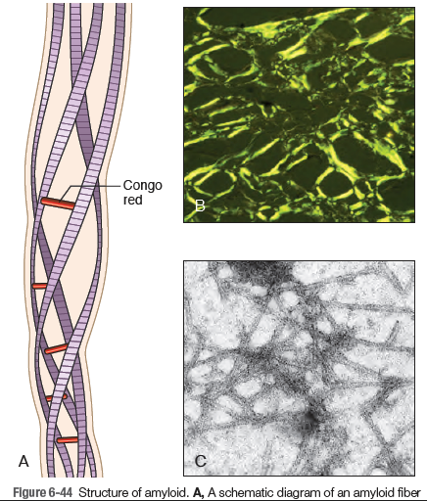

Slide 8
2- Chemical properties (main components)
Proteins and their derivates
1- Glycosaminoglycans (Fibril proteins)-approx. 95%
2- amyloid P - component -5%.

Slide 9
Main protein precursors
1-serum amyloid A protein (SAA)
2-AL proteins (monoclonal light chains Ig)
3-Transthyretin (TTR)
4-β2-microglobulin
5-β-amyloid protein precursor;

Slide 10
Other proteins are-
abnormal atrial natriuretic factor;
IAPP- insular amyloid polypeptide (amylin)
Lysozyme;
Apolipoproteins AI and AII;
Prion protein;
Calcitonin

Slide 11
Types of Amyloidosis
1) Systemic Amyloidosis
a- Primary Amyloidosis
b- Secondary Amyloidosis
2) Localised Amyloidosis

Slide 12
Primary Amyloidosis – AL (Ig related)
Immunoglobulin-related amyloidosis is mostly related to light chains, mainly λ (AL-amyloidosis)

Slide 13
Conditions causing AL-amyloidosis
Multiple myeloma
Waldenstrom’s macroglobulinemia- also known as Lymphoplasmacytic Lymphoma.
Monoclonal gammopathy of undetermined significance (MGUS)

Slide 14
Secondary amyloidosis (inflammatory amyloidosis)
Amyloid A (AA) amyloidosis is the most common form of systemic amyloidosis worldwide & the feature common to most cases is chronic inflammation

Slide 15
Causes
1-chronic inflammatory disorders- rheumatoid arthritis, ankylosing spondylitis, etc.
2-chronic inflammation due to bacterial infections- tuberculosis, leprosy, chronic osteomyelitis, etc.
3- Tumors - Most frequent:
Hodgkin's disease
Renal carcinoma
4-subcutaneous drug abuse

Slide 16
PATHOGENESIS

Slide 17
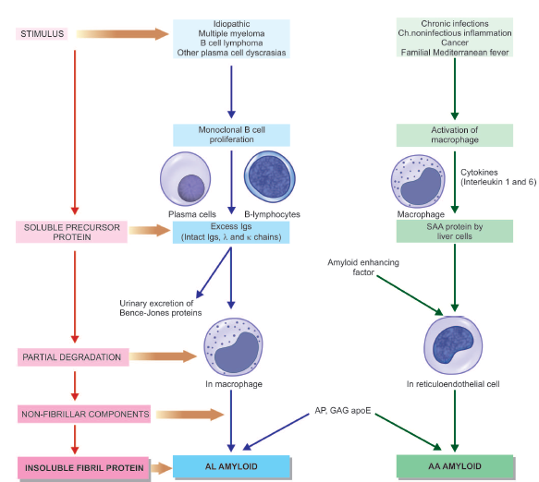

Slide 18
Contrasting features of primary & secondary amyloidosis

Slide 19
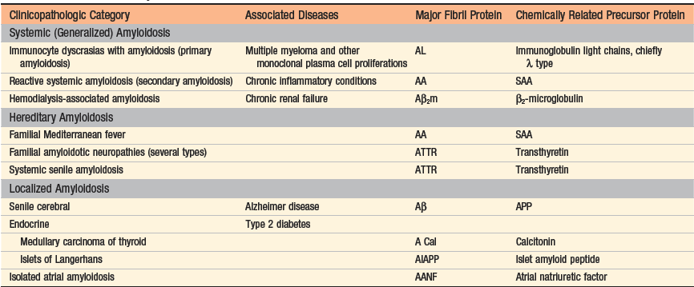
Classification of Amyloidosis

Slide 20
MORPHOLOGY
Primary Amyloidosis
Often involves these organs-
Heart
GIT
Respiratory tract
peripheral nerves
skin
tongue.
Secondary Amyloidosis
More severe, organs involved are-
Kidney
liver
spleen
LN
adrenals
thyroid.

Slide 21
Grossly- Affected organ is enlarged, firm having waxy appearance.
M/E- Shows different appearance with different stains-

Slide 22
Staining Characteristics of Amyloid
1- Stain on Gross – oldest method-
Iodine stain → Lugol’s Iodine imparts mahogany brown colour + H2SO4 → Blue colour.
2- H&E stain- amyloid appears as amorphous, hyaline, eosinophilic extracellular deposits.

Slide 23
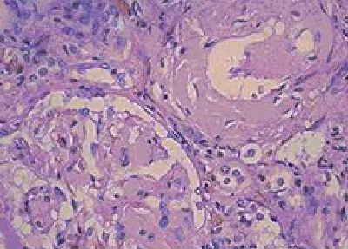
Amyloidosis –H&E stain Cardiac muscles Renal glomeruli

Slide 24
3- Metachromatic stain(Rosaniline dyes)-
Metachromasia-→ dye reacts with amyloid & undergoes a color change.
Rosaniline dyes-→ methyl violet & crystal violet
↓
Rose-pink color
to amyloid

Slide 25
4- Congo Red & Polarized light- Best staining method for confirmation.
With light microscopy congo red gives red colour.
In polarised light -→ shows “Apple-green birefringence”.

Slide 26
Also used to differentiate between pri & sec amyloidosis-
After prior treatment with permangnate or trypsin if congo-red positivity persists (congophilia)-→ Primary(AL) Amyloidosis.
Congo-red stain become negative-→ Secondary (AA) amyloidosis.

Slide 27
Amyloid by Congored under polarized light

Slide 28
5- Fluorescent stain-
Thioflavin T-→ give fluorescent yellow color under UV light.
6- Immunohistochemistry-
Antibody against fibrillary protein e.g. AL, AA etc. → Immunoreactivity i.e. Positive.

Slide 29
Morphology of organs
1- Kidney-
most commonly affected organ.
Most serious form.
Grossly-
Size- Normal to enlarged
In advanced cases- m/b shrunken & contracted.
M/E- Primarily in Glomeruli but interstitial peritubular tissue, arteries & arterioles are also affected resulting in obliteration of lumen.

Slide 30
Amyloidosis , Gross

Slide 31
Renal amyloidosis, H&E

Slide 32
Renal amyloidosis, Congo red

Slide 33
Renal amyloidosis under polarized light

Slide 34
Spleen-
Normal to marked splenomegaly
Two patterns are seen-
1- Sago Spleen- The deposit is limited to spleen follicles l/t tapioca-like granules on gross examination -→ k/a sago spleen.
Grossly- amyloid appears as translucent, pale waxy sago grain like structures.
M/E- amyloid deposit seen in spleen follicles. In advanced cases, entire follicles m/b replaced by amyloid.

Slide 35
Amloidosis Spleen, Gross

Slide 36
Section of a Sago Spleen

Slide 37
2- Lardaceous Spleen- Walls of the spleen sinuses & connective tissue framework in red pulp are involved.
Follicles are spared.
Fusion of early deposits → large map-like areas of amyloidosis k/a lardaceous spleen.

Slide 38
Lardaceous Spleen

Slide 39
Liver-
Grossly- mild to marked hepatomegaly.
M/E- Amyloid first appear in ‘space of Disse’, then encroaches on parenchymal cells & sinusoids-→ total replacement of large area of liver parenchyma.
However, normal liver function is usually preserved.

Slide 40
Amyloidosis Liver

Slide 41
High power view of Amyloidosis, Liver

Slide 42
Heart- More common in primary amyloidosis.
Also involved in senile systemic amyloidosis.
Grossly- m/b enlarged & firm.
M/E-
Subendocardial deposits →damaged conduction system → abnormal ECG.
Deposits b/w muscle fibres→ pressure atrophy of myocardium.

Slide 43
Cardiac Amyloidosis, Congored

Slide 44
Cardiac Amyloidosis, Congo red

Slide 45
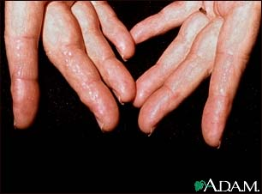
Amyloidosis, Tongue & Fingers

Slide 46
Amyloidosis Tongue under polarized light

Slide 47
Amyloidosis Adrenal, Congored

Slide 48
Amyloidosis LN, Congored

Slide 49
Amyloidosis bld vessels, H&E

Slide 50
Amyloidosis Bld vessels, Congored

Slide 51
Amyloidosis Immunofluorescence, AL

Slide 52
Diagnosis of amyloidosis
1. Presence of amyloid: congo red staining
2. Type of amyloid: immunohistochemistry
3. Mutation type: amino acid sequence analysis

Slide 53
Complications of Amyloidosis
congestive heart failure, arrhythmias, or both (cause of death more than 50%)
renal failure
bleedings

Slide 54
Frequently Asked Questions
1-Define Amyloidosis. Write its types and describe morphology of organs in Amyloidosis.
2- Write S.N. on
Nature of Amyloid
Primary Amyloidosis
Secondary Amyloidosis
Staining Characteristic of Amyloid
Sago and Lardaceous Spleen
3- Write difference between-
Primary and Secondary Amyloidosis

Slide 55
Reading List/Reference List
Robbins Basic Pathology: Kumar, Abbas, Aster, 9th Edition
Essential Pathology for Dental Students: Harsh Mohan, Sugandha Mohan, 5th Edition

