Slide 1
ITS DENTAL COLLEGE, GREATER NOIDA
SUBJECT : GENERAL PATHOLOGY
SESSION TOPIC :CHRONIC INFLAMMATION & GRANULOMATOUS INFLAMMATION
PROGRAM, YEAR: BDS, SECOND YEAR
FACULTY : Dr VERTIKA GUPTA (PROFESSOR & HOD)

Slide 2
Learning Objectives & Specific Learning Outcomes
General Objectives: To describe chronic Inflammation & granulomatous Inflammation.
Specific Learning Outcomes: At the end of the lecture, the learner should have the knowledge about Chronic Inflammation & Granulomatous Inflammation with respect to
1) Definition
2) Causes
3) Types
4) Morphologic features
5) Principal granulamatous conditions

Slide 3
CHRONIC INFLAMMATION

Slide 4
DEFINITION – Inflammation of prolonged duration (wks-mths-yrs) in which active inflammation, tissue destruction & attempts at repair are proceeding simultaneously.
CAUSES
Chronic inflammation starting de novo
2) Following acute inflammation
3) Recurrent attacks of acute inflammation
4) Prolonged exposure to potentially toxic agents
5) Autoimmunity

Slide 5
MORPHOLOGIC FEATURES
Infiltration by mononuclear cells (Macrophages, Lymphocytes, Plasma cells)
Tissue destruction/ necrosis
Proliferative changes-Attempt at healing by connective tissue replacement of damaged tissue (angiogenesis, fibrosis)

Slide 6
INFILTRATION BY MONONUCLEAR CELLS – MACROPHAGES , LYMPHOCYTES, PLASMA CELLS
A) MACROHAGES (dominant cell, component of MPS/RES)
Tissue cells derived from circulating bld monocyte after their emigration from bld stream.
In all tissues,
Macrophage acts as filters for particulate matter, microbes & senescent cells.
Acts as sentinels to alert specific components of the adaptive immune system to injurious stimuli.

Slide 7
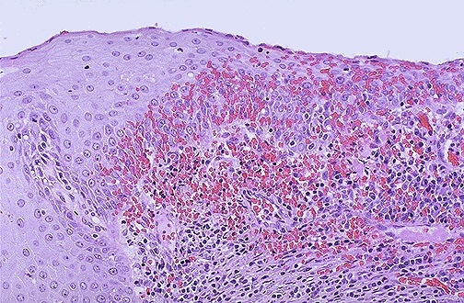
CHRONIC CERVICITIS

Slide 8
ACTIVATED MACROPHAGE
TISSUE INJURY & INFLAMMATION FIBROSIS -Reactive O₂ & - GF (PDGF, FGF, TGFβ)
nitrogen species - Fibrogenic cytokines
- Proteases - Angiogenesis GF
- AA metabolites
- Coagulation factors
- Cytokines including chemokines

Slide 9
B) LYMPHOCYTES & PLASMA CELLS
Mobilized in both Ab-mediated (B Lymphocytes) & cell mediated (T Lymphocytes) immune rxns & even in nonimmune inflammatory reactions.
Plasma cells develop from activated B Lymphocytes & produce Ab against the Ag
C) OTHER CELLS – Eosinophils, mast cells

Slide 10
2) TISSUE DESTRUCTION (central feature)
By activated macrophages
3)PROLIFERATIVE CHANGES - ATTEMPT AT HEALING BY CONNECTIVE TISSUE REPLACEMENT OF DAMAGED TISSUE (fibrosis , angiogenesis)

Slide 11
SYSTEMIC EFFECTS OF CHRONIC INFLAMMATION
FEVER – mild often with loss of wt & weakness
ANAEMIA
LEUCOCYTOSIS – lymphocytosis
ESR – elevated
AMYLOIDOSIS – secondary systemic (AA) amyloidosis

Slide 12
TYPES OF CHRONIC INFLAMMATION
CHRONIC NONSPECIFIC INFLAMMATION
2) SPECIFIC / GRANULAMATOUS INFLAMMATION

Slide 13
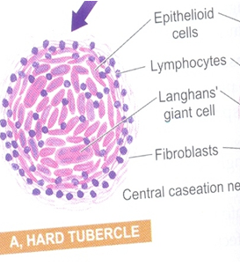
GRANULAMATOUS INFLAMMATION
GRANULOMA is a focus of chronic inflammation consisting of a microscopic aggregation of macrophages that are transformed into epithelial like cells (epithelioid cells) & are surrounded by collar of mononuclear cells mainly lymphocytes & occasional plasma cells.

Slide 14
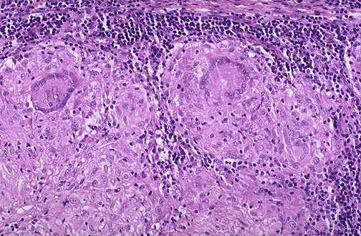

Slide 15
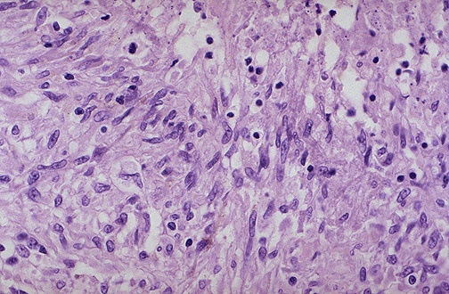

Slide 17
TYPES OF GRANULOMAS
FOREIGN BODY GRANULOMAS – are incited by relatively inert foreign bodies eg talc , sutures etc
IMMUNE GRANULOMAS – by microbes which are poorly degradable / particulate eg TB (central caseous necrosis) , sarcoidosis , syphilis, leprosy etc

Slide 18
PRINCIPAL GRANULAMATOUS CONDITIONS
BACTERIAL
TB – Both caseating & noncaseating granulomas
LEPROSY – noncaseating epithelioid cell granuloma
SYPHILIS – gumma ( histiocytes, plasma cells, central necrosis)
BRUCELLOSIS – nonspecific granulomas
CAT SCRATCH DIS – granulomas with central caseation

Slide 19
B) FUNGAL
ACTINOMYCOSIS- Granuloma with draining sinuses (sulphur granules)
BLASTOMYCOSIS- Ulceration with granuloma formation
CRYPTOCOCCOSIS
COCCIDIODOMYCOSIS
C) PARASITIC
SHISTOSOMIASIS- Granulomatous reaction present

Slide 20
D) MISCELLANEOUS
1)SARCOIDOSIS – noncaseating granulomas
2) CROHNS DISEASE – noncaseating granulomas
3) SILICOSIS
4)BERYLLIOSIS – noncaseating granulomas
5)FOREIGN BODY GRANULOMAS – noncaseating granulomas

Slide 21
Frequently asked Questions
Short notes on
Chronic inflammation
Granuloma or Granulomatous inflammation
Principal granulamatous conditions
2) Diagram of granuloma (lymph node, lung etc)

Slide 22
Reading List/Reference List
Robbins Basic Pathology: Kumar, Abbas, Aster, 9th Edition
Essential Pathology for Dental Students: Harsh Mohan, Sugandha Mohan, 5th Edition

