Slide 1
ITS DENTAL COLLEGE, GREATER NOIDA
SUBJECT : GENERAL PATHOLOGY
SESSION TOPIC : CHRONIC LEUKEMIA
PROGRAM, YEAR: BDS, SECOND YEAR
FACULTY : Dr Charu Singh(ASST PROFESSOR)

Slide 2
Learning Objectives & Specific Learning Outcomes
Learning Objectives: To explain ‘Chronic Leukemia’ with emphasis on its types, diagnosis and clinical implication.
Specific Learning Outcomes: At the end of the lecture, the learner should have knowledge of the following topics regarding ‘Chronic Leukemia’
Definition
Types
Etiology
Clinical features
Laboratory findings
Treatment & Prognosis

Slide 3
Chronic Leukaemia

Slide 4
Chronic myeloproliferative disorders
Clonal neoplastic disorders of pluripotent haematopoietic stem cell characterised by excessive proliferation of one or more of the myeloid cell lines
Include the following diseases :
Chronic Myeloid Leukemia
Chronic Myelofibrosis
Polycythemia vera
Essential Thrombocythemia

Slide 5
CML
Myeloproliferative disorder characterised by predominant proliferation of granulocytic cells
Distinguished from other myeloproliferative disorders by the presence of a chimeric BCR-ABL gene derived from portions of the BCR gene on chromosome 22 and the ABL gene on chromosome 9

Slide 6
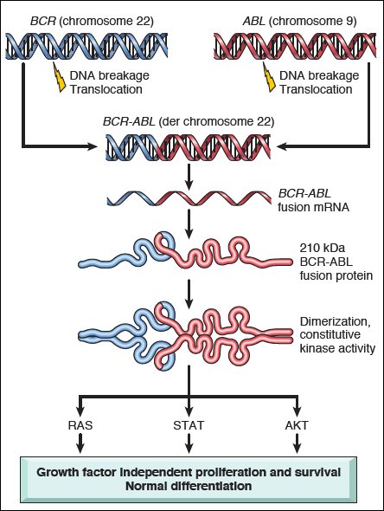

Slide 7
Clinical features
Peak incidence is in the fifth to sixth decades of life
Onset is insidious
Features of anemia - fatigability, weakness
Features of hypermetabolism - weight loss and anorexia.
Splenomegaly – frequently massive, can be assoc with acute pain
due to splenic infarction.
Hepatomegaly
Bleeding tendencies - easy bruising, epistaxis, menorrhagia and haematomas

Slide 8
Diagnosis

Slide 9
Peripheral blood smear
RBC – Normocytic normochromic anemia
WBC - TLC moderately to markedly ↑ (> 1,00,000/cumm)
Left shift with all stages of granulocyte maturation
Predominant cells are the segmented neutrophils and myelocytes
Blasts +
Eosinophils and basophils ↑
Platelet - Mild to moderate thrombocytosis

Slide 10
Phases Of CML
Chronic Phase
Accelerated Phase
Blast Crisis

Slide 11
Chronic Phase
Majority of cases diagnosed in chronic phase
Mild to moderate anemia
All stages of maturation from myeloblast to segmented neutrophils are present with ‘peaks’ of myelocytes and segmented neutrophils
Blast cells < 10%
Basophils and eosinophils are mildly ↑
Mild to moderate thrombocytosis
Easily controlled by therapy.

Slide 12
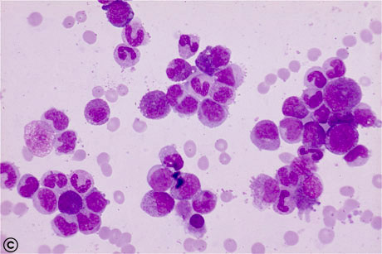

Slide 13
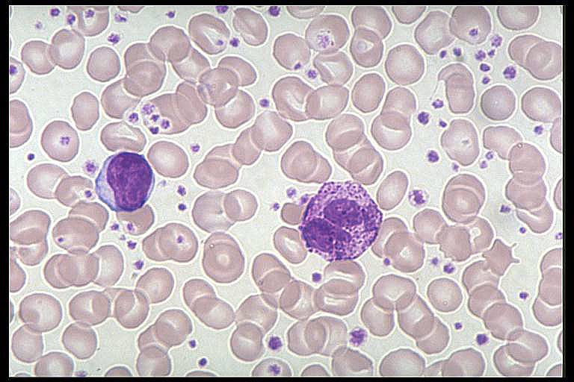
Thrombocytosis

Slide 14
Accelerated Phase
10-19% blasts in the peripheral blood and/or bone marrow
> 20% basophils in the peripheral blood
Persistent thrombocytopenia or thrombocytosis and progressive anemia
Progressive splenomegaly
Characterized by general worsening of symptoms like fever of unknown origin, bone pain etc.

Slide 15
Blast Crisis
Blasts in peripheral blood or bone marrow ≥20%
Blast proliferation at a site other than bone marrow
Worsening of symptoms
Stage is rapidly fatal, with median survival of 3-12 months only

Slide 16
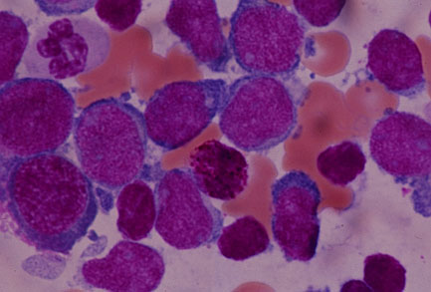
Blast Crisis

Slide 17
Bone Marrow Examination
Cellularity -hypercellular marrow with markedly ↑ granulopoiesis
Myeloid cells - M:E ratio ↑ with predominance of myelocytes
Erythropoeisis- normoblastic with reduced erythropoeitic cells
Megakaryocytes- conspicuous but usually smaller in size.

Slide 18
Cytochemistry
Neutrophil alkaline phosphatase (NAP) scores decreased.

Slide 19
Cytogenetics
Characteristic chromosomal abnormality called Philadelphia (Ph) chromosome seen in 90-95% cases of CML

Slide 20
Treatment
Imatinib oral therapy
Allogenic bone marrow (stem cell) transplantation
Interferon-α
Chemotherapy

Slide 21
Chronic Lymphoproliferative Disorders
Chronic lymphoproliferative disorders are malignant clonal proliferations of maturing lymphoid cells in the blood and bone marrow.
Classification of chronic lymphoproliferative disorders is based on immunophenotype and morphology.

Slide 22
Chronic Lymphocytic Leukemia (CLL)
Neoplastic disorder characterised by monoclonal proliferation of mature lymphocytes
CLL – with peripheral blood involvement
SLL- (small lymphocytic lymphoma) without blood involvement.

Slide 23
Clinical features
Median age at diagnosis is 60 years
M:F= 2:1
Features of anaemia - weakness, fatigue and dyspnoea
Generalized lymphadenopathy and hepatosplenomegaly
Haemorrhagic manifestations

Slide 24
Diagnosis

Slide 25
Peripheral Smear Examination
RBC - Normocytic normochromic anemia
WBC - ↑TLC usually more than 50,000/cmm
Proliferation of small, mature looking lymphocytes with high
N/C ratio, scanty cytoplasm and dense, clumped chromatin,
inconspicuous nucleoli
Smudge cells +
Platelets- normal or decreased.

Slide 27
Bone marrow examination
Proliferation of mature lymphocytes
Reduced myeloid precursors
Reduced erythroid precursors.

Slide 28
Immunophenotyping
CLL cells express CD19, CD20, CD5 and CD23

Slide 29
Cytogenetic Analysis
Deletions of 13q, 11q and 17p
Trisomy 12q

Slide 30
Other Investigations
Serum Ig levels- generally decreased
Coomb’s test is positive in 20 % cases.

Slide 31
Treatment
Alkylating drugs (e.g. chlorambucil, cyclophosphamide)
Corticosteroids
Radiotherapy

Slide 32
Prognosis
Extremely variable
Overall median survival is 4 to 6 years
In some patients, CLL transforms into an aggressive lymphoma (Richter's transformation)

Slide 33
Frequently Asked Questions
Theory
Q1- Short note on Philadelphia Chromosome
Q2- Diagnosis of Chronic Leukemia
Q3- Lab Findings of CML
Q4- Labeled diagrams showing morphology of CML
Q5- Phases of CML
Practical/Viva Voce
Q1-Leukemia vs. Lymphoma
Q2- Acute Leukemia vs. Chronic Leukemia
Q3- Morphology of Individual cells

Slide 34
Reading List/Reference List
Robbins Basic Pathology: Kumar, Abbas, Aster, 9th Edition
Essential Pathology for Dental Students: Harsh Mohan, Sugandha Mohan, 5th Edition

