Slide 1
ITS DENTAL COLLEGE, GREATER NOIDA
SUBJECT : General Pathology
SESSION TOPIC : Etiology and Pathogenesis of Cell Injury
BATCH : BDS 2nd year
FACULTY : Dr Charu Singh (Asst Professor)

Slide 2
Learning Objectives & Specific Learning Outcomes
Learning Objectives: To explain the Etiology and Pathogenesis of Cell Injury
Specific Learning Outcomes: At the end of the lecture, the learner should have knowledge of the following :-
Types Of Cell Injury
Etiology of Cell Injury
Pathogenesis of Reversible Hypoxic Cell Injury
Pathogenesis of Hypoxic, Chemical and Physical Injury
Free Radical Mediated Injury

Slide 3
Etiology and Pathogenesis Of Cell Injury

Slide 4
Introduction
Cell injury results when cells are stressed so severely that they are no longer able to adapt or when cells are exposed to inherently damaging agents or suffer from intrinsic abnormalities

Slide 5
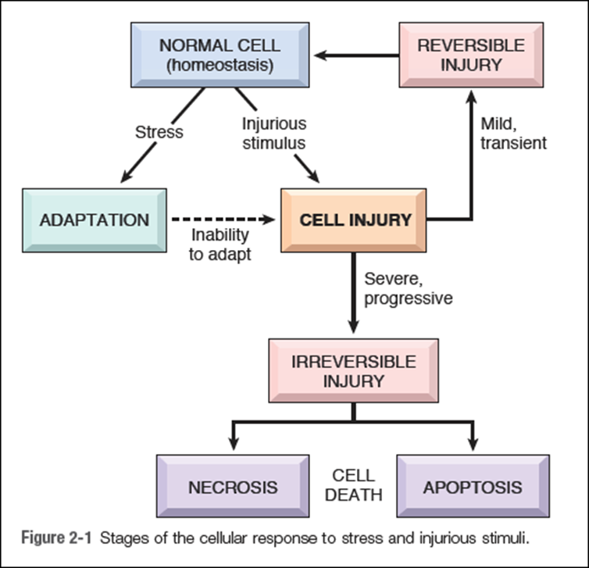

Slide 6
Types Of Cell Injury
Two types-
Reversible Cell Injury
Irreversible Cell Injury

Slide 7
Causes Of Cell Injury
Genetic Causes
Acquired Causes

Slide 8
Genetic Causes
Deficiency of functional proteins
Accumulation of damaged DNA or misfolded proteins
Variations in the genetic makeup.

Slide 9
Acquired Causes
Hypoxia and ischemia
Physical Agents
Chemical Agents and Drugs
Infectious Agents
Immunologic Reactions
Nutritional Imbalances

Slide 10
General Principles of Cell Injury
The cellular response to injurious stimuli depends on the nature of the injury, its duration, and its severity.
The consequences of cell injury depend on the type, state, and adaptability of the injured cell.
Cell injury results from different biochemical mechanisms acting on several essential cellular components

Slide 11
Pathogenesis
According to type of injury-
Pathogenesis of Hypoxic/Ischemic Injury
Pathogenesis of Chemical Injury
Pathogenesis of Physical Injury

Slide 12
Pathogenesis of Hypoxic/ ischemic injury

Slide 13
Reversible Cell Injury
If the stimulus is acute and brief or mild, the cell injury produces changes in the cells which are reversible up to a certain point
Biochemical mechanisms
Decreased generation of cellular ATP
Intracellular lactic acidosis: Nuclear clumping
Damage to plasma membrane pumps: Hydropic swelling & other membrane changes
Reduced Protein synthesis : Dispersed ribosomes

Slide 14
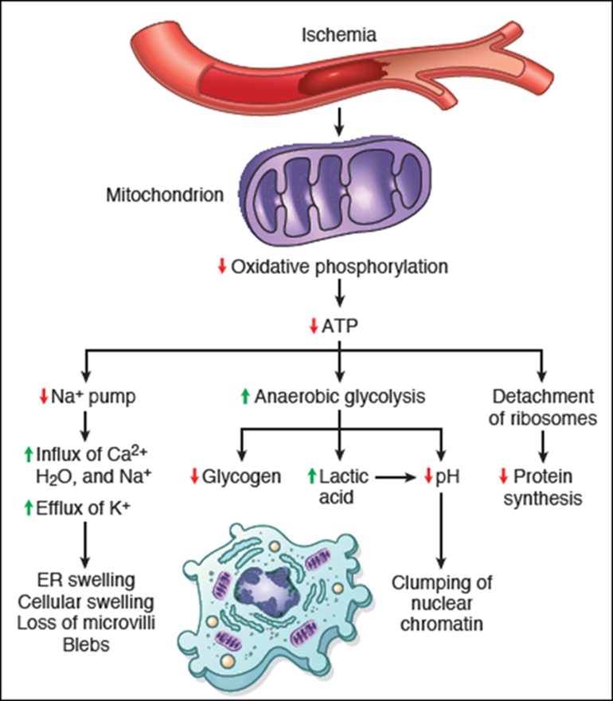

Slide 15
Morphological Changes
Microscopy - Two main features
Cellular swelling – failure of energy dependent pumps in plasma membrane → inability to maintain ionic and fluid homeostasis →small clear vacuoles seen within the cytoplasm (hydropic change or vacuolar degeneration)
Fatty change – appearance of lipid vacuoles

Slide 16
Ultrastructural changes of reversible cell injury
Plasma membrane alterations - blebbing, blunting and loss of microvilli
Mitochondrial changes - swelling and the appearance of small amorphous densities
Dilation of the ER – intracytoplasmic myelin figures
Nuclear alterations - disaggregation of granular and fibrillar elements

Slide 17
Irreversible Cell Injury
Persistence of ischaemia or hypoxia results in irreversible damage to the structure and function of the cell → cell death
Two essential phenomena distinguish irreversible from reversible cell injury :
Inability of the cell to reverse mitochondrial dysfunction on reperfusion or reoxygenation.
Disturbance in cell membrane function

Slide 18
Biochemical mechanisms
Calcium influx: Mitochondrial damage
Activated phospholipases: Membrane damage
Intracellular proteases: Cytoskeletal damage
Activated endonucleases: Nuclear damage
Lysosomal hydrolytic enzymes: Lysosomal damage, cell death and phagocytosis

Slide 19
Morphology
Nuclear changes-
Pyknosis - condensation of nuclear chromatin
Karyolysis - dissolution of pyknotic nucleus
Karyorrhexis - fragmentation of pyknotic nucleus

Slide 20
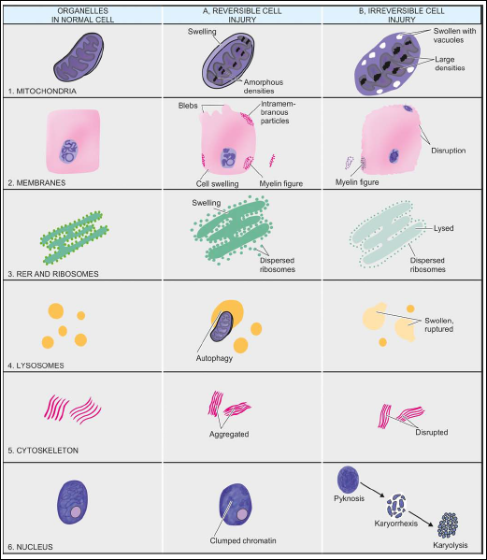

Slide 21
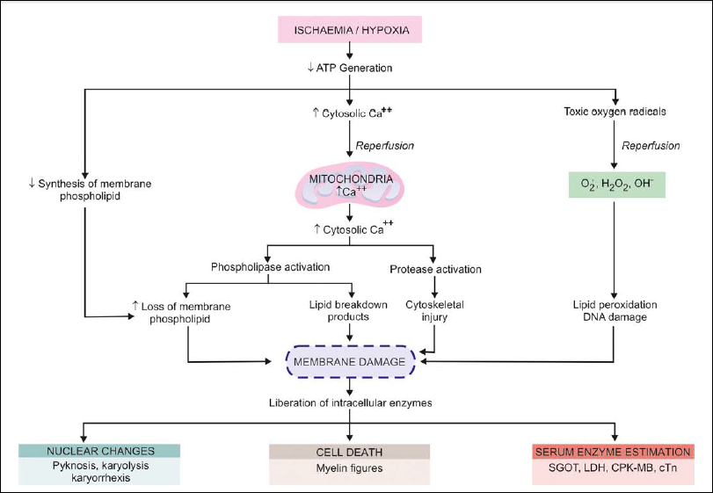

Slide 22
Ischemia-Reperfusion Injury
Restoration of blood flow to ischemic tissues can promote recovery of cells if they are reversibly injured, but can also paradoxically exacerbate the injury and cause cell death
Mechanisms
Oxidative stress
Intracellular calcium overload
Inflammation
Activation of the complement system

Slide 23
Free Radical-Mediated Cell Injury
Free radicals are chemical species that have a single unpaired electron in an outer orbit
Unpaired electrons are highly reactive and “attack” and modify adjacent molecules, such as inorganic or organic chemicals—proteins, lipids, carbohydrates, nucleic acids — key components of cell membranes and nuclei
Reactions are autocatalytic - molecules that react with free radicals are themselves converted into free radicals, thus propagating the chain of damage

Slide 24
Types of Free Radicals
Oxygen derived free radicals: Reactive oxygen species (ROS) are oxygen-derived free radicals. Eg superoxide anion (O2 • – ), hydrogen peroxide (H2O2) and hydroxyl ions(•OH)
Reactive nitrogen species/nitric oxide (NO) derived free radicals: e.g. nitric oxide (NO),peroxynitrite anion (ONOO–), NO2 and NO3–.
Free radicals from drug and chemical

Slide 25
Generation Of Free Radicals
Reduction-oxidation reactions that occur during normal metabolic processes
Absorption of radiant energy
Rapid bursts of ROS are produced in activated leukocytes during inflammation → NADPH oxidase
Enzymatic metabolism of exogenous chemicals or drugs
Transition metals such as iron and copper donate or accept free electrons - Fenton reaction
NO (by endothelium, macrophages, neurons) → ONOO- (peroxynitrite anion), NO2 and NO3−

Slide 26
Pathologic Effects of Free Radicals
Lipid peroxidation in membranes - double bonds in unsaturated fatty
acids of membrane lipids are attacked by O2-derived free radicals,
particularly by ˙OH
Oxidative modification of proteins
Lesions in DNA

Slide 27
Conditions With Free Radical Injury
Ischemic reperfusion injury
Radiation injury by causing radiolysis of water
Chemical carcinogenesis
Cellular aging
Inflammatory damage

Slide 28
Removal of Free Radicals
Spontaneous decay Free radical–scavenging systems

Slide 29
Pathogenesis Of Chemical Injury
Chemicals induce cell injury by one of two general mechanisms:
Direct toxicity - chemicals can injure cells directly by combining with critical molecular components. For eg :-
Mercuric chloride poisoning - mercury binds to the sulfhydryl groups of cell membrane proteins → increased membrane permeability and inhibition of ion transport
Cyanide poisons mitochondrial cytochrome oxidase → inhibits oxidative phosphorylation
Conversion to toxic metabolites - toxic chemicals are converted to reactive toxic metabolites, which then act on target molecules. For eg :-
CCl4 →highly reactive free radical ˙CCl3 →lipid peroxidation
Acetaminophen →toxic product → cell injury

Slide 30
Pathogenesis Of Physical Injury

Slide 31
Frequently Asked Questions
1) Describe etiology and pathogenesis of Hypoxic Cell Injury
2) Write short notes on :-
Free Radical Injury
Antioxidants
Myelin Figures

Slide 32
Reading List/Reference List
Robbins Basic Pathology: Kumar, Abbas, Aster, 9th Edition
Essential Pathology for Dental Students: Harsh Mohan, Sugandha Mohan, 5th Edition

