Slide 1
ITS DENTAL COLLEGE, GREATER NOIDA
SUBJECT : GENERAL PATHOLOGY
SESSION TOPIC : Hepatitis
PROGRAM, YEAR: BDS, SECOND YEAR
FACULTY : Dr Charu Singh (ASST PROFESSOR)

Slide 2
Learning Objectives & Specific Learning Outcomes
Learning Objectives: To explain Hepatitis with emphasis on its types, diagnosis and clinical implication
Specific Learning Outcomes: At the end of the lecture, the learner should have knowledge of the following topics with reference to different types of hepatitis :-
Etiology
Pathogenesis
Morphology
Diagnosis
Clinical features

Slide 3
Hepatitis

Slide 4
Introduction
Hepatitis- inflammation of the liver
Causes
Drugs
Toxins
Alcohol
Viral infections (A, B, C, D, E)
Other infections (parasites, bacteria)
Physical damage

Slide 5
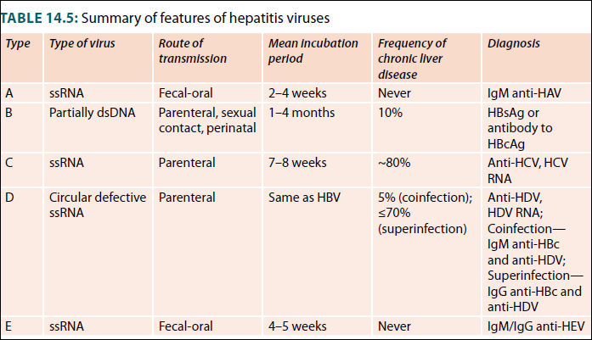
Viral Hepatitis
Definition: Viral hepatitis may be defined as viral infection of hepatocytes that produces necrosis and inflammation of the liver.

Slide 6
Clinicopathologic Syndrome
Carrier state
Acute asymptomatic infection with recovery
Acute symptomatic infection with recovery
Chronic hepatitis
Fulminant hepatitis

Slide 7
Carrier State
A “carrier” is an individual who harbours and can transmit an organism but does not manifest symptoms
2 types of carrier are seen-
Asymptomatic healthy carrier
Asymptomatic carrier with chronic disease
Hep A & E- no carrier state
Hep B – largest carriers in the world i.e. 10 %
Hep C- 2-3% carriers

Slide 8
Morphology
The liver cells of carriers show ground glass appearance due to HBsAg in the cytoplasm
These cells stain orange with Orcein stain

Slide 9
Acute Asymptomatic Acute Infection with Recovery
It is usually incidentally identified because of mild elevation of serum transaminases or presence of antiviral antibodies

Slide 10
Acute Hepatitis
Divided into 4 phases-
Incubation period
Symptomatic pre-icteric phase
Symptomatic icteric phase
Post-icteric phase/ convalescence

Slide 11
Incubation period
Pts remain asymptomatic & peak infectivity occurs during the last days of incubation period & the early days of acute symptoms

Slide 12
Pre-icteric phase
Marked by prodromal constitutional symptoms that include anorexia, nausea, vomiting, fatigue, malaise, arthralgia and headache
Earliest evidence of hepatocellular injury is – ↑Transaminases

Slide 13
Icteric phase
Onset of clinical jaundice while constitutional symptoms diminish. Other features are-
Dark coloured urine
Clay coloured stool
Pruritus
Loss of weight
Abdominal discomfort due to enlarged tender liver
Diagnosis – by LFT

Slide 14
Post-icteric phase
After icteric phase (1-4 wks) , there is recovery phase (2-12 wks), which is more prolonged in Hep B & C
< 1 % of Acute hepatitis → fulminant hepatitis
5-10% of Acute Hepatitis → Chronic hepatitis

Slide 15
Morphology
Gross
Liver may be normal or swollen in acute hepatitis
Involvement may be diffuse or patchy
Cut section muddy-red, mushy with yellow or green discoloration due to jaundice

Slide 16
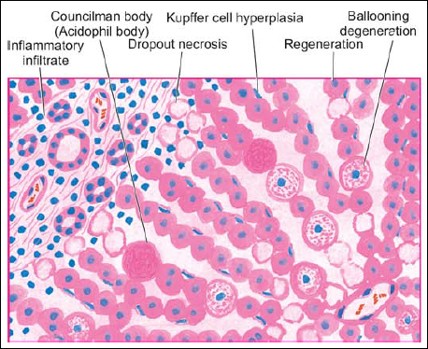
Microscopy
Hepatocyte injury
Ballooning degeneration - characterized swelling of hepatocytes, empty and pale stained cytoplasm, with clumping of cytoplasm around the nucleus
Hepatocyte necrosis
Dropout necrosis
Acidophilic or apoptotic or Councilman body
Bridging necrosis

Slide 17
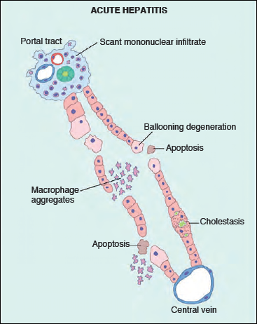
Inflammation: involves all areas of the lobule
Mononuclear inflammatory – lymphocytes and macrophages
Lobular hepatitis: It is inflammation involving liver parenchyma away from portal tract
Interface hepatitis
Kupffer cells - hypertrophy and hyperplasia
Lobular disarray

Slide 18
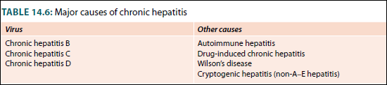
Chronic hepatitis
Chronic hepatitis is defined as symptomatic, biochemical, or serologic evidence of hepatic disease for more than 6 months. Microscopically, there should be inflammation and necrosis in the liver

Slide 19
Morphology
Gross
Early stage: Liver may appear normal
Later stage: Liver feels firm because of increased fibrosis → may progress to macronodular cirrhosis.

Slide 20
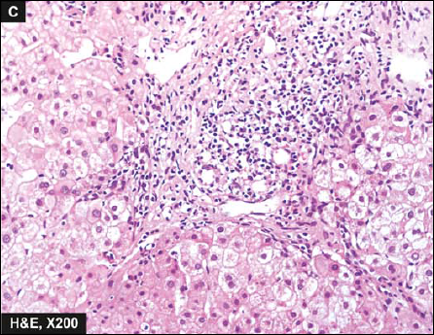
Microscopy
Portal inflammation - limited to portal tracts and predominantly consists of lymphocytes, macrophages, and occ plasma cells
Interface hepatitis (piecemeal necrosis/ periportal necrosis): characterized by spill over of inflammatory cells (lymphocytes and plasma cells) from portal tract into the adjacent parenchyma at the limiting plate→ associated with degeneration and apoptosis of periportal hepatocytes

Slide 21
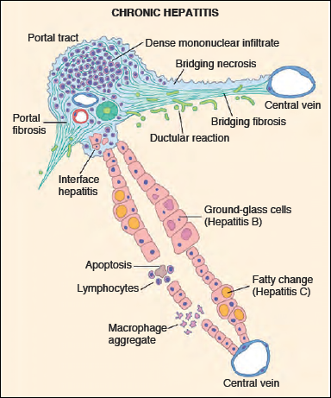
Parenchymal inflammation and necrosis - Bridging necrosis between portal tracts and portal tracts-to-terminal hepatic veins may be seen
Fibrosis: It is the hallmark of chronic liver damage

Slide 22
Fulminant Hepatitis
Hepatic insufficiency progresses within 2 to 3 weeks from onset of symptoms to hepatic encephalopathy, in patients who do not have chronic liver disease
Causes
Viral hepatitis: HBV and HAV. Occasionally, HCV and others
Non infectious causes: Acetaminophen toxicity.
Unknown

Slide 23
Morphology
Gross
Distribution of liver destruction varies - may involve the entire liver or only random areas
Massive necrosis: Liver may shrink → 500 to 700 g. It appears shrunken, red covered by a wrinkled, too-large capsule
Cut section - necrotic areas appear muddy red, mushy with areas of hemorrhage.

Slide 24
Microscopy
Massive necrosis of hepatocytes in contiguous lobules and the reticulin framework is collapsed in these regions
Minimal inflammatory reaction
If patient survives for several days, there may be inflammatory cells that phagocytose the necrotic cells
If the parenchymal framework is preserved, regeneration can completely restore the liver architecture

Slide 25
Liver Function Tests
Tests | Significance
1- S. Bilirubin | in all hepatitis
2- S.enzymes assays-
a- Alk.phosphatase | Inc. in hepatobilliary ds,bone ds, pregnancy
b- γ-glutamyl transpeptidase | Like alk.phos. But specific for hepatobilliary ds.
c-Transaminases-
SGOT (AST) SGPT (ALT) | Inc. is specific for liver inc. in hepatic injury & MI
3-S.Proteins | Hypoalbminemia in hepatocelulr ds Hyprglblnmia in cirrhosis
4-Clotting factors | PT &PTT are increased.
5-S.lipids | Inc in cholestasis Decrse in diffuse liver ds
6-Urine Tests-
Bile salts/ Bile pigmnts | Inc in cholestasis
Urobilinogen | Inc in hepatocellular & hemolytic ds, absent in obstruction.

Slide 26
Frequently Asked Questions
Q1- Enumerate various types of hepatitis.
Q2- Write S.N. on-
a- Liver Function Test
Q3- Write differences between infectious and serum hepatitis.

Slide 27
Reading List/Reference List
Robbins Basic Pathology: Kumar, Abbas, Aster, 9th Edition
Essential Pathology for Dental Students: Harsh Mohan, Sugandha Mohan, 5th Edition

