Slide 1
ITS DENTAL COLLEGE, GREATER NOIDA
SUBJECT : GENERAL PATHOLOGY
SESSION TOPIC : INTRODUCTION TO HEMATOLOGY
PROGRAM, YEAR: BDS, SECOND YEAR
FACULTY : Dr VERTIKA GUPTA (PROF & HOD)

Slide 2
INTRODUCTION TO HEMATOLOGY

Slide 3
Hematopoiesis is production of formed elements of bld.
Organs & tissues involved in hematopoiesis are divided into:
Myeloid tissue – Bone marrow & cells derived from it
Lymphoid tissue – Thymus, Lymph nodes, Spleen

Slide 4
NORMAL DEVELOPMENT OF BLOOD CELLS
1st few gestational weeks - stem cells in yolk sac
3rd gestational month - liver becomes site of blood cell formation, with the help of spleen, lymph nodes, and thymus & continues till birth
4th gestational month - bone marrow becomes functional

Slide 5
By birth – All bones contain active marrow & process continues till puberty
However, during childhood progressive fatty replacement of red marrow occurs through out long bones so that
By age of 18yrs – only vertebrae, rib, sternum, skull, sacrum, pelvis & proximal ends of humerus & femur retains red marrow, rest become yellow & fatty

Slide 6
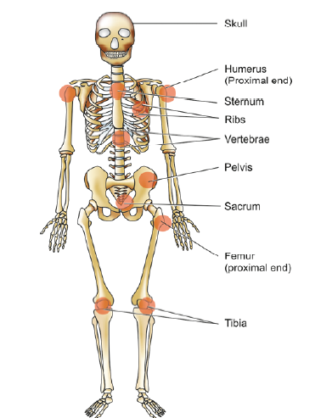
Sites of hematopoiesis in the bone marrow in adults

Slide 7
ORIGIN & DIFFERENTIATION OF HEMATOPOIETIC CELLS

Slide 8
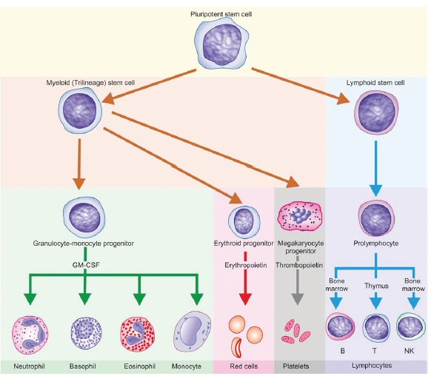

Slide 9
Types of Cellular Elements
Red blood cells – Erythrocytes
LS:90-120 days Func: O₂ transport
White blood cells – Leukocytes
Neutrophils, Eosinophils ,Basophils Lymphocytes,
Monocytes
LS : variable (eg Neutrophil :8-12 hrs)
Func : body defense against infection & ts injury
Platelets – Thrombocytes
LS: 10 days
Func: maintains integrity of bld vessels & prevents loss

Slide 10
BONE MARROW

Slide 11
BONE MARROW EXAMINATION
BM examination done for diagnosis of lesions seen in BM
BM aspiration
Trephine biopsy

Slide 12
Features | Aspiration | Trephine biopsy
SITE | Sternum, iliac crest ( anterior & posterior) Medial aspect of proximal part of tibia | Post iliac crest
INSTRUMENT | Salah, klima, Islam BM aspiration needle | Jamshidi trephine needle, vin-silverman type , Islam trephine biopsy needle
STAINS | Romonowsky stains Perl’s rxn for Fe | H &E , reticulin stain
MORPHOLOGY | Better cellular morphology | Better marrow architectural patterns

Slide 13
Bone marrow aspiration needle

Slide 14
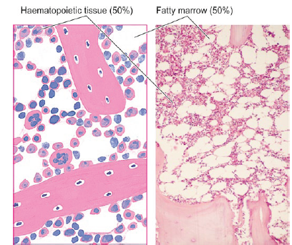
Bone Marrow

Slide 15
Normal Bone Marrow

Slide 16
ERYTHROPOIESIS
Following stages are seen:
Proerythroblast
Basophilic ( early) erythroblast
Polychromatic (intermediate) erythroblast
Orthochromatic (late) erythroblast
Reticulocyte
Mature RBC

Slide 17
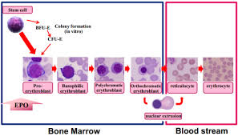
ERYTHROPOIESIS

Slide 18
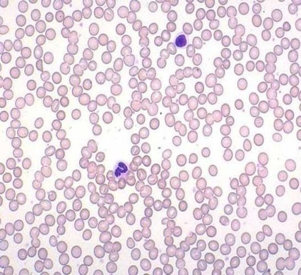
Mature Red Blood Cell
Size: 7-9 μm in diameter( avg- 7.2μm)
Cytoplasm: Pink
The red blood cell is non-nucleated, biconcave disc & lack cytoplasmic structure eg lysozyme, enzymes.
LS : 90- 120 days

Slide 19
MEMBRANE & CYTOSKELETON
RBC membrane is trilaminar structure having a bimolecular lipid layer interposed between two layers of protein.
Important membrane proteins are:
- Band 3 protein
Glycophorin
Spectrin
Band 4.1 protein
Ankyrin

Slide 20
RED CELL FUNCTION
To carry O₂ from lungs to the tissues
To transport CO₂ to the lungs
RED CELL DESTRUCTION
1) Extravascular destruction: macrophages of spleen, bone marrow, liver
Heme is reduced to bilirubin and eventually degraded to urobilinogen and excreted in the urine & feces.
2) Intravascular Destruction
Decreased haptoglobin levels in blood indicate intravascular hemolysis

Slide 21
ERYTHROPOIETIN
Erythropoietin is the hormone which regulates erythropoiesis & is produced in response to hypoxia by the kidneys

Slide 22
Reading List/Reference List
Robbins Basic Pathology: Kumar, Abbas, Aster, 9th Edition
Essential Pathology for Dental Students: Harsh Mohan, Sugandha Mohan, 5th Edition

