Slide 1
ITS DENTAL COLLEGE, GREATER NOIDA
SUBJECT : GENERAL PATHOLOGY
SESSION TOPIC : ANAEMIAS - INVESTIGATIONS
PROGRAM, YEAR: BDS, SECOND YEAR
FACULTY : Dr VERTIKA GUPTA (PROF & HOD)

Slide 2
Learning Objectives & Specific Learning Outcomes
General Objectives: To describe investigations done in a case of anaemia.
Specific Learning Outcomes: At the end of the lecture, the learner should have the knowledge about anaemias with respect to investigations done in a case of anaemia.

Slide 3
INVESTIGATIONS IN A CASE OF ANAEMIA
Hb estimation
PBS examination
Red cell indices
WBC, RBC, platelet count
Reticulocyte count
ESR
Bone marrow examination
Specific tests for specific anaemias

Slide 4
1) Hb estimation
Done by cynmeth Hb method employing Drabkin’s solution ( usually). To see if the Hb levels are appropriate for particular age & sex.

Slide 5
2) PBS EXAMINATION
Stained with Romanowsky stains( eg Leishman, MGG, Wright) – metachromatic stains which develop
Blue colour with acidic cellular components
Orange-red colour with basic cellular components
Eg nucleic acid – stained blue in colour
The following abnormalities are looked for in bld smear

Slide 6
A) Changes in erythroid series
Variation in Size : Anisocytosis
ii. Variation in shape : poikilocytosis
iii. Hypochromasia (decreased amount of hemoglobin)
iv. RBC inclusions
B) Changes in WBC series – TLC , DLC, other abnormalities
C) Changes in platelets – no./ morphology
D) Presence of neoplastic cells/ abnormal cells/ hemoparasites

Slide 7
A) Changes in erythroid series
Variations in Size: Anisocytosis
Average diameter of RBC is 7.2 microns with a range of 6-9 microns, almost the same size as the nucleus of a small lymphocyte
Red blood cells can vary in size from smaller than normal, microcytes, to larger than normal, macrocytes.
When red cells of normal size, microcytes and macrocytes are present in the same field, the term anisocytosis is used

Slide 8
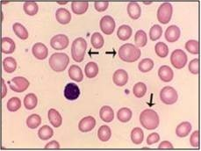
Microcytes seen in –IDA , Thalassemia, sideroblastic anaemia , deficiency of trace minerals eg cobalt, Zn etc
Macrocytes seen in – MA , Aplastic anaemia, chr liver disease, hypothyroidism, alcoholism

Slide 9
ii. Variation in shape – poikilocytosis
Spherocytes - tear drop cells
Ovalocytes/ elliptocytes - stomatocytes
Sickle cells - acanthocytes
Echinocytes - Target cells
schistocyte

Slide 10
Spherocyte
spherical red cell (not biconcave) with no central area of pallor

Slide 11
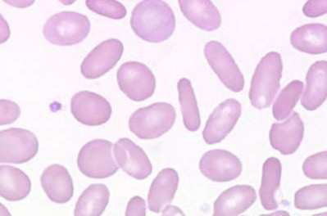
Ovalocyte/ elliptocyte
Oval- shaped, elliptocytes are more cigar shaped

Slide 12
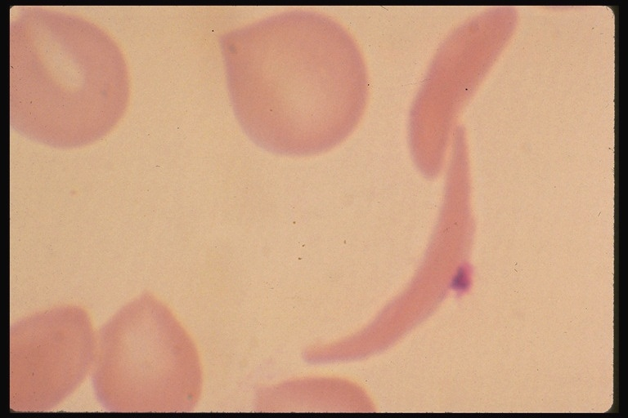
Sickle cell ( Drepanocyte)
sickle shaped red cells
Seen in – sickle cell anaemia

Slide 13
Tear drop cell (Dacrocyte)

Slide 14
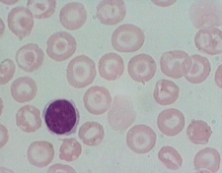
Target cell (Codocyte)
Thin-walled cells showing a darkly-stained central area of hemoglobin which has been separated from the peripheral ring of hemoglobin

Slide 15
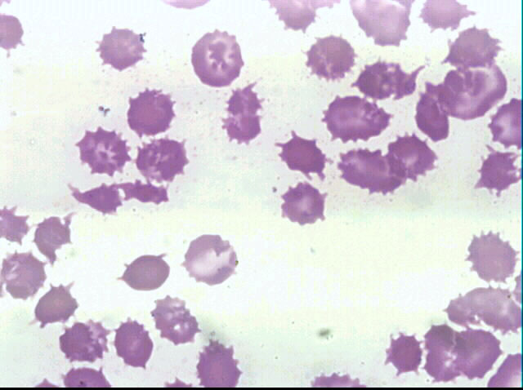
Acanthocytes
5-10 thorn-like projections irregularly spaced around the cell

Slide 16
Schistocytes
Triangular, helmet shaped, fragmented or greatly distorted cells
Seen in - Hemolytic anemias

Slide 17
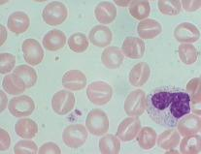
Stomatocyte
uniconcave erythrocytes which have an elongated or slit-like central pallor.

Slide 18
iii. HYPOCHROMASIA
Decreased amount of hemoglobin is referred to as hypochromasia or hypochromia
Seen in – IDA, thalassemia, sideroblastic anaemia

Slide 19
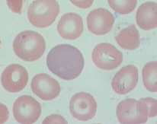
POLYCHROMASIA
RBC with residual RNA
Pinkish-gray to pinkish-blue in color

Slide 20
iv) RBC INCLUSIONS
1) Basophilic Stippling
refers to many coarse or fine, purple-staining granules distributed thruout red cells
caused by aggregation of ribosomes
seen in - Lead poisoning
- Megaloblastic anemia
- Thalassemias
- Aplastic anaemia

Slide 21
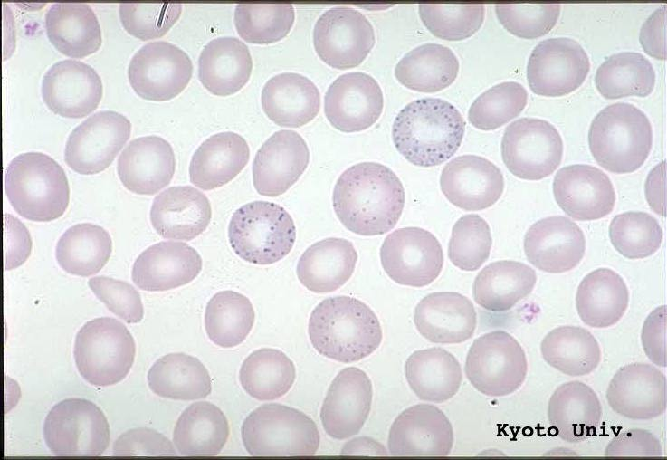

Slide 22
2) Pappenheimer bodies
3) Howell-jolly bodies
Cabot rings
5) Heinz bodies
6) Nucleated RBC

Slide 23
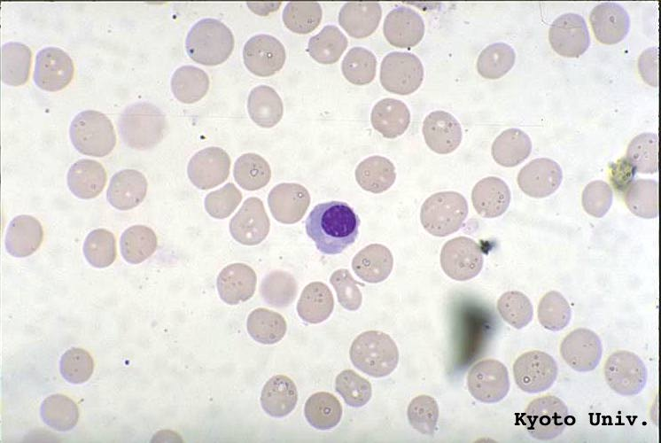
Nucleated RBC

Slide 24
B) CHANGES IN WBC SERIES
TLC , DLC
Mention presence of
- Relative ↑or↓in various types of leucocytes
Atypical / immature leucocytes
Hypersegmented (shift to rt)/ hyposegmented (shift to lt) PMN

Slide 25
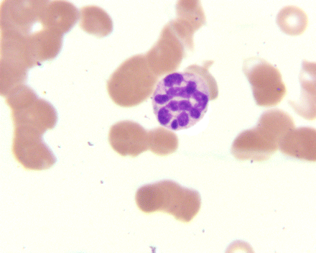
Hypersegmented neutrophil

Slide 26
C) CHANGES IN PLATELETS
Relative no – normal↑or ↓
Morphology – normal or enlarged forms (giant platelets)
D) PRESENCE OF NEOPLASTIC CELLS/ ABNORMAL CELLS/ HEMOPARASITE

Slide 27
3) RED CELL INDICES
  Mean corpuscular volume (MCV)
      N: 81- 97 fl
  RDW(Red cell Distrubution Width)
  Mean corpuscular hemoglobin (MCH)
      N: 28-34 pg
  Mean corpuscular hemoglobin concentration (MCHC)
      N: 33-35 g/dl

Slide 28
4) WBC, RBC, PLATELET COUNT (absolute)
If required (to exclude pancytopenia)
In infection – WBC count ↑
In hge – platelet count ↑
5) RETICULOCYTE COUNT
Normal range : 0.5 – 2.5%

Slide 29
6) ESR
Increased due to anaemia itself or due to underlying chronic disease.
7)BONE MARROW EXAMINATION
BM aspiration , Trephine biopsy
8) SPECIFIC TESTS FOR SPECIFIC ANAEMIAS
Includes biochemical tests, radioassay & others

Slide 30
Frequently asked Questions
1) Describe the investigations done in a case of anaemia.

Slide 31
Reading List/Reference List
Robbins Basic Pathology: Kumar, Abbas, Aster, 9th Edition
Essential Pathology for Dental Students: Harsh Mohan, Sugandha Mohan, 5th Edition

