Slide 1
ITS DENTAL COLLEGE, GREATER NOIDA
SUBJECT : General Pathology
SESSION TOPIC : Intracellular Accumulations
BATCH : BDS 2nd year
FACULTY : Dr. Charu Singh (Asst Professor)

Slide 2
Learning Objectives & Specific Learning Outcomes
Learning Objectives: To explain the Intracellular Accumulations.
Specific Learning Outcomes: At the end of the lecture, the learner should have knowledge of the Intracellular Accumulation of Different Pigments

Slide 3
Intracellular Accumulations

Slide 4
Introduction
Intracellular accumulation of abnormal amounts of various substances is one of the manifestations of metabolic derangements in cells
The substance may be located in the cytoplasm, within organelles (typically lysosomes) or in the nucleus

Slide 5
Pathways of abnormal intracellular accumulations
Inadequate removal of a normal substance secondary to defects in mechanisms of packaging and transport
Accumulation of an abnormal endogenous substance as a result of genetic or acquired defects in its folding, packaging, transport, or secretion
Failure to degrade a metabolite due to inherited enzyme deficiencies
Deposition and accumulation of an abnormal exogenous substance when the cell has neither the enzymatic machinery to degrade the substance nor the ability to transport it to other sites

Slide 6
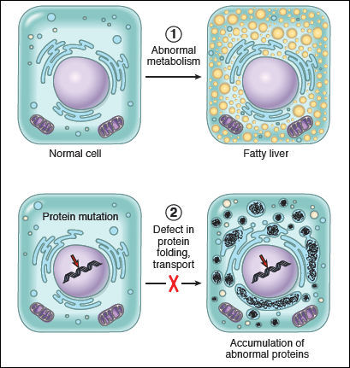
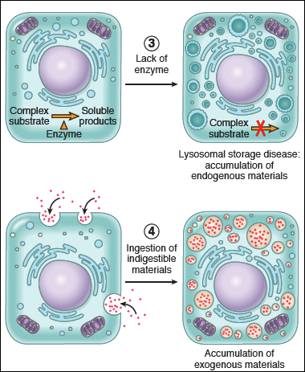

Slide 7
Proteins
Intracellular accumulations of proteins usually appear as rounded, eosinophilic droplets, vacuoles, or aggregates in the cytoplasm
Electron microscopy - amorphous, fibrillar, or crystalline in appearance
Causes
Proteinuria
Russell’s bodies
α1-antitrypsin deficiency
Mallory’s body
Amyloidosis

Slide 8
Glycogen
Glycogen masses appear as clear vacuoles within the cytoplasm
Staining with PAS imparts a rose-to-violet color to the glycogen
Conditions associated with excessive accumulation of intracellular glycogen are :-
Diabetes mellitus
Glycogen storage diseases or glycogenosis

Slide 9
Pigments
Pigments are colored substances, which are either normal constituents of cells (e.g. melanin) or are abnormal and accumulate in cells
Pigments can be :-
Exogenous - coming from outside the body
Endogenous - synthesized within the body itself

Slide 10
Exogenous Pigments
Carbon (anthracotic)
Tattooing
Arsenic
β-carotene

Slide 11
Most common exogenous pigment is carbon (coal dust)
When inhaled → picked up by macrophages within alveoli →transported through lymphatic channels to regional lymph nodes (tracheobronchial region)
Accumulations of this pigment blacken the tissues of the lungs (anthracosis) and the involved lymph nodes
In coal miners the aggregates of carbon dust may induce a fibroblastic reaction or emphysema →coal worker’s pneumoconiosis
Tattooing is a form of localized, exogenous pigmentation of the skin
The pigments inoculated are phagocytosed by dermal macrophages → reside for the remainder of the life

Slide 12
Endogenous Pigments
Lipofuscin
Melanin
Haemoprotein-derived pigments

Slide 13
Lipofuscin
It is an insoluble pigment, also known as lipochrome or wear-and-tear pigment
It is not injurious to the cell or its functions but is a telltale sign of free radical injury and lipid peroxidation.
M/E - yellow-brown, finely granular cytoplasmic, often perinuclear, pigment
Sites - liver and heart of aging patients
Causes - severe malnutrition and cancer cachexia.

Slide 14
Melanin
It is an endogenous, brown-black pigment
It is formed when the enzyme tyrosinase catalyzes the oxidation of tyrosine to dihydroxyphenylalanine in melanocytes.

Slide 15
Disorders of melanin pigmentation
Generalised hyperpigmentation
Addison’s disease - generalised hyper pigmentation of the skin, especially in areas exposed to light, and of buccal mucosa
Chloasma - during pregnancy under the influence of oestrogen
Focal hyperpigmentation
Cäfe-au-lait spots - seen in neurofibromatosis and Albright’s syndrome
Peutz-Jeghers syndrome - focal peri-oral pigmentation
Melanosis coli - pigmentation of the mucosa of the colon

Slide 16
Generalised hypopigmentation - Albinism
Tyrosinase enzyme is genetically defective and no melanin is formed in the melanocytes
Albinos have blond hair, poor vision and severe photophobia
Localised hypopigmentation
Leucoderma
Vitiligo
Acquired focal hypopigmentation due to leprosy, healing of wounds, DLE, radiation dermatitis

Slide 17
Hemoprotein Derived Pigments

Slide 18
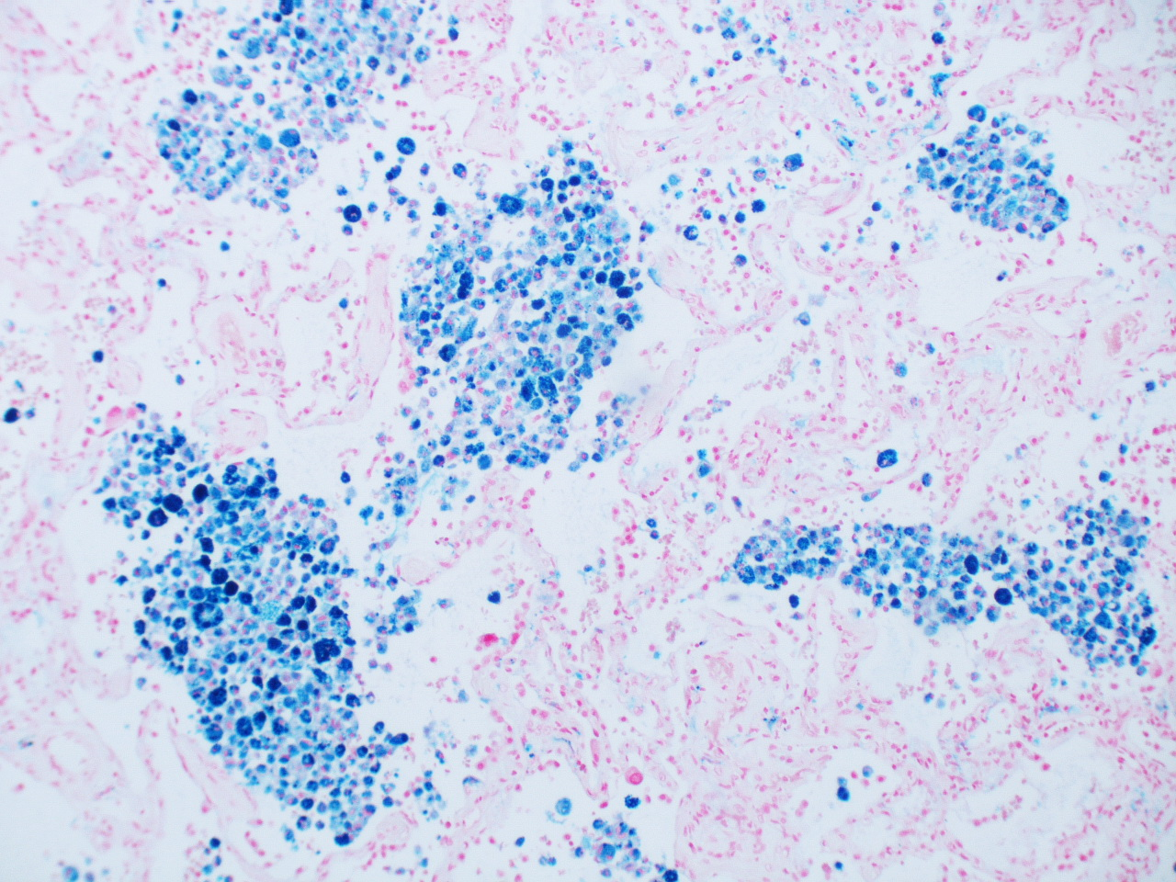
Hemosiderin
It is a hemoglobin-derived, golden yellow-to-brown, granular or crystalline pigment and is one of the major storage forms of iron
When there is a local or systemic excess of iron, ferritin forms hemosiderin granules
Hemosiderin pigment represents aggregates of ferritin micelles
Seen in the mononuclear phagocytes of the bone marrow, spleen and liver

Slide 19
Causes
Local excesses:-
Bruise
Brown induration of lung in chronic venous congestion of lung
Systemic excesses: Systemic overload of iron is known as hemosiderosis. The main causes:-
Increased absorption of dietary iron (hemochromatosis)
Excessive destruction of red cells: e.g. hemolytic anemias
Repeated blood transfusions

Slide 20
Acid Haematin (Haemazoin)
Contain haem Fe in ferric form in acidic medium & is a haemoprotein derived brown-black pigment
Most commonly seen in malaria & mismatched blood transfusion

Slide 21
Bilirubin
Normal major pigment found in bile
It is derived from porphyrin ring of the haem moiety of Hb and does not contain iron
Excess of bilirubin l/t ‘Jaundice’

Slide 22
Porphyria
Porphyrins are normal pigment present in Hb, myoglobin & cytochrome
It is an uncommon disorder of inborn abnormality of porphyrin metabolism. There is genetic deficiency of one of the enzyme reqd. for haem synthesis which l/t excessive production of porphyrins.

Slide 23
Porphyria is of 2 types-
Erythropoietic porphyria- defective haem synthesis in red cell precursors in bone marrow.
Hepatic Porphyria - More common & have defects in synthesis of haem in liver. Further subtypes are-
Acute Intermittent Porphyria
Variegate porphyria
Porphyria Cutanea Tarda

Slide 24
Frequently Asked Questions
1) Describe intracellular accumulation. Write in detail about pigments.
2) Write short notes on :-
Melanin
Hemosiderosis
Aging Pigment

Slide 25
Reading List/Reference List
Robbins Basic Pathology: Kumar, Abbas, Aster, 9th Edition
Essential Pathology for Dental Students: Harsh Mohan, Sugandha Mohan, 5th Edition

