Slide 1
ITS DENTAL COLLEGE, GREATER NOIDA
SUBJECT : General Pathology
SESSION TOPIC : Pathologic Calcifications
BATCH : BDS 2nd year
FACULTY : Dr. Vertika Gupta (Professor & HOD)

Slide 2
Learning Objectives & Specific Learning Outcomes
Learning Objectives : To explain Pathological Calcifications (Dystrophic and Metastatic)
Specific Learning Outcomes : At the end of the lecture, the learner should have knowledge about pathologic calcification with regards to :-
Types & their differences
Site
Etiology & Pathogenesis
Morphology

Slide 3
PATHOLOGIC CALCIFICATION

Slide 4
Introduction
Pathologic calcification is the abnormal tissue deposition of calcium salts, together with smaller amounts of iron, magnesium, and other mineral salts
Two forms of pathologic calcification :-
Dystrophic calcification
Metastatic calcification

Slide 5
Dystrophic Calcification
Deposition of calcium salts in dying or dead tissues
Normal serum levels of calcium
Absence of derangements in calcium metabolism

Slide 6
Pathogenesis
Two Phases
Initiation – precipitates of Ca phosphate accumulate in the mitochondria of necrotic cells with the creation of a microcrystal or extracellularly in membrane bound vesicles
Propagation – minerals deposited in the initiation phase are propagated to form mineral crystals

Slide 7
Causes
2 types
Calcification in dead tissue - caseous, enzymatic fat necrosis, in dead eggs of schistosoma, cysticercosis and hydatid cysts
Calcification in degenerated tissues
Heart valves: Occurs in aging or damaged heart valves
Atherosclerosis
Monckeberg’s medial calcific sclerosis: Calcification in the media of the muscular arteries in old people

Slide 8
Metastatic Calcification
Deposition of calcium salts in apparently normal tissues
It is associated with hypercalcemia secondary to deranged calcium metabolism
Sites
Lungs: Alveolar septa of the lung
Kidney: Basement membrane of the renal tubules
Blood vessels: On the internal elastic lamina of systemic arteries and pulmonary veins
Stomach: Interstitial tissues of the gastric mucosa

Slide 9
Causes
1) Excessive Absorption Of Ca From The Gut
Hyper vitaminosis D
Milk alkali syndrome
Hypercalcemia of infancy
2) Excessive Mobilisation Of Ca From Bone
Elevated PTH causing bone resorption
Primary hyperparathyroidism (eg parathyroid adenoma)
Secondary hyperparathyroidism (parathyroid hyperplasia, chronic renal failure)
Destruction of bone e.g. multiple myeloma, metastatic carcinoma.
Prolonged immobilisation of a patient results in disuse atrophy of the bones & hypercalcemia

Slide 10
Pathogenesis
Occurs due to excessive binding of inorganic phosphate ions with elevated calcium ions due to underlying metabolic derangement
This leads to precipitates of calcium phosphate at the preferential sites, due to presence of acid secretions or rapid changes in pH levels at these sites

Slide 11
Morphology
Gross - fine, white granules or clumps, often felt as gritty deposits
Microscopy –
Calcium salts have a basophilic, amorphous granular, sometimes clumped appearance
Psammoma bodies: Single necrotic cells on which several layers of mineral get deposited progressively to create lamellated shape
Special stains –
Von kossa - Black color
Alizarin red S - Red color

Slide 12
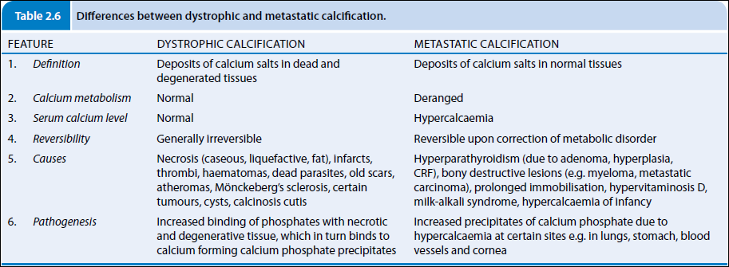

Slide 13
Frequently Asked Questions
1) Describe Pathologic Calcification in detail.
2) Write short note on :-
Pathologic Calcification
3) Write differences between Dystrophic and Metastatic Calcification.

Slide 14
Reading List/Reference List
Robbins Basic Pathology: Kumar, Abbas, Aster, 9th Edition
Essential Pathology for Dental Students: Harsh Mohan, Sugandha Mohan, 5th Edition

