Slide 1
ITS DENTAL COLLEGE, GREATER NOIDA
SUBJECT : GENERAL PATHOLOGY
SESSION TOPIC : SYPHILIS- EPIDEMIOLOGY, TYPES AND STAGES OF SYPHILIS, PATHOLOGICAL FEATURES, DIAGNOSTIC CRITERIA, ORAL LESIONS
PROGRAM, YEAR: BDS, SECOND YEAR
FACULTY :Dr VERTIKA GUPTA (PROFESSOR & HOD)

Slide 2
Learning Objectives & Specific Learning Outcomes
General Objectives: To describe Syphilis.
Specific Learning Outcomes: At the end of the lecture, the learner should have the knowledge about Syphilis with respect to
Epidemiology
Types/ Stages of syphilis
Pathological features
Diagnostic criteria
Oral lesions

Slide 3
SYPHILIS

Slide 4
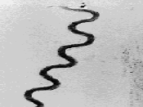
Chronic veneral disease
CAUSATIVE ORGANISM
Treponema pallidum (TP, spirochete)
-Coiled spiral filament
-Moves actively in fresh preparation

Slide 5
EPIDEMIOLOGY
Syphilis is an endemic infection in all parts of the world. In USA, approx 6000 cases are reported every year, but this number has been rising since 2000. A strong racial disparity is evident; African Americans are affected 30 times more often than whites.

Slide 6
Can’t be stained by usual methods but can be demonstrated by
Dark ground illumination
Immunoflourescence technique
Silver impregnation method
Nucleic acid amplification technique by PCR

Slide 8
NONTREPONEMAL SEROLOGICAL TESTS
A) Reiter protein complement fixation test(RPCF)
B) RPR (rapid plasma reagin ) test
C) VDRL (veneral dis research lab) test
2)TREPONEMAL SEROLOGICAL TESTS ( more specific)
Measures Ab’s reactive to TP (positive in 4-6 wks)
Fluorescent treponemal Ab absorption test(FTA-Ab’s)
Agglutinins assays eg Microhaemagglutination assay for TP Ab’s (MHA-TP) & Serodia TP-PA
TP passive haemagglutination test (TPHA)

Slide 9
IMMUNOLOGY (does not produce endo/exotoxin)
Pathogenesis of the lesions - host immune response. PCR can be done but serology mainstay of diagnosis
MODE OF TRANSMISSION
- Sexual contact
- Transfusion of infected bld
- Transplacental route (congenital syphilis)

Slide 10
3 STAGES
Primary Syphilis
Secondary Syphilis
Tertiary Syphilis

Slide 11
PRIMARY SYPHILIS
The initial lesion of primary syphilis (chancre) develops at the site of transmission after an incubation period of about 3wks, and then heals spontaneously in 3-7 weeks after formation.
The chancre usually begins as a single, painless papule that rapidly becomes eroded to produce clean based shallow ulcer. Contiguous induration produces a button like mass.

Slide 12
Chancres may be found on the penis, anal canal, mouth, or external genitalia including the cervix and labia.
The primary lesion usually is associated with regional lymphadenopathy.

Slide 13
M/E
T. pallidum are readily demonstrable in material scraped from the ulcer base using dark field/immunoflouresence microscopy
Chancre show
-infiltration by plasma cells, lymphocytes & scattered macrophages
-proliferative endarteritis
Ab test are positive in 1-3wks after appearance of chancre. Spirochaetes demonstrated in exudates by DGI.

Slide 14
SECONDARY SYPHILIS
• Develops about 4-10 weeks after the appearance of the primary lesion.
• May include a localized or diffuse mucocutaneous rash and generalized nontender lymphadenopathy (neck & inguinal region). The rash is usually macular with discrete red-brown spots <5cm in dia seen in oral cavity, palm of hands & soles of the feet.

Slide 15
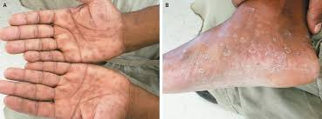
Secondary syphilis

Slide 16
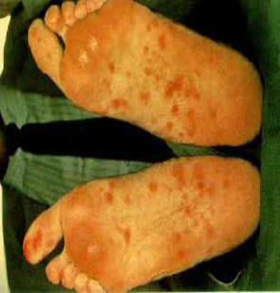
Secondary syphilis

Slide 17
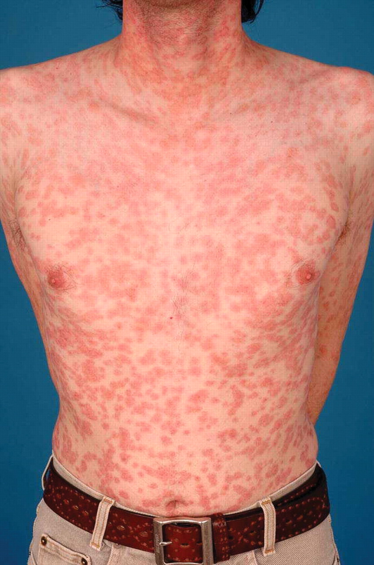
Secondary syphilis

Slide 18
Condyloma latum – broad based elevated plaques, seen in moist areas of skin
• Ab test are always positive. It is a highly infective stage
Symptomatic secondary syphilis usually resolves without treatment. The disease then enters a latent stage.

Slide 19
TERTIARY SYPHILIS
Symptomatic tertiary syphilis is the result of a chronic, progressive inflammatory process that eventually produces clinical symptoms years to decades after the initial infection.
Lesions are less infective than previous stage & T.pallidum are demonstrated with great difficulty.

Slide 20
Cardiovascular syphilis
Results from endarteritis of the aorta, subsequent medial necrosis, aortitis, and aneurysm formation. Other large arteries may be affected as well.
2. Neurosyphilis
– Tabes dorsalis (affects spinal cord)
– Meningovascular syphilis
– Parenchymatous neurosyphilis ( general paresis)

Slide 21
3) Gummatous syphilis:
- Syphilitic gummas manifests as gray-white & rubbery, single/multiple, microscopic to large tumor like masses that usually affect skin, bone, and mucous membranes of upper airway & mouth , but may involve any organ system.
- The lesions often cause local destruction of the affected organ system.
- Hepar lobatum – scarring of hepatic parenchyma as a result of gummas

Slide 22
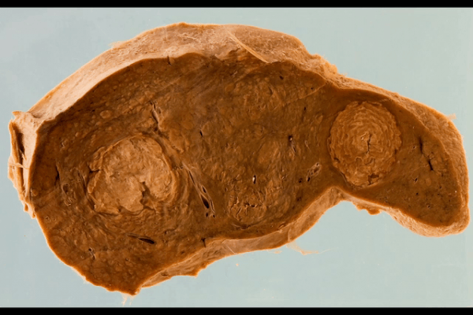
Syphilitic Gumma - Liver

Slide 23
M/E: Gumma consists of
Centre of coagulated necrotic material
Surrounded by plump & palisaded macrophages , plasma cells, lymphocytes, occasional giant cells & a peripheral zone of dense fibrous ts.
T. pallidum are scant

Slide 24
Gumma-M/E

Slide 25
Gumma-M/E

Slide 26
SYPHILITIC LESIONS IN ORAL CAVITY
Primary syphilis – chancre on lips
Secondary syphilis – maculopapular eruptions & mucous patches in the mouth
Tertiary syphilis – gummas or diffuse fibrosis may be seen on hard palate or tongue
Congenital syphilis
Fissures at the angle of mouth
Hutchinson’s incisors

Slide 27
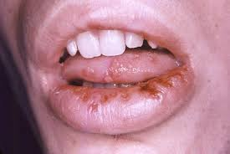
Oral lesions in syphilis

Slide 28
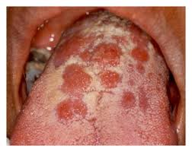
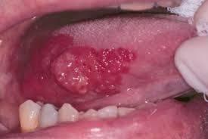
Oral lesions in syphilis

Slide 29
Hutchinson teeth

Slide 31
CONGENITAL SYPHILIS
More likely if primary & secondary Syphilis in mother
Rare if maternal Syphilis > 5 yrs
Late abortion/ still birth
Hepatomegaly
Pancreatic fibrosis
Syphilitic osteochondritis
Pneumonitis

Slide 32
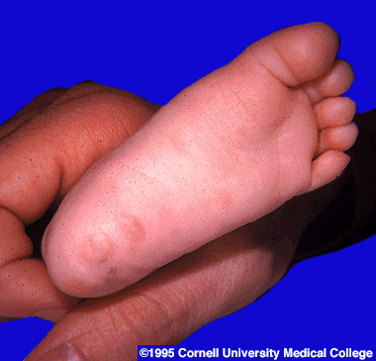
2) Infantile form (if child born alive)
Nasal discharge & congestion ( snuffles)
Desquamating or bullous rash – hand & feet, mouth, anus
Visceral & skeletal changes resembling those in stillborn infants may also be seen
Rash

Slide 33
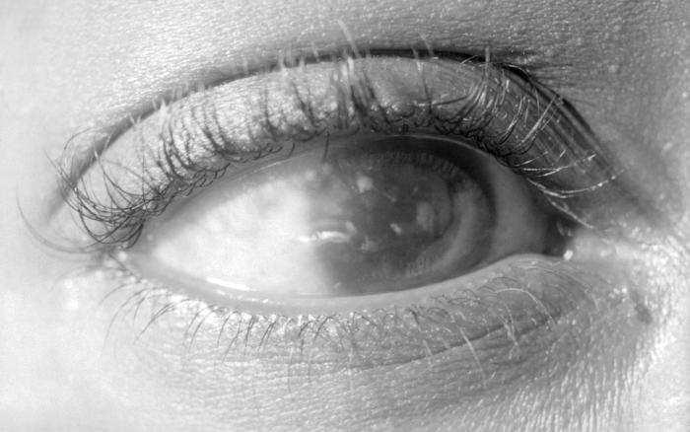
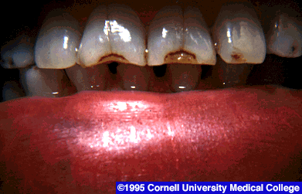
3) Late manifestation( childhood form)
Refers to cases of untreated cong syphilis of >2yrs duration
Triad of
Interstitial keratitis with blindness
Eighth nerve deafness
- Hutchinson teeth – incisor teeth which are small with notches in the enamel

Slide 34
Others
A) Syphilitic osteochondritis & periosteitis
Nose – saddle nose deformity
Lower limb (tibia) – saber shin
B) deformed molar teeth (mulberry molar)
C) chronic meningitis
D) chorioretinitis

Slide 35
Frequently asked Questions
Short notes on
Gummatous syphilis
Congenital syphilis
Oral lesions in syphilis

Slide 36
Reading List/Reference List
Robbins Basic Pathology: Kumar, Abbas, Aster, 9th Edition
Essential Pathology for Dental Students: Harsh Mohan, Sugandha Mohan, 5th Edition

