Slide 1
ITS DENTAL COLLEGE, GREATER NOIDA
SUBJECT : GENERAL PATHOLOGY
SESSION TOPIC : TYPHOID & LEPROSY-EPIDEMIOLOGY, PATHOGENESIS, PATHOLOGICAL FEATURES, DIAGNOSTIC CRITERIA
PROGRAM, YEAR: BDS, SECOND YEAR
FACULTY : Dr VERTIKA GUPTA (PROFESSOR & HOD)

Slide 2
Learning Objectives & Specific Learning Outcomes
General Objectives: To describe Typhoid & Leprosy
Specific Learning Outcomes: At the end of the lecture, the learner should have the knowledge about Typhoid & Leprosy with respect to
Epidemiology
Pathogenesis
Pathological features
Diagnostic criteria

Slide 3
TYPHOID (ENTERIC) FEVER

Slide 4
Salmonella are primary intestinal parasites.
Causes :
Enteric fever (Typhoid fever by Salmonella typhi and paratyphoid fever caused by Salmonella paratyphi A, B and C )
Gastroenteritis or food poisoning
3. Septicemia

Slide 5
EPIDEMIOLOGY
Typhoid fever affects upto 30 million individuals world wide each year.
Infection by S,typhi is more common in endemic areas where children & adolescents are most often affected.
By contrast, S.paratyphi predominates in travelers & those living in developed countries.

Slide 6
PATHOGENESIS
Incubation period : 7-10 days
Infection by ingestion of contaminated food & water i.e feco-oral route
Source of infection - case or carrier
Convalescent person excrete organism in faeces & urine for 3-12 weeks
Chronic carriers - organisms present in gall bladder & shed in faeces intermittently

Slide 7
Pathogenesis

Slide 8
MORPHOLOGY
Affects primarily terminal ileum & colon
GROSS:
- Peyer's patches in terminal ileum become sharply delineated, plateau like elevations upto 8 cm in dia, with enlargement of draining L.nodes (mesenteric).
- Peyer's patches involvement produces swelling, congestion & ulceration.

Slide 9
Shedding of mucosa & swollen lymphoid ts creates oval ulcer with their long axis along the length of the ileum. No significant fibrosis, hence fibrous stenosis seldom occurs.
Main complication - perforation of the intestine & hemorrhage.

Slide 10
M/E
Blunted villi
Vascular congestion & edema
Mononuclear inflammation
Macrophages( containing bacteria, RBC & nuclear debris), lymphocytes & plasma cells
SPLEEN
Gross- enlarged, soft, bulging
M/E
- Uniformly pale red pulp
- Obliterated follicular markings
- Prominent sinus histiocytosis and reticulo-endothelial proliferation

Slide 11
LIVER
Typhoid nodule
BONE MARROW & LYMPHNODE
Typhoid nodule
GALL BLADDER
Typhoid cholecystitis which may be associated with gall stones – chronic carrier state
Also involves- kidneys (nephritis), bones (osteomyelitis), joints(arthritis), meninges (meningitis) & testis(orchitis)

Slide 12
CLINICAL FEATURES
1st week: fever, continuous type or step ladder type
2nd week: widespread mononuclear phagocyte invasion with rash (rose spots), abdominal pain & prostration.
3rd week: ulceration of peyer's patches, intestinal bleeding & perforation.
Persistence of organism in gall bladder or urinary bladder – passage of organism in urine or faeces – CARRIER STATE ( source of infection to others)

Slide 13
LAB DIAGNOSIS
Isolation and identification of causative agent from of patient blood, faeces, urine, bone marrow, bile, CSF
- Bacteremia occurs early in the disease. Blood cultures are positive in 1st week in 90% cases, in 2nd week in 75% cases, in 3rd week in 60% cases & in 4th week and later in 25% cases

Slide 14
B. Demonstration of circulating antigens - by coagglutination test.
C. Demonstration of antibodies in patient serum
FELIX-WIDAL TEST
Significant titers helps in diagnosis
Serum agglutinins rise abruptly during the 2nd or 3rd week

Slide 15
TREATMENT
Earlier Chloramphenicol was the drug of choice but produced plasmid mediated drug resistance and had side effects like aplastic anaemia
Quinolones : Ciprofloxacin, Norfloxacin, Ofloxacin
3rd generation Cephalosporins : Cefotaxime, Cefoperazone, Ceftriaxone
Cholecystectomy for carriers

Slide 16
LEPROSY (HANSEN DISEASE)
It is a chronic infectious disease caused by Mycobacterium leprae, affecting mainly the skin & peripheral nerves & resulting in disabling deformities. M.leprae resembles M.tuberculosis but is less acid fast.
Mainly involves the cooler parts of the body like skin, mouth, respiratory tract, peripheral nerves, superficial L.nodes & testis.

Slide 17
EPIDEMIOLOGY
The disease is endemic in areas with hot & moist climates & in poor tropical countries.
India accounts for one-third of all registered cases globally.
In India, disease is seen more commonly seen in regions like TN, Bihar, Pondicherry, AP, Odisha, WB & Assam.

Slide 18
MODE OF TRANSMISSON
Leprosy is a slowly developing communicable disease
Incubation period between exposure to organism & appearance of signs varies from 2 to 20 yrs.
Infectivity may be from following:
- Direct contact with untreated patients
- Materno-foetal transmisson
- Infected mother milk to infant

Slide 19
CLASSIFICATION
1) LEPROMATOUS LEPROSY(LOW RESISTANCE )
2) TUBERCULOID LEPROSY(HIGH RESISTANCE)
3) BORDERLINE LEPROSY

Slide 20
LEPROSY CURRENTLY CLASSIFED AS
(Modified Ridley & Jopling’s classification)
TT-TUBERCULOID POLAR(HIGH RESISTANCE)
BT –BORDERLINE TUBERCULOID
BB-MID BORDERLINE
BL –BORDERLINE LEPROMATOUS
LL-LEPROMATOUS POLAR(LOW RESISTANCE)

Slide 21
CLINICAL FEATURES

Slide 22
Lepromatous leprosy (more severe form)
Also known as anergic leprosy because of the unresponsiveness (anergy) of the host immune response.
Cooler areas of skin are commonly affected. Skin lesions are generally symmetrical, multiple , hypopigmented & erythematous macules, papules, nodules or diffuse infiltrates. Nodular lesions may coalesce to give leonine facies.
Lesions are hypoaesthetic/anaesthetic but sensory disturbance is not that distinct.

Slide 23
Leprosy – Clinical features

Slide 24
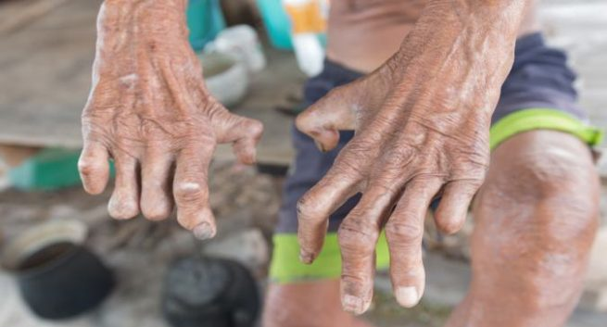
Leprosy – Clinical features

Slide 25
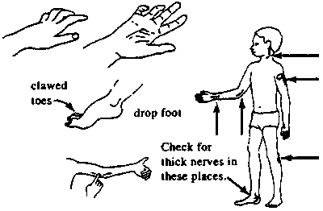
Leprosy – Clinical features

Slide 26
TUBERCULOID LEPROSY
Skin lesions occur as single/few asymmertical, hypopigmented, erythematous macules.
Sensory disturbance is distinct.

Slide 27
MORPHOLOGY

Slide 28
LEPROMATOUS LEPROSY
In the dermis there is proliferation of lipid laden macrophages particularly around bld vessels, nerves & dermal appendages. The foamy marophages are known as lepra cells or Virchow cells.
Lepra cells are heavily laden with acid fast bacilli (globi or cigarettes - in - pack)
Dermal infiltration of lepra cells separated from epidermis by subepidermal uninvolved clear zone.
Epidermis overlying the lesion is thinned out , flat or may even ulcerate.

Slide 29
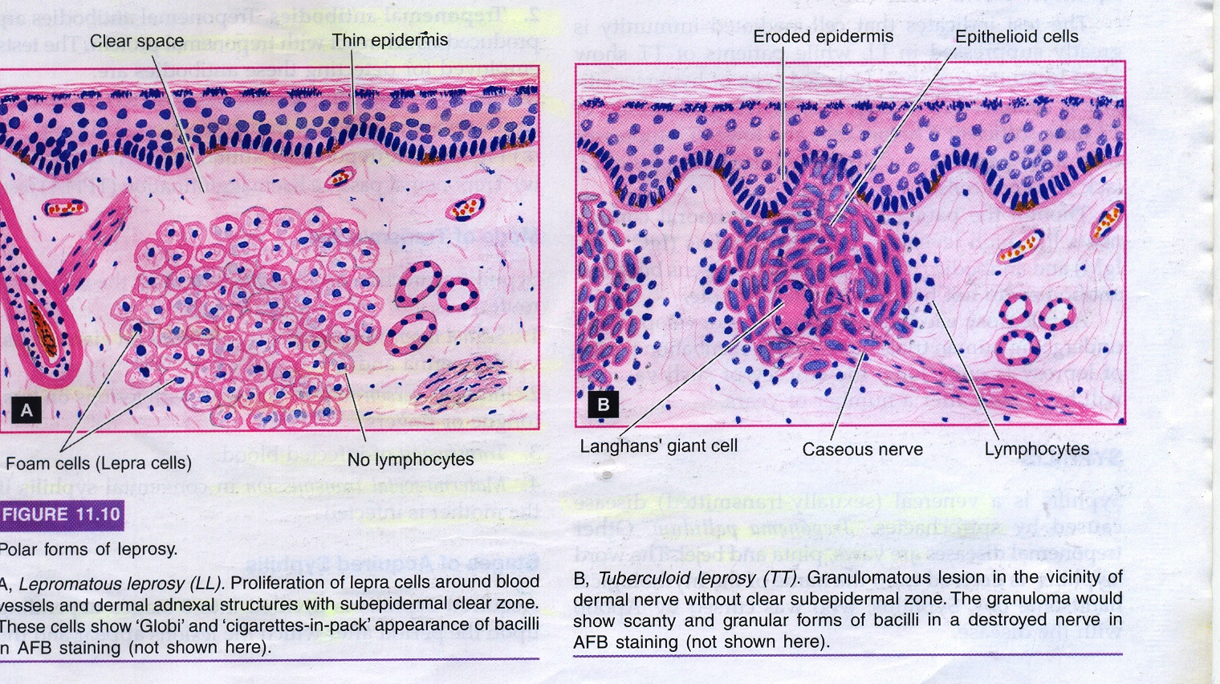

Slide 30
TUBERCULOID LEPROSY
Dermal lesions show granulomas resembling hard tubercles composed of epithelioid cells , langhan’s giant cells & a peripheral rim of lymphocytes.
Granulomatous infiltrate erodes the basal layer of epidermis ie there is no clear zone.
Lepra bacilli are few
Lesions have predilection for dermal nerves which may be destroyed.

Slide 31
 | LL | TT
SKIN LESIONS | Symmetrical,multiple, hypopigmented, erythematous, maculopapular or nodular (leonine facies) | Asymmetrical, single or a few lesions, hypopigmented & erythematous macules
NERVE INV | Present but sensory disturbance is less severe | Present with distinct sensory disturbance
H/P | Collection of foamy macrophages or lepra cells in the dermis separated from epidermis by a ‘clear zone’ | Hard tubercle eroding the basal layer of epidermis, no clear zone

Slide 32
BACTERIOLOGY | Lepra cells are highly positive for lepra bacilli seen as ‘globi’ or ‘cigarettes- in – pack’ appearance | Lepra bacilli few, seen in destroyed nerves as granular or beaded forms
IMMUNITY | Suppressed (low resistance) | Good immune response (high resistance)
LEPROMIN TEST | Negative | Positive

Slide 33
DIAGNOSIS OF LEPROSY
1) Diagnosis of leprosy is most commonly based on the clinical signs and symptoms. In an endemic country or area, an individual should be regarded as having leprosy if he or she shows ONE of the following cardinal signs:
skin lesion consistent with leprosy and with definite sensory loss, with or without thickened nerves
positive skin smears

Slide 34
2) For patients presenting the above symptoms, a leprosy diagnosis is confirmed after analysis of tissues biopsied from infected sites.
Histopathological diagnosis is made
Typically, a stain for acid-fast bacteria is performed .
Additional steps may include
- Culturing infected tissue to confirm other bacteria are not involved - M. leprae cannot be cultured in vitro
-Using PCR

Slide 36
3) OTHER TESTS
Lepromin skin test
Polymerase chain reaction (PCR)

Slide 37
Frequently asked Questions
Difference between Lepromatous leprosy & Tuberculoid leprosy

Slide 38
Reading List/Reference List
Robbins Basic Pathology: Kumar, Abbas, Aster, 9th Edition
Essential Pathology for Dental Students: Harsh Mohan, Sugandha Mohan, 5th Edition

