Slide 1
Welcome to II year

Slide 2
Text books and stationary
Text book of Microbiology for dental students – Dr. D R Arora (CBS Publications)
OR
Text book of Microbiology for dental students – Prof. C P Baveja (Arya Publications)
Practical Pathology and Microbiology (Dental Students) – Dr. K. Uma Chaturvedi, Dr. V.K. Sharma, Dr. Tejinder Singh, Dr. C. P. Baveja (Arya Publications)
For practical: Practical manual, a rough note book, colour pensils - 1 OHP marker blue or black, compass, scale, sanitizer/ paper soap.

Slide 3
Introduction, scope and history of microbiology
Microbiology: Study of micro-organisms
Micros: small, Bios: life, Logos: study

Slide 4
Universal presence of microbes
Branches of microbiology: Medical, Plant, Animal, Soil, Environmental, etc.
Branches of Medical microbiology:
General microbiology
Immunology
Systemic bacteriology
Mycology
Virology
Parasitology

Slide 5
Importance of microbiology:
Beneficial role:
Check environmental pollution
Production of yogurt, wine, antibiotics, interferons
Genetically engineered microbes help to produce mass production of hormones, enzymes, vaccine production against diseases
Harmful effects:
Diseases
Destruction of plants and animals
Spoil food and material

Slide 6
History of microbiology
Disease = Devine wrath or supernatural can be transmitted from man to man by contact is known since biblical times.
4th Century BC: Democritus (Greek philosopher) proposed ‘The atomic theory’: Atom the smallest unit.
1st Century BC: Varo & Collumella postulated that diseases were caused by invisible organisms which they called ‘Animalia minuta’.
95-55 BC: Lucretius(Roman) – Fathered the concept of ‘Spontaneous Generation’ which was dominant until 1800’s. Small animals/insects generated spontaneously & had no parents.

Slide 7
1546 Fracastorius: proposed ‘The Contagion Theory’ – living germs are possible cause of Syphilis, but could not prove it.
1626-1697 Francesco Redi: disproved the theory of Spontaneous Generation
Needham (Irish Priest): performed ‘The three flask experiment’
1769 Spallanzani (Italian abbot): Microbes enter with air
1609 Jansen: proposed the theory of Microscope

Slide 8
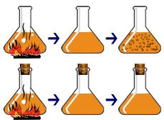
Redi’s and Needham’s experiment

Slide 9
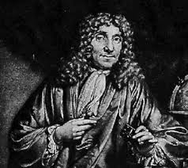
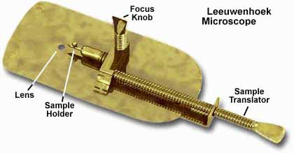
1683 Antony Van Leewenhock developed the first microscope called – Father of Microscopy.
He was a Dutch draper & amateur lens grinder
Could grind lenses of 300-400 times magnification & observed small living beings and called them ‘Animalcules’

Slide 10
Robert Hooke: proposed ‘The cell theory’ and developed ‘The compound Microscope’
1840 Homes & Ignaz Semmelweis – proposed ‘The Germ Theory’ puerperal sepsis was transmitted by contaminated hands of doctors.

Slide 11
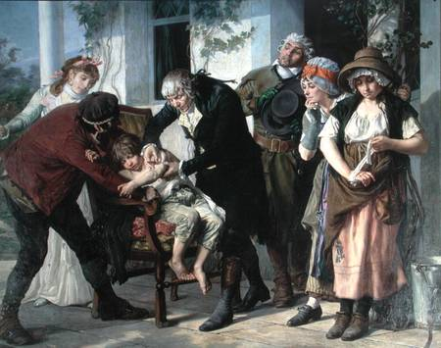
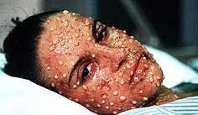
1749-1823 Edward Jenner:
Developed the technique of immunisation.
Transferred the pus from cow pox to humans------>insignificant disease developed but became immune to small pox (a dreaded disease).

Slide 12
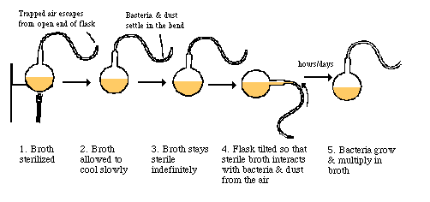
1822-1895 Louis Pasteur: Father of Microbiology.
Italian chemist
Proposed ‘The Microbial Theory of Fermentation.
Disproved the theory of spontaneous generation by ‘ The Swan Neck Flask experiment’ – micro-organisms are present in air.
There are aerobic as well as anaerobic organisms.

Slide 13
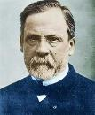
Silk worm disease in plants is produced by micro-organisms.
Developed various sterilization techniques: Steam sterilizer, Hot air oven, Autoclave, Pasteurization.
- Causative agent of rabies is too small and pass through bacterial filters. He produced rabies in dogs by giving intra-cerebral injections of saliva & brain tissue extract of infected animals.

Slide 14
Produced live attenuated vaccines against: Rabies, Fowl Cholera, Anthrax & Erysipelas. Attenuation of organism done by:
Rabies vaccine: Spinal cord of infected rabbits suspended in air for several days. Gave 13 injection in1885 to Joseph Meister
Anthrax vaccine: incubate at 42º – 43ºC for few days – Pouilly-le-forte experiment
Fowl Cholera : by ageing of cultures
Attenuation: organisms lose their pathogenecity i.e. disease producing capability, but retained their antigenecity i.e. ability to produce antibody in the host.

Slide 15
1827-1912 Joseph Lister: Father of antiseptic surgery.
Professor of surgery in Glasgow Royal Infirmary.
He applied Pasteur’s work and introduced antiseptic techniques in surgery effecting pronounced drop in mortality and morbidity.
Used carbolic acid as antiseptic during surgery.

Slide 16
1843-1910 Robert Koch: Father of Bacteriology.
German Physician
Isolation of pure strains of bacteria on solid medium
Introduced staining techniques of bacteria
Discovered Mycobacterium tuberculosis as the causative agent of tuberculosis and got Nobel Prize.
Also discovered Anthrax bacilli causes anthrax in cattle, and cholera bacilli causes cholera.

Slide 17
Koch’s Postulates : A microorganism can be accepted as the causative agent of an infectious disease only when-
Organism should be constantly associated with the lesion of disease
Organism should be isolated from the lesion in pure culture
Isolated organism in pure culture when injected in susceptible experimental animal should produce the same lesions of disease.
From the lesions produced in experimental animals the micro-organism must be re-isolated and demonstrated in pure culture and smear.
Antibody to the organism develop during the course of disease.
Exception: Mycobacterium leprae and Treponema pallidum – they donot grow in artificial medium.

Slide 18
Koch’s postulates

Slide 19
Koch’s phenomenon: Koch observed that guinea-pigs already infected with tubercle bacilli responded with an exaggerated inflammatory response when injected with tubercle bacilli or its protein. This hypersensitive reaction is called Koch’s phenomenon.

Slide 20
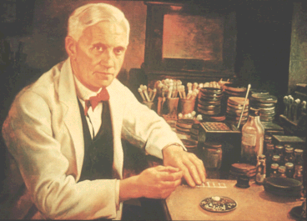
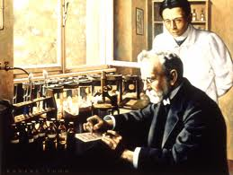
1854-1915 Paul Ehrlich: Father of chemotherapy.
Discovered an arsenical compound sometimes called ‘Magic bullet’ was capable of destroying the spirochaetes of syphilis without destroying the normal tissue.
1881-1955 Sir Alexander Fleming: Discovery of Penicillin

Slide 21
1883 Elie Metchnikoff a Russian scientist working at Pasteur Institute, formulated the theory of phagocytosis and proposed phagocytes as the prime defense against microbial invasion.
Paul Ehrlich hypothesized that immunity could be explained by non-cellular component of blood.
They both shared the Nobel Prize in 1908 for their contribution to immunology.

