Slide 1
Morphology of Bacteria I
BDS 2nd yr
Date:9/1/17
Dr Nitika Anand

Slide 3
General Features of Bacteria
Bacteria are free living microscopic unicellular organisms.
Possess both DNA & RNA but lack
chlorophyll.
Lack membrane bound nucleus.Nucleus comprises of DNA in the form of single,
circular chromosome attached to mesosome.

Slide 4
Size: Medically imp. bacteria measures 0.2-
1.5μm in diameter & 3-5μm in length.
Shape of bacteria:
1.Cocci:Round or oval in shape.
2.Bacilli:Rod or cylindrical shaped.
3.Coccobacillus:Bacilli with same length & width.
4.Vibrio:Curved or comma shape.

Slide 5
5.Spirillum:Spiral forms with one to three fixed curves.
6.Spirochaete:Slender & flexous spiral forms.
7.Mycoplasma:Cell wall deficient organisms.No stable morphology.
Group patterns
Frequent method of reproduction is Binary fission.Each cell splits in half forming two cells .

Slide 6
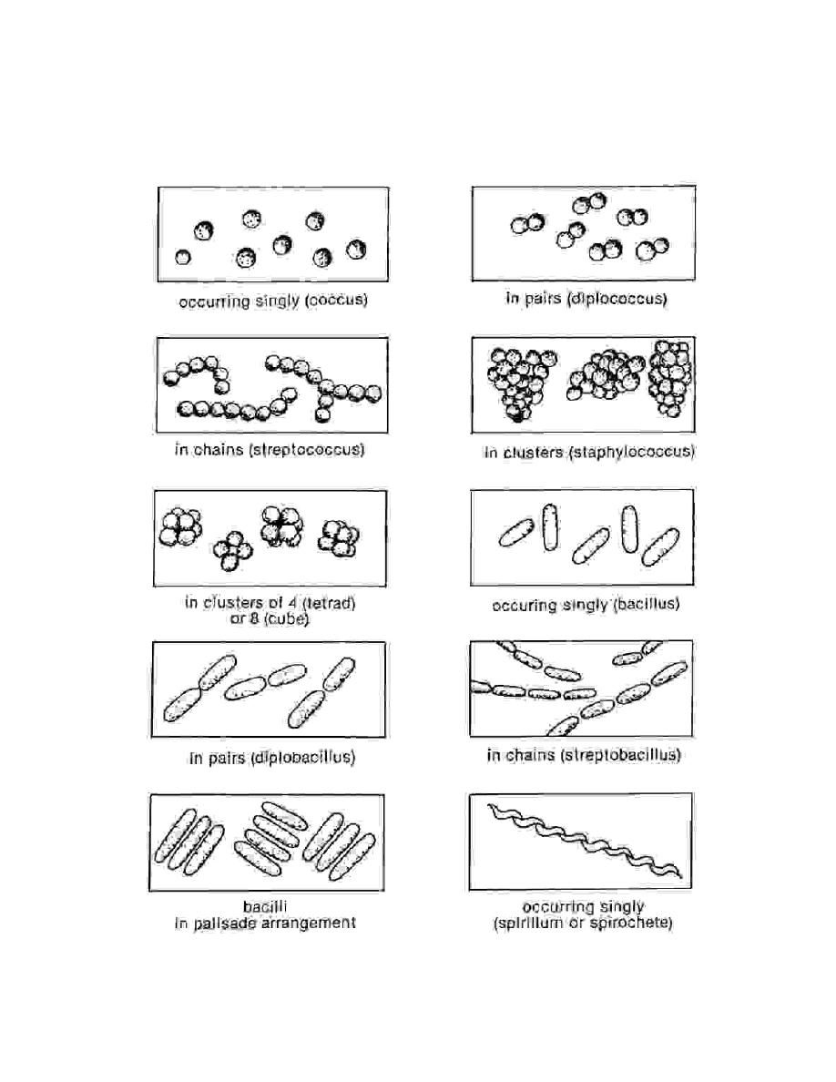

Slide 7
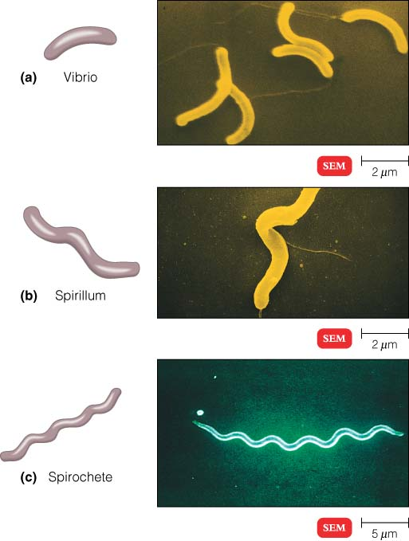

Slide 8
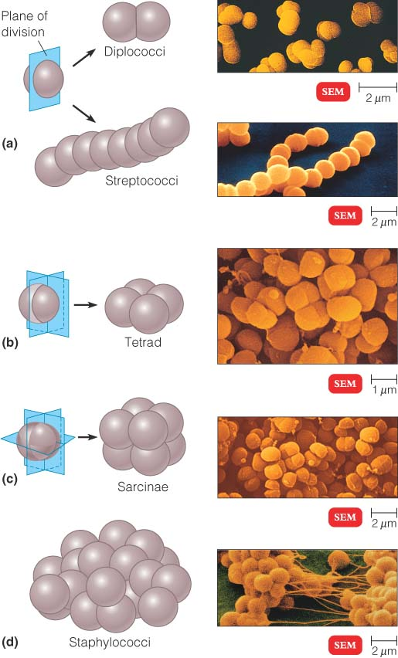

Slide 9
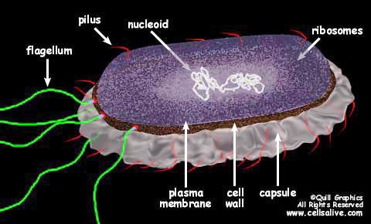
Anatomy of Bacterial cell

Slide 10
1)Cell Wall
Complex rigid structure which gives definite shape to bacteria.
Freely permeable.
Cell wall mainly consist of peptidoglycan.
Peptidolycan has 3 parts:
a)Backbone of N-acetylglucosamine & N-acetylmuramic acid .

Slide 11
b)Identical tetrapeptide side chains attached to
N-acetyl muramic acid.
c)Peptide cross bridge that cross links the
backbone.
On the basis of chemical composition of
cell wall & response to gram staining,
Bacteria are divided into:
Gram positive bacteria
Gram negative bacteria

Slide 12
Peptidoglycan structure

Slide 13
Cell wall of Gram Positive bacteria
Thicker than gram negative bacteria b’coz
of thick peptidoglycan layer(50% of cell wall)
Teichoic acid : act as surface antigen.Teichoic acid is of 2 types:
a)Wall teichoic acid(linked to cell wall)
b)Lipoteichoic acid:linked to cell membrane

Slide 14
Cell wall of Gram Negative bacteria
Thin peptidoglycan layer(5-10% of total cell wall).
Outside peptidoglycan lies 3 components:
1)Lipoprotein
2)Outer membrane: Comprising of outer membrane
proteins(OMP),Porins,Phospholipid.
3)lipopolysaccharides(LPS): Lipopolysaccharide consists of
Sugars(O polysaccharide) –Function as Antigen
Lipid A -which is Endotoxin(causes fever and shock)

Slide 15
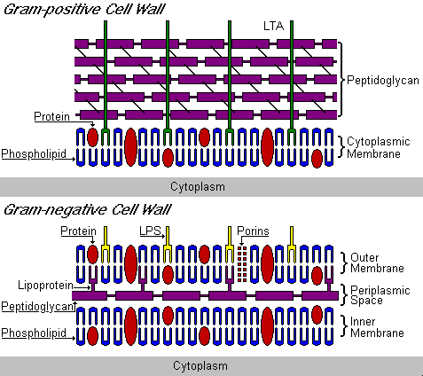

Slide 16
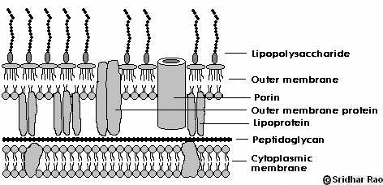
Gram –ve cell wall

Slide 17
Functions of cell wall
Maintains cell shape, any cell that loses its cell wall, loses its shape as well.
• Protects bacteria from osmotic lysis.
• Acts as a barrier, protects cell contents from external environment.

Slide 18
2)Cytoplasmic membrane
Lies internal to cell wall
Protects protoplasm
Thin layer(5-10nm),Elastic & consist mainly of phospholipids(40%) & proteins(60%).
Lack sterols except for Mycoplasma.
It is semipermeable membrane.

Slide 19
Functions of cell membrane
• A selectively permeable barrier: substances that pass through the membrane are limited by pore sizes and the hydrophobic nature of the membrane.
Excretion of hydrolytic enzymes.
• Site of initiation of cell wall synthesis.
• Site of attachment of the chromosome.
• Site of synthesis of phospholipids.

