Slide 1
Morphology of Bacteria II
BDS 2nd yr
Date:11/1/17
Dr.Nitika Anand

Slide 2
Cytoplasm
Viscous solution containing organic & inorganic solutes.
Contains small granules-ribosomes.
Do not contain Golgi bodies, ER, mitochondria.
Do not show internal mobility(cytoplasmic streaming).

Slide 3
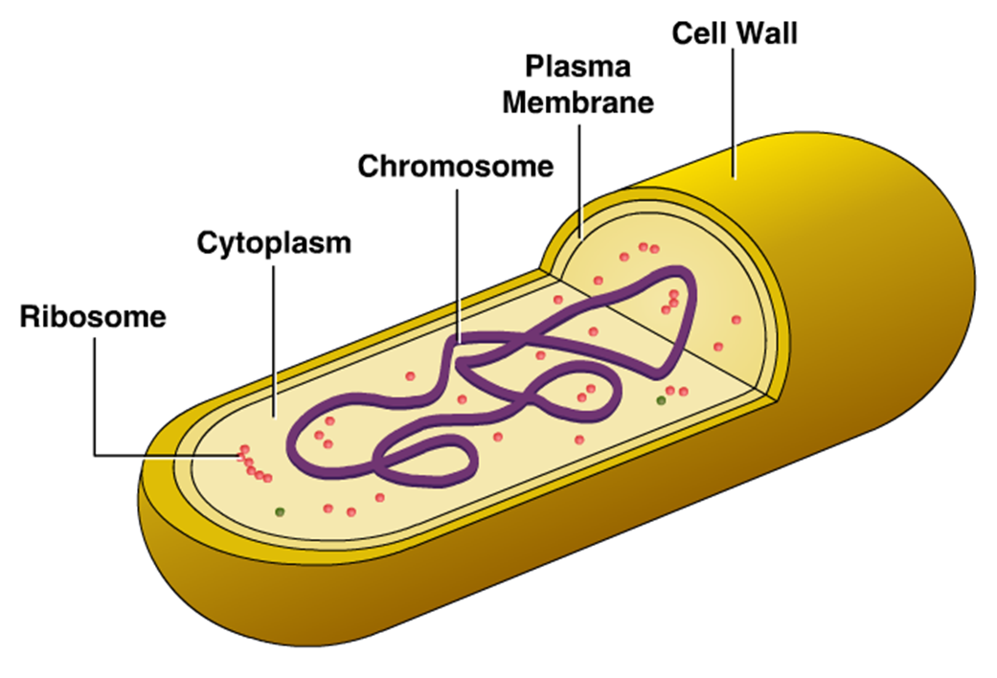

Slide 4
Ribosomes
Site of protein synthesis.
Composed of ribosomal RNA (rRNA) &
ribosomal proteins.
Sedimentation coefficient is 70S(30S,50S).

Slide 5
Mesosomes
These are convoluted bodies which develop by invagination of cytoplasmic memb into cytoplasm.
Mesosomes are of 2 types: lateral & Septal
Functions
-Primary site for respiratory enzymes.
-Increases surface area.
-This is analogous to mitochondria in eukaryotes.

Slide 6
Intracytoplasmic Inclusions
Intracytoplasmic inclusions can be gas vacuoles, crystals or storage bodies.
Bacteria often store reserve material in the
form of insoluble cytoplasmic granules.
Eg
Polysaccharide granules(glycogen or starch)
Metachromatic granules(inorganic phosphate)

Slide 7
Bacterial nucleus
Genetic information is contained in a single, circular,double stranded molecule of DNA(1 mm long).It appears in super coiled state.
Nuclear membrane & nucleolus are absent.
Bacterial chromosome is attached to mesosomes.

Slide 8
Capsule or Slime layer
Many bacteria possess protective,
gelatinous layer lying external to cell wall.
It is called as slime layer if it is loosely attached to the cell wall.
If firmly attached to the cell wall,it is called as Capsule. It is polysaccharide in nature.
Capsule can be demonstrated by Negative staining( India ink staining) & by Quellung reaction

Slide 9
Flagella
Motile bacteria possess filamentous appendages
k/n as Flagella(Organ of locomotion).
Arrangements of flagella
A)Monotrichous: Single polar flagellum eg Vibrio
B)lophotrichous: Tuft of flagella at one or both poles eg Spirilla.
C)Amphitrichous: Single flagella at both poles .
eg Alcaligens faecalis
D)Peritrichous: Flagella all over cell.eg Salmonella

Slide 11
Fimbriae or Pili
They are hair like microfibrils .More numerous than flagella.
Originate in cytoplasmic membrane.
Composed of protein Pilin.
Functions
Help in adhesion b/w bacteria & host cell.
Pili are specialized fimbriae that help in conjugation b/w two organisms.

Slide 12
Spores & sporulation
Spores are highly resistant ,metabolically dormant structures formed during unfavourable conditions.
Bacterial spores are called Endospores.
Endospores are highly resistant than vegetative cells to disinfectants, drying,heating.

Slide 13
Process of Sporulation
Spore develops from Forespore(Portion of protoplasm near one end of cell)
DNA replicate & divide into 2 halves
DNA incorporated into Forespore
Transverse septum develops from cytoplasmic

Slide 14
membrane that divides forespore from sporangium
forespore is completely encircled by doublelayered membrane
Inner layer becomes inner memb,outer layer becomes Spore coat .

Slide 15
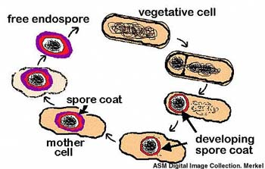
Process of sporulation

Slide 17
Types of spores

Slide 18
Spore Germination
When favorable conditions exist viz access to moisture & nutrients like amino acids,
sugar, the spores germinate.
Spores looses its heat resistance, refractality,
calcium dipicolinate ,takes up water & swells.
The germ cell appears by rupturing spore coat & elongates to form vegetative bacterium.

