Slide 1
Culture Media & culture tecniques

Slide 2
Culture media
Basic constituents of culture media are:
a)Agar:
Obtained from seaweeds.
Long chain polysaccharide.
No nutritive value.
Melts at 98 C & sets at 42 C.
b)Peptone:
Complex mixture of partially digested proteins.
Important source of nutrition for bacteria.
c)Other ingredients:Water,sodium,chloride, electrolytes.

Slide 3
Types of culture Media
Based on consistency
a)Solid media
b)Semi solid
c)Liquid media
Based on Functional use
a)Simple media
b)Complex media
c)Special media-Enriched media, Enrichment media, Selective media
Indicator media,Transport media.

Slide 4
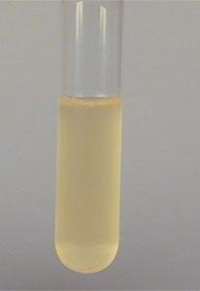
Types of Culture Media
Solid culture media: Provide isolated colonies.Eg Blood agar.2% agar is used
Semi solid culture media: Prepared by reducing conc of agar to 0.5%.Used for testing motility of bacteria.
Liquid culture media :Sensitive for isolation of small number of microbes.No agar present.

Slide 10
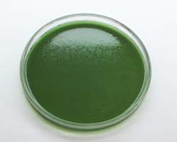
Selective media
Solid media that contains substances which support growth of desired bacteria while inhibit growth of other
unwanted bacteria.
Eg:TCBS media selective for Vibrio

Slide 11
Differential media
This media distinguish one bacteria from another by difference in growth characteristics. Eg MacConkey agar differentiates b/w lactose fermenters & non lactose fermenter.

Slide 13
Transport media
Are used to maintain viability of certain delicate organisms in specimens during transport to laboratory.Eg
Alkaline peptone water for Vibrio
Stuart’s Transport media for Gonococci

Slide 14
Culture techniques

Slide 15
Methods of Aerobic culture
Streak culture
Lawn culture
Pour plate culture
Stroke culture
Stab culture

Slide 16
Methods of culture
1)Streak culture(Surface plating)
Method routinely employed for obtaining discrete colonies of bacteria.
Done using platinum or nichrome wire loop with 2-4 mm diameter.

Slide 17
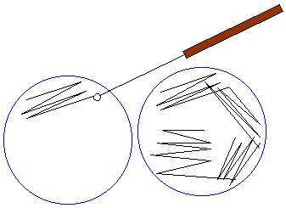
Procedure:
1)Loop is sterilized.
2)Loopful of inoculum is placed near
peripheral area on plate & smeared to form a well.
3)Loop is resterilized & parallel streaks are drawn from well spreading the inoculum thinly over plate in different segments of plate .Plate is then incubated.

Slide 18
2)Lawn culture
Provides uniform surface growth of bacteria
Used for antibiotic sensitivity testing
Used for bacteriophage typing.
Used when large amount of bacterial growth is required for preparing vaccines,antigens

Slide 19
Procedure
Prepared by flooding surface of solid culture plate with suspension of bacteria & incubating the plate.
Alternately the solid culture plate may be
inoculated by sterile swab soaked in bacterial suspension.

Slide 20
3)Pour plate culture
Used to determine viable counts in liquids viz: water,urine
Procedure
1)Prepare sample dilutions.
2)Place aliquot of diluted sample in empty
sterile plate
3)Pour in 15 ml of melted agar,swirl to mix well.

Slide 21
4)Let agar solidify & incubate the plate.

Slide 22
4)Stroke culture
Done in tubes containing agar slopes.
Used for providing pure growth of bacteria for slide agglutination & other tests.

Slide 23
5)Stab culture
Used for maintaining stock cultures.
Used for demonstration of gelatin liquefaction of bacteria.
Procedure
Carried out by stabbing the medium in tubes
with long straight wire & incubate.

Slide 24
6)Liquid culture
Done in liquid medium contained in tubes, flasks or bottles.
Used for blood culture, sterility tests where concentration of bacteria is small.
Procedure
Medium is inoculated by touching with charged
loop or by adding inoculum with pipette or
syringe & incubating.

