Slide 1
Specimen Collection, Processing & Identification of Bacteria
BDS 2ND YR
DATE:30/1/17
Dr.Nitika Anand

Slide 2
Specimen collection & Processing
Specimen collection depends on type of clinical illness.
Instructions for specimen collection:
Ideally collect specimen before start of antimicrobial therapy.
Follow strict aseptic technique during collection.

Slide 3
Collect specimen in sterile,easy to open ,leak proof container.
Label specimens properly.
Collect specimens in adequate quantities.
Process specimen immediately .If delay is inevitable,refrigerate the sample.
Transport specimen in suitable transport media.

Slide 4
Identification of bacteria
Once a bacterium has been obtained in pure culture,it can be identified by :
-STAINING METHODS
-MOTILITY TEST
-CULTURAL CHARACTERISTICS
-BIOCHEMICAL PROPERTIES
-TYPING OF BACTERIA
-SEROLOGICAL TESTS
-MOLECULAR METHODS

Slide 5
STAINING METHODS
1)Gram’s stain: Size,shape & arrangement of bacteria can be determined.It divides bacteria into:
Gram positive & Gram negative

Slide 6
Procedure of Gram staining
Bacterial smear is first stained with para-rosanaline dye like crystal violet, it is then treated with iodine solution that act as Mordant.Next it is washed with decolorizer eg. alcohol or acetone & finally stained with dye of contrasting colour eg. safranine.

Slide 7
Principle of Gram staining
Both gram positive & negative bacteria take up violet colour with crystal voilet.After treatment with decolorizer,gram positive bacteria retain this dye & violet colour while gram negative loose the dye and then take up counter stain & appear pink in colour.The mechanism behind gram reaction may be attributed to following:

Slide 8
a)Protoplasmic pH theory
Gram positive bacteria have a more acidic protoplasm thus retaining basic primary dye more strongly than gram negative bacteria.

Slide 9
b)Cell wall permaebility theory
Crystal voilet & iodine forms insoluble dye iodine complex(CV-I) in both gram positive & negative bacteria .During decolorization CVIcomplex is retained in gram positive bacteria owing to thick peptidoglycan layer while in gram negative bacteria the decolourizer (alcohol) solubilze lipid outermemb in gram negative bacteria thus producing pores in its cell wall through which CVI complex is washed away.

Slide 10
2)Ziehl –Neelsen stain: Divides bacteria into
Acid fast & non Acid fast.
3)Albert’s stain: For identification of Corynebacterium diphtheriae that produce metachromatic granules.
4)Silver Impregnation technique: For staining thin bacteria eg spirochaetes.
5)Negative staining: For demonstration of bacterial capsule.

Slide 11
Negative staining
Albert staining
Acid fast staining

Slide 12
Motility Test
To demonstrate motility in bacteria. Various methods are :
a)Hanging drop motility test
b)Flagellar staining
c)Demonstration of motility in semisolid medium(Mannitol motility agar medium)

Slide 13
Cultural charactertistics
1)shape: circular,irregular,rhizoid.
2)Size in millimeters
3)Elevation: elavated,convex,flat
4)Texture:smooth,wavy,rough,granular.
5)Margins:entire,undulate,crenated,curled
6)Pigment production,Hemolysis.
7)transluscent,transparent
8)Emulsifiability:easily emulsifiable or not.
In liquid medium: degree of growth, turbidity,presence of deposit are noted

Slide 14
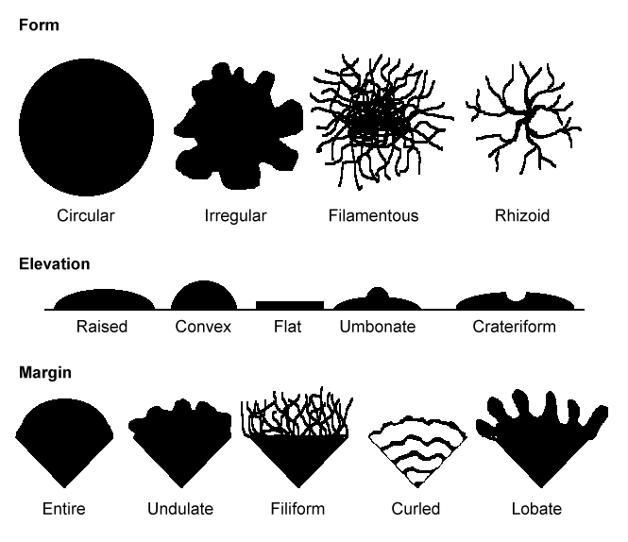

Slide 15
Biochemical Properties
Following cultures,biochemical tests are done to identify bacteria based on their ability to use substrates & ferment sugars.Common tests are
Sugar fermentation test
Indole production, Methyl red test
Urease test
Citrate utilisation test
Catalase test,Coagulase test
Oxidase test

Slide 16
Typing of Bacteria
The process of differentiating strains based on their phenotypic and genotypic differences is known as 'typing‘.It is following types:
Phage typing: Detects difference in susceptibility to phages.
Biotyping: Detects difference in biochemical properties.
Serotyping: Detects difference in surface antigens.
Bacteriocin typing: Detects susceptibility to antibacterials(bacteriocins) produced by strains.

Slide 17
IMMUNOLOGICAL TESTS
Involve detection of either Antigen or Antibody
Detection of Antigen involves use of specific Antibody.Eg Ezyme immunoassays
Antibody detection is done when microbial antigen is not present in routine specimens or if not easily detectable. Eg Flocculation test.

Slide 18
Molecular Methods
Molecular methods are modern methods of
diagnosis which are rapid,highly specific and sensitive.eg
Polymerase chain reaction(PCR)
DNA probing

