Slide 1
Bacterial genetics and PCR

Slide 2
Gene: it is a segment of DNA that specifies a particular polypeptide chain.
Extrachromosomal genetic elements: only in bacteria
Plasmids: small, circular autonomously replicating & can confer additional properties like drug resistance, toxigenecity, bacteriocin production
Episomes: plasmid DNA integrated in host cell genome.
F’ plasmid: plasmids that code for production of sex pilus.
Two types: self transmissible or conjugative and non self transmissible or non conjugative.

Slide 3
Genetic variations
Phenotype variations: characteristics expressed by a cell in a given environment. Ex: β galacosidase enzyme is only produced by E-coli when grown in a media containing lactose otherwise not – LAC OPERON THEORY.
B. Genotypic variations: stable, heritable & not influenced by environment.
Mutation: random, undirected, heritable variation caused by alteration in nucleotide sequence.

Slide 4
Methods of gene transfer from external source
Transformation: Acquisition of naked DNA by a bacterium from its environment and its incorporation in its genome. Occurs in closely related bacterial strains.
Griffith’s experiment in 1928:

Slide 5
Killed capsulated pneumococci--------------->mice alive.
Capsulated live pneumcococci ---------------->mice died
Live non-capsulated pneumococci + heat killed capsulated pneumococci ---------->mice died
Live capsulated pneumococci
isolated from blood of mice
Heat killed capsulated pneumococci ---------------------------->mice alive
Inject in mice
Inject in mice
Inject in mice

Slide 6
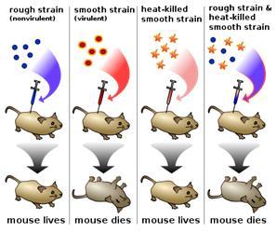

Slide 7
Transduction: Transfer of a portion of DNA from one bacterium to another by a bacteriophage.
Two types: (a) Generalized transduction: when it involves any segment of DNA at random.
(b) Restricted transduction: When a specific bacteriophage transduces only a particular genetic trait.
Role: Not only chrosomal DNA but episomes, plasmids may also be transfused. Eg. Penicillin resistance in staphylococci is due to tranafer of plasmids from one bacterium to another

Slide 8
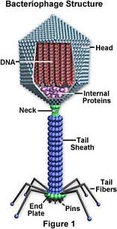
Bacteriophages are viruses that parasitize bacteria and multiply in it.
It has two types of cycle.
(i) Virulent or Lytic cycle and (ii) Temperate or Lysogenic cycle.

Slide 9
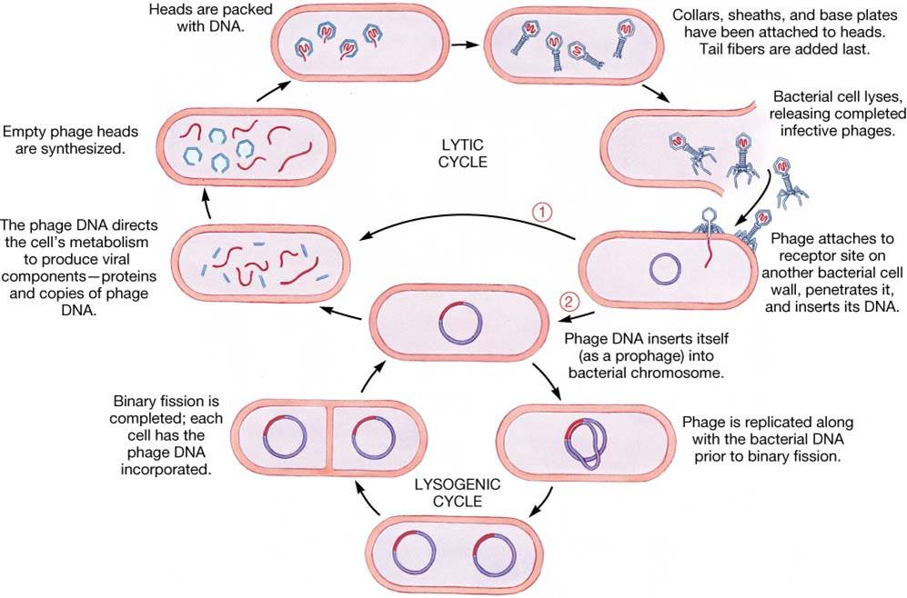

Slide 10
3. Lysogenic conversion: Phage DNA itself becomes the new genetic element and confers additional characteristics to the bacterial cell like toxigenecity, drug resistance eg. β phage of diphtheria bacillus confers toxigenecity – PHAGE CONVERSION

Slide 11
conjugation: Process by which a donor bacterium makes physical contact with a recipient and transfer genetic elements into it.
R plasmid or R factor:
- Resistance Transfer factor+Resistant determinants
(RTF for conjugal transfer) + (r for drug resistance)
If RTF + r present together: self transmissible
If only r present: non self transmissible plasmid then resistance transferred by bacteriophages

Slide 12
CONJUGATION

Slide 13
Antibiotic resistance
Mutational: antibiotic resistance develops due to decreased permeability, or development of alternative pathways, or development of inactivating enzymes. Usually single drug resistance develops – Low level resistance.
Plasmid mediated: Transferable and multi drug resistance develops – High level resistance

Slide 14
Polymerase chain reaction (PCR)
Principle:
Primer mediated temperature dependant technique
Enzymatic amplification of a specific target sequence of DNA to such an extent that it can be detected.
Ingredients needed:
Specific target DNA
Short strands of DNA called primers
Heat resistant polymerase (Taq polymerase)
Nucleotides for making DNA

Slide 15
Steps of PCR (cycles)
Denaturation: heat at 95ºC – bonds that hold the two strands of DNA together are broken.
Annealing (hybridise)of primers: temperature is reduced to 50-60ºC – primers attach to both 3’ end of target strip.
3. Primer extension: at 72ºC Polymerase enzyme triggers the formation and extension of new strand of DNA.
After 30 such cycles 1 copy of DNA forms 1million copies that can be easily detected by gel electrophoresis.

Slide 16
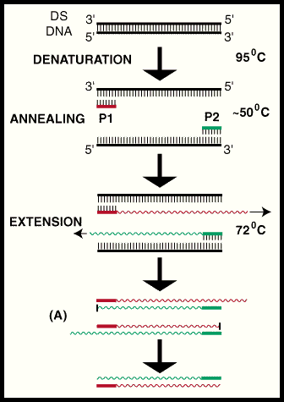

Slide 17
Applications – diagnosis of infections
Virus: HIV, Hepatitis V., Herpes V., Rota V., and several others. (RNA viruses detected by reverse transcriptase PCR like for HIV)
Bacteria: Mycobacterium tuberculosis, Mycoplasma, Helicobacter, Streptococcus etc.
Fungi: Candida, Cryptococcus, Pneumocystis carinii, etc.
Protozoa: Toxoplasma, Plasmodium, etc.

Slide 18
DNA probes
Def: they are single strand of DNA of 20-25 nucleotides conjugated with easily detectable markers like radio active isotopes, or enzymes.
Use: to identify complementary DNA strand in sample that may in solution or fixed to solid support.
Use:
Bacteria: M.tuberculosis, Mycoplasma, Legionella
Virus: HIV, Herpes, Hepatitis

Slide 19
Genetic engineering or Recombinant DNA technology
Method:
Isolate gene coding for desired protein -->introduce it into suitable microorganism in which it is functional---------> obtain the required protein.
Use:
Hormone production: Insulin, Growth hormone
Vaccine production: Hepatitis B, HIV
Interferon production, Factor VIII, Erythropoetin.

Slide 20
Transposable genetic elements / Transposons / Jumping genes
Small (4-25kb) DNA sequences that cannot replicate on its own but can move from one plasmid to another or to DNA or to phage DNA or vise versa.
DNA with gene in the centre and the two ends carrying inverted repeat sequence.
They form single stranded loop and double stranded stem
GENE
REPEAT SEQUENCE

