Slide 1
Antigen-Antibody Reactions- I
Non-labelled antibody.

Slide 2
Definition: antigen combines with its specific antibody in an observable manner in presence of electrolytes, suitable temperature & pH.
Uses:
In Vivo(In the body):
Antibody mediated immunity against infectious diseases
Cause tissue injury in some hypersensitivity reactions and autoimmune diseases
In Vitro(In the lab):
For diagnosis of infections
Detection & quantitation of non infectious agents like enzymes, hormones etc

Slide 3
Characteristics:
Reaction is specific, however cross reactions may occur due to antigenic similarity
Entire molecule of Ag & Ab react and not the fragments
Only surface Ags participate in the reaction
Reaction is firm but reversible. Firmness depends on
Affinity: intensity of attraction between Ag & Ab
Avidity: strength of bond
No denaturation of Ag or Ab
Ag &Ab can combine in varying proportions. Ag is usually polyvalent, whereas Abs are bivalent except IgM which is pentavelent

Slide 4
Antibody titre: Highest dilution of serum which gives an observable reaction with the antigen

Slide 5
Types of antigen-antibody reactions
(Non labelled antibody tests)
Precipitation Reactions:
Precipitation: When a soluble antigen reacts with its antibody in the presence of electrolytes at optimal temperature & pH, if the Ag-Ab complex thus formed becomes too large to stay in solution and forms an insoluble precipitate and sediments at the bottom of test tube.
If the complex fails to settle & remains suspended as floccules the reaction is called Flocculation.

Slide 6
Mechanism of precipitation
Marrak 1934 – LATTICE HYPOTHESIS (Prozone phenomenon)
Antigen-polyvalent, antibody bivalent
When optimal concentration of Ag & Ab i.e. zone of Equivalence
Large lattice is formed which settles down as precipitate
Zone of Ab excess – valencies of antigen are taken up by several antibodies ----> no lattice formation
Zone of Ag excess – valencies of Ab are fully satisfied -----------> no lattice formation
This Lattice hypothesis is true for Agglutination reactions also

Slide 7
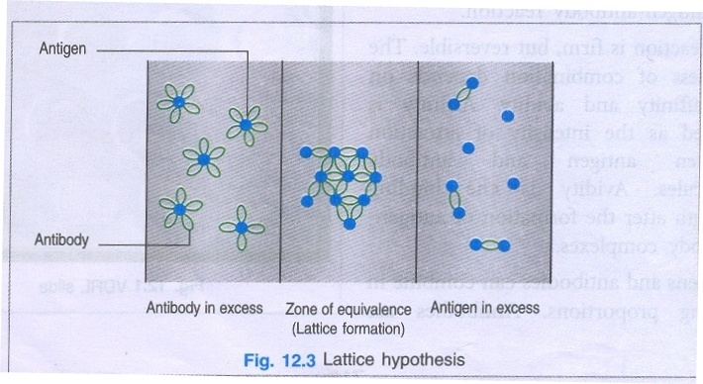

Slide 8
Application of precipitation reactions
Can be done for both quantitative & qualitative determination of Ag and Ab
More sensitive for Ag detection than Ab detection
Uses:
Lancefield’s grouping of Streptococci
Antibody detection VDRL & RPR for Syphilis
Identification of blood and seminal stains, food adulterants, C-reactive protein (CRP)
To standardise toxins and antitoxins

Slide 9
B. Agglutination
Def: If a particulate antigen combines with its antibody in presence of electrolytes, at optimal temperature and pH, resulting in visible clumping of particles.
Particulate Ag: Ag present over the surface of a cell/RBC/ bacterium/latex beads etc.
More sensitive than precipitation reactions in which soluble Ag is used
Better with IgM than IgG
Principal: same as precipitation reaction

Slide 10
Types of agglutination reaction
Slide Agglutination:
Suspension of Ag in saline on a slide (unknown)
+
One drop of antiserum
CLUMPING (Positive) No Clumping(Negative)
(within seconds)
Eg. a. Blood Grouping
b. identification of bacterial strains

Slide 11
2. Tube Agglutination:
Used for quantitative determination of antibody titre
Fixed volume of particulate Ag suspension is added to equal volume of serially diluted serum in test tubes & incubated
Highest dilution of serum that gives positive agglutination is the antibody titre
Uses: a. WIDAL test for Typhoid fever
b. Brucella Agglutination test

Slide 12
Heterophile Agglutination test: Heterophile antibodies can react with micro-organisms or cells of unrelated species due to common antigenic sharing.
Ex. a. Weil Felix Reaction: some strains of Proteus are agglutinated by serum of patients of rickettsial infection
b. Paul Bunnel test – Sheep RBC agglutinated by sera of Infectious mononucleosis (caused by Epstein Barr virus)

Slide 13
4. Anti-globulin test (Coomb’s test) – to detect incomplete anti-Rh antibodies.
When sera containing incomplete anti-Rh Abs is mixed with corresponding Rh-positive erythrocytes, the incomplete antibodies coat the erythrocytes, but no agglutination occurs.
When such coated RBC’s are treated with antiglobulin or Coombs serum (rabbit antiserum against human IgG), the cells are agglutinated.
Two types of Coomb’s test-
Direct Coomb’s test- sensitization of RBC’s with Rh antibodies takes place in vivo (tested in neonatal or cord blood)
Indirect Coomb’s test – sensitization of RBC’s done in vitro (tested in maternal blood) used to detect free Rh antibodies

Slide 14
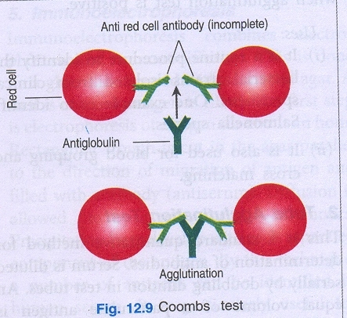

Slide 15
Passive agglutination test: Precipitation test can be converted to agglutination test by attaching soluble Ags to the surface of carrier particles like –
a. latex particles
b. RBC
c. Bentionite
Uses: Rheumatoid factor
C-reactive protein
Pregnancy tests
Abs is adsorbed on these particles and thus detect the Ags

Slide 16
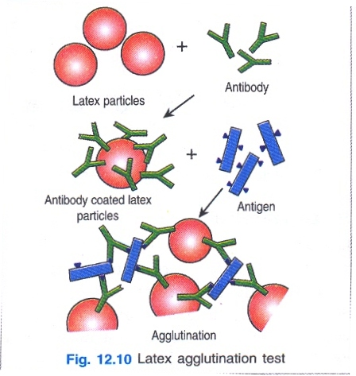

Slide 17
6. Co-agglutination: Fc portion of IgG molucule binds to proteinA of Staphyllococcus aureus (Cowan I strain) whereas the Fab terminal remains free.
When corresponding Ag is mixed with these coated cells, Fab terminal binds to antigen resulting in agglutination.
Uses:
Detection of bacterial antigens in blood, CSF, urine – Neisseria, Streptococcus pyogenes & Haemophyllus influenzae can be done

Slide 18
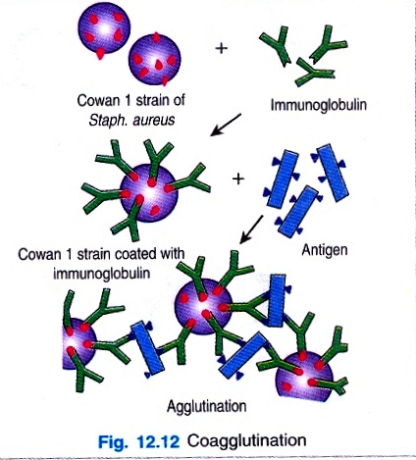

Slide 19
C. Complement fixation test
Definition: Ag-Ab complex has the ability to fix the complement
This fixation is detected by – sheep RBC coated by amboceptor (rabbit Ab to sheep RBC)
If complement is not fixed it will lyse these RBC’s coated with Abs

Slide 20
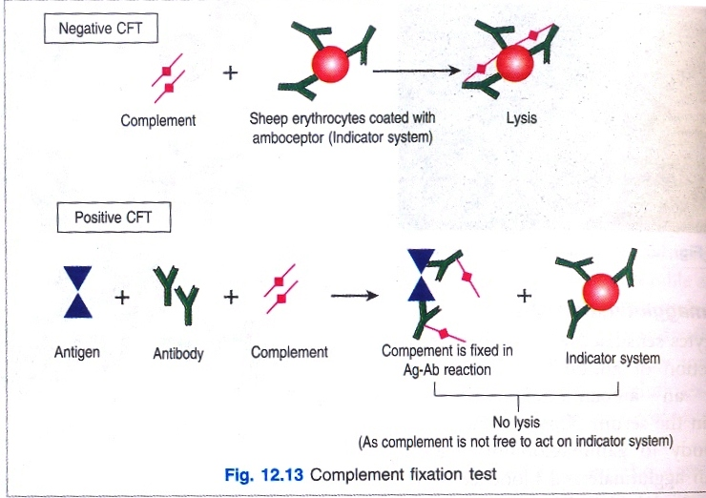
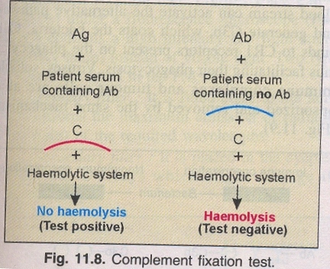

Slide 21
D. Neutralization tests
Def: Specific antibodies are able to neutralize the biological effect of toxin, viruses and enzymes.
Viral neutralization tests:
If Virus --->is inoculated in tissue ---> Growth &
culture/chick embryo multiplication
Virus + Neutralising Abs ----->No growth in tissue
(if present) culture/chick embryo
(POSITIVE)

Slide 22
Toxin neutralization tests: Bacterial exotoxins are highly antigenic & their activity may be completely neutralised by appropriate conc. of specific antibody.
This can be tested in
IN VIVO TESTS: tested in experimental animals.
-Toxigenecity tests of Corynebacterium diphtheriae
-Schick test
ii. IN VITRO TESTS:
Anti streptolysin O test (ASO test) for Streptococcus pyogenes
-Nagler reaction for Clostridium perfringens.

Slide 23
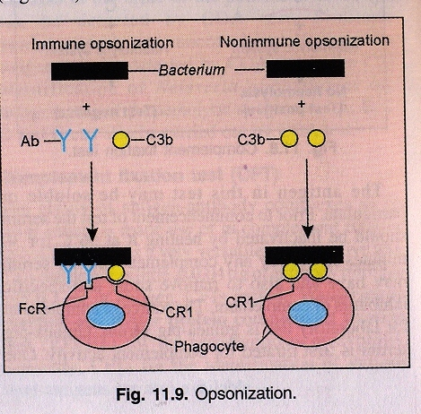
Opsonisation
Def: A substance such as complement or antibody that can bind to the surface of a cell or particle making it readily phagocytised is known as opsonisation.
Immune opsonisation: when opsonisation is with immune complex and complement together
Non immune opsonisation: when opsonisation only due to C3b of complement

