Slide 1
Labelled antibody assay
-Antibodies labelled with specific markers are used for detection of antigen and haptens
-Immunoassays are highly sensitive and can detect even picogram quantities of antigen

Slide 2
Types of immunoassay
Immunofluorescence: antibodies are labelled with fluorescence dyes
Enzyme linked immunosorbent assay(ELISA), and enzyme immunoassay(EIA): Abs labelled with enzyme
Radio immunoassay: Antibodies labelled with radio active substance like Iodine- I¹²⁵ or I¹³¹

Slide 3
Each assay can be –
Direct method – single step procedure where specific label is directly coupled to the Ab which is employed to detect the Ag
Indirect method – two step procedure (more commonly used), to detect antibody.
Step I – reaction between known Ag and its specific Ab is allowed for formation of Ag-Ab complex
Step II – second labelled Ab directed against the immunoglobulin component of the Ag-Ab complex is mixed.
If 1st antibody is of human origin
2nd labelled Ab – anti human globulin
Indirect method is more sensitive and cost effective as one labelled antibody reagent can be used for several Ags.

Slide 4
1. Immunofluorescence (IF)
Principle: Fluorescence is the property of certain dyes which absorb light in the ultra-violet wave length region (200-400nm) and a wavelength of light in the visible region (500-600nm) is emitted.
Such fluorescence dyes such as fluorescein, lissamine and rhodamine can be tagged with antibody molecules and made visible under UV in the fluorescent microscope. This is the basis of immunological test called immunofluorescence.
Dyes used - FITC: green fluorescence, Rhodamine: red/orange

Slide 5
Direct immunofluorescence –to detect antigen
Blood film/ smear from clinical specimen/ tissue section is fixed on glass slide with 95%ethanol
Add FITC/Rhodamine conjugated specific Abs
Incubate at 37ºCfor ½ hour
Wash to remove excess antibodies not conjugated
with Ag
Examine under Fluorescent microscope
Use: to detect Herpes virus in CSF, Rabies virus in brain smear

Slide 6
Indirect immunofluorescence – to detect antibody in patient serum
Smear known Ag on glass slide
Place patient’s serum over in which may contain Abs and incubate for ½ hour
Wash to remove excess unconjugated Abs
Add FITC tagged antiglobulin and incubate for ½ hour
Wash to remove all unbound fluorescent conjugate
Examine under fluorescent microscope
Uses: a. To detect Abs against Treponema pallidum, Herpes, Rabies in serum

Slide 7
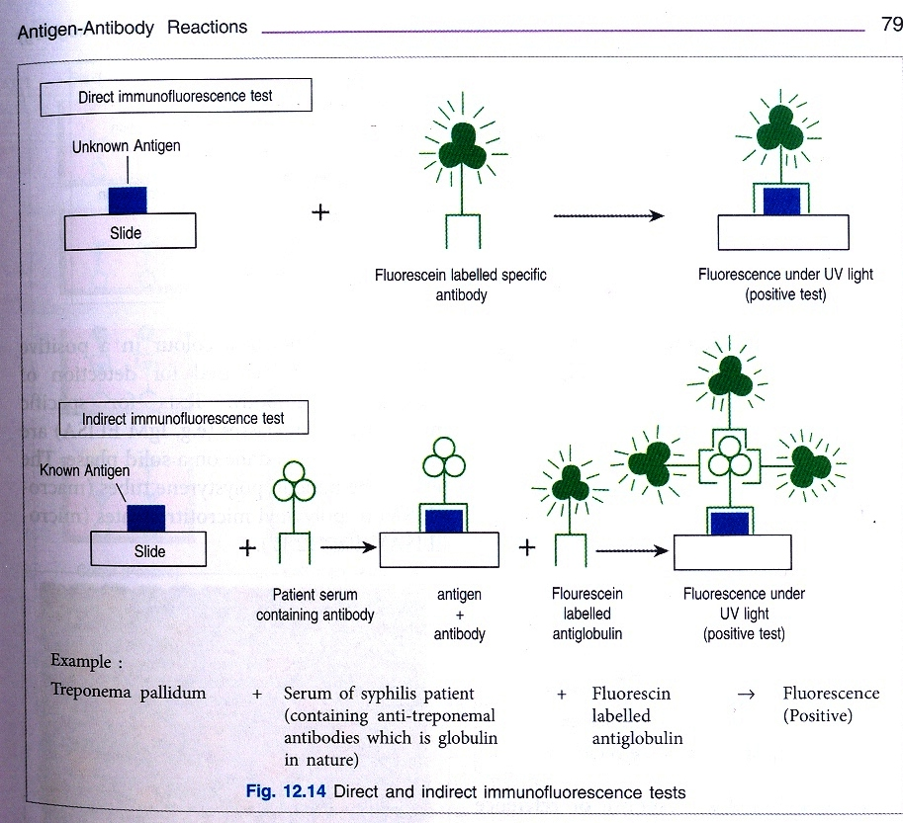

Slide 8
Enzyme Linked Immunosorbent Assay(ELISA) or Enzyme Immuno Assay (EIA)
Principal: the test is done on solid phase and performed as a direct or indirect assay depending on whether the enzyme is conjugated to primary or secondary antibody and used in detection of Ag or Ab.

Slide 9
Enzyme used – Horse radish peroxidase,
Alkaline phosphatase
Substrate – H₂O₂ + chromogen – for peroxidase,
O-phenyl phosphate + chromgen – alkaline phosphatase
Detection – formation of yellow-orange colored end product if Ag-Ab reaction takes place
Measured by – Spectrophotometry on ELISA Reader wave length 492nm
Test performed in – 96 wells Microtitre plates or tubes (Polysterene wells)

Slide 10
Types of ELISA
A. Indirect ELISA:
Wells are first coated with purified Ag or synthetic peptides
Add patient’s serum and incubate
Wash the wells
Add enzyme labelled goat antihuman immunoglobulin
Incubate and wash
If Ag-Ab complex is present, peroxidase conjugate shall bind and remain in well, any free fraction is removed by washing
Add substrate, if enzyme present ------>substrate broken down ----------> colored end product
IF NO ANTIBODY NO COLOUR

Slide 11
B. Competitive ELISA: Unlabelled human Ab from patient serum and labelled human Ab compete for the same antigen binding site.
If antibody present in serum – No color or reduced color produce.

Slide 12
C. Sandwich ELISA – For detection of antigen.
Antibody-antigen-antibody sandwich produced
Two types
(i) Single-antibody or Direct sandwich ELISA: Known (1st) Ab is attached to solid phase------> add patient’s serum which may contain Ag------> Wash-------> add the (2nd) conjugated antibody which will react with Ag held by the Ab-------> Add substrate ---> Color produced
(ii) Double-antibody or Indirect sandwich ELISA: here 2nd antibody of sandwich must be from a different species than solid phase Ab and the 3rd Ab is conjugated with enzyme.

Slide 13
Uses: -HIV antigens and antibodies in serum -Abs against Hepatitiis B, Hepatitis C -Mycobacterium tubercolosis antibodies in serum, -Entamoeba histolytica antigens in faeces - Haemophilus influenzae and Streptococcal antigens in CSF

Slide 14
Microtitre plate
Uses: -HIV antigens and antibodies in serum -Abs against Hepatitiis B, Hepatitis C -Mycobacterium tubercolosis antibodies in serum, -Entamoeba histolytica antigens in faeces - Haemophilus influenzae and Streptococcal antigens in CSF

Slide 15
Radio immuno assay (RIA) – very sensitive and specific & can measure analytes upto picograms
Principle: RIA is based on the competition of radio labelled known antigen and unlabelled unknown antigen for limited binding sites for known specific Abs in solution or attached to tube (solid phase).
Labelling done with ¹²⁵I
After Ag-Ab reaction the Ag is separated into free and bound fractions and their radioactivity determined
Conc. Of unlabelled Ag from specimen is calculated from the ratio of bound and total labels and compared with the reference curve.
Uses: measure serum proteins, hormones, tumour markers, drugs, insulin.

Slide 17
Western blot
Protein antigens are separated by electrophoresis in gel according to their motility and molecular weight are blotted on nitrocellulose paper
Add patient serum
If antibodies present they will attach to antigens
Detected by enzyme tagged antihuman globulin and its substrate
Substrate changes color and permanently stains nitrocellulose paper
Position of the band indicates the antigen to which antibody has reacted
Uses: HIV detection of antibodies

Slide 18
Adjuvants
Adjuvants are compounds that potentiate the immune response when mixed and administered with antigens.
They contribute to greater and more prolonged antibody production and increased effector cell counts.
They act in several ways:
They alter the distribution & persistence of Ags within the host.
They stimulate lymphocytes nonspecifically.
They activate macrophages.

Slide 19
Examples of adjuvant
Incomplete Freund’s adjuvant:
aluminium hydroxide or phosphate
+
aqueous solution of antigen
When emulsified in light mineral oil so that tiny water droplets containing Ag are dispersed throughout the oil.
The emulsion forms a depot of Ag in the tissues from which small quantities of antigen is released slowly sometimes for a year or more.
Complete Freund’s adjuvant: Killed Bordetella pertusis or killed mycobacteria along with the above.

Slide 20
Immuno electron microscopy
Virus in specimen can be detected by treating it with specific antisera
Clumping of viral particles can be seen under electron microscope
Use: Rota virus in faeces

Slide 21
Capsular swelling
When pneumoccus is treated with specific antisera there is swelling of the capsule. This is known as Quellung reaction

Slide 22
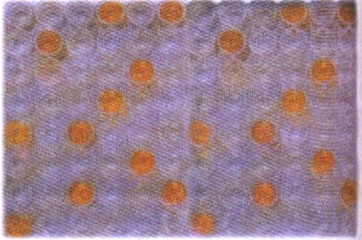

Slide 25
