Slide 1
HYPERSENSITIVITY REACTIONS

Slide 2
Definition : Abnormal immune response which produces physiological or histopathological damage
Tissue damage
Disease
Death
Allergy (altered response) Von Pirquet 1966:
Increased resistance – immunity
Increased susceptibility – hypersensitivity
Antigen – allergen or sensitiser

Slide 3
Difference between immediate and delayed hypersensitivities
 | FEATURES | IMMEDIATE | DELAYED
1 | Type | I, II & III | IV
2 | Onset &duration | Minutes to hours | Days
3 | Immune response | Antibody mediated | Cell mediated
4 | Passive transfer | Possible with serum | Not with serum, with transfer factor
5 | Desensitisation | Easy but short lived | Difficult but long lasting
6 | Induction | Antigen or hapten entry by any route | By injection of antigen intradermally or by skin contact or by Fruend’s adjuvant
7 | Route of sensitization | Any route | Intradermal

Slide 4
COOMBS AND GEL (1963) classification:
Type I: Anaphylaxis – Ig E or reagin antibody mediated
Type II: Cytotoxic – Antibody mediated
Type III: Immune complex (Ag –Ab complex) mediated
Type IV: Delayed or Cell mediated
Type V: Stimulatory hypersensitivity

Slide 5
Type I – Anaphylaxis (1902) –Theobald Smith
Ana –without, phylaxis –protection
Also known as immediate hypersensitivity reaction
Duration – ½ hour – 8 hrs
Tested on guinea pig using egg protein
1st dose (sensitising dose)----------->injected into guinea pig--------------> No adverse effect
2nd dose(shocking dose) ---->injected after 2-3 weeks ----> Shock & death (Anaphylactic shock)

Slide 6
Mechanism of anaphylaxis
Cells involved : (a) Mast cells present in submucosa of GIT, respiratory tract, skin &vascular endothelium and (b) Basophils of blood
Antibody involved : IgE or reagnic antibodies possessing specific complimentary on mast cells/basophils

Slide 7
Steps involved :
Individual must first come in contact with an antigen and produce IgE antibody to that Ag (may be role of some genetic factor)
IgE gets fixed to mast cells & basophils which have high affinity receptors for Fc portion of IgE
Upon re-exposure to the sensitising Ag the IgE molecules on the mast cell surface become cross linked thus activating the mast cells
Mast cells activation leads to release of intracellular granules containing potent mediators of inflammation

Slide 8
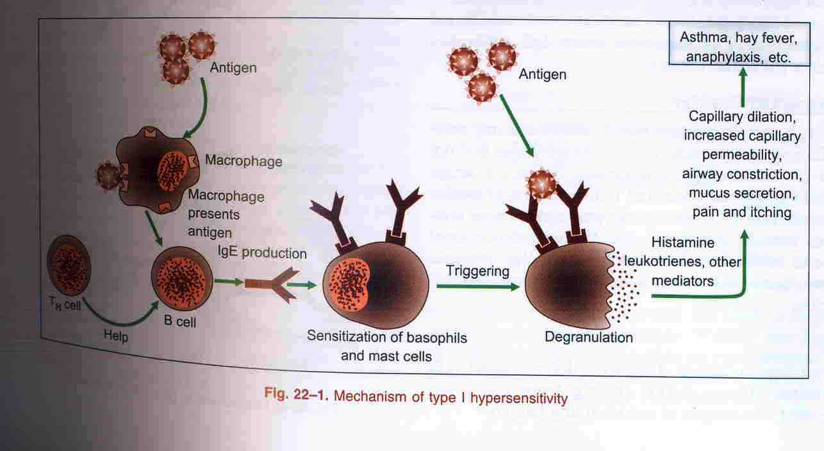

Slide 10
Mediators
A. Primary or pre formed mediators (present in mast cells & basophils):
Histamine – increase vasopermeability, bronchoconstriction
Heparin – complex with proteases, anticoagulant
Eosinophil chemotactic factor
Tryptase & Chymase digestion of basement membrane
B. Secondary or membrane derived mediators (formed de novo after cell activation)
Prostaglandin D2 –increase vasopermeability, bronchoconstriction
Leucotrienes C4, D4, E4 – increase vasopermeability, bronchoconstriction
Platelet activating factor – platelet aggregation, increase vasopermeability, bronchoconstriction

Slide 11
DETECTION –
Ag is injected intradermally & wheal & flare response is seen within 15-20 minutes known as cutaneous anaphylaxis

Slide 12
EXAMPLES
1. Prausnitz & Kustner (P-K) and Passive cutaneous anaphylactic (PCA) Reactions –
P-K Reaction: Kustner was allergic to cooked fish ------> Kustner’s serum was injected intracutaneously to nonallergic Prausnitz ------> 24 hrs later Prausnitz injected with extract of cooked fish I/C in same place, he developed wheal & flare reaction within 20 mins.
------->Indicates normal individual has been passively sensitised by immuglobulin from allergic individual
2. Schultz-Dale Reaction(Anaphylaxis in vitro):
Sensitised uterine muscle suspended in ringer solution contracts vigorously when comes in contact with A

Slide 13
3. Atopy( a strange disease): it is an IgE dependent allergy from unknown exposure to an antigen or autocoupling hapten. These can be
Inhalant allergy- asthma or hay fever, Food allergy- cutaneous eruptions or GIT disorders , Injectant allergy or Drug allergy
4. Miscellaneous
Anaphylactoid reaction – like anaphylactic reaction

Slide 14
Desensitisation(Immunotherapy): inject very small doses of the allergen repeatedly over a long period in increasing dose
IgE consumed IgG(blocking antibodies) produced
OR
Ts cells block IgE production by B cells

Slide 15
TYPE II OR CYTOTOXIC HYPERSENSITIVITY
MECHANISM:
IgG or IgM antibody directed against cell surface components cause damage to, or lysis of, the affected cell
Damage is either complement mediated or through opsonisation of the antibody coated cell by killer cell through ADCC mechanism

Slide 16
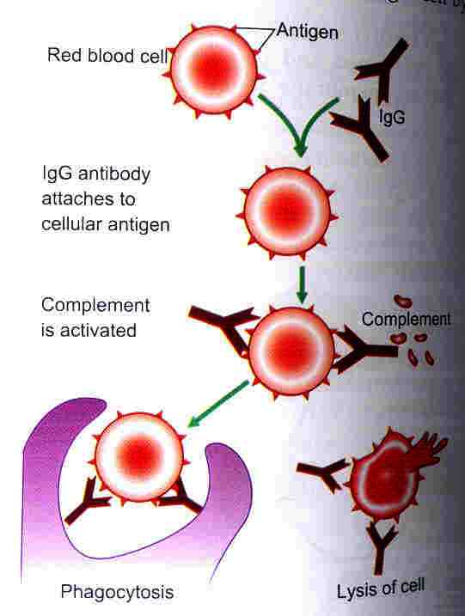

Slide 18
EXAMPLES
Haemolytic disease of new born or Erythroblastosis fetalis or Hydrops fetalis
Drug induced haemolytic anaemia – Penicillin, Methyl-dopa attach to surface of RBC
Autoimmune haemolytic anaemia, thrombocytopenia, aggranulocytosis
Anaemia due to some infectious diseases eg. Salmonella, Mycobacteria – bacterial endotoxin coats the patients RBC’s --->attracts IgG/IgM ----------->lysis

