Slide 1
HYPERSENSITIVITY REACTIONS

Slide 2
TYPE III OR IMMUNE COMPLEX HYPERSENSITIV ITY REACTION
MECHANISM:
Deposition of immune complexes (Ag-Ab complex)on tissue basement membrane
Complement is bound and activated through classical pathway
Leads to release of anaphylatoxins like C3a &C5a
These induce basophils to release histamine & increase vascular permeability
Polymorphs bind to immune complex through Fc and C3b receptors and phagocytize the immune complex ------>release lysosomal enzymes -------------->causing damage to the basement membrane

Slide 3
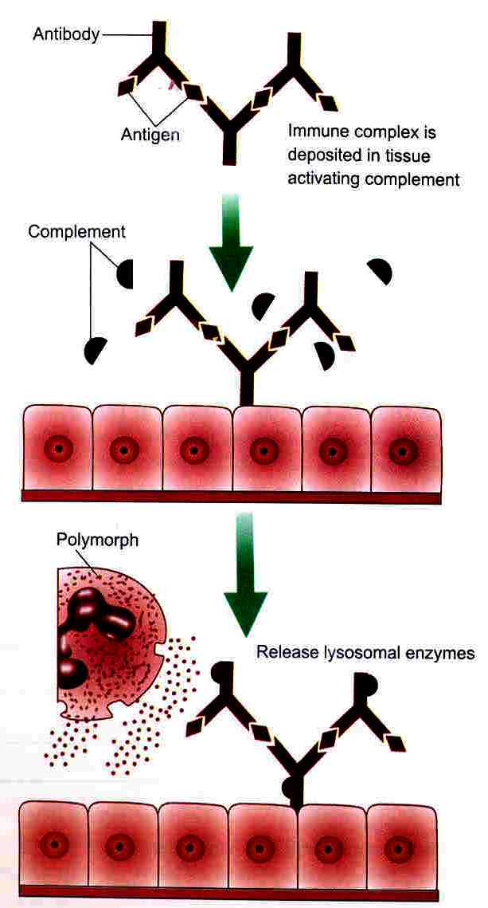
MECHANISM

Slide 7
FACTORS INFUENCING IMMUNE COMPLEX DEPOSITION
Size of complex
Local vascular permeability
Certain favoured sites like renal glomerulus, choroid plexus, skin.

Slide 8
EXAMPLES
ARTHUS REACTION (Local anaphylaxis) in 1903
SERUM SICKNESS OR SYSTEMIC IMMUNE COMPLEX DISEASE

Slide 9
Mechanism: Serum sickness – single injection of a high concentration of horse antitoxin against tetanus, gas gangrene etc.
7-12 days later Abs to horse Ags appear while horse Ags are still persisting since large dose was administered
Initially these complexes were formed in antigen excess, so these soluble (small) complexes circulated and get deposited in various sites particularly skin, joints, kidney, heart causing complement mediated damage to the lining
Later when plasma level of antibody increases large Ag-Ab complexes formed which got phagocytised
SELF LIMITING DISEASE

Slide 10
Immune complex diseases
Auto Immune diseases:
Systemic Lupus Erythematosus (SLE)
Rheumatoid artheritis
Goodpasture’s syndrome
Drug reaction like allergy to sulphonamide
Infectious diseases
Poststreptococcal glomerulonephritis
Meningitis
Hepatitis
Malaria
mononucleosis

Slide 11
TYPE IV OR CELL MEDIATED OR DELAYED HYPERSENSITIVITY REACTION
Mediated by sensitised T cells and macrophages not by antibodies.
Appears after hrs or days of primary contact with Ag and lasts for several days.
Reaction is characterized by large influxes of inflammatory cells, macrophages, T lymphocytes.
Passive transfer not by transfer of serum but by transfer factor or by sensitised T lymphocytes

Slide 12
MECHANISM of DTH
Primary contact with Ag ---->sensitization of 1-2 weeks ----->TH1 subtypes CD4 cells activated. (Several APC’c like Langerhan’s cells & macrophages pick up the Ag that enters through the skin & transport it to regional LN’s present Ag bound to MHC II alleles and T cells are activated).
On subsequent exposure – sensitized T cells secrete several cytokines and activate macrophages and nonspecific inflammatory cells and result into granuloma formation.

Slide 13
MECHANISM

Slide 15
TYPES
1. TUBERCULINE (Infection) TYPE:
Robert Koch injected 1-3 units of tubercular protein PPD to sensitised individual ------->24-48 hrs later developed erythema & induration which showed infilteration by T lymphocytes (80%) & macrophages (20%)
Seen in infections like tuberculosis, brucellosis, protozoal & fungal infections.
MECHANISM: Sensitised T lymphocytes become activated upon re-exposure to Ag and release lymphokines like macrophage activating factor.

Slide 17
2. CONTACT DERMATITIS TYPE:
Contact of skin with drugs, chemicals in sensitised individuals------> macules, papules or weeping eczemas are produced infiltered by mononuclear cells
MECHANISM: Substances are haptens (nonantigenic) +skin protein become antigenic
DETECTION: by Patch test

Slide 19
TYPE V OR STIMULATORY HYPERSENSITIVITY
Certain autoantibodies IgG stimulate the target cells rather than inhibition or killing.
Normally – TSH ---->acts on thyroid gland and activates adenyl cyclase ----->converts ATP to cAMP and releases thyroid hormones.
If Long acting thyroid stimulating autoantibodies (LATS)formed ------->they attach to thyroid cell receptor and stimulates the cell like TSH --------------->increases thyroxine secretion ---->producing excessive secretion of thyroid hormone -----GRAVES DISEASE or THYROTOXICOSIS
TSH level: , Thyroid hormones level (T3 &T4):

