Slide 1
Autoimmune disorders
BDS 2nd year
Date:27/3/17
Dr.Nitika Anand

Slide 2
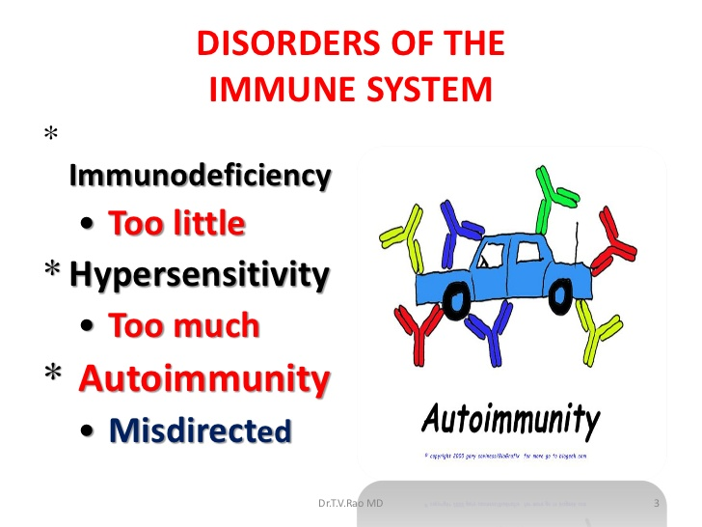

Slide 3
Autoimmunity is a condition in which body produces autoantibodies & immunocompetent cells against the normal components of the body.
Referred to as “Injury to self”.
Autoimmunity leads to structural or functional damage to tissues.

Slide 4
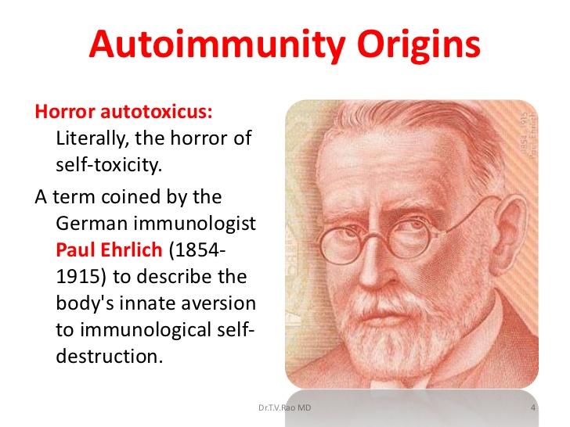

Slide 5
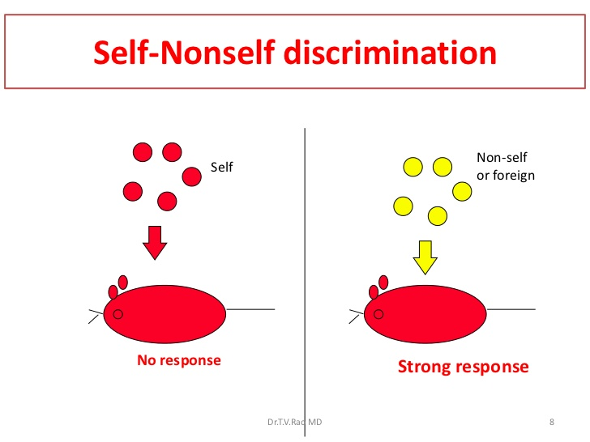

Slide 6
IMMUNOLOGICAL TOLERANCE
This is condition in which contact with antigen specifically abolish mounting of Immune response against it when it is administered subsequently.

Slide 7
Types of immunological tolerance
a)Tolerance to Self antigen:
Normally body do not mount immune response
against self antigen known as Self tolerance.
When immune response is mounted against Self
antigen,autoimmune disease develop.
b) Tolerance to non self antigen:
A condition where a non self antigen induces a state of unresponsiveness to itself.

Slide 8
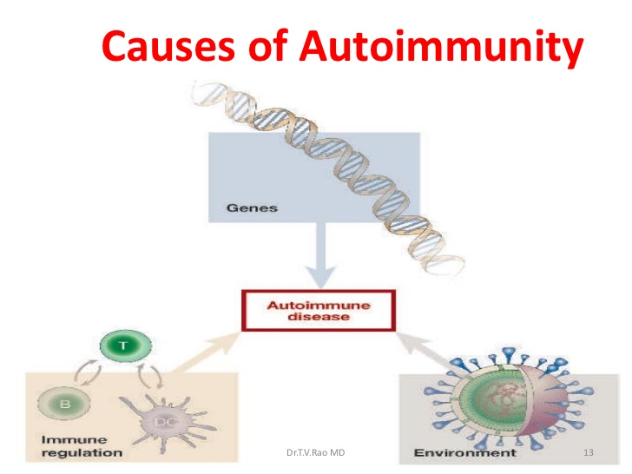

Slide 9
Mechanisms of autoimmunity
1)Hidden or sequestered Antigens:
Certain antigens are present in closed system & are not accessible to immune apparatus.Therefore,they not recognised as Self Ag.
When these antigens are released into circulation due to trauma etc,they invoke immune response.
Eg: -eye lens protein enclosed in its capsule.
-sperm antigens that develop during puberty .

Slide 10
2)Antigen alteration:
Cells or tissues may undergo antigenic alteration as a result of Physical(irradiation), chemical(drugs) or biological effects (viruses, bacterial enzymes). Such altered ‘neoantigens’ may elicit immune response.

Slide 11
3)Breakdown of immunological homeostasis
During embryonic life, clones of cells having immunological reactivity with self antigens are eliminated.
Such clones are called forbidden clones. Their persistence or development in later life due to mutation can lead to autoimmunity.

Slide 12
4)Cross reacting Foreign antigens(Molecular mimicry):
Sharing of antigens by different organisms is
the basis of “cross reacting antigen theory”
of autoimmunity.
Eg Streptococcus M protein & heart muscle share antigenic similarity. Immune response induced by repeated Streptococcal infection can damage the heart.

Slide 13
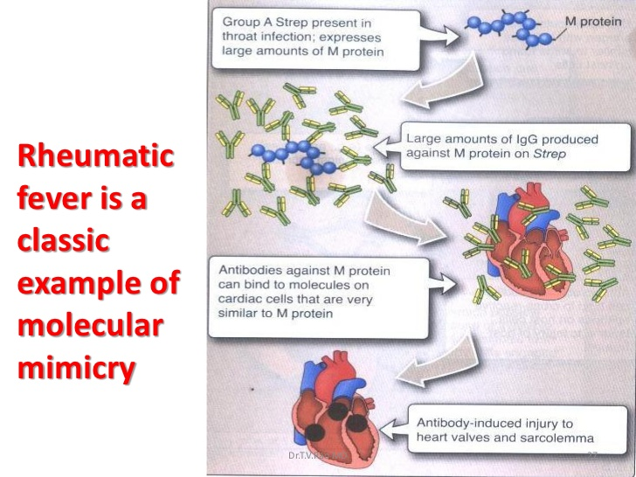

Slide 14
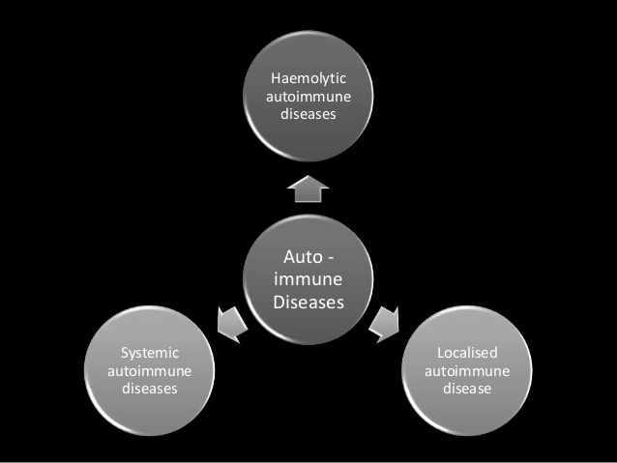
CCLASSIFICATION OF AUTOIMMUNE DISORDERS

Slide 15
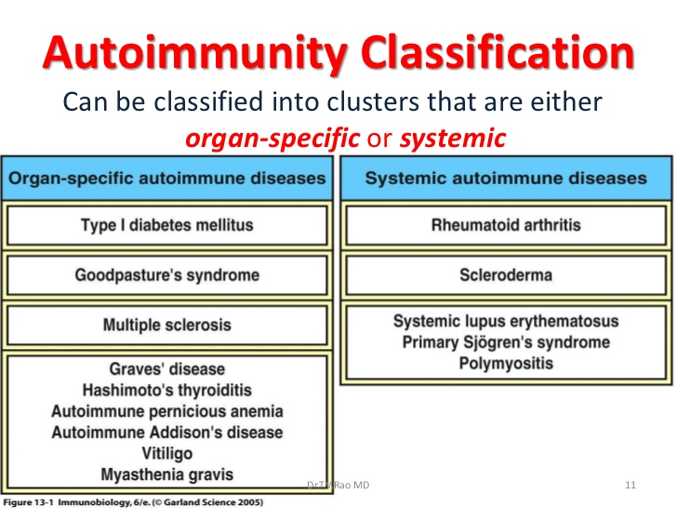

Slide 16
Autoimmune disorders of oral cavity

Slide 17
Oral lichen planus
Common mucocutaneous disease.
Condition can affect either skin,mucosa or both.
It affects adults older than 40 yrs although younger adults , children can be affected.
Etiology: It is T cell mediated autoimmune
Disease in which CD8 T cells triggers apoptosis of oral epithelial cells

Slide 18
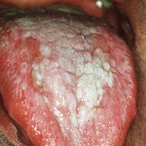

Slide 19
Oral manifestations:
It presents as bilateral white striations,
papules or plaques on buccal mucosa ,
Tongue,gingivae.
Lesions on buccal mucosa accompanies or
precedes the appearance of lesions on skin
& genital mucous membrane

Slide 20
Pemphigous vulgaris
This is an autoimmune , intraepithelial blistering disease affecting skin & mucous membrane.
Etiology: Disease is triggered by autoantibodies against keratinocyte cell surface.

Slide 21
Oral manifestations
It presents as ill defined, irregularly shaped erosions on gingiva , buccal mucosa that are painful & slow in healing.
Mucosal lesions may precede cutaneous lesions by months.

Slide 22

Pemphigous vulgaris frequently affects inner lining of mouth.
In this image, there is loss of top layer of skin of the lip.

Slide 23
Erythema multiforme
This is an acute self limiting dermatitis.
EM minor represents localized eruption of skin with mild mucosal involvement.
EM major & Stevens johnson syndrome(SJS) represents severe & life threatning mucosal & skin disease.

Slide 24
Etiology: Certain drugs & infectious agents can cause EM. EM minor is triggered by HSV , Mycoplasma infection. Sulfa drugs are common triggers.
Oral manifestations: Oral lesions in EM include macules,papule or vesicles on tongue,palate, buccal mucosa, gingiva that are painful.

Slide 25
In SJS ,oral lesions are severe & painful that
even mastication become impossible.Painful vesicles
appear on mucosa, lips and become ulcerated with bloody crusting.
Disease resembles acute necrotising ulcerative gingivostomatitis.

