Slide 1
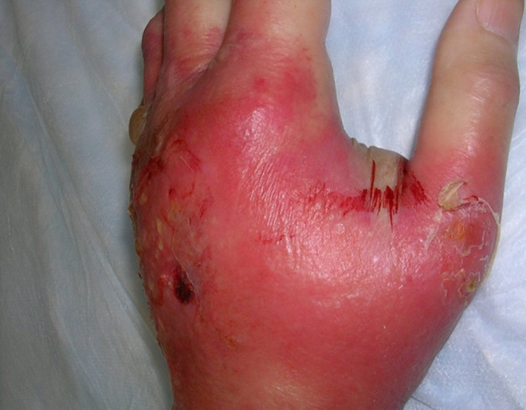
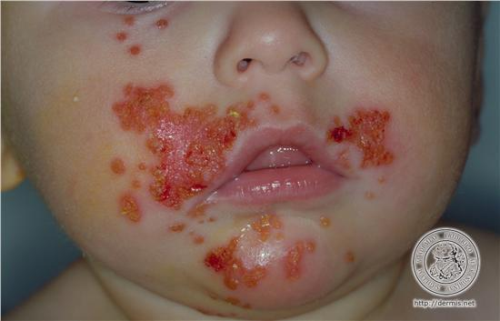
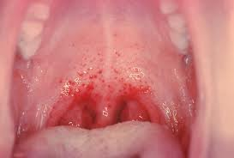
Genus Streptococcus
Gram positive cocci in chains

Slide 2
Streptococci (Classification)
O₂ requirement
Aerobic & facultative Obligate anaerobes
anaerobes eg.Peptostreptococcus
Hemolysis
Alpha hemolytic Beta-haemolytic Gamma hemolytic
(Viridans group) (Enterococcus group)
Classified Serological grouping Classified
into species (Carbohydrate C) into species
based on based on
physiological 20 Lancefield groups physiological
& biochemical (A to V except I &J) & biochemical
properties properties
Serological typing(M Protein)
Griffith types (1,2,3 etc. upto 80 types)

Slide 3
Alpha haemolytic: greenish discoloration around colonies detected on BA due to partial hemolysis. Eg. Viridans streptococci and Streptococcus pneumoniae.
Beta haemolysis: clear colorless zone of complete haemolysis. Eg: Streptococcus pyogenes.
Gamma hemolysis: non hemolytic

Slide 4
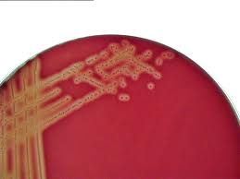
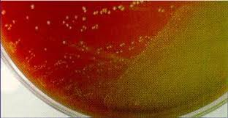
Beta and alpha haemolysis

Slide 5
Streptococcus pyogenes
(Group A streptococci)
Morphology: Gram positive cocci(GPC)
0.5-1.0µm in diameter arranged in chains due to the cocci dividing in one plane only & daughter cells failing to separate complete.
Some strains have protein capsule of hyaluronic acid.

Slide 6
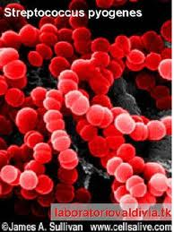
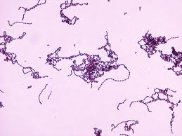
Gram’s stain and 3D image

Slide 7
Cultural characteristics:
Aerobes & facultative anaerobes.
Grows only on media containing blood, serum or glucose in 24 hours.
On BA: colonies are small, pin-point, semi-transparent, low convex with wide zone of β-haemolysis.
Selective medium -1:500,000 crystal violet BA
Liquid media – glucose broth. Growth occurs as granular turbidity with powdery deposit. Bacterial chains being heavier settle down as deposit.

Slide 8
Biochemical Reactions:
CATALASE negative, all staphylococcus are catalase positive.
Bacitracin sensitive.

Slide 9
Antigenic Structure:
Capsular Hyaluronic Acid- capsule inhibits phagocytosis
Group Specific Polysaccharide Antigen- 20 Lancefield groups (A toV except I&J)
Type Specific Antigen- Protein antigens(80 Griffith serotypes) further subdivided based on surface proteins into M,T &R.

Slide 10
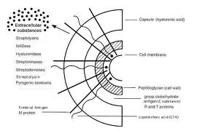

Slide 11
Toxins and Enzymes – contribute to virulence
Toxins: Exotoxins.
Haemolysins: 2 types of haemolysins produced.
Streptolysin ‘O’- Oxygen labile & heat labile, lyses RBC & cytotoxic for neutrophils &cardiac tissue. It is antigenic antistreptolysin’O’(ASO)appears in serum following streptococcal infection, titre >200 units.
Streptolysin ‘S’- Oxygen stable responsible for haemolysis around colonies on BA plate. Not antigenic.
ii. Pyrogenic toxin(Erythrogenic toxin) - Responsible for rash in Scarlet fever.

Slide 12
Enzymes:
Streptokinase(fibrinolysin): Promotes lysis of fibrin. Facilitates spread of infection by breaking down fibrin barrier.
Deoxyribonuclease (Streptodornase): liquify the highly viscous DNA and responsible for thin serous character of streptococcal pus.
Nicotinamide adenine dinucleotidase (NADase): leucotoxic.
Hyaluronidase: breaksdown hyaluronic acid & helps spread of infection in intracellular spaces

Slide 13
Pathogenesis
Organism | Area of involvement | Lesion
Str. Pyogenes: i. Pyogenic infections(Supp-urative infec-tions) | Respiratory tract | Acute tonsillitis or pharyngitis, scarlet fever
 | Skin infections | Wounds, burns and skin lesions, eczema, eryseplas, impetigo
 | Genital infections | Puerperal sepsis
 | Deep infections | Bone and joint infections, septicaemia, lymphadenitis,
ii. Non suppurative complications |  | Rheumatic fever and Acute Glomerulonephritis

Slide 14
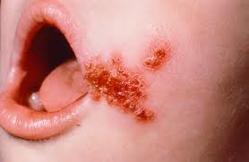
Pharyngitis and impetigo

Slide 15
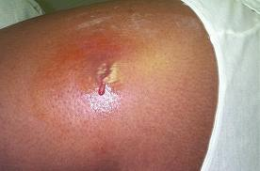
Cellulitis of the arm

Slide 16
Non-Suppurative Complications
Acute Rheumatic fever(ARF) – A disease involving the heart valves more commonly Mitral and Tricuspid valves.
Acute Glomerulonephritis(AGN)- disease of the glomerulus of kidney
These complications occur 1-4 weeks after the acute infection.
Str. pyogenes is no longer detectable when these complications set in.
ARF is preceded by sore throat and AGN usually by skin infection, sometimes also by throat infection.
Reason: probably common cross reacting antigen.

Slide 17
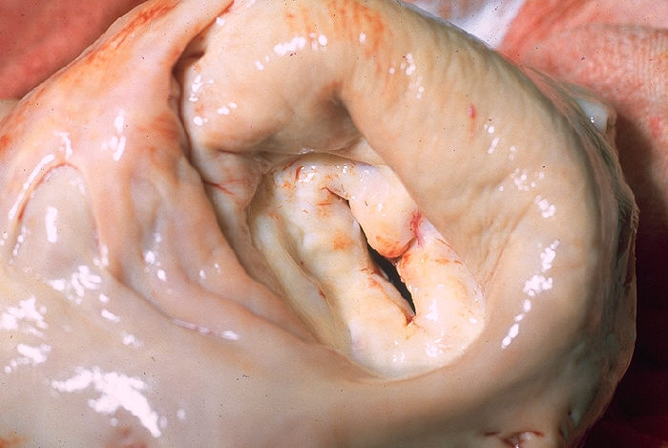
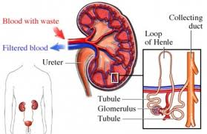
Mitral stenosis and AGN

Slide 18
Group A streptococcal infection of throat -----> antibodies produced ----> Abs cross react with myocardium and heart valves ------> complement component C3 &C5 activation and tissue destruction.
Streptococcal skin infection -----> Ab’s produced that cross react with components of glomerular basement membrane -----> comlement activation and tissue destruction.

Slide 19
Lab diagnosis
For pyogenic (Acute suppurative)infections: Streptococcus pyogenes can be isolated.
Specimen: pus, blood, CSF.
Collection & transport: collect aseptically and inoculate immediately OR transport in Pike’s transport medium.
Gram’s staining: GPC in chains
Culture: specimen is inoculated on blood agar medium and incubated at 37ºC for 18-24 hours.

Slide 20
e. Colony morphology and Staining:
On BA – Pin-point semitransparent colonies with wide zone of β-haemolysis.
Gram stain from colonies: GPC in chains.
Liquid medium(glucose broth): Granular turbidity with powdery deposit.
f. Biochemical Reactions: catalase negative
g. Identification:
Bacitracin sensitivity: more sensitive than other bacteria to bacitracin 1unit/ml
CAMP test negative – test positive for group B.
h. Lancefield grouping.

Slide 21
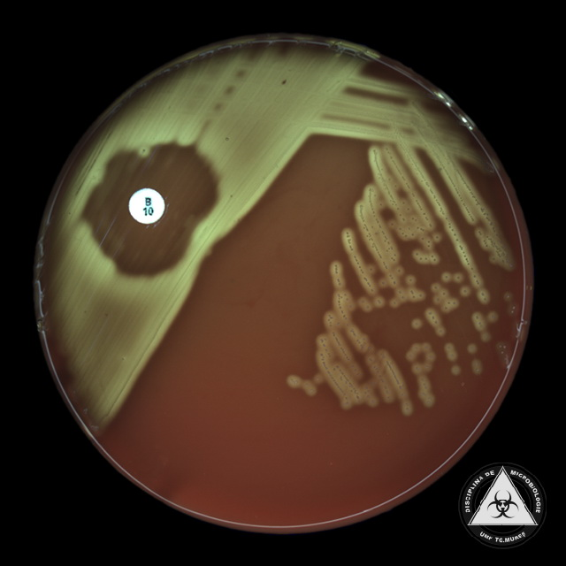
Bacitracin susceptibility

Slide 22
2. For Non suppurative complications-
Str. Pyogenes cannot be isolated
Antibody detection (Serology)provide retrospective evidence of streptococcal infection
Antistreptolysin O (ASO) test: a titre of >200 units is significant in ARF and indicates prior streptococcal infection.
ASO test is a toxin neutralisation test
For AGN antideoxyribonuclease B (anti-DNAase is more reliable. Titres > 300to350 is significant.

Slide 23
Treatment
Penicillin G is the drug of choice.
In patients allergic to penicillin erythromycin or cephalexin is used.
Vaccines are not available.

