Slide 1
Clostridium
Food Poisoning & Tetanus

Slide 2
Anaerobes : Bacteria that can survive in absence of oxygen only
Classification
Spore forming Non sporing
Anaerobes Anaerobes
Further classified as
based on based on morphology
disease produced and staining characters

Slide 3
Sporing forming anaerobes based on disease produced
Tetanus Clostridium tetani
Gas gangrene Clostridium perfringens
Clostridium septicum
Clostridium novyi
Food poisoning
Gastroenteritis Clostridium perfringens
Botulism Clostridium botulinum
D. Acute collitis Clostridium defficle

Slide 4
Non Sporing anaerobes – based on morphology and staining characters
Cocci –
Gram positive – Peptococcus, Peptostreptococcus, Sporosarcina
Gram negative – Veillonella
Bacilli –
Gram positive – Eubacterium, Lactobacillus, Bifidobacterium, Propionibacterium, Actinomyces, Mobiluncus
b. Gram negative – Bacteroides, Fusobacterium, Leptotrichia
Spirochaetes - Treponema, Borrelia

Slide 5
Genus Clostridium
Strict anaerobes
Spore forming Gram positive bacilli
Spores can be terminal or sub-terminal but are buldging i.e. bigger in diameter than the bacillary body
Pathogenecity is due to the exotoxins produced by the bacteria.

Slide 6
Clostridium tetanii
Causative agent of TETANUS
Spores widely distributed in soil, dust, dung & intestine of man &animals

Slide 7
Morphology
Gram positive slender bacillus 2-5um x 0.4-0.5 with spherical terminal spores giving the characteristic drumstick/tennis racket appearance
Motile by peritrichous flagella
Pleomorphic, old cultures are gram variable

Slide 8
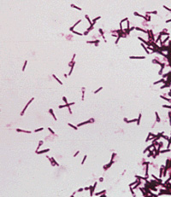
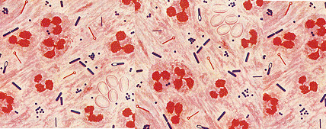
Gram stain
Gram stain of pus

Slide 9
Culture
Obligate anaerobes
Growth improved by addition of blood/serum
Grows well on Robertson cooked meat broth (RCM), thioglycollate broth
In RCM – meat is not digested but becomes black on prolonged incubation
On BA – bacilli produce a swarming growth (thin spreading film) with α-haemolytic colonies

Slide 10
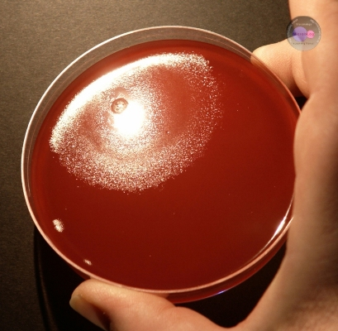
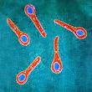
Swarming growth on blood agar & cl tetani with spores

Slide 11
PATHOGENECITY: TOXINS (PLASMID MEDIATED)
TOXIN 1----- TETANOSPASMIN
  Powerful neurotoxin
  Highly potent
  Protein and Heat labile
  Oxygen stable
  Destroyed by proteolytic enzymes
  Responsible for clinical manifestations
  Good antigen
  Can be toxoided
  Specifically neutralized by antitoxin

Slide 12
TOXIN 2- TETANOLYSIN
Heat and oxygen labile
Hemolysin
May act as leucotoxin but pathogenic role is unclear

Slide 13
PATHOGENESIS
Cl tetani has little invasive power
Wound is contaminated with spores of Cl tetani present in soil, dust faeces etc
Germination of spores & toxin production occurs only if favourable conditions exist like reduced O-R potential, devitalised tissues and foreign bodies

Slide 14
Toxin absorbed by motor nerve endings & transported to CNS intra-axonally
Toxin specifically blocks synaptic inhibition in spinal cord at inhibitory terminals that use glycine & GABA as neurotransmittor. Action resembles strychnine like effect
Leads to uncontrolled spread of impulses initiated anywhere – spasms & muscle rigidity due to spontaneous contraction of agonist & antagonist muscles

Slide 15
Tetanus
Local tetanus – persistent spasm of surrounding muscle. Prognosis – good.
Cephalic tetanus – Prognosis – very poor
Neonatal tetanus – infection originates from umbilical stump and progress to generalized tetanus. Mortality rate >90%
Generalised tetanus – most common, symptoms are:
Spasm of masseter muscles (trismus or lock jaw)
Sustained contraction of fascial muscles – Risus sardonicus
Persistant spasm of back muscles – opisthotonus (sustained contraction of agonistic & antagonistic muscles)

Slide 16
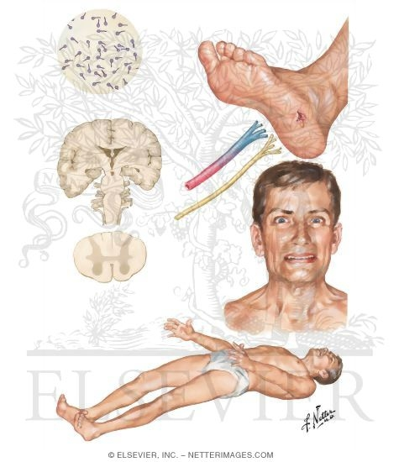

Slide 17
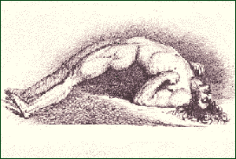
Opisthotonus

Slide 18
Prevention/Prophylaxis
Tetanus is a preventable disease
Active immunisation – tetanus toxoid – three doses 0.5ml, given I/M at interval of 4-6 weeks. Immunity lasts for 7-10 years as DPT.
Booster dose given after 5 years
Combined immunisation after injury – in emergency inject tetanus toxoid in one arm and 250 units of Human tetanus immuglobulin I/M in another arm.

Slide 19
Treatment
Debridement of wound – cleaning of wound
Penicillin drug of choice, if allergic then cephalosporins.
Patient placed in dark room

Slide 20
Lab diagnosis
Diagnosis made based on clinical presentation
Specimen – wound swab, exudate or tissue from wound
Gram’s staining – gram positive bacilli with drum stick appearance
Culture done on blood agar and aminoglycoside blood agar & incubated under anaerobic conditions – swarming growth
Culture on Robertson cooked meat medium

Slide 21
Animal inoculation – for demonstration of toxigenecity.
0.2ml of 2-4 days old culture of RCM injected in tail of two mouse(one test animal other control animal)
Contol injected 1000 units antitoxin an hour earlier
Positive case if test animal develops tail rigidity, stiffness of leg, trunk, fore limb & dies within 2 days

Slide 22
Clostridium botulinum
Paralytic disease presenting as food poisoning
Botulus – sausage in latin
Morphology : Gram positive bacilli, motile, produces subterminal oval bulging spores.
Produces highly potent exotoxin, it is neurotoxin
Symptoms appear after 12-36 hoursof ingestion of contaminated food vomitting, thirst, constipation, diplopia, dysphagia, dysarthria, ascending paralysis &respiratory faliure.

