Slide 1
Mycobacterium tuberculosis
Dr Divya Sahay

Slide 2
Genus Mycobacterium

Slide 3
Straight or slightly curved rods
Mycobacterium – fungus like bacteria
Hydrophobic due to thick waxy cell wall so difficulty to stain
But once stained with hot carbol fuchsin they resist decolorisation with dilute mineral acids and alcohol – Acid fast bacilli (AFB)

Slide 4
Classification
Mycobacteria causing human diseases –
Cultivable :
Tubercle bacilli (mammalian)
Human type - M. tuberculosis
Bovine type - M. bovis
Vole type - M. microti (Murine)
African type - M. africanum
Atypical mycobacteria
Photochromogens
Scotochromogens
Non-photochromogens
Rapid growers

Slide 5
Mycobacterium causing skin ulcers
M. ulcerans
M. balnei
Saprophytic mycobacteria
M. smegmatis
M. phlei
Non-cultivable
M. leprae

Slide 6
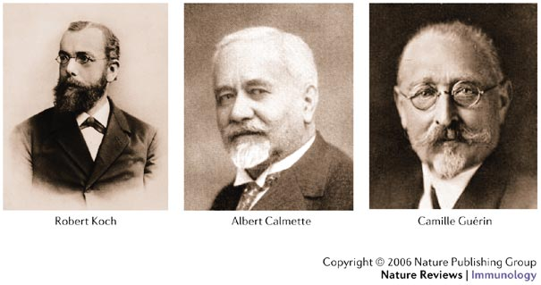
Mycobacterium tuberculosis (Tubercle bacilli)
Discovered by Robert Koch as causative agent of tuberculosis

Slide 7
Morphology
Slender slightly curved rods 1-4µm x 0.2-0.8µm
Acid & alcohol fast
Gram positive cell wall but does not get stained by Gram’s stain

Slide 8
Zeihl Neelsen or acid fast stain
Acid fast due to presence of mycolic acid in cell wall
Slender, straight or slightly curved rods
Stain bright red, tissue cells & other bacteria stain blue
In tissues or sputum smears bacilli have beaded or barred appearance

Slide 9
Fluorescent staining with auramine O, rhodamine
Yellow luminous bacilli under fluorescent microscope

Slide 11
Culture characteristics
Obligate aerobes
Slow growing, generation time 14-15 hours
Colonies appear in 2-3 weeks sometimes may take 6-8 weeks incubation at 37ºC
Grow only in media containing egg, asparagine, potatoes, serum & meat extract

Slide 12
Lowenstein Jensen (LJ) media
Selective media, growth occurs in 2-8 weeks
Contains whole egg, asparagine, mineral salts, malachite green and glycerol or sodium pyruvate
Solidified and sterilised as slants in screw capped bottles by inspissation
Malachite green – selective agent – inhibits growth of other organisms as well as provides contrast with colonies
Growth seen as dry, rough, buff coloured, raised with wrinkled surface – Rough, Buff & Tough
Tenacious & not easily emulsified

Slide 13
Other solid media
Dorset egg medium
Tarshis blood medium
Middlebrook medium – transparent medium

Slide 14
Growth on LJ medium

Slide 15
Liquid medium
Used for sensitivity testing, antigen production.
Virulent strains grow as serpentine cords
Glycerol broth
Dubos and Davis medium – contains Tween 80
Biochemical reactions:
Niacin test and nitrate reduction tests are positive.
Highly resistant due to waxy coat.

Slide 16
Pathogenesis
95% infection by inhalation of droplets coughed/sneezed by patient of pulmonary tuberculosis.
Human tuberculosis –
Primary tuberculosis
Post primary tuberculosis

Slide 17
Primary TB
Inhaled bacilli ----->Engulfed by alveolar macrophages survive and multiply & replicate to form the initial lesion ----- >GHON’s focus (a parenchymal sub pleural lesion formed in upper part of lower lobe or lower part of upper lobe
Some bacilli are transported by macrophages to hilar lymph nodes which get enlarged
Ghon’s focus + enlarged LN = PRIMARY COMPLEX
Bacilli may further spread by lymphatic and hematogenous dissemination to other organs and tissues

Slide 18
95% primary complex is asymptomatic and undergoes spontaneous healing by resolution fibrosis or calcification.
Bacilli in lesion slowly die.
Few may remain viable for several years

Slide 19
Pathogenesis of Primary TB
Mycobacteria multiply within naïve macrophages ------- >lyse the cell ----- >infect other macrophages ------ > within 10 days two types of antigen specific T cells are formed
CD4 Helper T cells ------- >secrete interferonϒ------- >activate macrophages to kill intracellular to kill mycobacteria called Epitheloid cells ------ >some of these fuse to form multinucleated GIANT cells.
b. CD8 suppressor T cells ------- > kill infected macrophages ------ >Caseating Granuloma ---------- > anoxia, acidosis --------- >kill mycobacteria ---------- >healing by calcification & fibrosis

Slide 20
Post primary or secondary TB
Caused by reactivation of primary lesion or by exogenous reinfection
Granuloma formation occurs in apex of lungs(60-70%) or disseminate to kidneys, meninges, bones
Large areas of tissue destruction and necrosis (caseation) – Tuberculoma
Proteases liberated by activated macrophages cause softening & liquefaction of caseous material and rupture into blood vessels and airways to reach other parts of body or released as aerosols in sputum/coughing (Open tuberculosis)

Slide 21
Caseous material after expulsion produce cavities – Cavitation
Healing is by fibrosis and calcification

Slide 23
Patient of pulmonary tuberculosis

Slide 24
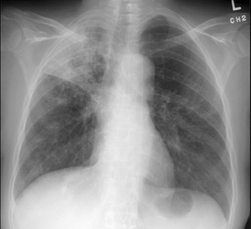
Macroscopic picture of lung & Radiographic view

Slide 25
Tuberculine test
Tuberculine test or Montoux test: It is Delayed or type IV hypersensitivity reaction shows previous exposure to tubercle protein.
- Not for lab diagnosis

Slide 26
Lab diagnosis
I. Routine investigations:
DLC: lymphocytosis
ESR: raised
Radiograph: cavitation or calcification
II. Confirmation requires staining and isolation of bacteria
Specimen:
Post Primary Pulmonary tuberculosis – sputum, early morning specimen for 3 consecutive days

Slide 27
Microscopy : Ziehl Neelsen staining. Acid fast bacilli seen. For microscopic detection 50,000-100,000 bacilli/ml is required
If less no. of organisms then Concentration of specimen is needed:
Petroff’s method: Equal volumes of sputum + 4%NaOH ---- >mix ----- >incubate at 37ºC for 30 mins ------- >centrifuge at 3000 rpm for 30 mins ------->discard supernatant, sediment is neutralise by adding 8% HCl in presence of phenol red indicator then used for smear preparation and culture
Result – Acid fast bacilli seen

Slide 28
Culture: may be positive with10-100 bacilli/ml
Concentrated sputum is inoculated in 2 LJ slopes
Media incubated at 37ºC for 6-8 weeks and examined weekly - rough, buff & tough colonies & confirm with Niacin test and nitrate reduction test positive.
Nucleic acid techniques: By PCR 10-1000 bacilli can be detected

Slide 29
Treatment -chemotherapy
Domiciliary treatment with Antitubercular drugs (ATT)
Primary drugs:
(R) Rifampicin
(H) Isoniazide
(Z) Pyrazinamide
(S) Streptomycin
(E) Ethambutol
(T) Thiacetazone
PAS
bacteriocidal
bacteriiostatic

Slide 30
Multi drug regimn given given to avoid development of drug resistance – combination of 3-4 drugs
DOTS: Directly observed therapy short course
New cases HRZE thrice a week for 2 months followed by HZ thrice a week for 4-5months
Default cases and extra pulmonary tuberculosis SHRZE thrice a week for 2 months followed by HZ for 4-5 months

Slide 31
MDR-TB: multi drug resistant tuberculosis such cases are resistant to many of the primary drugs – A MAJOR PROBLEM
Due to patients taking incomplete treatment – organism develops resistance to the primary drugs
2nd line drugs: cycloserine, capreomycin, aminoglycoside, quinolones, macrolides, Ofloxacin - Expensive treatment

