Slide 1
Salmonella, Shigella

Slide 2
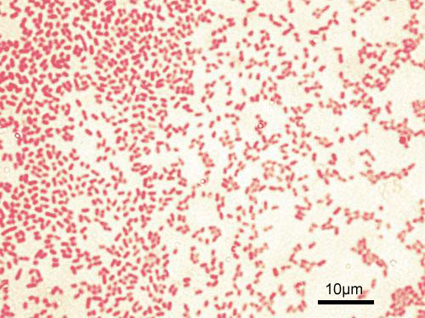
Genus Salmonella
GNB, Non lactose fermenting pale colonies on MacConkey agar

Slide 3
Primary intestinal parasite
Causes :
Enteric fever (Typhoid fever by Salmonella typhi and paratyphoid fever caused by Salmonella paratyphi A, B and C )
Gasteroenteritis or food poisoning
Septicaemia

Slide 4
Selective media for fecal specimen
Deoxycholate citrate agar (DCA) –2-3mm colorless transluscent colonies
Xylose lysine deoxycholate (XLD)agar – red colonies with black centres due to H₂S production
Wilson & Blair Bismuth sulphite agar (BSA) – 2-3mm jet black colonies with metalic sheen due to H₂S production, sulphite rduced to sulphide

Slide 5
Gram staining and growth on MA and XLD

Slide 6
Growth on DCA and BSA

Slide 7
Enrichment medium for fecal specimen
Selenite F broth
Tetrathionate broth

Slide 8
Antigenic structure
Flagellar H antigen – strong immunogenic,on agglutination with antisera produces large fluffy clumps, heat labile, found in two forms phase 1&2
Somatic O antigen – lipopolysaccharide endotoxin, less immunogenic than H, heat stable, agglutinates with antisera, is of 60 different types

Slide 9
Virulence Vi antigen – heat labile and covers O antigen, destroyed by heating at 60ºCfor 1hour
Classification : based on identification of O and H antigens – Kauffmann White Scheme

Slide 10
Pathogenesis
IP – 7-10 days
Infection by ingestion of contaminated food & water, feco-oral route
Source of infection - case or carrier
Convalscent person excrete organism in faeces & urine for 3-12 weeks
Chronic carriers- organisms present in gall bladder & shed in faeces intermittently

Slide 11
Enteric fever
Organisms enter by feco-oral route ---- >reach GIT ------ > engulfment by polymorphs & lymphocytes and multiply within these cells and reach messentric lymph nodes -------> lymphatics & cells burst ------->reach thoracic duct ------->reach blood ( Primary bacterarmia) 10-14 days ------> invade liver, spleen, gall bladder, bone marrow & intestine & multiply -------> re enter blood (Secondary bacteraemia) intense & severe producing fever 20-40 days -----> invade Payer’s patchin intestine TYPHOID ULCERS

Slide 12
Lab diagnosis
Isolation and identification of causative agent from of patient blood, faeces, urine, bone marrow, bile, CSF
Demonstration of circulating antigens
Demonstration of antibodies in patient serum

Slide 13
Demonstration of antibody in patient serum
Widal test : Agglutination test to detect
(i) H & O antibodies against S. typhi (TH &TO)
(ii) H antibodies against S. paratyphi A & B (AH &BH)

Slide 14
Prophylaxis- vaccines
Parenteral :
a. Killed whole cell vaccine – heat killed, phenol preserved whole cell vaccine
2 doses of 0.5ml each intramuscular injection at interval of 4-6 weeks, booster dose every 3 years
b. Vaccine of purified antigen – under trial
B. Oral vaccine : Live avirulent mutant strain of S. typhi, three doses given on alternate days. Available as enteric coated capsules
Carriers : NOT TO HANDLE FOOD

Slide 15
TREATMENT
Earlier Chloramphenicol was the drug of choice but produced plasmid mediated drug resistance and had side effects like aplastic anaemia
Quinolones : Ciprofloxacin, Norfloxacin, Ofloxacin
3rd generation Cephalosporins : Cefotaxime, Cefoperazone, Ceftriaxone
Cholecystectomy for carriers

Slide 16
Genus: Shigella
Causes Bacillary dysentry

Slide 17
Pseudomonas
Pseudomonas are large group of aerobic non-sporing, GNB, motile by polar flagella
Some of them causes human infections typically opportunistic.

Slide 18
Cultural Characteristics:
- Strict aerobe.
-Grows well on ordinary media producing
large, opaque irregular colonies with fruity or earthy odour.
On nutrient agar: Colonies are smooth, transluscent, convex with sweet aromatic odour. It produces water soluble pigment pyocyanin(bluish green) which diffuses into the medium.
Biochemical tests: Oxidase positive , catalase positive.

Slide 19
Pigments Produced
1) Pyocyanin: It is bluish green pigment soluble in chloroform and water. This pigment is diagnostic of Ps.aerugonosa as it is not produced by other species.
2) Pyoverdin/Fluorescine: Greenish yellow pigment insoluble in chloroform and water.
3) Pyorubin: Reddish brown pigment.
4) Pyomelanin: Brown to black pigment

Slide 20
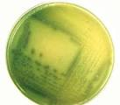

Slide 22
Oxidase test

Slide 23
Commonly caused infections are:
UTI following cathaterization.
Acute purulent meningitis following lumbar
Puncture
Respiratory infection in deblitated persons.
Septicemia in immunocompromised patients
Nosocomial infections
Wound and burn infections
Chronic otitis media
Eye infections

Slide 24
Treatment
Highly resistant against several antibiotics
Carbapenams, Cephalosporins, Quinolones, Tobramycin, Clindamycin can be given.

