Slide 1
Actinomyces and Nocardia
BDS 2nd yr
Date:29/5/17
Dr.Nitika Anand

Slide 2
Actinomycetes
Gram positive filamentous bacteria.
Intermediate in properties between true bacteria and fungi.
Contain two genera : Actinomyces and Nocardia

Slide 3
Genus : Actinomyces
Disease : Actinomycosis
Chronic granulomatous disease characterised by multiple abscess, tissue destruction, fibrosis &multiple sinus formation discharging pus as granules (sulphur + bacteria)
Species: Actinomyces israelii – most common
A. naeslundi
A. odontolyticum associated with plaque
A.viscosus

Slide 5
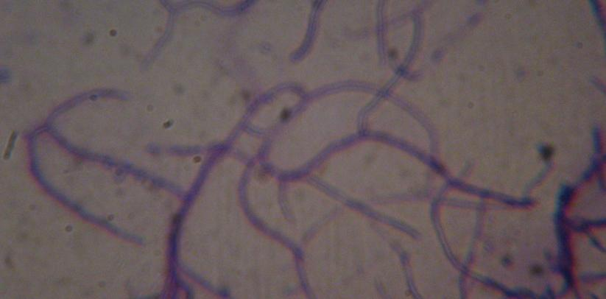
Morphology
Are gram positive, non sporing, non motile, non acid fast bacilli.
Grow in filaments.

Slide 6
Culture characteristics
Are facultative anaerobes,grow better under anaerobic or microaerophilic conditions.
Grows well on BHI agar.The colonies have a characteristic molar tooth appearance.

Slide 8
Clinical syndromes
Actinomyces causes actinomycosis.
It is a subacute and chronic bacterial infection characterized by formation of multiple abcesses and development of sinus tracts discharging white to yellowish granules known as sulfur granules.
Actinomycosis occur in 4 clinical forms:
Cervico facial – Most common manifestation in humans.
Commonest in cheek & maxilla.
Disease is endogenous in origin

Slide 9
Infection imparts woody texture to inflamed tissue.
The abcess contains yellowish flecks(sulphur granules) that represent colonies of actinomyces.

Slide 10
b)Thoracic – lungs
c)Abdominal – ileocaecal region is common site.
Typically present as slow growing tumor. Infection spreads to abdominal wall leading to formation of draining sinuses.
d)Pelvic- Occasionally occurs in women.

Slide 11
Lab diagnosis
Specimen :
pus from lesion or sinuses
Sputum – pulmonary disease
Tissue biopsy
Microscopy:
Crush granules between two slides and prepare smear
Perform Gram’s staining and Acid fast staining using 1% H₂SO_{4.}

Slide 13
Culture
Pus granules are washed & inoculated into thioglycollate broth as well as streaked on Brain heart infusion agar and blood agar and incubate anaerobically with 5-10% CO₂ for 2 weeks – Spider colonies like molar teeth
Biopsy – H&E stain: Mycelial mass surrounded by chronic inflammatory cells.

Slide 15
Genus Nocardia

Slide 16
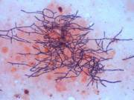
Morphology
Nocardiae resemble Actinomyces morphologically but are strict aerobes,non-motile,Gram positive bacteria.
Are acid-fast when decolorised with 1% sulphuric acid.
Gram stained sputum smear showing Gram positive branched mycelia in Pulmonary nocardiosis

Slide 17
Pathogenesis
a)Nocardiosis – Opportunistic pulmonary disease in immunocompromised individual including AIDS
Disease acquired by inhalation ------ >causing pulmonary disease primarily as pneumonia, lung abscess or lesions resembling tuberculosis
b)Mycetoma: Disease acquired by implantation . Chronic granulomatous lesion involving subcutaneous and deeper tissues mainly the foot- (MADURA FOOT)

Slide 18
Lab diagnosis
Specimen - Pus or purulent specimen
Microscopy –
Gram’s staining – Gram positive filamentous bacteria
Zeihl Neelsen staining with 1% H₂SO₄ – red colored acid fast bacilli against a blue background

Slide 19
Culture:
Pus, sputum are grown on Nutrient agar,Sabouraud’s dextrose agar or BHI agar and incubated at 37 C for 3 weeks.Nocardia grow as dry pigmented (red, yellow, pink) colonies.
Treatment :Sulphonamides with or without Trimethoprim for 3 months or more.

