Slide 1
Spirochaetes
Speira: coil, chaite: hair

Slide 2
Morphology
Gram negative cell wall
Large, slender, helical, motile bacteria
Helical structure is due to presence of endoflagella- fine fibrils which are attached at each pole, run between peptidoglycan & outer membrane coiled between the bacterial body to give rise to spiral formation.
Pathogenic genera:
Treponema
Leptospira
Borrelia

Slide 3
Genus Treponema trepos: turn, nema: thread
Slender spirochaetes with fine spirals and pointed ends
Some are pathogenic while others are commensal in mouth and genitalia
Pathogenic:
Disease : Causative agent
Veneral syphilis : Treponema pallidum
Endemic syphilis: T. endemicum
Yaws : T. pertenue not by sexual
Pinta : T. carateum contact

Slide 4
Treponema pallidum (pallidum: pale)
Morphology: thin, delicate, long 6-14µm x 0.1-0.2µm, with tapering ends, motile flexible organism
Does not stain by gram stain due to thinness of the organism
About 10 regular coils at 1µm regular intervals
Morphology &motility best seen in wet living preparation by :
Dark ground microscopy
Phase contrast microscopy

Slide 5
In dried preparation it needs to be thickened by silver impregnation methods:
Films by Fontana’s Method
Tissue section by Levaditi’s method
By prolonged Giemsa – stains pale pink
Immunofluroscence staining – can be detected in tissues & body fluids
Ultrastructurally : 3-4 flagella are attached at each pole and extend towards the other pole and interdigitate over the centre of the organism

Slide 6
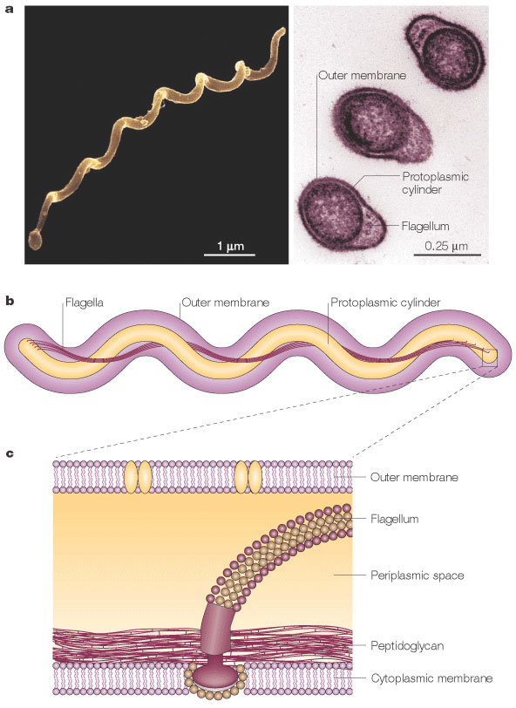
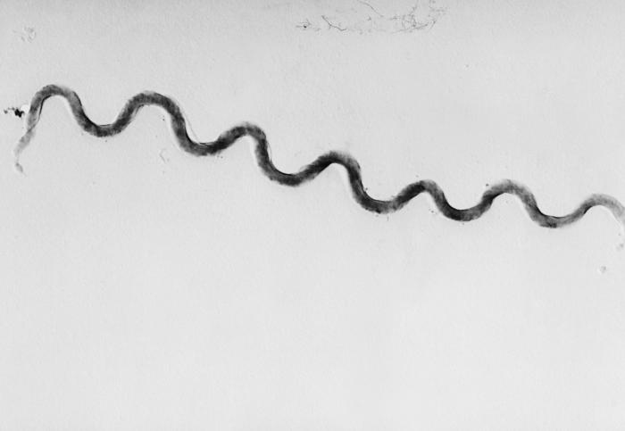
Treponema pallidum
Cell wall & endoflagella

Slide 7
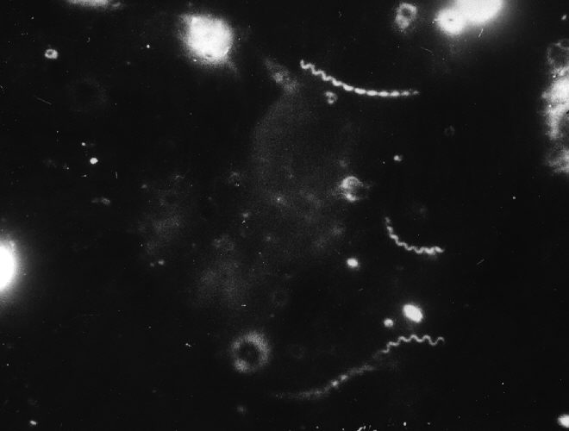
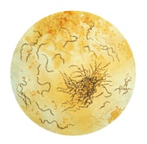
morphology
Fontana stain
Dark ground microscopy

Slide 8
Cultivation
Pathogenic treponemes cannot be cultivated in artificial media.
Nichols strain of Treponema pallidum is maintained by serial subcultures in rabbit testis used for antigen preparation for serological tests.

Slide 9
Antigenic structure
Three types of antibodies appear in serum of syphilitic patients.
A non-specific antibody (reagin) appears in serum of syphilitic patients which reacts with a lipid hapten extracted from beef heart (cardiolipin)
Group-specific antigen- protein antigen present in all treponemes. Reiters strain used as antigen for group-specific serological test.
Species-specific antigen- polysaccharide in nature found in Treponema pallidum only. Nichols strain used as antigen for species-specific serological test

Slide 10
Pathogenesis
Strict human pathogen
Transmission of disease:
95% sexually transmitted or veneral
5% by close contact with mucous membrane lesions as in kissing, blood transfusion
Medical personel/dentists – accidental figerprick with infected needle
May be transmitted congenitally

Slide 11
Clinical menisfestation: 4 stages
1. Primary syphilis
Primary lesion : HARD CHANCRE or Huntarian chancre
Treponemes penetrate intact or abraded mucus membrane & multiply at site of inoculation
In 3-90 days CHANCRE develops which is usually solitary, painless, relatively avascular, circumscribed, indurated 1-2cm in diameter ulcerated in the centre & predominantly infilterated by mononuclear cells

Slide 12
Site :
95% external genitalia of male/female
5% tongue, lips, palate, gingiva, tonsils & nipples
Numerous treponemes present in chancre (highly infectious)
Treponemes then invade regional lymph nodes (inguinal, pelvic, cervical, axillary) causing lymphadenitis
Lymph nodes are swollen, discrete, rubbery & non tender

Slide 13
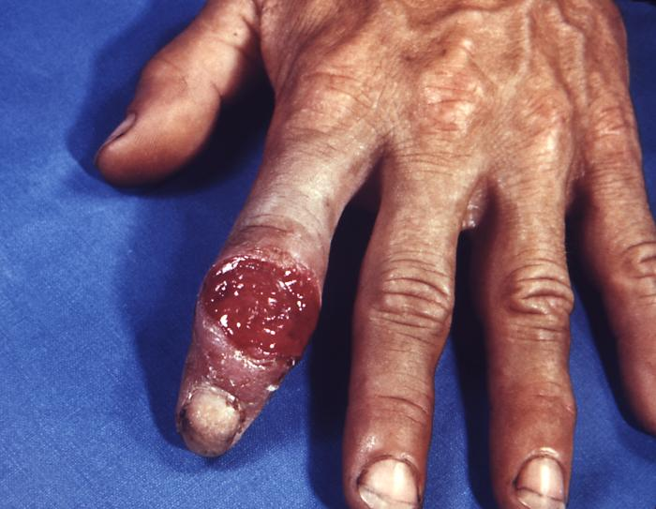
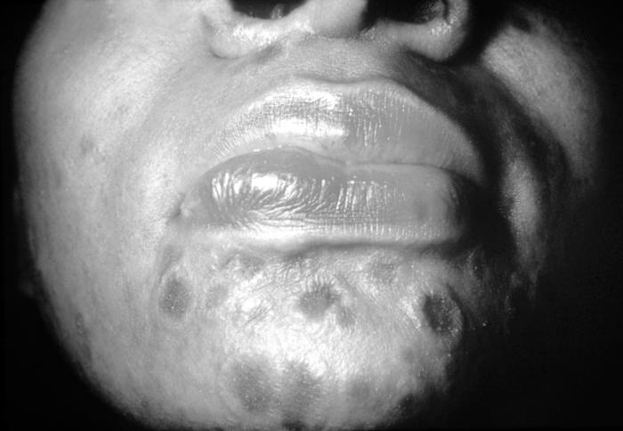
Primary chancre on finger
Primary chancre on chin

Slide 14
Chancre heals spontaneously without any treatment in 3-6 weeks leaving a thin scar
Patient is then asymptomatic for 2-6 months then manisfestations of Secondary syphilis appear.
Serological usually positive but may sometimes be negative.

Slide 15
2. Secondary syphilis
Sets in 2-6 months after primary lesion heals during which period patient is asymptomatic
Lesions are due to wide spread multiplication of treponemes & their dissemination through blood
Symptoms lasts for 4-5 years - most infectious
Marked constitutional symptoms

Slide 16
Diffuse erythematous cutaneous lesions particularly on trunk & extremities
Mucous patches in the oropharynx
Rashes may colase at muco-cutaneous junctions forming wart like Condylomata
There may also be lymph node enlargement and sometimes involvement of bones, joints, eyes & other organs
Highly infectious
Medical personnel & may become accidental victims
Serological tests positive

Slide 17
Oral lesions in secondary syphilis
Multiple, painless, greyish white plaques overlying ulcerated surfaces called mucous patches on tongue, gingiva, lips and mucosa
Condylomata

Slide 18
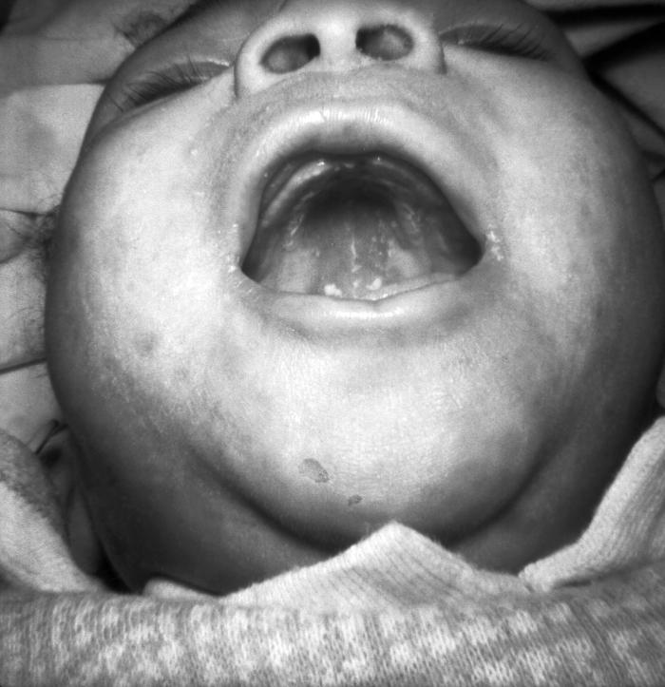
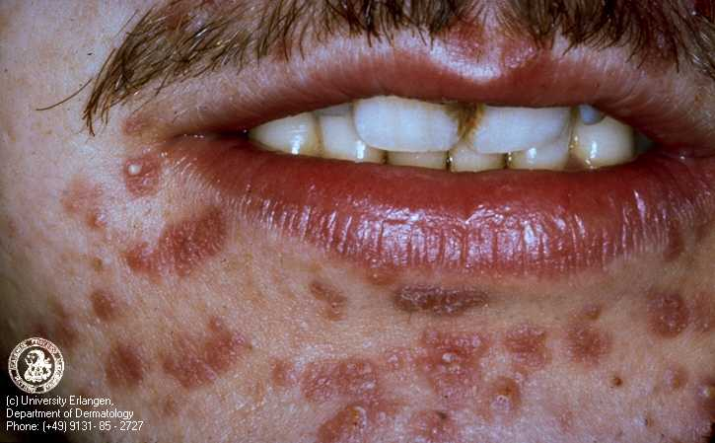
Diffuse erythmatous cutaneous rash
Oral mucous patches

Slide 19
3. Latent syphilis
Patient is asymptomatic for 1-30 years till tertiary syphilis sets in
Serological tests are positive

Slide 20
4. Tertiary syphilis
Decades later patient develops tertiary syphilis
Slowly progressive, destructive inflammatory disease involving CVS, CNS or any organ
Organisms are absent or very few in lesions- non infectious
Severity of the disease due to intense cellular response to the organism & their products

Slide 21
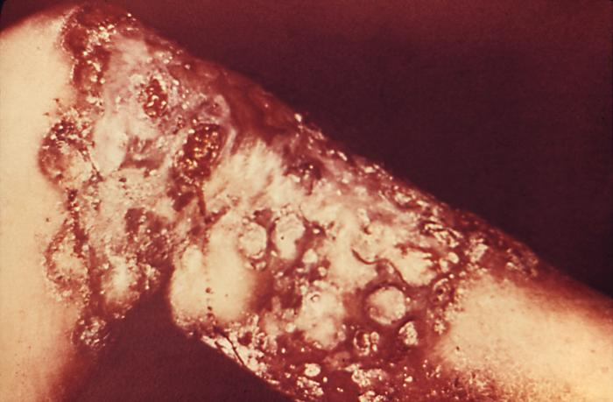
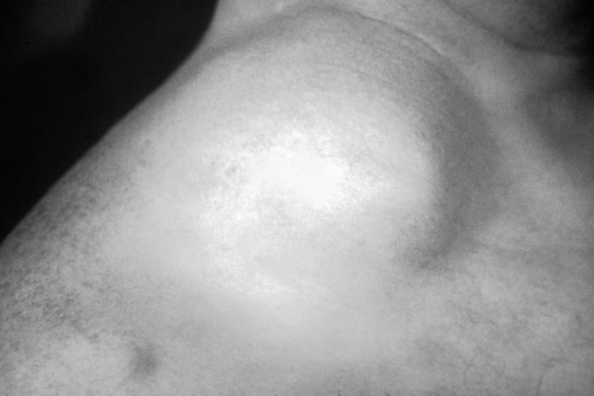
gumma
Aortic aneurism

Slide 22
Heart & aorta – Aneurisms (dilatation)
CNS – Tabes dorsalis (due to demyelination of post horn cells of sp. cord wide based gait & parasthesia), & general parasis of insane
Internal organs like liver, bone, testis, tongue & palate – GUMMA (focal granulomatous inflammation with central necrosis)
Tongue - interstitial glossitis due to endartritis obliterance
Immunocomprised host – explosive wide spread lesion lues maligna

Slide 23
Oral lesions
Primary syphilis: chancre of the lip may be present at the angles of the mouth, upper or lower lip. Other sites are o tongue, gingiva and tonsillar area.
Secondary syphilis:
Generalized skin lesions in about 75% as dull macular or papular spots found on face, hands, feet and genitalia.
mucosal ulcers in about 33%,
generalized lymphadenopathy in about 50%,

Slide 24
Tertiary syphilis: Gumma – localized, single or multiple varying in size from a pinhead to several centimeters in diameter develops on skin and mucous membrane and bones. They are non infective.
Late or quaternary syphilis: condition is seen after 10-20 years of primary syphilis presents as cardio-vascular and neuro-syphilis.

Slide 25
Congenital syphilis
Treponemes cross placental barrier
1/3rd pregnancies result in abortion
1/3rd result in still births
1/3rd new born babies develop congenital syphilis
Frontal bosse, high palatal arch, saddle nose, short maxilla, mulberry molars, irregular thickening of mandible, relative protuberance of mandible
Hutchinson’s triad – hyperplasia of incisor & molar, interstitial keratitis, 8th nerve deafness

Slide 26
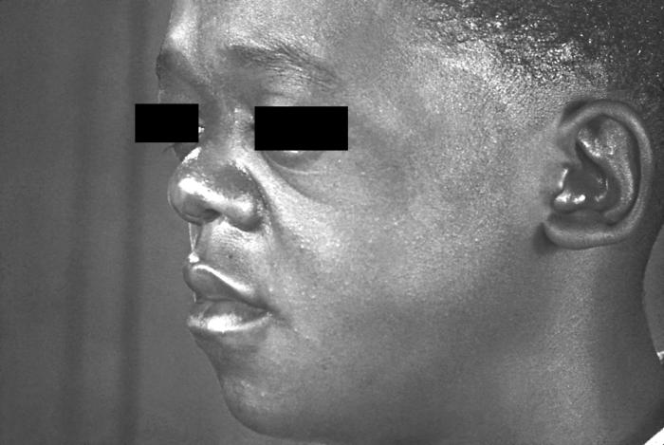
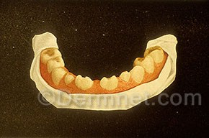
Saddle nose
Deformity of teeth

Slide 27
Lab diagnosis
Treponema pallidum cannot cultured
Demonstration of treponemes by microscopy – in exudate & tissues
Demonstration of treponemal antigen in tissues by PCR
Serological diagnosis –
Nontreponemal tests or standard tests for syphilis –VDRL and RPR
Treponemal tests –
Those using cultivable treponemes as antigen
Those using pathogenic T. pallidum as antigen

Slide 28
Treatment
Early cases single injection of 2-4million units of benzathine penicillin I/M
Late syphilis repeated weekly for 3 weeks
Erythromycin , tetracycline

Slide 29
Genus Leptospira

Slide 30
Leptospira interrogans
Actively motile, delicate,spirochaetes with fine & tightly coiled spirals and hooked ends
L. interrogans serovar. icterohaemorrhagiae
6-20µm x0.1µm observed under dark ground microscopy, silver impregnation & electron microscopy
Pathogen of cattle & pigs, produces zoonotic disease in handlers
Causes leptospirosis known as Weil’s disease characterised by fever, vomitting, infectious jaundice, purpuric haemorrhages, renal faliure

Slide 31
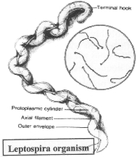

Dark ground microscopy
Electron microscopic view

Slide 32
Genus Borrelia
Large, motile, refractile. spirochaete, 3-10 wide open coils, 8-10 µm x 0.2- 0.5µm, transmitted by blood sucking arthoropods, stain readily by H&E stain, gram negative, can be cultured
Borrelia recurrentis – Relapsing fever
Borrelia burgdorferi - Lyme’s disease

