Slide 1
Hepatitis viruses

Slide 2
Def : Primary infection of liver by any of the heterogeneous group of ‘hepatitis virus’ currently consisting of A,B,C,D,E &G.
F – transfusion associated virus later found to be mutant of B
Other viruses causing disease include – Yellow fever V., Human cytomegalo V., Rubella V., Epstein-Barr V., Herpes simplex V., Entero V.

Slide 3
Hepatitis A virus (Hepatovirus)- HAV
Family-Picornaviridae
27nm nonenveloped, icosahedral with ss RNA
Earlier designated as Entero virus 72
Transmission by faeco-oral route
Acute self limiting disease - blockage of biliary passages due to infection & inflamation of hepatocytes.
IP: 2-6 weeks

Slide 4
Pathogenesis: Virus after entering multiplying in intestinal epithelium reaches the liver by haematogenous route --->producing inflammation & necrosis of liver cells causing blockage of billiary secretion resulting in jaundice (ictrerus)
Clinical features:
Preicteric phase: 1-2 wks, fever, nausea, vomitting
Ecteric phase: 2-6 weeks, appearance of jaundice with hepatomegaly, pain & tenderness in right hypochondrium
Convalescent phase)Complete recovery occurs in 8-12 weeks
Fulminant form & liver faliure – rare (in 0.5%)

Slide 5
HEPATITIS A VIRUS
Icterus or jaundice

Slide 6
Lab diagnosis:
Serum alanine & aspartate aminotranferases
Faecal HAV detected by immuno EM or ELISA
Serology- IgM detectable for 2-6months by ELISA or RIA, IgG persists for many years
Viral culture from faeces- in human fibroblasts or monkey kidney cells
Prophylaxis :
Proper collection & disposal of sevage
Passive immunisation with normal human globulin
Hepatitis A vaccine: formaline inactivated alum conjugated virus grown in human fibroblasts or monkey kidney cell line – IM 1,2 & 6 months. Immunity lasts 10-20 years .

Slide 7
Hepatitis B virus (HBV) Hepadna virus
HBV or Dane particle : complex 42nm double shelled particle
HBsAg surface Ag or envelope is made up of lipid, protein & carbohydrate
It encloses HBcAg or core Ag, icosahedral or nucleocapsid
Inside core is genome dsDNA & DNA-dependant DNA polymerase
Plus strand is incomplete leaving 15-50% of molecule single stranded
Minus strand is complete

Slide 8
HBeAg- derived from the core protein is found in plasma & is indicator of active viral replication
In serum of Hepatitis B patients along with Dane particles two subvirion morphological forms are present in large excess (100-1000 times) over 42nm virions
Spherical particles 22nm in diameter
Elongated tubules 22nm in diameter
Both these are composed of HBsAg (Australia antigen) devoid of HBcAg & nucleic acid. They are non-infectious & are solely surplus HBsAg

Slide 9
HBV

Slide 10
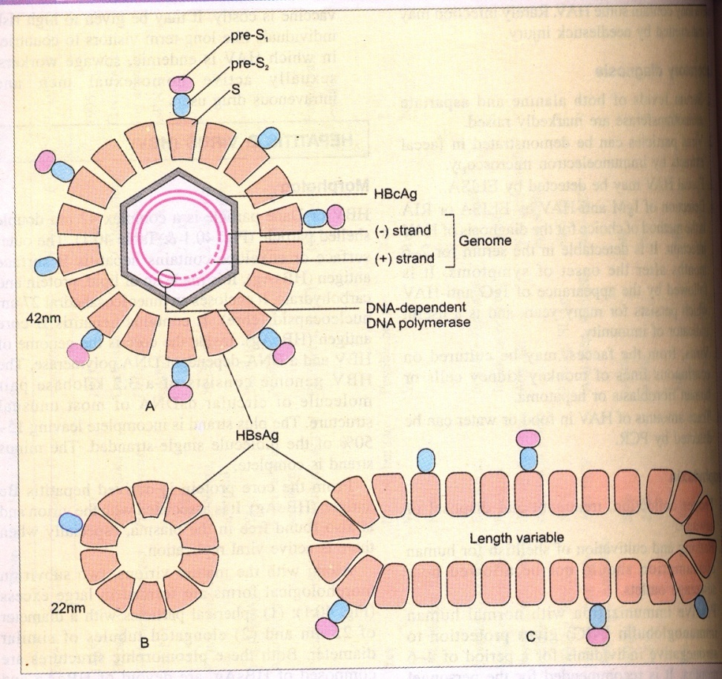
VIRAL PARTICLES PRESENT IN SERUM

Slide 11
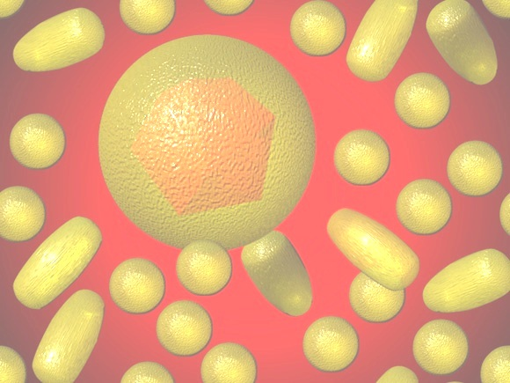
HBV in serum

Slide 12
HBV cannot be cultivated in laboratory
Pathogenesis:
Transmission by:
Parenteral- HBV is present in blood, body fluid, semen, vaginal secretion, saliva, colostrum, breast milk, menstural blood. <1µl blood can transmit infection
Perinatal- mother to child during perinatal period
Sexual

Slide 13
Course of disease:
Preicteric (prodromal) phase –
IP : 6weeks - 6months
Malaise, anorexia, weakness, myalgia, nausea , vomitting, pain in right hypochondrium, polyarteritis nodosa, glomerulonephritis due to circulating immune complex
2. Icteric phase – 2days to 2weeks. Appearance of jaundice, pale stools &dark urine with hepatocellular damage
3. Convalscent phase (Recovery) – long for several weeks

Slide 14
Complications: seen in 1-5 % cases
Chronic active hepatitis, chirrosis, hepatocellular carcinoma
Extrahepatic complications- polyarteritis, arthralgia, glomerulonephritis
Carriers : are of 2 types
Super carriers- they have HBeAg, HBsAg ,
DNA polymerase in their blood. HBV may also be present. <1µl of blood/serum can transmit the infection.
2. Simple carriers - they have low level HBsAg but no HBeAg, HBV & DNA polymerase in blood. They can transmit infection only when large volumes of blood are transferred eg. blood transfusion.

Slide 15
Pathogenesis is immune mediated - hepatocytes & viral antigens ----->attacked by antibody dependant NK cell & cytotocic T cells
Immunodeficient person & children(immune system not well developed) may remains asymptomatic or become carriers

Slide 16
Lab diagnosis
Both alanine & aspartate aminotransferases and bilurubin markedly raised
Serological demonstration of viral markers – HBsAg, antiHBs, HBeAg, antiHBe, antiHBc IgM & IgG &HBV DNA (by PCR)
HbcAg – not detected in serum, can be detected by immunofluorescent microscopy in liver cells

Slide 17
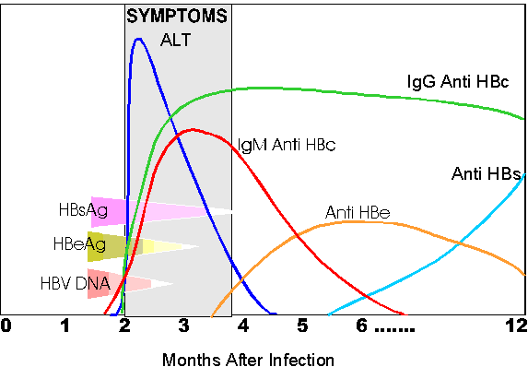
Lab diagnosis
Jaundice
2nd Ab
1st Ab
4th Ab
3rd Ab

Slide 18
HbsAg & HbeAg can be detected in patient’s serum during incubation period, acute hepatitis chronic active hepatitis.
Anti-Hbc IgM -1st antibody to be detected in serum indicates acute hepatitis & chronic active hepatitis.
Anti-Hbc IgG - indicates acute hepatitis & chronic active hepatitis.
Anti-Hbs – indicates past infection & immunization without infection.
Asymptomatic carrier states – anti-Hbe(IgG) & anti-Hbc(IgG).
Viral DNA - can be detected in patient’s serum during incubation period, acute hepatitis chronic active hepatitis.

Slide 19
Prophylaxis
General measures – screening of blood donors, drug abuse, homosexuals, use of disposal syringe, medical personnel should use gloves, masks, hand washing. Blood spills – clean with 0.5% hypochlorite or 2% glutraldehyde
Passive Immunisation- Hepatitis B immuneglobulin (HBIG) from human volunteers with high level antiHBs (300-500 IU) I/M

Slide 20
Active Immunisation: required for high risk workers like health care personnel, patient on dialysis, parenteral drug users, spouses of HBV infected person
Plasma derived vaccine – purified 22nm HBsAg obtained from symptomless carriers treated with proteinase, 8 M urea & formaldehyde
Recombinant yeast hepatitis B vaccine – cloning of HBsAg gene in yeast, and the HBsAg produced is extracted & used as vaccine. Dose 0,1 &6 month. Booster dose every 3 years

Slide 21
 |  | HAV | HBV | HCV | HDV | HEV
1 | Genome | RNA | DNA | RNA | RNA | RNA
2 | Virus family | Picorna V. | Hepadna V | Flavi V | Delta V. | Calci V
3 | transmission | enteric | Parenteral, perinatal, sexual | Parenteral, sexual, placental, | parenteral | enteric
4 | Antigen in blood | HAV | HBsAg, HBeAg | HCV | HDV | HEV
5 | Antibodies in blood | Anti HAV | antiHBs antiHBe antiH Bc | Anti HCV | antiHDV | antiHEV
6 | Carrier state | no | 5-10 % | 50% | >50% | no
7 | Chronic hepatic chirrosis | no | 1-5% | 20% | >50% | No
8 | Liver cancer | no | yes | Yes | no | no

Slide 22
Hepatitis D virus (HDV) -Delta virus
Defective sattelite virus requiring HBV as helper virus
Spherical 36-38nm diameter HBsAg coat & HDAg nucleoprotein
SS RNA of minus sense
Transmission – parenteral route
Pathogenesis – 2 types of infections
Simultaneous co-infection with HBV in same inoculum
Superinfection- HDV infection to HBVcarriers. More serious as hepatocytes already damaged.
>50% become chronic carriers & chronic active chirrosis

Slide 23
Hepatitis C virus (HCV) Hepacivirus
Transmission – parenteral, placental, conjunctival
IP. -6-8weeks
75% infections subclinical
Less severe than HBV infection
50% of acute HCV infections become chronic with raised ALT level

Slide 24
Hepatitis E virus (HEV)
Caliciviridae family
Transmission faeco-oral
Causes epidemic, endemic & sporadic cases
IP – 5-6 weeks
Symptoms like hepatitis A infection

Slide 25
Hepatitis G virus (HGV)
Flaviviridae, SS RNA positive sense
Transmission – faeco-oral route
Lab diagnosis – serology & reverse transcriptase PCR

