Slide 1
Paramyxoviruses Family: Paramyxoviridae
Mumps, Measles and Rubella.

Slide 2
Morphology
Spherical, enveloped particle
100-300 nm diameter
Envelope is covered by projections (peplomers) that are of 2 types –
Haemagglutinin & neuraminidase – HN
Fusion protein – F
Nucleocapsid is of hellical symmetry & contains SS RNA genome as a single piece.
Measles virus envelope contains only haemagglutinin but not neuraminidase.

Slide 3
Mumps virus – Epidemic parotitis
Predominantly disease of childhood
Acquired from direct contact with infected saliva or aerosols inhalation from infected patient.
Characteristic presentation – Non-suppurative inflammation of the parotid glands in 95% cases.
Complication – Orchitis is common complication in adult male patients.

Slide 4
Mumps

Slide 5
Morbilli virus – Measles
Highly infectious childhood disease spread by inhalation of aerosols of respiratory secretions
Clinical features: high fever, cough & conjunctivitis and Koplik’s spots(whitish spots) can be seen on buccal mucosa.
With the decline of acute symptoms in 1-2 days, widespread maculopapular rash 1st appears on the neck then spreads to the rest of the body.
Rash fades in about 1week & the patient recovers uneventfully in 10-14 days.

Slide 6
Maculopapular rash on skin and Koplick’s spots in buccal mucosa

Slide 7
Complications of measles
Secondary bacterial infections like – otitis media, bronchopneumonia.
Post measles encephalitis(infection of brain) in 1:1000 cases and subacute sclerosing panencephalitis (SSPE) may occur very rarely.

Slide 8
Rubella virus – causes Rubella or German measles
Primarily a mild childhood disease
Member of Togaviridae family, enveloped single stranded RNA virus
Prophylaxis: combined measles-mumps-rubella (MMR)vaccine recommended to all infants at 15 months age followed by booster at 4-6 years.

Slide 9
Pathogenesis:
Postnatal rubella: Acquired by inhalation, virus multiplies locally in cervical lymph nodes, after2-3 weeks virus disseminates throughout the body by blood. Patient develops-
Fever
Macular rash that 1st appears on face then spreads to trunk and legs
Patient recovers in one week
ii. Congenital rubella: rubella virus crosses the placental barrier and causes congenital malformations

Slide 10
German measles

Slide 11
Lab diagnosis
Lab diagnosis is important in pregnant women and infants with congenital rubella.
Viral isolation: not commonly done
Serology: demonstration of antibodies by ELISA – TORCH (Toxoplasma, Rubella, Cytomegalo virus & Herpes simplex virus) test
IgM detection in single specimen of blood has diagnostic value
IgG detection – four fold rise in paired serum sample is significant.

Slide 12
Miscellaneous viruses

Slide 13
Polio viruses
Causative agent of poliomyelitis.
Small, non-enveloped SS RNA virus.
Children most susceptible
Acquired by feco-oral route
Virus --> Mouth --->multiplies in lymphatic tissues of oropharynx and intestine ----> Blood stream----> reaches spinal cord and brain --> destroys the anterior horn cells of spinal cord.

Slide 14
90% are inapparent infection, 4-8% present as minor illness.
0.1-2% present as paralytic poliomyelitis and presents as motor nerve paralysis and disuse muscle atrophy.

Slide 15
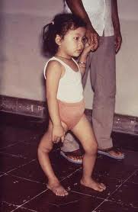
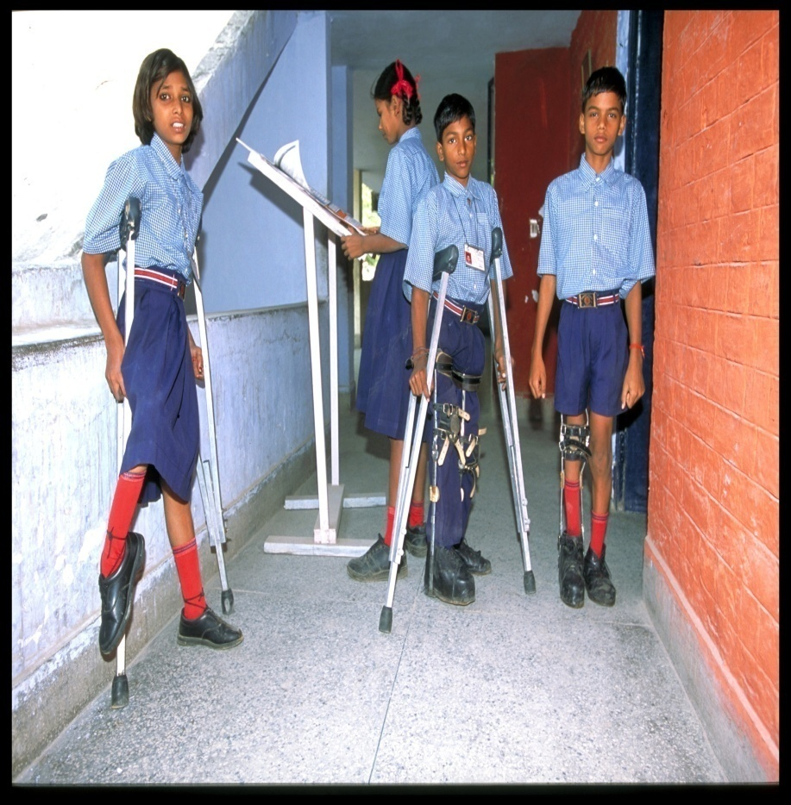
Poliomyelitis
Poliomyelitis

Slide 16
Prophylaxis:
Salk’s killed polio vaccine (IPV): 3 doses given at 4-6 wks interval, deep subcutaneous or intramuscular injection, booster after 6 months. Induces IgM and IgG in serum not IgA in intestine.
Live attenuated oral polio vaccine - OPV(Sabin vaccine) : It induces IgM, IgG as well as IgA which produces local immunity of intestine. Dose: 1st dose at age 6 weeks, followed by two doses at 4-6weeks interval. Booster dose after 1 year.

Slide 17
Pulse Polio: Strategy of mass immunization by which one can eradicate poliomyelitis. Extra doses (pulses) of OPV are given to all children below 5 years age to achieve 100% coverage.
Wild polio virus survives in sewage water only for 48-72 hours -----> it then needs a susceptible host (children < 5 years) to survive ------> if intestine of all such children is flooded with OPV, hence wild virus cannot gain entry -----> ULTIMATELY IRRDICATION FROM NATURE.

Slide 18
Rota virus
Double shelled icosahedral capsid resembling a wheel with short spokes – rota or wheel.
Genome – double stranded segmented RNA
Causes gastroenteritis in children and presents as diarrhoea.
Transmitted by feco-oral route
Self limiting disease.
Other gastroenteritis causing viruses transmitted by feco-oral route: Norwalk C virus, Adeno V., Astro V., Corona V., & Calici V.

Slide 19
Dengue fever or Break bone fever
Mosquito (Ades) borne disease characterized by fever of sudden onset, headache, retrobulbar pain, conjunctival infection, severe pain in back and joints lymphadenopathy and maculpapular haemorrhagic rash.
Caused by a Flaviviridae

Slide 20
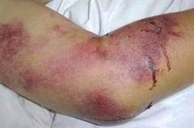
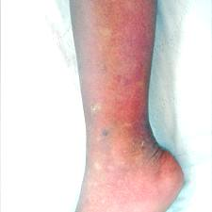
Haemorrhagic rashes

Slide 21
Other viruses
Orthomyxoviruses: RNA virus, Causative agent of influenza. Acquired by inhalation.
Rabdo virus: RNA virus, produce the disease Rabies or Hydrophobia is transmitted by the bite of canine animals like dog, fox, cat. Rabies is a natural infection in these animals.
Adenoviruses: DNA virus, Cause infections of respiratory tract, GIT, eye and urinary tract. Infection is acquired through conjunctiva or nasal mucosa.

Slide 22
Oncogenic viruses:
- Papillomaviruses: DNA virus, associated with cervical cancer.
Poliomaviruses: DNA virus, produce a variety of malignant tumours.
Epstein barr virus: Burkitt’s lymphoma and Nasopharyngeal carcinoma
Exanthem producing viruses:
Variolavirus: Small pox
Varicella zoster virus: Chicken pox
Morbillivirus: Measles
Rubella virus: German measles
Parvo virus: Erythema infectiosums

Slide 23
Arboviruses (arthropod-borne viruses) are transmitted by blood sucking insects from one vertebrate host to another.
Dengue and Chikungunya viruses cause febrile illness associated with haemorrhagic rashes.
Japanese B encephalitis causes encephalitis or brain fever.
Kyasanur forest disease – Haemorrhagic fever.

