Slide 1
Superficial mycoses

Slide 2
Surface infections: eg. Pityriasis versicolor, Tinea nigra, Piedra
Cutaneous infections: eg. Dermatophytes

Slide 3
Pityriasis versicolor Synonym: Tinea versicolor
Characterised by mild chronic infection of the stratum corneum caused by lipophilic yeast , Malassezia furfur
Clinically: hypopigmented macular lesions often associated with slight scaling or itching.
More frequent in hot & humid weather
Commonest sites: parts of body rich in sebaceous glands eg. chest, back, neck

Slide 4
Tinea versicolor

Slide 5
Tinea nigra
Infection of keratinized layer of skin caused by Exophiala werneckii
It is a dimorphic fungi that produces melanin
Clinical presentation: well demarcated brown-black macular lesion which appears as brownish spot of skin
Common sites: palms & soles

Slide 6
Piedra-infection of hair
Two types: Black piedra and white piedra
Black piedra:
Caused by dermaticeous fungi Piedraia hortae
Infection of shaft of hairs of beard & scalp
Clinical presentation: fungal nodules present on hair shaft

Slide 7
White piedra:
Caused by yeast like organism Trichosporon beigelli
Hair of scalp, moustache and beard commonly affected
Commonly found in South America, Central and Eastern Europe & Japan
Clinical presentation: soft, pasty, cream-colored growth along hair shaft
Notes:
Owth

Slide 8
Black piedra
White piedra

Slide 9
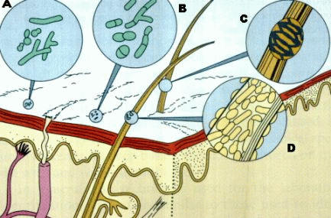
A. Pityriasis versicolor, B. Tinea nigra, C. Black piedra, D. White piedra

Slide 10
Dermatophytosis (Tinea or ring worm)
Infection of superficial keratonised tissue (dead tissue) – skin, hair & nail

Slide 11
Causative agent
Fungi belonging to 3 genera:
Trichophyton
Microsporum
Epidermophyton
Culture on SDA: cottony or powdery & pigmented growth. Pigmentation differs in different species
M/E : septate hyphae & produce two types of asexual spores - unicellular Microconidia and multicellular Macroconidia
Identification of genus is based on shape of macroconidia
Microconidia are same for all 3 genera

Slide 12
Genus Trichophyton: affects skin, hair & nail
M/E - numerous microconidia few pencil shaped macroconidia
Genus Microsporum : affects skin & hair
M/E - few microconidia numerous large, multicellular spindle shaped macroconidia
Genus Epidermophyton : affects skin & nail
M/E – microconidia absent, macroconidia multicellular club shaped

Slide 13
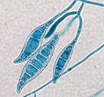
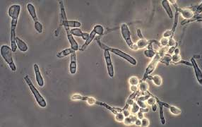
Microsporidium macroconidia
Trichophyton macroconidia

Slide 14
Epidermophyton
Microconidia

Slide 15
Pathogenecity : papulosquamous scally patches
Favus : dense crust (scutula)
In hair follicle : ectothrix infection (outside hair) and endothrix (inside hair shaft) seen.

Slide 16
Ectothrix and endothrix infection of hair

Slide 17
Clinical forms
Symptoms and appearance of lesions vary according to site of lesion
On skin typically lesion are circular which spread with erythematous border with scaling and inflammation
Inflammation probably due to irritation by fungal products, hypersensitivity or secondary infection
Clinical classification : tinea capitis (scalp),corporis (non hairy skin), cruris (groin & perinium), athelet’s foot (toe clefts), barbae (beard)

Slide 19
Taenia corporis
Taenia capitis

Slide 20
Taenia of toe clefts
Taenia of nail

Slide 21
Lab diagnosis
10% KOH (dissolves the keratin)wet mount
Wood’s lamp exam- shows specific fluorescence
Culture on SDA with chlorohexamide – incubate at 25ºC for 3-6 weeks – for colony morphology, pigment on reverse.
Lacto-phenol cotton blue mount – for morphology of fungus
Genus Trichophyton: numerous microconidia few pencil shaped macroconidia
Genus Microsporum : few microconidia numerous large, multicellular spindle shaped macroconidia
Genus Epidermophyton : microconidia absent, macroconidia multicellular club shaped

Slide 22
Growth of trichophyton on SDA

Slide 23
Treatment
Mild infection: Topical use of cotrimazole or miconazole, ketoconazole
Severe infections: Griesofulvin tablets to be taken for 4-6 weeks for skin infections and one year for nail infections.

