Slide 1
GIARDIA LAMBLIA
more prevalent in children than adults.
More common in warm than cool climate.
HABITAT
It inhabits duodenum and upper part of jejunum of man

Slide 2
MORPHOLOGY
It exist in two forms---
(1)TROPHOZOITE
(2)CYST

Slide 3
TROPHOZOITE
It is a pear shaped with rounded anterior and posterior end. 10-20 x5-15um
The dorsal surface is convex while on the ventral surface it has a shallow posteriorly notched concavity. (SUKLING DISC)
Bilaterally symmetrical& has one pair of nuclei , one on each side of midline One pair of axostyles , one pair of parabasal bodies present on the axostyles.

Slide 5
Four pair of flagella & probably four pair of blepharoplast are situated on each side of midline, slightly anterior to the two nuclei.
Two axonemes (also k/as axostyles) arise from the median pair of blepharoplast. These axonemes pass out from the posterior end of the body& give rise to posterior (caudal) pair of flagella.

Slide 6
From the two lateral blepharoblast there originate two axonemes that proceed forward, cross each other & give rise to lateral pair of crossed flagella.
By rapid movement of the flagella, the trophozoite move from place to place & by applying their suckling disc to epithelial surface they become firmly attached.

Slide 7
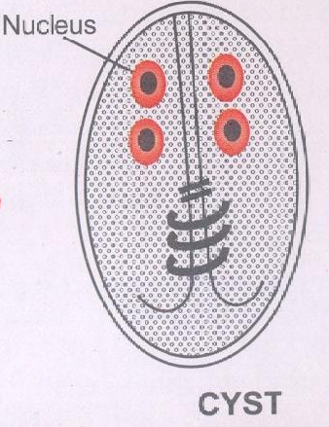
CYST
Mature cyst is oval in shape& measure 11-14um x 7-10um in size.it has two pair of nuclei which may remain clustered at one end or lie in pair at opposite ends.
The remains of the flagella & margin of the suckling disc may be seen inside the cytoplasm of the cyst.

Slide 9
Pathogenecity: disturbance of intestinal functions
Clinical features: persistant loose bowel, steatorrhoea, enteritis, anaemia, allergy

Slide 10
Lab diagnosis: Demonstration of trophozoites and cysts in fresh faecal sample by wet mount preparation (saline and iodine mount)
Treatment: Metronidazole 250mg thrice daily for 7 days
Tinidazole twice daily for 3-5 days

Slide 11
LEISHMANIA DONOVANI
Causes Kala-azar
The infection is generalised & the parasites
are distributed inside the internal organs.

Slide 12
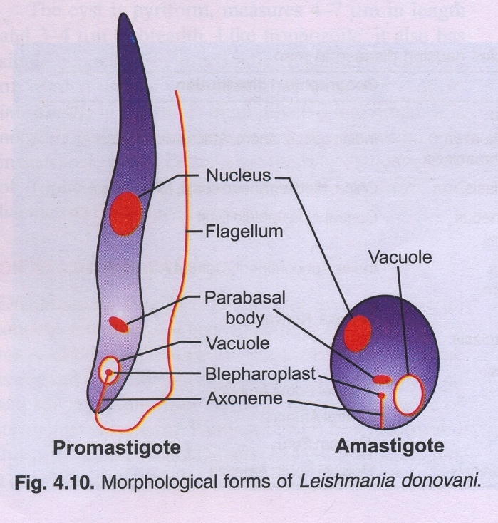

Slide 13
MORPHOLOGY:The parasite exists in two
stages:
Amastigote Stage(Aflagellar form:occurs in man.
Promastigote Stage or flagellar form:occurs in –
Gutof insect(sandfly)
Artificial culture - NNN medium

Slide 14
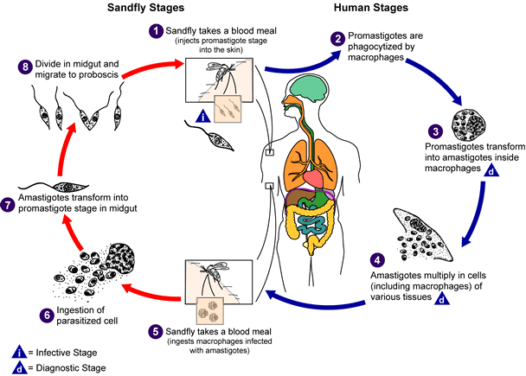
LIFE CYCLE OF LEISHMANIA

Slide 15
LIFE CYCLE OF LEISHMANIA DONOVANI
Mode of transmission :from man to man it is carried by species of sandfly of Genera Phlebotomus & Lutzomiya.
Vertebrate host: man & dog
Invertebrate host: female sandfly of genus Phlebotomus.
Infective stage: promastigote stage

Slide 16
Sandfly takes a blood meal & injects promastigote forms into the blood of man.
Promastigote forms are phagocytosed by the cells of reticulo-endothelial system.
Promastigote forms are then converted into amastigote forms inside the RE cells
Amatigote forms multiplies by longitudinal binary fission.

Slide 17
The host cell the ruptures & the entire reticulo-endothelial system becomes progressively infected.
Sandfly takes a blood meal & injest monocytes infected with amastigotes.
Amastigote form transforms into promastigote form which mutiplies by longitudinal binary fission to form enormous number of flagellates.

Slide 18
Multiplication occurs in the midgut of sandfly & the flagellates spread towards the buccal cavity & pharynx.
A heavy pharyngeal infection occurs of sandfly is observed b/w 6th & 9th
day of infective blood-meal. Due to this sandfly has difficulty in getting blood meal. Thus it pricks the skin of man, regurgitates promastigote forms in the wound caused by its proboscis..

Slide 19
PATHOGENICITY:
Incubation Period- generally varies from 3 to 6 months, but may exceed one to two years.
Clinical features-
disease Kala –azar or visceral leishmaniasis, characterised by:
PYREXIA
SPLENIC ENLARGEMENT- one of the most striking features & the organ enlarges to several inches ,with the progress of the disease,below the coastal margin,often filling up the entire abdomen.
LYMPHADENOPATHY
LIVER IS ALSO ENLARGED.
The skin over the entire body is dry, rough &harsh & often pigmented.

Slide 20
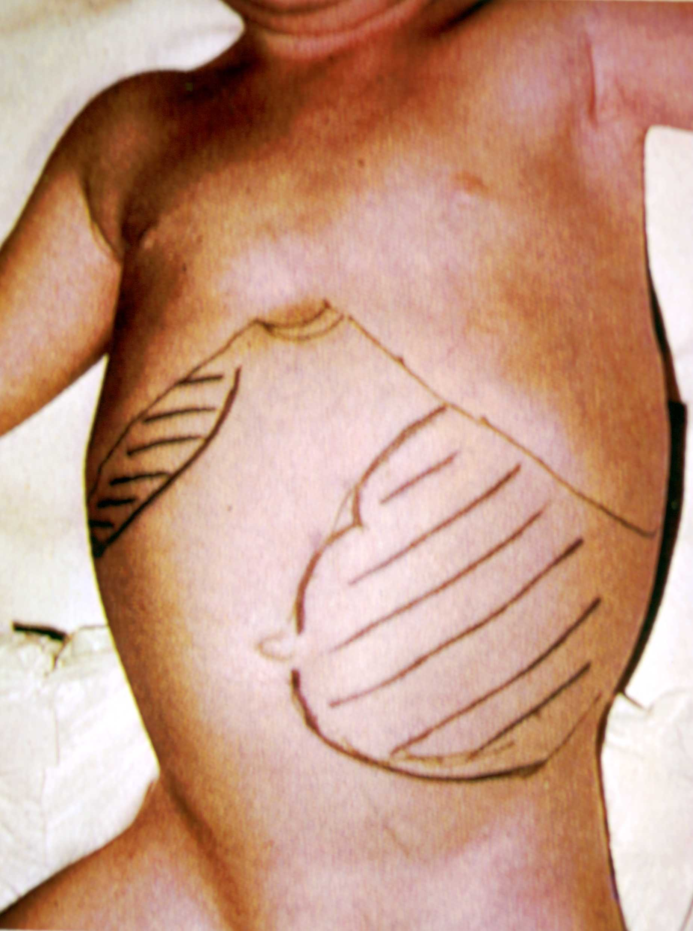

Slide 21
Lab Diagnosis
Anaemia, pancytopenia & rise in serum proteins and globulin.
Peripheral blood smear: demonstrate amastigote forms.
Bone marrow biopsy and spleenic puncture: Amastigote forms
Blood culture in NNN medium: promastigote forms
Non specific serological tests: Aldehyde test: indicates increased serum gamma globulin.
Specific test: Indirect haem-agglutination assay, Indirect fluorescent antibody test, ELISA

Slide 22
TREATMENT:
Specific drugs include following:
ANTIMONY COMPOUNDS-Pentavalent antimony compounds are now the drug of choice.
Others- Monomycin, Paromycin, Allopurinol,Amphotericin-B, Aminoridine

Slide 23
Prophylaxis: preventive measures include the following-
Attack on parasite control measures should be treatment campaign .ln china the campaign should be directed against dogs serving as resvoirs of infection
Attack on vector this consists of measures directed against the sandfly the transmiting agent
Personal prophylaxis-use of mosquito net,avoid ground floor for sleeping.

