Slide 1
INTESTINAL Nematodes
BDS 2nd year Date:10/8/2016
Dr.Nitika anand

Slide 2
INTESTINAL NEMATODES
Intestinal nematodes in small intestine
Ascaris lumbricoides(Largest intestinal nematode in man)
Ancylostoma duodenale
Intestinal nematodes in large intestine
Enterobius vermicularis
Trichuris trichiura

Slide 3
1)Ascaris lumbricoides (Roundworm)
Morphology:
a)Adult worms:
Large, stout nematodes tapering at both ends.Life span is 1 yr.Female worms are slightly larger than male worms.
Body cavity is filled with irritating fluid k/n as “Ascaron”.

Slide 4
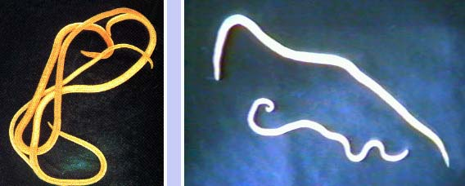
MALE:20cm
FEMALE:30cm
Adult worm of A. lumbricoides

Slide 5
Life cycle
Definitive Host: Man
No intermediate host
Mode of infection:Ingestion of food,water,raw veggies contaminated with embryonated egg.
Infective form:Embryonated egg
Habitat:Small intestine.

Slide 6
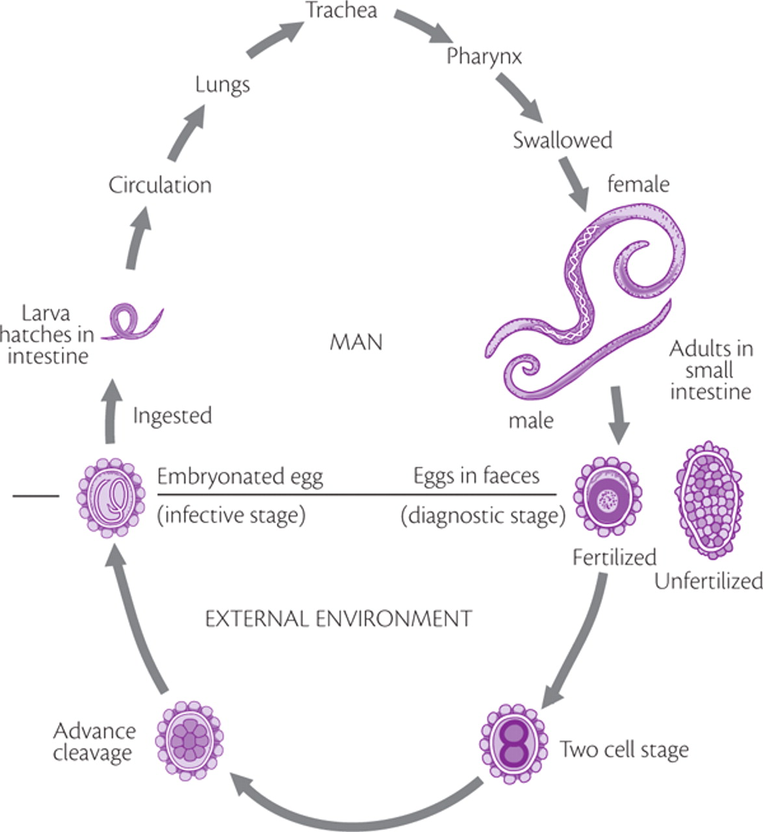
Moulting in
Reach portal

Slide 7
Pathogenesis & symptoms
1)Symptoms due to migrating larvae
a)In Lungs(Loeffler’s syndrome): Present as fever,cough,dyspnoea,bloody sputum, pain over chest
b)In general circulation: May produce disturbances in brain,kidney,heart,spinal cord.

Slide 8
2)Symptoms due to adult worm
Gastrointestinal symptoms: Intermittent cramps,Loss of appetite,malnutrition, hypovitaminosis A causing nightblindness
Release of body fluid Ascaron causes allergic manifestations viz: Urticaria, oedema of face.

Slide 9
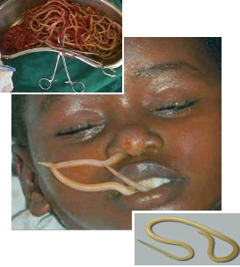
Ectopic Ascariasis

Slide 10
LAB DIAGNOSIS
a)Stool Exam:Adult worms or eggs may be detected.Eggs not seen if only male worms are present.
b)Xray diagnosis:Adult worm can be detected by radiography with barium emulsion which is absorbed by worm in 4-6 hrs & cast a string like shadow.
c)Bile exam:Bile obtained by intubation reveal ascaris eggs.

Slide 11
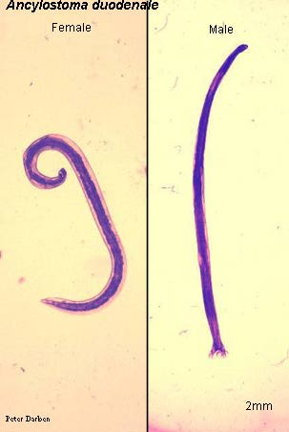
2)Ancylostoma duodenale
(Hookworm)
Morphology:
a)Adult worm: Small ,greyish white in colour,cylindrical in shape.
Anterior end is bent dorsally,
hence the name Hookworm.
Life span 1-2 yrs.

Slide 12
b)Egg: Oval measuring 65μm X 45μm .
Contains segmented ovum with 4 blastomeres.Surrounded by outer hyaline shell.Not infective when freshly passed.
Clear space b/w hyaline shell & segmented ovum.

Slide 13
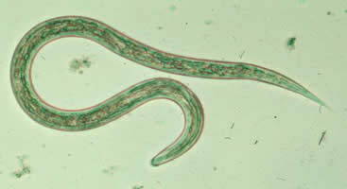
Life cycle
Infective agent:Filariform larvae
Host:Man is only host.
Mode of infection:Penetration through skin.
Common sites:Skin b/w toes,dorsum of feet, soles, hands.
Filariform larva

Slide 14
Life cycle

Slide 15
Pathogenesis & clinical features
1)Affects due to migrating larvae:
a)Ground itch:local irritation at the site of entry. Disappears in 1-2 weeks.
b)Pulmonary symptoms:Cough, wheezing, bronchitis,marked eosinophilia occurs .

Slide 16
2)Affects due to mature worms: They attach
to jejunum producing Microcytic,hypochromic anemia.
Patients develop epigastric pain, vomoting,diarrhea.

Slide 17
Lab diagnosis

