Slide 1
Fasciola hepatica Sheep liver fluke
Geographical distribution: Cosmopolitan
Definitive host: sheep, cattle, man
1st Intermidiate host: snail
2nd Intermidiate host: aquatic plants
Habitat: Adult worm stays in billiary passage of definitive host
Operculated eggs passed in faeces

Slide 2
Morphology
Adult: Hermaphrodite, leaf shaped with 2 suckers a terminal and a ventral
Eggs: oval, oerculated
Infective stage: encysted metacercaria attached on aquatic plants like watercress are ingested with undercooked water plants

Slide 3
Adult worm

Slide 4
Life cycle
Adult in billiary passages ---->Eggs laid reach intestine and passed in faeces into fresh water (lakes, ponds)----> hatch under suitable conditions 22-25ºC in 9-15 days ------>release free swimming miracidium which burrows itself in suitable snail within 8 hours -----> multiply & develops in snail for 3 weeks -----> hundreds of free swimming straight tailed cercaria released in water ----> attach to aquatic plants and encyst as metacercaria -----> ingested by definitive along with uncooked plant meal

Slide 6
Pathogenecity
Hepatosplenomegaly, abdominal pain, fever, ascitis, jaundice, eosinophilia.
Lab diagnosis:
Eosinophilia
Demonstration of eggs in faeces
Serology – ELISA – demonstration of antibody

Slide 7
Treatment
Mebendazole: single dose
Albendazole
Prophylaxis:
Improve sanitation
Avoid eating uncooked aquatic plants

Slide 8
Kingdom – Protista , Subkingdom - Protozoa
Phylum | Subphylum | Class | Genus
Sarcomastigophora | Mastigophora | Kinetoplastidea | Leishmania , Trypanosoma
 |  | Diplomonadida | Giardia
 |  | Trichomonadida | Trichomonas
 | Sarcodina | Lobosea | Entamoeba
Apicomplexa |  | Coccidea | Cryptosporidium Toxoplasma
 |  | Haematozoea | Plasmodium

Slide 9
Tissue nematodes

Slide 10
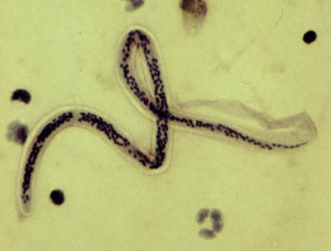
WUCHERERIA BANCROFTI

Slide 11
INTRODUCTION
Common name:- Bancroftian filarial worm
The name filaria bancrofti was proposed by cobbold in 1877 & generic name Wuchereria was given in 1878.
They belong to the phylum NEMATODE
It is a viviparous nematode.

Slide 12
GEOGRAPHICAL DISTRIBUTION
It occurs in asia ,africa ,australia and south america.
HABITAT
Adult male & female worm resides in lymph nodes & lymphatic vessels of man
Microfilaria are found in blood

Slide 13
MORPHOLOGY
ADULT WORMS
They are transparent, creamy, white, long ,hair like structures.
They are filiform in shape with both ends tapering
MALE WORM - 2.5-4cm×0.1mm ,posterior end curved ventrally, & 2 spicules of unequal length
FEMALE WORM- 8-10cm×0.2-0.3mm with straight posterior end
The female is viviparous &liberate sheathed embryo (microfilaria) into lymph from where they find their way into blood.

Slide 14
MICROFILARIA
It is transparent & colorless with blunt head & pointed tail
It measures 245-295um×7.5-10um in size & is covered by hyaline sheath which is much longer than the microfilaria, it can move forward and backward within the sheath
The somatic cells or nuclei appears as granules in the central axis of the microfilaria
These forms the landmarks for the recognition of various microfilaria

Slide 15
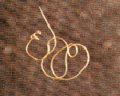
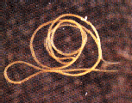
MALE WORM FEMALE WORM

Slide 16
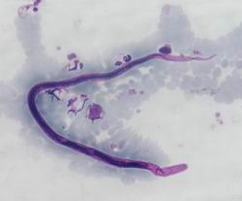
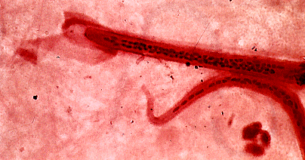
MICROFILARIAE WITH SHEATH

Slide 17
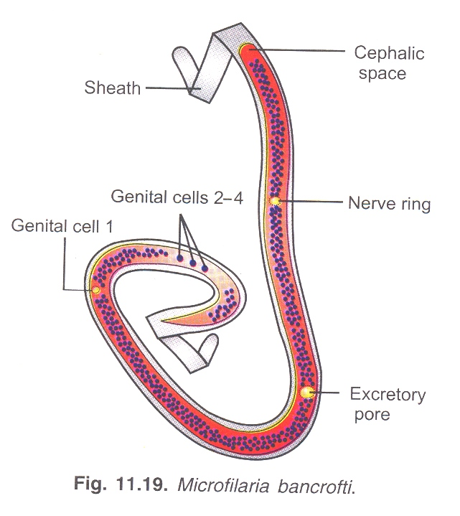

Slide 19
LIFE CYCLE
It passes its life cyle in 2 hosts
DEFINITIVE HOST- man
INTERMEDIATE HOST-female culex mosquito
INFECTIVE FORM TO MAN:- 3rd stage larva
MODES OF TRANSMISSION:- mosquito bite
Adult worm resides in lymph nodes & lymphatic usually inguinal, scrotal, abdominal of man
↓
male fertilize female & gravid female give birth to microfilaria
↓
Through lymphatic they reach into circulation

Slide 20
↓
Microfilaria appear for about 2 hr after midnight
↓
Then disappear more or less for rest of 24hrs from peripheral circulation and remain in pulmonary circulation
↓
Sheathed microfilaria are ingested by mosquito during its blood meal
↓
Reaches stomach of mosquito and cast of their sheath in 2-6hrs

Slide 21
↓
Penetrate stomach wall and in course of 4-7hrs reach thoracic muscles
↓
In next 2 days they metamorphose into short sausage shape organism (Ist stage larvae)
↓
In 3-4 day they moult once or twice to become 2nd stage larvae
↓
On 10-11 day metamorphisis complete, body cavity, genital organ are fully developed (3rd stage larva – infective stage)

Slide 22
↓
Larvae then migrate from thoracic muscle to proboscis
↓
They get deposited on skin near site of puncture by mosquito
↓
They penetrate through skin & enter into lymphatic where they develop into adult worm & the cycle is repeated.

Slide 23
PATHOGENESIS
Infection caused by wuchereria bancrofti is k/a BANCROFTIAN FILARIASIS.
It is mainly d/t presence of adult worm in lymph node & vessels
Microscopically lymph node show presence of lymphocytes, plasma cells ,polymorphs, eosinophils & there may be foci of necrosis.
In chronic disease. Nodes & vessel may contain dead worms surrounded by fibrotic & calcified tissue causing LYMPHADENITIS.

Slide 24
Mechanical irritation caused by movement of parasite inside lymphatic system, liberation of metabolite by larvae & absorption of toxic products from dead worms leading to LYMPHANGITIS with redness ,swelling & pain
In case of chronic Infection lymph valve proximal to worm become damaged which leads to its ↑ permeability
↓
Leakage of lymph into interstitial tissues LYMPHOEDEMA & ELEPHANTIASIS

Slide 25
This condition can be seen in one or more limbs, breast, penis & scrotum or vulva in which there is non pitting edema with growth of new adventitious tissue. and thickened skin
This can be accompanied by bacterial and fungal infections

Slide 26
CLINICAL FEATURES
Pt. with acute attack develops intermittent recurrent fever lasting 3-15 days,
Headache,malaise , localised pain & tenderness with oedema & erythema above lymph vessel & glands
Acute lymphangitis and lymphadenitis of the groin or axilla
LYMPHOEDEMA & ELEPHANTIASIS
Examination of blood often show eosinophilia

Slide 27
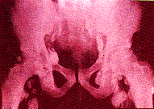
X-RAY:- ENLARGED LYMPH NODES

Slide 28
ELEPHANTIASIS

Slide 29
LAB DIAGNOSIS
BANCROFTIAN FILARIASIS can be diagnosed by
1. Detection of microfilariae
peripheral blood smear with regular nocturnal periodicity therefore to detect it blood must be taken during night b/w 10p.m -2a.m
Bld smear are prepared & stained with leishman or giemsa stain & then examined under microscope.

Slide 30
Microfilariae can also be seen in microscopic mount of anticoagulated bld by their undulating motion,displacing the RBC frm side to side as they move
Acridine orange microhaematocrit tube tech. can also be used for the detection of microfilariae.
2. Detection of adult form
adult worm can be seen in biopsied lymph node
And calcified worm can be seen in x-ray exam.

Slide 31
IMMUNODIAGNOSIS
Filarial antigen may be detected in pt. serum by enzyme immunoassay using monoclonal Ab against microfilarial larval surface Ag.
DNA PROBE
DNA probes have developed for w. bancrofti

Slide 32
TREATMENT
Diethylcarbamazine is the drug of choice for the treatment
It is given orally in dose of 6mg/kg body wt.
It kills microfilariae but its action on adult worm is much less
PROPHYLAXIS
Bancroftian filariasis can be prevented by
control of vector by spraying insectisides such as DDT ,malathion etc. on common resting sites

Slide 33
But as nowadays many species have become resistant, a film of oil may be sprayed over water surfaces or larvivorous fish may be added to the ponds

