Slide 1
Cestodes

Slide 2
Taenia
Taenia saginata (Beef tape worm)/(Unarmed tape worm), uncommon in hindus as generally do not eat beef.
Taenia solium (Pork tape worm)/(Armed tape worm), uncommon in muslims as they do not eat pork.
Habitat: adult worms of both live in small intestine (jejunum) of man

Slide 3
Hosts
Definitive host: man for both saginata & solium
Intermediate host:
T saginata: cattle
T solium: pig & sometimes man

Slide 4
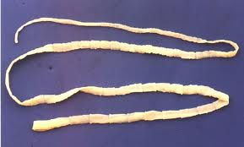
Morphology
Adult: Body thin tape like white & semitransparent divided into scolex, neck and proglottids.

Slide 5
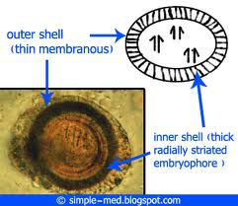
Eggs: Same for both species
Spherical & bile stained,31-43µm.
Inner embryophore is thick-walled, radially striated & brown in color
Contains an oncosphere 14-20µm, containing 3 pairs of hooklets
Does not float in saturated solution of common salt
Eggs of T. solium are infective to both pig and man, while those of T. saginata is infective only to cattle.

Slide 7
Scolex of saginata and solium

Slide 8
Proglottids of saginata and solium

Slide 9
Life cycle of T. solium
Definitive host: Man (harbours adult worm)
Intermediate host: pig, occasionally man
Infective stage: ingestion of raw or undercooked beef containing encysted larval stage (cysticercus cellulosae) called measly pork
Eggs or gravid segments in chains of 5-6 are passed along with faeces on the ground
Ingested by pig while grazing in field.

Slide 10
Reach duodenum where embryphore of egg ruptures and liberates oncospheres.
With the help of their hooklets, they penetrate the intestinal wall & enter into portal circulation then they reach the general circulation -----> via liver ----> right side of heart ----->lungs ----> left side of heart
From general circulation they are filtered out in striated muscles where in 10-12 weeks they develop into bladder worm called cysticercus cellulosae (infective stage)

Slide 11
Cysticercus cellulosae: mature cysticerci are oval, milky-white. They have the invaginated scolices with its 4 suckers and a rostellum.
Cysticerci can survive in skeletal muscles of pig for about 8months
When man eats undercooked pork containing encysted larval stage -----> larvae hatch out in small intestine ------> scolices evaginate and attach to the mucosal surface by their suckers and develop into adult worms.
They grow to sexual maturity in 2-3 months and start laying eggs which pass in faeces

Slide 12
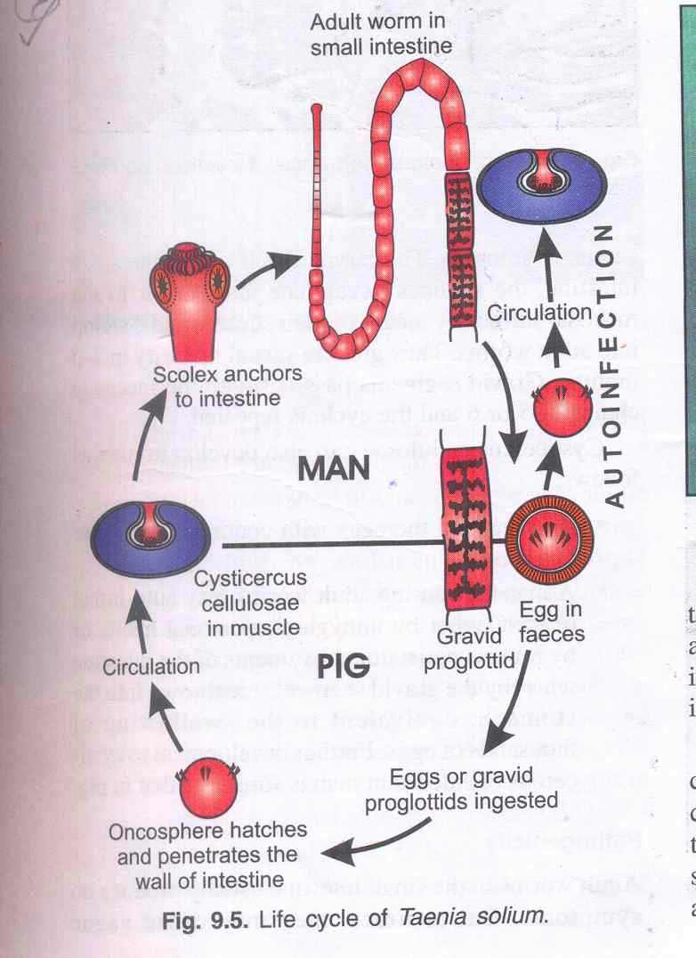
Cisticercus cellulosae
Infective stage

Slide 13
Cysticercus cellulosae in man
Mode of infection:
Ingestion of food/water contaminated with eggs of T. solium.
Autoinfection due unhygienic personal habits or by reverse peristalsis eggs/gravid segments reach stomach----> embryophore ruptures -------------->oncosphere liberated -----> penetrate intestinal wall ----> reach general circulation and filtered out in striated muscle, brain ----> develop into cysticercus cellulosae.

Slide 14
Cisticercous cellulosae

Slide 15
Life cycle of T. saginata
Definitive host: man
Intermediate host: cattle
Infection acquired by ingestion of raw or undercooked beef containing encysted larvae cysticercus bovis (Measly beef)
Habitat: adult worm in small intestine of man
Cysticercus bovis does not occur in man
Life cycle similar to T. solium

Slide 16
Pathogenecity and clinical features
Due to adult worm in intestine: usually symptomless but may present as abdominal discomfort, indigestion, loss of appetite, bowel disturbances.
Due to larval form: symptoms depend upon location of cysticerci. They usually occur in large nos.-
Muscle and subcutaneous tissue: visible nodule
Brain: epileptic attacks, intracranial space-occupying lesion
Anterior/vitreous chambers of eye – Visual disturbances

Slide 17
Lab diagnosis
For adult worm:
Demonstration of eggs in stool by direct smear and by formol-ether concentration method.
Demonstration of proglottids and scolices in stool sample – for species diagnosis
Diagnosis of cysticercosis: Biopsy of subscutaneous nodule, X-ray of skull, CT scan of brain, serological tests.

Slide 18
Treatment
Praziquantel
Niclosamide
Albendazole

Slide 19
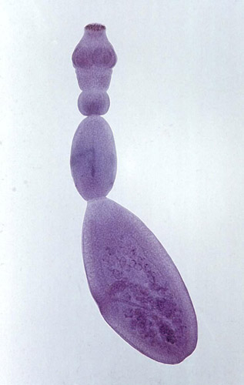
Echinococcus granulosus
Dog Tape worm

Slide 20
Morphology
Adult worm – found in intestine of dog
small tapeworm 3-6 mm in length.
consist of a scolex,neck and strobila.
Scolex:possesses four suckers and a
protrusible rostellum with two circular rows of hooklets.
Neck:short and thick.
Strobila:consists of three segments.
The first segment is immature, the second is mature and the third is gravid.
Eggs: same as taenia

Slide 21
Life cycle
Dog:definitive host.
Sheep:intermediate host.
Man is the accidental intermediate host

Slide 23
The adult worm in intestine of dog discharges egg in faeces.
Swallowed by sheep (intermediate host) or
Man acquire infection.
In duodenum hexacanth embryo hatch out.
Penetrate into the intestinal wall and then into the portal vein
Liver act as first filter(where 60-70 %)of human inf. Embryo then enter into pulmonary circulation.

Slide 24
Lung acts as secondary filter and then embryo pass through pulmonary circulation.
Lodge in various organs like brain ,heart , spleen, etc..
Develops into hydatid cyst.
Development of hydatid cyst in man is the dead end for the parasite as dog has no access to viscera of man while ingestion of cyst from viscera of sheep ,the dog again acquires the infective form and cycle is repeated
s

Slide 25
Hydatid cyst in man.
The disease is generally acquired during childhood though it does not manifest before adult life
The cyst wall secreted by the embryo consists of-
Ectocyst
Endocyst
ECTOCYST:
Outer layer
Rough, acellular, laminated, hyaline membrane upto 1 mm in thickness.
elastic therefore, when excised or ruptured,it curls

Slide 26
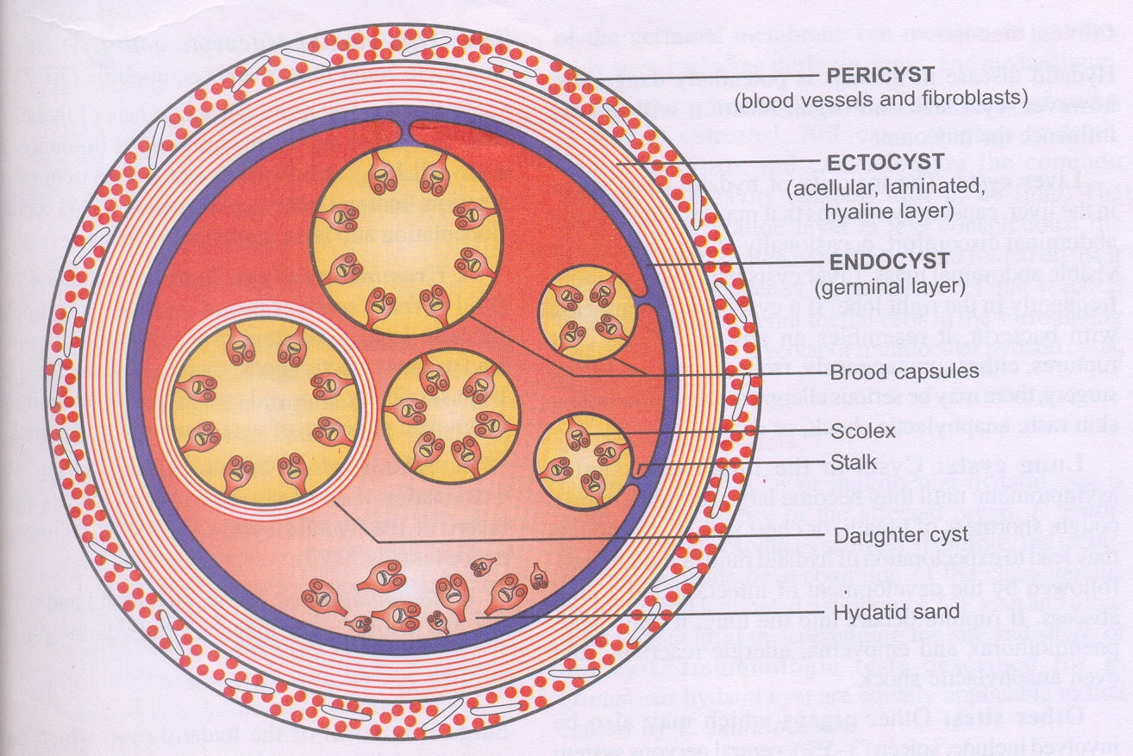

Slide 27
ECTOCYST:
Outer layer
Rough, acellular, laminated, hyaline membrane upto 1 mm in thickness.
elastic contains brood capsules, scolices & daughter cysts
ENDOCYST:
inner or germinal layer.
Consists of a no. of nuclei embedded in a protoplasmic mass.
Measures 22-25um in thickness.
It gives rise to ectocyst on outside and brood capsules & scolices on inside.
HYDATID SAND- when the embryo break free from the membrane & float in the fluid within the cyst, they are known as hydatid sand.

Slide 28
CLINICAL DISEASE
Potentially dangerous ;present in various body organs
LIVER CYSTS (1st filter)
Majority of hydatid cyst occur in the liver.
symptoms: chronic abdominal discomfort with a palpable or visible abdominal mass.
If the cyst ruptures from trauma or during surgery, there may be serious allergic reactions, including skin rash, anaphylactic shock or death.
LUNG CYSTS (2nd filter)
Asymptomatic until they become large enough to cause cough, dyspnoea, or chest pain.

Slide 29
TREATMENT
Surgical removal of the hydatid cyst in toto is the treatment of choice
Postoperative chemotherapy given for at least 2 yrs after radical surgery.
Praziquantel & albendazole are the chemotherapeutic agents.

