Slide 1
Oral microbiology - I
Normal oral flora + plaque + dental caries

Slide 2
ORAL CAVITY – IDEAL MICROBIAL INCUBATOR
Normal oral flora – (i)Resident flora – regularly present (ii) Transient flora – inhabit for a limited period (pathogens or non pathogenic)

Slide 3
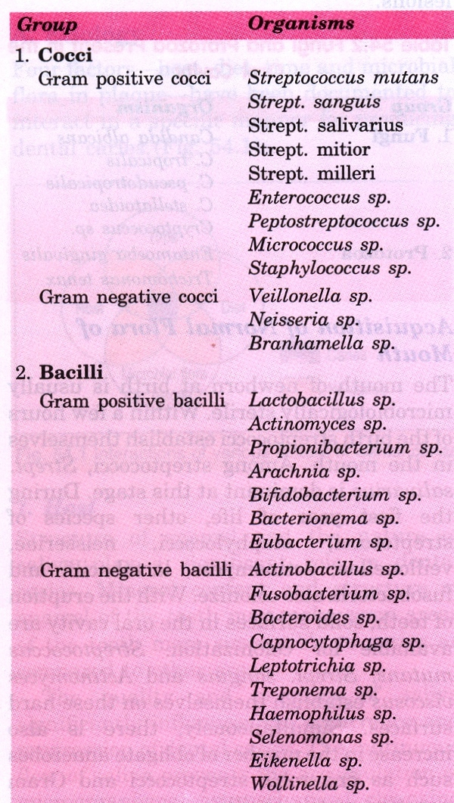
Normal
flora
of oral
cavity

Slide 4
Role of Resident flora
Beneficial Role:
Prevent colonization of pathogens
Synthesises vitamins esp. K & B (Biotin & Riboflavin)
Antibodies produced against commensals cross react with pathogens
Bacteriocin – harmful for pathogens
Endotoxin – help defense mechanism by triggering alternative complement pathway
production of digestive enzymes – amylase, lipase, protease

Slide 5
Disease production:
Immunocomprised states – nonpathogenic organisms may become pathogenic
Streptococcus mutans – causes caries
Viridans streptococci ------------->septicaemia ----------------->endocarditis
Commensal enterococcus faecalis ---->UTI
Prolonged use of broad spectrum antibiotics may cause – acute necrotising ulcerative gingivitis, periodontitis, Vincent’s angina, candidiasis

Slide 6
Microbe-Host interaction in oral cavity
Microbial factors Host factors
Adherence 1. Anatomical factors
Production of 2. Salivary factors
antimicrobial agents 3. Crevicular fluid
Sensitivity to 4. Diet
antimicrobial agents 5. Oral hygiene
4. Metabolic capability 6. Oral & systemic
5. Nutritional requirement diseases
7. Oral immune
defenses
Notes:
pability

Slide 7
Microbial factors
Adherence – factors like pili, fimbriae, lipoteichoic acid favor bacterial adherence
Antimicrobial agents produced by some bacteria like bacteriocin, hydrogen-peroxide

Slide 8
Host factors
Anatomical factors – malocclusion irregular teeth, poor restoration are factors which favor plaque formation
Salivary factors – mechanical washing, swallowing, glycoproteins of saliva promotes adherence & nutrition, lysozyme & lactoferrin are lethal to bacteria, buffering, IgA
Crevicular fluid – contains IgG,IgM &IgA, complement & transferrin, lysozyme protease, elastase & electrolytes
Miscellaneous factors – reduced redox potential promotes growth of anaerobes.

Slide 9
Dental Plaque
Def: soft deposits that form a bio film adhering to teeth and other hard surfaces in oral cavity including intra-oral prosthesis
Consists of micro-organisms +amorphous material
Classification: based on site of origin
Supragingival
Subgingival
Marginal

Slide 10
Formation of plaque
Oral bacteria produce extra cellular adhesives (glucan, dextran, fructan) from carbohydrates
Adherance to pellicle on tooth surfaces
Pellicle – salivary glycoprotein adsorbed to enamel forming a bio film
Adsorption of more bacteria forming a confluent layer – PLAQUE ------>calcification -------> forming CALCULUS or TARTER

Slide 11
Composition of dental plaque
Initially Streptococcus mutans/Str.sanguis colonise dental pellicle thru adhesins
Actinomyces found in oral cavity bind ------> Co-aggregation
Other bacteria like Prevotella intermidia, Fusobacterium nucleatum, Porphyromonas gingivalis, Mycoplasma, yeast & even viruses bind
As well as binding with host cells, epithelial cells along with macrophages & leucocytes

Slide 12
Effects of plaque formation
Calculus formation – both supra & sub gingival plaque may become calcified
Dental caries
Periodontal disease – the disease may effect the marginal gingiva, priodontal ligament, cementum or alveolar bone
Other oral diseases –
Infections of dental plaque or periapical tissues
Acute necrotising ulcerative gingivitis (ANUG)
Peridontal abscess
Actinomycosis of cervicofascial region
Candidiasis – specially after antibiotic therapy

Slide 13
Dental caries
Caries – Latin =decay or rottenness
Calcified tissues of teeth ---->demineralization and destruction
Due to – (i)decreased host resistance(ii) increased cariogenic challenge from diet ----> proliferation of bacteria
Mechanism of caries – demineralization of inorganic components of teeth --------> weakening of tooth structures ------->cavity formation ------> eventually loss of teeth

Slide 14
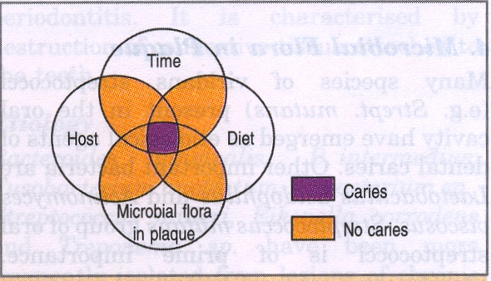
Etiology

Slide 15
1. Host factors
Structure of enamel – mineral content & structure of enamel may make some areas more susceptible
Nature of saliva – quality & quantity of saliva & functions as:
Mechanical washing – prevents accumulation of debris
Neutralizes acid – buffering effect
High Ca & P content – important in remineralisation in early disease
Lysozyme – bactericidal

Slide 16
2. Diet
Micro flora of oral cavity ferment dietary carbohydrates producing acid which dental tissues
Cariogenecity – High – Sucrose, Moderate – Glucose & fructose, Low – xylitol
Sucrose also acts substrate for synthesis of adherent polysaccharides which in adhesion of bacteria to dental plaque -----> plaque thickens ------->more acid production ------>prolongs maintenance of low pH on tooth surface

Slide 17
Time
Prior to ingestion of carbohydrate pH of oral cavity – slightly acidic or alkaline
After ingestion of carbohydrate pH rapidly reduced by 2 or more
Repeated ingestion of carbohydrate at short intervals favors caries formation

Slide 18
Microbial flora in plaque
Many species of viridans streptococci eg. Strep.mutans, strep.sorbinus, strep.sanguis, Strep.salivarius present in oral cavity produce glycosyltransferases which converts dietary sucrose to GLUCAN
Others like lactobacillus, actinomyces

Slide 19
Prevention
Good oral hygiene – reduction of microbial flora
Regular brushing & flossing – prevent stagnation of food
Decreased intake of sucrose rich diet
Improvement of tooth resistance by incorporation of fluorides in water or topical application
Removal of dental plaque by mechanical methods (scaling)
Sealing of more prone anatomical sites by fissure sealants

Slide 20
Microbiological test to assess dental caries
No specific microbiological test for assessment
However salivary counts of S.mutans and lactobacilli have been advocated for detection for patients of higher risk of developing caries
Prevention & reduce extensive costly oral treatment

