Slide 1
Growth and Development

Slide 2
Introduction
Importance of studying growth and development

Slide 3
Definition of growth :-
Growth refers to increase in size – Todd
Growth may be defined as the normal changes in the amount of living substance. - Moyers
Growth usually refers to an increase in size and the number - Proffit

Slide 4
Definition of Development
Development is progress towards maturity” - Todd
Development connotes a maturation process involving progressive differentiation at the cellular and tissue levels - Enlow

Slide 5
Correlation between growth and development
Growth is basically anatomic phenomenon and quantitative in nature.
Development is basically physiologic phenomenon and qualitative in nature.

Slide 6
Normal features of growth and development
Differential growth
Pattern
Nomality
Variability
Timing, rate and direction.

Slide 7
Differential growth
Not all tissue system s of the body grow at the same rate. Different tissues and in term different organs grow at different rates. This process is called differential growth.

Slide 8
Scammons Curve
As the graph indicates, growth of the neural tissues is nearly complete by 6 or 7 years of age. General body tissue, including muscle, bone and viscera, show and S-shaped curve, with a definite slowing of the rate of growth during childhood and an acceleration at puberty. Lymphoid tissues proliferate far beyond the adult amount in late childhood, and then undergo involution at the same time that growth of the genital tissues accelerates rapidly.

Slide 9
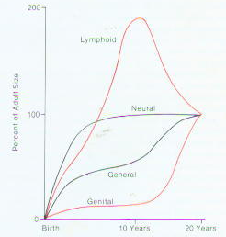

Slide 10
Cephalocaudal Gradient of growth
Represents the changes in over all body proportions during normal growth and development.
In fetal life, at about the third month of intrauterine development, the head takes up almost 50% of the total body length. At this stage, the cranium is large relative to the face and represents more than half the total head.

Slide 11
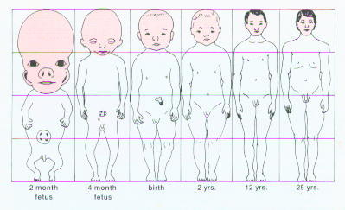
Cephalocaudal Gradient of growth

Slide 12
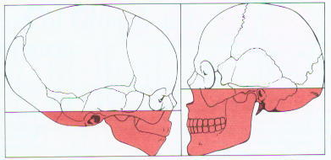
Cephalocaudal Gradient of growth

Slide 13
In contrast, the limbs are still rudimentary and the trunk is underdeveloped. By the time of birth, the trunk and limbs have grown faster than the head and face, so that the proportion of the entire body devoted to the head has decreased to about 30%.

Slide 14
The overall pattern of growth thereafter follows this course, with a progressive reduction of the relative size of the head to about 12% the adult. Thus “Cephalocaudal gradient of growth”. This simply means that there is an axis of increased growth extending from the head towards the feet.

Slide 15
Growth Spurts
Refers to Sudden increase in growth of general Body.
Woodside in his study of Burlington Group showed.
Girls Boys
Just after birth 3 yrs 3 yrs
Juvenile growth Spurt 6-7yrs 7-9yrs
Pubertal growth spurt 10-12yrs 12-15yrs

Slide 16
Importance of Growth Spurts:
Pubertal increments offers best time for
large number of cases for the orthodontic and
orthopedic treatment. It also helps in
determining the predictability, growth
direction, patient management and total
treatment time.

Slide 17
Orthopedic correction of maxilla and
Mandible.
Understanding the growth, predictability of future growth of maxilla, mandible and alveolar process helps in diagnosing and achieving excellent results of the mal-occlusion.

Slide 18
Growth spurts serve as excellent indicators for timing of orthodontic treatment
Correlation of
a. Skeletal age,
b. Dental age
c. Chronological age.
With on set of puberty.

Slide 19
Biological changes seen during puberty.
Biological changes differ with boys and girls
In Boys :
Stage I:
- Fat spurt - Initially maturing boy gains
weight and becomes chubby –production of estrogen before production of testosterone.

Slide 20
Stage II
Spurt in height, development of secondary sexual characteristics.
Occurs 1 year after the Stage I
Stage III
Occurs 8-10months after stage II and coincides with the peak velocity with gain in height
At this stage auxillary hair appears and facial hair appears on upper lip. Spurt in muscle growth occurs.

Slide 21
Stage IV:
Occurs from 15-24 months after stage III
Spurt of growth in height ends. Facial hair on chin and upper lip. This indicates growth is almost complete.
In Girls: (9-12 yrs)
Stage I:
- Beginning of growth spurt appearance secondary sexual characteristics .

Slide 22
Stage II:
Occurs 1 year after stage I coincides with peak velocity physical growth.
Stage III:
Occurs 1-1½ years later stage II. marked by on set of menstruation.
By this time growth spurt all but complete.

Slide 23
Methods of Studying Growth
A
Experimental approach
Measurement approach
B
Longitudinal study
Cross sectional study.
Semi longitudinal study.

Slide 24
Longitudinal study:
Advantages: Temporary problems are smoothen with time, variability in development within a group is put in proper perspective, serial comparison makes study of specific developmental pattern of individual possible.

Slide 25
Disadvantages: Time consuming, expensive, sample loss or attrition, averaging.
These are measurements made of the same person or group at regular intervals through time.

Slide 26
Cross sectional studies :
These are measurements made of different samples or different individuals and studied at different periods.
Advantages: Quicker, less expensive, statistical treatment of data is easier. Studies can be readily repeated. Method can be used in archeological data.

Slide 27
Disadvantages: It must be assumed that groups being measured and compared are similar. Cross sectional group averages tend to obscure individual variations.

Slide 28
(
Longitudinal and cross sectional studies can be combined to seek the advantages of both. In this way one might compress 15 years of study into 3 years of gathering growth data.

Slide 29
Measuremental approach
Non destructive Technique for measuring growth in living animals including man
The Species will be available for
additional measurements at another
time.

Slide 30
Measurement Approaches:
Craniometry : Based on measurement of skulls found among human skeletal remains. From such skeletal material, it has been possible to piece together a great deal of knowledge
Advantage: Craniometry has the rather precise measurements can be made on dry skulls.
Disadvantage: It is a Cross Sectional study.

Slide 31
Cross-Sectional means that although different ages are represented in the population, the same individual can be measured at only one point in time.
Anthropometric Study: This measurement can be made on either a dried skull or a living individual, but results would be different because of the soft tissue thickness overlying both landmarks.
Advantages: This produces longitudinal data: repeated measures of the same individual.

Slide 32
Cephalometric radiology: is of considerable importance not only in the study of growth but also in clinical evaluation of orthodontic patients. This approach can combine the advantages of craniometry and anthropometry. It allows a direct measurement of bony skeletal dimensions, but it also allows the same individual to be followed over time.

Slide 33
Experimental approach
Detailed study may be destructive
Largely restricted to non human beings

Slide 34
Experimental approaches:
Vital Staining:
John Hunter originated this method. In eighteenth century. Hunter observed that bones of Pigs that are occasionally fed with textile waste were often stained in an interesting way. He observed that active agent was a dye called alizarin which still used for vital staining studies.

Slide 35
Vital staining is method of studying skeletal growth in which dyes that stain mineralizing tissues are injected in to animal. These dyes remain in teeth and bones and can be detected later after the sacrifice of animal.

Slide 36
These dyes react strongly at sites where bone calcification is occurring. Since these are the sites of active skeletal growth, the dye marks the locations at which active growth is occurring.

Slide 37
Tetracycline was discovered too late in 1960’s as an excellent vital stain that binds to calcium often resulting in discoloration of tooth
Vital staining method can not be used in humans.

Slide 38
Alizarin Red 5
Tetracycline Used for vital
Lead Acetate staining.
Trypon Blue.

Slide 39
Radio-Isotopes
With development of radio active tracers it is possible to use radio actively labeled metabolite that becomes incorporate in tissues as sort of vital stain.
The location of radio active element is detected from tissues by the weak radio-activity given off at the site where material was incorporated.

Slide 40
Isotope technetum (Tc^{99m}) (Gamma Emitting)
33 M_{Tc}
Calcium ⁴⁵
Potassium ³²
¹⁴C Proline
³H Thymidine
This radioactivity in tissues of experimental
animals is detected in tissue culture by
method called Autoradiography

Slide 41
In Autoradiography a film emulsion is placed over a this section of tissue containing the isotope and then it is exposed in dark by the radiation that indicates where growth is occurring.

Slide 42
Implant Radiography:
- This method of study developed by professor Arne Bjork and Coworkers at Royal Dental College in Copenhagen Denmark in 1969. This has provided important new information about growth pattern of jaws.

Slide 43
In this technique, Innert metal pins are placed in bones of face and Jaws. These metal pins are innert and are well tolerated by skeleton.
Cephalometric reading taken periodically and superimposition of radiographs provide precise changes in position of bone and Jaw growths.

Slide 44
Natural markers.
The persistence of certain developmental features has led to their use as natural markers by means of serial radiography.
Eg: trabaculae,nutrient canals and lines of arrested growth can be used for reference to study deposition, resorption and remodeling.
Certain natural markers are used as cephalometric landmarks.

Slide 45
Functional Matrix theory Melvin Moss (1965)

Slide 46
Implant markers.
Bjork devised a method of implanting tiny bits of tantalum or biologically inert alloys into growing bone which served as radiographic reference markers for serial cephalometric study.
The method allows precise orientation of serial cephalograms and information on the amount and sites of bone growth.

Slide 47
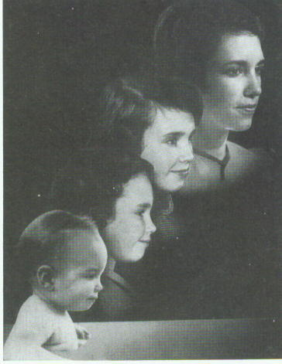
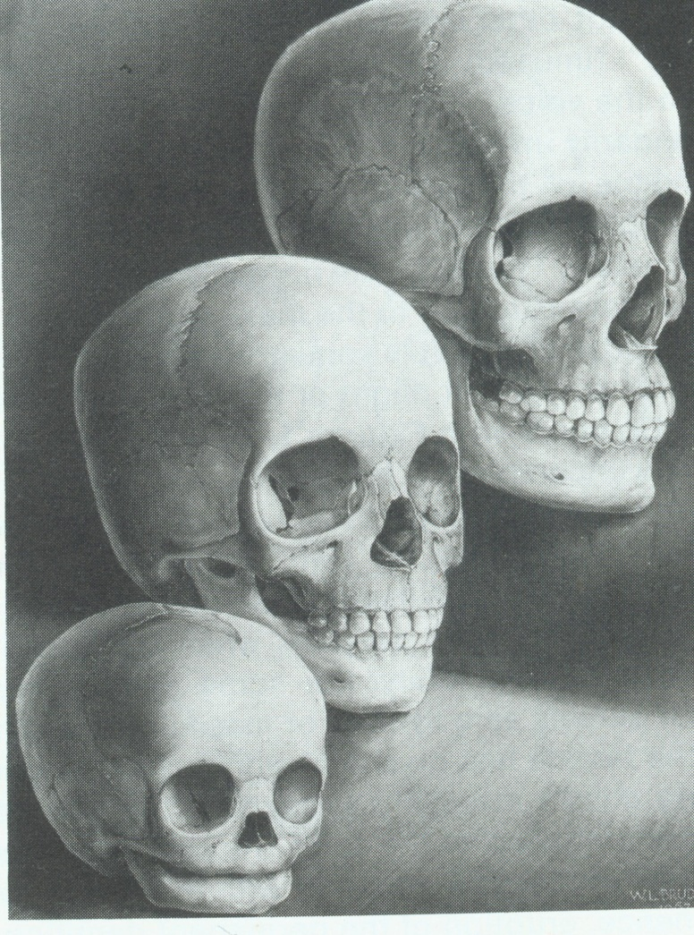
Theories of Growth and Development

Slide 48
According to BAUME:
Growth Center:
Is a site of endochondral ossification with
tissue separating force,contributing to the
increase of skeletal mass.
Growth Site:
Regions of Periosteal or suture bone
formation and modeling resorption adaptive
to environmental influences.

Slide 49
GROWTH THEORIES 1) Genetic Theory 2) Sutural Theory 3) Cartilagnous theory 4) Functional Matrix thory 5) Cybernetic Theory 6) Composite Theory

Slide 50
Genetic Theory
1950’s to 1970’s:
Mainly based on observations
No evident scientific data
Lacked scientific understanding and soon replaced
by other theories.

Slide 51
Sutural Theory:
Proposed by Sicher in 1955: According to Sicher
“The primary event in sutural growth is the proliferation of the connective tissue between the two bones. If sutural tissue proliferates, it creates the space for appositional growth at the border of the bones”.

Slide 52
We now know that functions of future are :
Unite the bone
Absorb the forces,
Act as a joint
Act as a growth site and not growth centre

Slide 53
Evidences Against Sicher’s Theory:
Auto transplants of sutures fail to grow in cultural medium though provided with same environment and conditions.
Extripation of sutures has no appreciable effect on growth of skeletal.
The shape and growth within sutures is dependent on external stimuli.
It is possible to bring the sutural grwoth to halt by mechanical stresse applied across the sutures.

Slide 54
Cartilagenous Theory (James Scott-1956)
The fact that, for many bones of the hand and legs, cartilagedoes the growing while bone merely replaces it makes this theory attractive for the bones of the jaws.
According the Scott:-
Spheno-occipital synchondrosis cartilage -responsible for the growth of cranial base.
Nasal septal cartilage – Responsible for the growth of maxilla
Condylar cartilage – Responsible for the growth of mandible

Slide 55
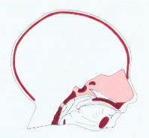

Slide 56
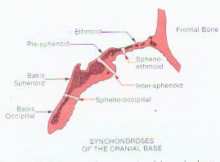
Synchondroses of the cranial base
Spheno ethmoidal
Inter-sphenoidal
Spheno-occipital

Slide 57
Spheno-occipital Synchodrosis:
Important growth center of craniofacial skeleton, especially cranial base.
Cartilage of Nasal Septum:
Growth of maxilla is difficult to explain on the cartilage theory. Proponents of the cartilage theory hypothesize that the cartilaginous nasal septum serves as a pacemaker for other aspects of maxillary growth.

Slide 58
Two kinds of experiments have been carried out to test the idea that cartilage can serve as a true growth center.
1. Transplanting nasal cartilage to cultural medium or any other place did not give equivocal results, that is sometime it grew, sometimes it did not. Indicating doubtful growth potential of the nasal septal cartilage whereas, if a piece of the epiphyseal plate of a long bone is transplanted, it will continue to grow in a new location or in culture, indicating that these cartilages do have innate potential.

Slide 59
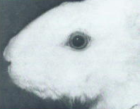
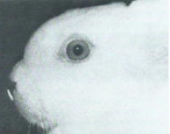
A
B
Effect of removal of the cartilaginous nasal septum on forward growth of the snout in the rabbit.

Slide 60
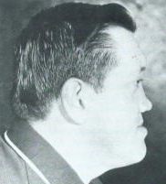
Profile view of man whose cartilaginous nasal septum was removed at age 8, after an injury.

Slide 61
Condylar Cartilage and Mandibular Growth
Since longtime, its being hypothesized that condylar cartilage is the growth center for the growth of mandible.
Experiments of transplanting condylar cartilage showed little or No growth potential.
It is no clear that condylar cartilage is secondary cartilage, which grows by appositions and not by intestitial deposition. Whereas, epiphyseal cartilage is primary cartilage.
Mandibular condylar thus do not have innate growth potential and not a growth center.

Slide 62
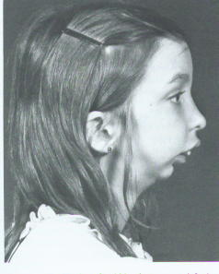

Slide 63
The fact that after the condylar fracture in children do not all together inhibit growth of mandible indicates that condyle is not a growth center.
Studies carried out in Scndinavia in 1960’s demonstrated that after the fracture of mandibular condyle in child, there was an excellent chance that the condylar process would regenerate to approximately its original size and small chance that it would overgrow after the injury.

Slide 64
FUNCTIONAL MATRIX HYPOTHESIS

Slide 65
THE ORIGIN,GROWTH AND MAINTENANCE OF ALL SKELETAL TISSUES AND ORGANS ARE ALWAYS SECONDARY,COMPENSATORY AND OBLIGATORY TO TEMPORALLY AND OPERATIONAL PRIOR EVENTS OR PROCESSES THAT OCCUR IN SPECIFICALLY RELATED NON-SKELETAL TISSUES,ORGANS OR FUNCTIONAL SPACES

Slide 66
Each of these function is completely carried out by
FUNCTIONAL CRANIAL
COMPONENT

Slide 67
Functional cranial component
Skeletal unit
Functional matrices
Macroskeletal
Eg-coronoid,
angular
Microskeletal
Eg-endocranial
surface Of calvaria
Periosteal
Eg-teeth and
muscles
Capsular
Eg-orofacial,
neurocranial

Slide 68
Skeletal unit
Composed of –bone, cartilage and tendinous tissue
MACROSKELETAL UNIT-
Adjoining portions of number of neighbouring bones carrying out a single function eg- endocrainal surface of calvaria

Slide 69
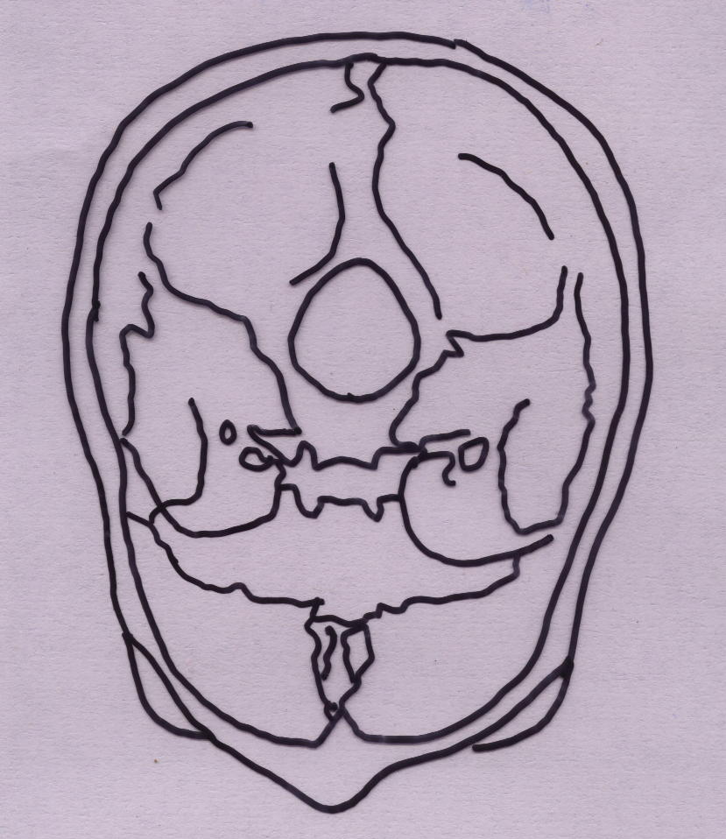
Macro skeletal unit

Slide 70
MICROSKELETAL UNIT
bones consisting of number of small skeletal units
MAXILLA-orbital
-pneumatic
-palatal
-basal
MANDIBLE-coronoid
-angular
-alveolar
-basal

Slide 71
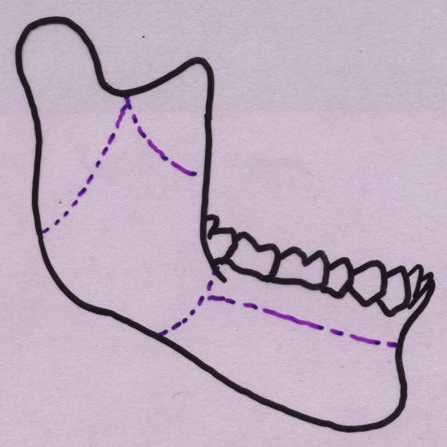

Slide 72
FUNCTIONAL MATRICES
This consist of soft tissue-muscle,gland,nerve,vessels,fat and teeth as well as non skeletal cartilages
DIVIDE INTO TWO TYPES-
Periosteal matrices
Capsular matrices

Slide 73
PERIOSTEAL MATRICES
All non skeletal functional units adjacent to skeletal unit form the periostel matrices
They act by bringing transformation of the related skeletal units
Best explanation – coronoid process and temporalis muscle
Removal,denervation, postinfectively-
decrease in the size or total disappearance

Slide 74
Hence in simple terms it can be stated-
Coronoid process does not grow itself first and thus provide a platform upon which the temporalis muscle can alter its function but it is the opposite which is true

Slide 75
CAPSULAR MATRICES
FOUR CAPSULES ARE PRESENT-
NEURO CRANIAL
ORO FACIAL
OTIC
ORBITAL

Slide 76
Each of these capsules is an envelop containing functional cranial component
Sandwitched between two covering layers
Capsules expands due to volumetric increase of capsular matrix
This results in the translative movement of the embedded bones

Slide 77
NEUROCRAINAL CAPSULE
Sandwiched between-skin and dura mater
Consists of-5 layers of scalp
-bone
-two layer dura mater

Slide 78
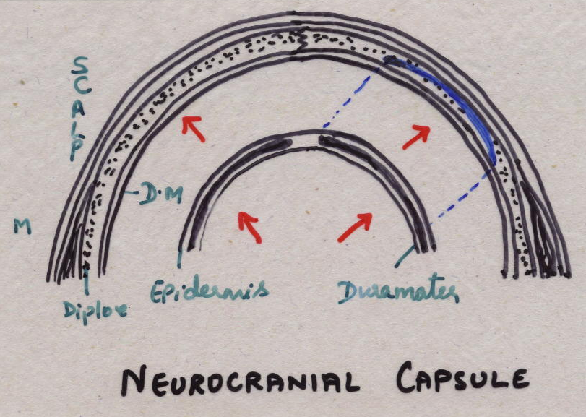

Slide 79
ORO FACIAL MATRIX
Surround and protect oronasopharyngeal space.
Surrounded by skin and mucous membrane on either side.
Originates by process of enclosure.
Volumetric growth of these spaces is the primary morphogenetic event in facial skull growth

Slide 80
Orofacial Capsule

Slide 81
Primary function is maintaining airway this is accomplished by “AIRWAY MAINTENANCE SYSTEM”-BOSMA
Growth of functional spaces-increase in the size of capsule
Followed by passive movement of functional cranial component

Slide 82
Servosystem theory
or
Cybernetic theory: Proposed by petrovic accordingly, the growth of maxilla and mandible and cranial base depends upon cybernetic control. This cybernetic control is mainly by Secretion of hormones. These hormones mainly include growth hormone - somatomedin, testosterone and estrogen.

Slide 83
Author describes the secretion of hormones is by the signal established independed of the feedback system.
This signal secretion is described as COMMAND .
This signal is transmitted to the Reference input elements. In maxilla they include septal cartilage, septopremaxillary frenum, the labionarinary muscles and the maxillary bones. In mandible reference input elements include muscle attachments to the mandible that is lateral pterygoid, medial pterygoid and tempralis muscles.

Slide 84
The commanding signal is first established in the maxilla through the above quoted reference input elements and thus maxilla grows in sagittal and vertical direction. The corresponding actuating signal followed to the above process is felt in the mandible through the reference input elements and mandible growth occurs.

Slide 85
Functional matrix theory revisited
Melwin Moss in 1997 proposed continuation of his classical functional matrix theory with the new concept. He published series of articles in American Journal of Orthodontics in 1997.
According to this concept the mechanical stimulus is pursued by the specialized cells by process called as mechanoperception. Then these signals are transmitted through the tissues by way mechanoconduction or mechanotrasmision. Finally, these signals are transmitted to the genome of the bone were protein synthesis is taking place.

Slide 86
These signals alter the protein metabolism depending upon the severity and longativity of the mechanical stimulus. In short the earlier concept of FMH theory remained same as form is determine by the function.
Moss also recognizes the important role of genetics and human genome in determining the ultimate size and shape of the craniofacial skeleton. He quotes reference of human genome project which is being carried in a mega scale allover the world. According to the human genome project human chromosomes contain the genetic informations necessary for buildingup of entire human body.

Slide 87
Genes now beyond doubt have been proved to effect
the physical growth of the person, behavior of person and
psychology of person.
Thus Moss FMH revisited theory states the ultimate
growth controlling factor of the craniofacial skeleton
depends on two factors.
Genetic factors
Environment factors.

Slide 88
Mechanisms of growth
3 mechanisms at the cellular level
Hyperplasia
Hypertrophy
Secretion of extracellular matter

Slide 89
Mechanism of growth in soft tissues
In soft tissues growth occurs by a combination of two mechanisms namely hyperplasia and hypertrophy – Interstitial growth

Slide 90
Mechanism of growth in hard tissue
It is of two types
Intramembranous Endochondral
Bone formation. Bone formation

Slide 91
Mechanism of growth in hard tissues
Intramembranous bone formation:
Occurs in areas exposed to tension
It differs from endochondral bone formation by formation of bone directly from mesenchymal tissue
Seen in areas like
Cranial vault
Maxilla
Mandible except condylar cartilage

Slide 92
Undifferentiated mesenchymal cells differentiate
Osteoblasts
Osteoid Matrix
Calcification and formation of bone results

Slide 94
Mechanism of growth in hard tissues
Endochondral bone formation:
Occurs in regions exposed to high levels of compression
In craniofacial region it is seen in areas like
Synchondrosis at the cranial base
Condylar cartilage
Nasal septal cartilage

Slide 95
Cartilage cells undergo hypertrophy
Marix become calcified.
Cells Degenerate
Osteogenic tissues invade disintegrating cartilage and replace it by formation of bone.

Slide 97
Bone metabolism
Bone is the primary calcium reservoir of the body (99% stored in skeleton)
Bone structure is sacrificed to maintain the critical serum calcium levels at 10mg %

Slide 98
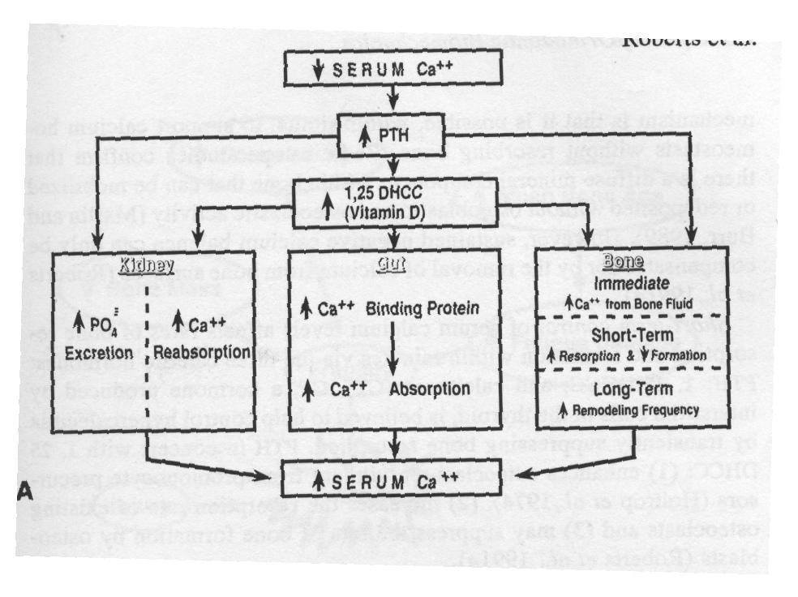
Bone metabolism
Calcium homeostasis is supported by 3 mechanisms :
Rapid instantaneous flux of calcium from bonefluid (seconds) by selective transfer of calcium ions into and out of bone fluid.
Shorterm control of serum calcium levels affects rates of bone formation $ resorption
Longterm regulation of metabolism- have effects on skeleton
.

Slide 99
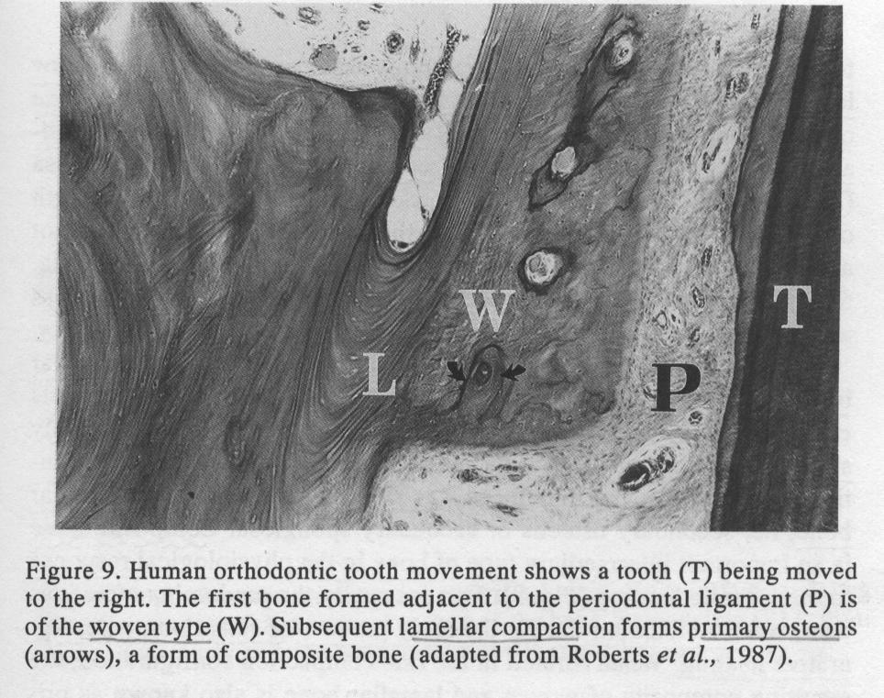
Types of Bones
Woven bone – The first bone formed in response to orthodontic loading usually is the woven type. It is weak, disorganized, and poorly mineralized
Lamellar bone – a strong, highly organized, well-mineralized tissue

Slide 100
Types of bones
Composite bone – is an osseous tissue formed by the deposition of lamellar bone within a woven bone lattice, a process called Cancellous compaction. This is the quickest means of producing relatively strong bone
Bundle bone - is a functional adaptation of lamellar structure to allow attachment of tendons and ligaments

Slide 101
Mechanisms of bone growth
Modeling
Remodeling
Displacement
Combination of remodeling & displacement
Rotation

Slide 102
MODELING
Bone modeling involves independent sites of resorption and formation that change the size and shape of a bone.

Slide 103
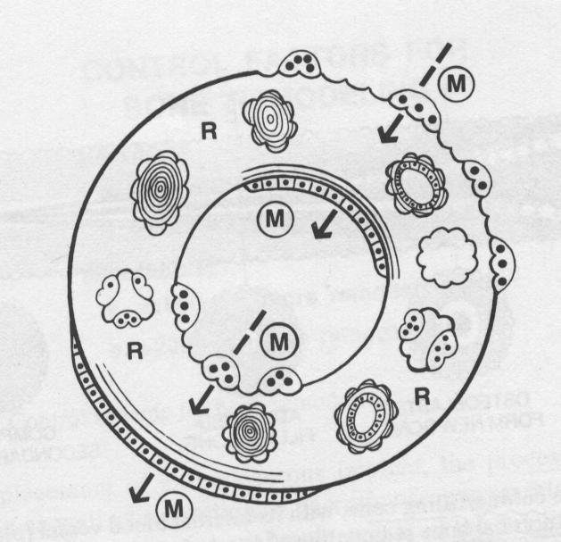

Slide 104
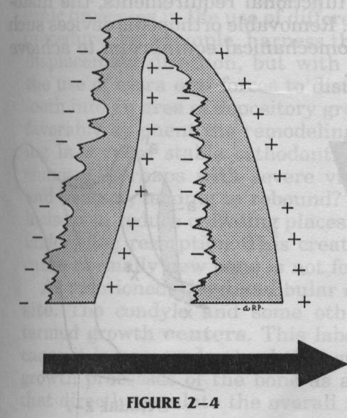
Remodelling
A process involving deposition and resorption occuring on opposite ends
Four types
Biochemical remodelling
Haversian remodelling
Pathologic remodelling
Growth remodelling

Slide 105
Functions of Remodelling
Progressively change the size of whole bone
Sequentially relocate each component of the whole bone
Progressively change the shape of the bone to accommodate its various functions

Slide 106
4. Progressive fine tune fitting of all the separate bones to each other and to their contiguous ,growing, functioning soft tissues
5. Carry out continuous structural adjustments to adapt to the intrinsic and extrinsic changes in conditions .

Slide 107
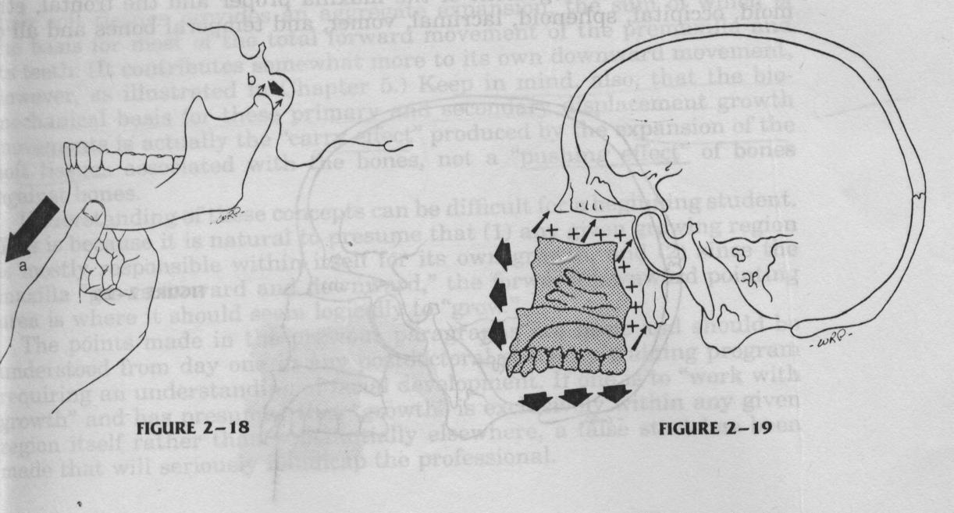
Displacement
Refers to a shift in the position of the bone
Two types
Primary displacement
Secondary displacement

Slide 108
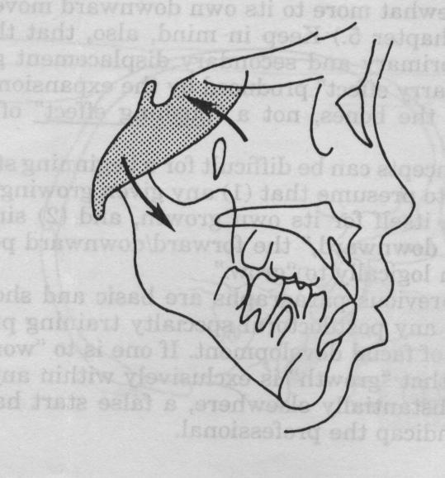
Rotation
According to Enlow, growth rotation is due to diagonally placed areas of deposition and resorption
Two types
Remodelling rotations
Displacement rotations

Slide 109
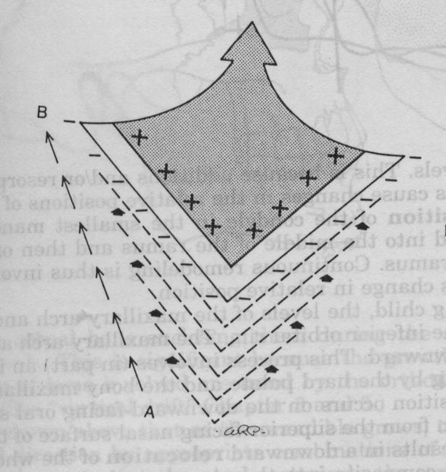
‘V’ - Principle
Deposition occurs on the inner side and resorption on the outerside of the bones causing enlargement and displacement.
The displacement is towards wide end of ‘V’
Examples
Neck of the condyle
Palatal process of maxilla

Slide 110
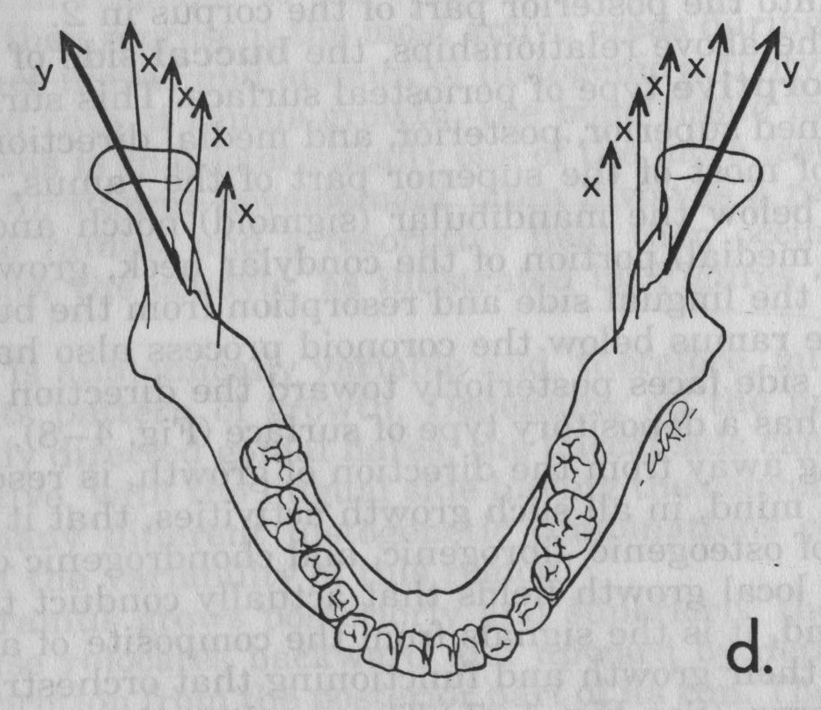
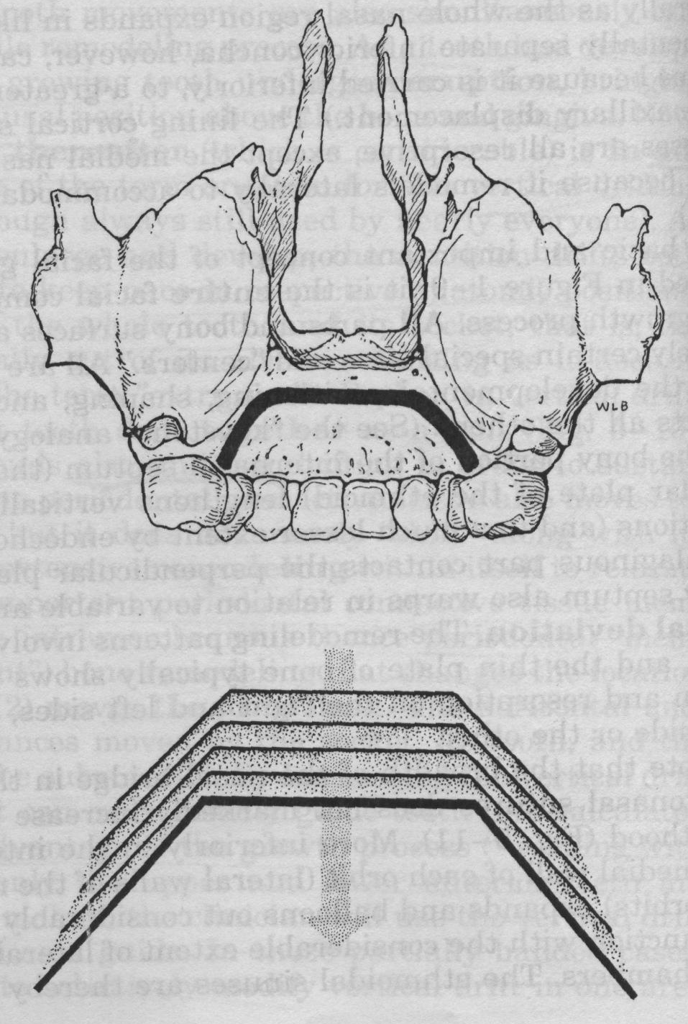

Slide 111
Growth equivalent principle
This principle proposed by Hunter & Enlow
relates the effects of cranial base growth on
the facial bone Growth.

