Slide 1
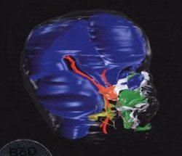
Seminar
Theories of Growth and Development

Slide 2
INTRODUCTION
It is a true that growth is strongly influenced by genetic factors, but it also can be significantly affected by the environment in the form of nutritional status, degree of physical activity, health or illness, and a number of similar factors.
Since a major part of the need for orthodontic treatment is created by disproportionate growth of the jaws, in order to understand the etiologic processes of malocclusion and dentofacial deformity, it is necessary to learn how facial growth is influenced and controlled.

Slide 3
DEFINITIONS
Growth:
Growth is an increase in size, it is quantitative phenomenon and measured by linear or volumetric scale. [ Todd ]
Growth is increase in size, change in proportion and progressive. [ Krogman ]
Growth is any morphological parameter which is measurable. [ Melvin moss ]

Slide 4
Development :
It is progress towards maturity. [Todd-1931]
Development is increase in complexity. [Proffit-1986]
Development refers to all the naturally occurring unidirectional changes in the life of an individual from its existence as a single cells to its elaboration as a multifunctional unit terminating in death.[Moyer-1988]

Slide 5
Growth sites
These are location at which growth occurs .
There are following main growth sites in cranial and facial bone -
• suture of face and cranium
• nasal septum cartilage • mandibular condyle
• synchondroses of cranial base
• alveolar bone
• posterior border of ramus

Slide 6
Growth center ( Koski 1968)
Growth center is a location at which independent growth occurs . They have innate potential of growth.
All the growth centers also are growth sites but reverse is not true.

Slide 7
THEORIES OF GROWTH
There are various theories to explain growth of craniofacial region.
Genetic theory [Brodie-1941]
Sutural dominance theory [H.Sicher-1955]
Cartilaginous theory [James Scott-1953]
Enlow’s V principle
Functional matrix theory. [Melvin moss-1962]

Slide 8
6) Functional matrix hypothsis revisited [Melvin moss- 1997]
7) Van limborgh’s multifactorial theory [1970]
8) Neurotropism theory [Behrents-1976]
9) Servosystem theory [Petrovic,1982]

Slide 9
Genetic theory [Brodie 1941 ]
According to this theory genes controlled all aspects of growth and is preplanned.
Genes are the exclusive determinants for all growth parameters including regional growth amounts, velocities and minute details of regional configuration.

Slide 10
In addition to multiple genes there are the effects of the environment on the product of the genetic control during formation.
This was one of the earliest theories put forward. Only some part of this theory is accepted.

Slide 11
Sutural dominance theory [H.Sicher;1955]
Suture between the membranous bones of the cranium and jaws were considered growth centers.
According to this theory, the proliferation of sutural connective tissue and it’s replacement by bone in the sutures being a primary determinant.

Slide 12
According to Sicher, paired parallel sutures that attach facial areas of the skull and the cranial base region push the nasomaxillary complex forwards to pace it’s growth with that of the mandible.

Slide 13
Rejection of Theory:
If this theory would have been correct, growth at the sutures should occur largely independently of the environment, and it would not be possible to change the expression of growth at the sutures very much.
But it can be seen that growth at sutures will respond to outside influences under a number of circumstances. If cranial or facial bones are mechanically pulled apart at the sutures, new bone will fill in, and the bones will become larger.

Slide 14
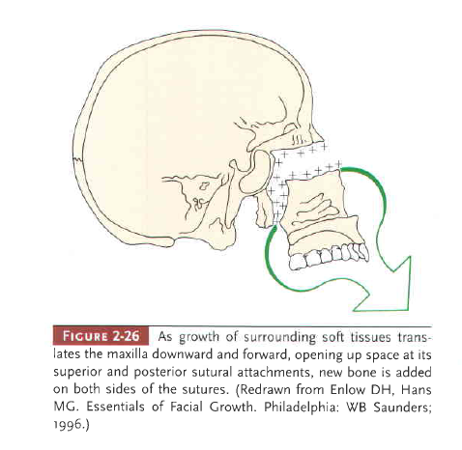

Slide 15
Other reasons of rejection :
When the area of suture between two facial bones was transplanted to another location, the tissue does not continue to grow. This indicates lack of innate growth potential in sutures.
Growth takes place in untreated cases of cleft palate even in the absence of sutures.

Slide 16
It is clear now that sutures, and the periosteal tissues more generally, are not primary determinants of the craniofacial growth
Thus sutures must be considered as the sites of the growth not growth centers.

Slide 17
Cartilaginous theory [James Scott,1953]
Scott assumed that the primary controlling factors in craniofacial growth are found only in the cartilage and the periosteum, and the sutures are secondary and passive. He viewed that cartilaginous sites throughout the skull as primary centers of growth.

Slide 18
Cartilage is present in the ‘epiphyseal plate of long bones, in the synchondroses of the cranial base, and the mandibular condyle, where it provides linear growth by endochondral proliferation.
Two kinds of experiments have been carried out to test the idea that cartilage can serve as a true growth center
Analysis of the results of transplanting cartilage in culture or other location (abdominal wall).
An evaluation of the effects on growth after removing cartilage at an early age.

Slide 19
Transplantation Experiments:
If a piece of a epiphyseal plate of a long bone is transplanted, it will continue to grow, indicating that these cartilages do have innate potential.
Rejection:
But transplantation experiments demonstrate that not all skeletal cartilage acts the same when transplanted.
Transplanting cartilage from the nasal septum give equivocal results: sometimes it grew, sometimes it did not.
The mandibular condyle does show little or no growth when transplanted.

Slide 20
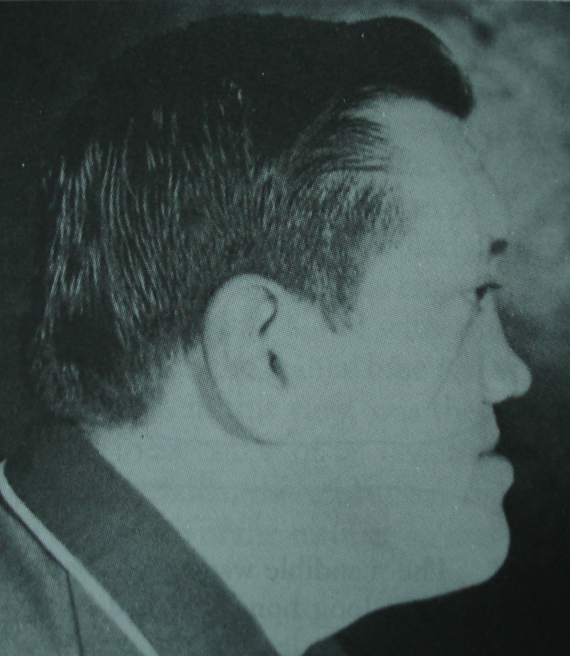
Cartilage Removal Experiments:
According to this theory growth of maxilla depends upon nasal septal cartilage, it is the pacemaker for growth of entire nasomaxillary complex.
If nasal septal cartilage is removed, the growth of midface becomes deficient.

Slide 21
Rejection:
It is seen that in 75% to 80% of human children who suffers from condylar fracture resulting loss of the condyle, does not impede the mandibular growth. The condyle regenerates very nicely from the periosteum at the fracture site. And fractured condyle resorbs itself.
Only in 15% to 20% of children growth deficit occurs which is related scar tissue formed due to infection or trauma induced bleeding and not because of loss of condylar cartilage.
Scar tissue impedes the normal function of mandible which results in deficient growth.

Slide 22
Functional Matrix Theory [Melvin moss 1962]
If neither suture nor cartilage was the determinant for growth of the craniofacial skeleton, it would appear that the control would have to lie in the adjacent soft tissues.
This point of view was put formally in the 1960s by Moss, in his "functional matrix theory" of growth, and was reviewed and updated by him in the 1990s.
This theory is based on functional cranial component theory of Vander Klaus.

Slide 23
Moss stated that growth of the face occurs as a response to functional needs and is mediated by the soft tissues in which the jaws are embedded.
In this conceptual view, the soft tissues grow, and both bone and cartilage follow.
The growth of the cranial vault is a direct response to the growth of the brain.
Moss theorizes that the major determinant of growth of the maxilla and mandible is the enlargement of the nasal and oral cavities, which grow in response to functional needs.

Slide 24
The mandible is translated in space by the growth of muscles and other adjacent soft tissues and that addition of new bone at the condyle is in response to the soft tissue changes.

Slide 25
Functional cranial component
( tissues, organs, spaces, skeletal part )
skeletal unit functional matrix
(bone, cartilage tendons
micro skeletal unit macro skeletal unit
(Various parts of maxilla, ( Endocranial surface and mandible ) calaveria )

Slide 26
Functional matrix
Periosteal matrices Capsular matrices
( muscles, vessels, nerves, ( neurocranial and & glands ) orofacial capsule )
Acts directly on skeletal unit Acts indirectly
Produce a secondary
compen- Produce a secondary
atory transformation by translation in space
Deposition & Resorption by expansion

Slide 27
Neurocranial capsule :
This capsule sandwiched in between layer of skin and duramater.
The neurocranial capsule surrounds and protects the neurocranial capsular functional matrix which is brain, leptomeninges and CSF.

Slide 28
Orofacial capsule : this is sandwiched in between covering layer of skin and mucosa.
This capsule surrounds and protects the oro-nasopharyngeal spaces.
Most orthodontic therapy is based on the fact that when this functional matrix grows or is moved, the related skeletal unit ( the alveolar bone ) responds appropriately to this morphogenetically primary demand.

Slide 29
Functional matrix hypothesis revisited: Moss,1997 1.The role of mechanotransduction
This new version deals only with the responses to periosteal matrices. It now includes the molecular and cellular processes underlying the triad of active skeletal growth processes-
1.deposition 2.resorption 3.maintenance

Slide 30
It does so by the inclusion of two complementary concepts:
1)Mechanotransduction- occurs in single bone cells.
2)Connected cellular network- Bone cells are computational elements that function multicellularly as a connected cellular network.

Slide 31
Mechanotransduction
Mechanosensing process enable a cell to sense and to respond to extrinsic loading by using the process of mechanoreception and mechanotransduction.
The mechanoreception transmits an extra cellular physical stimulus into a receptor cell, the mechanotransduction transforms the stimulus into an intra cellular signal.

Slide 32
Physical stimulus
Mechanoreception
Mechanotransduction
Signal

Slide 33
Osseous mechanotransduction
Static and dynamic loading are applied to bone tissue, leading to deform both extra cellular matrix and bone cells.
When stimulus threshold level exceeded, the loaded tissues responds by triad of bone cell adaptation process.
One bone loading stimulus can evoke three adaptational responses (deposition, resorption and maintenance) where as non osseous processes generally evoke one.
Osseous signal transmission is Aneural.

Slide 34
There are 2 mechanotransductive process- 1) Ionic or electric 2) mechanical- through physical continuity of the transmembrane molecule integrin.
It is by such an interconnected physical chain of molecular levers that periosteal functional matrix activity may regulate the genomic activity of its strained skeletal unit bone cells, including their phenotypic expression.

Slide 35
Extracellular loading
INTEGRIN (Mechanoreception)
intracellularly cytoskeletal ACTIN
(Mechanotransduction)
Control Intranuclear process
Regulate genomic activity
alter phenotypic expression.

Slide 36
Functional matrix hypothesis revisited: 2. the role of an osseous connected cellular network
Bone as an osseous connected cellular network (CCN): •All bone cells, except osteoclasts, are extensively interconnected by Gap junction that form an osseous CCN.
Each osteocyte enclosed within its mineralized lacuna, has many cytoplasmic (canalicular) processes that interconnected with similar processes of up to 12 neighboring cells.

Slide 37
Gap-junction exhibit both electrical and fluorescent dye transmission, in addition to permitting the intercellular transmission of ions and small molecules.
Mechanotransductively activated bone cells, e.g. osteocyte, can initiate membrane action potentials capable of transmission through interconnected Gap-junction.
In network theory, cells are organized into “layers”
1) an initial input 2) intermediate or hidden layer
3) a final output

Slide 38
Loading of bone
stimulate initial cells
( loading exceeds threshold value)
Intracellular signals generated
transmitted to intermediate or hidden layer cells (osteocyte)
( when exceeds threshold value)
transmission to final layer cells (osteoblasts)
Adaptive response

Slide 39
A skeletal CCN displays an untrained, self-organized, self-adaptive and epigenetically regulated system.

Slide 40
Functional matrix hypothesis revisited: 3. The genomic thesis
The whole plan of growth, the whole series of operations to be carried out, the order and site of synthesis and their co-ordination are all written down in the nucleic acid message.
The initial version of the functional matrix hypothesis claiming epigenetic control of morphogenesis was based on macroscopic (gross) experimental, comparative and clinical data. Recently revised it now extends hierarchically from gross to microscopic (cellular & molecular) levels and identifies some epigenetic mechanisms capable of regulating genomic expression.

Slide 41
The epigenetic /genomic method consists of the presentation of two opposing views- • The genomic thesis • An epigenetic antithesis and
resolving synthesis.
The genomic thesis :
The genomic thesis holds that the genome from the moment of fertilization, contains all the information necessary to regulate ---
1)The intranuclear formation and transcription of mRNA.

Slide 42
2)To regulate all of the intracellular and intercellular process of subsequent, and structurally more complex cells, tissue, organ, and organismal morphogenesis.
All (phenotypic) feature are ultimately determined by the DNA sequence of the genome.

Slide 43
In this thesis , morphogenesis is the predetermined reading out of an intrinsic and inherited genomic organismal blueprint, the genome also regulates size, shape and location of cell, tissue, organ.

Slide 44
The functional matrix hypothesis revisited: 4. The epigenetic antithesis and the resolving synthesis
The epigenetic antithesis : The epigenetic antithesis, detailing both processes and mechanism, clarify the causal chain between genome and phenotype.
Its goal is to identify and describe comprehensively the series of initiating biological process and their related underlying (biochemical, biophysical) responsive mechanisms that are effective at each hierarchical level of increasing structural and operational complexity.

Slide 45
Craniofacial epigenetics:
Epigenetics refers to the entire series of interaction among cells and cell products which leads to morphogenesis and differentiation. thus all cranial development is epigenetic.
In terms of clinical orthodontics, all therapy is applied epigenetics and all appliances acts as prosthetic functional matrices.
Clinical therapeutics includes a number of epigenetic processes, whose processes of tissue adaptation by both skeletal unit and functional matrices.

Slide 46
A resolving synthesis
Morphogenesis is regulated by the activity of both genomic and epigenetic processes and mechanisms.
Genomic factors are considered as intrinsic and prior causes, epigenetic factors are considered as extrinsic and proximate cause.
Epigenetic processes and events are the immediately proximate causes of development and as such they are the primary agencies.

Slide 47
Von Limborgh’s multifactorial theory (1970 )
Von limborg explains the process of growth and development in view of combination of all existing theories.
He suggested the five factors that have been believed to control the growth.
1) Intrinsic genetic factors- genetic control of skeletal units themselves.

Slide 48
2) Local epigenetic factors : genetic control originating from adjacent structures.
3) General epigenetic factors : genetic factors determining growth from distant structures like sex hormones , growth hormones.
4) Local environmental factors : non genetic factors from external environment like habits, muscle force.
5) General environmental factors : general influences such as nutrition, oxygen.

Slide 49
This theory explains the interaction between the genetic and environmental factors.
Thus, what may be environment for the bone is in turn dependent on the growth and function the soft tissues. The growth of muscle and soft tissues has a genetic component.

Slide 50
Neurotrophism mechanism (Behrents-1976)
Neurotrophism is a non-impulse transmitting neural function that involves axoplasmic transport and provides for long term interaction between neurons and innervated tissues that homeostatic ally regulates the morphological, compositional and functional integrity of those tissues.

Slide 51
Types of neurotrophic mechanism
Neuro-epithelial trophism
Neuro-muscular trophism
Neuro-visceral trophism
In contrast to somatic nervous system, the autonomic nervous system seems to play an important role in growth, development, and aging.

Slide 52
Servo system theory (Petrovic’s 1982 )
According to this theory there are different growth cartilages.
Primary cartilage growth – if growth results from cell division of differentiated chondroblasts (epiphyseal cartilage of long bones, cartilages of synchondrosis of cranial base and nasal septum), it appears to be subjected to general extrinsic factors and more specifically to somatotropic hormone, somatomedin, sexual hormone and thyroxine.

Slide 53
In this case the effect of local biomechanical factors is reduced to modulation of the direction of growth with no effect on amount of growth.
Secondary cartilage growth : if growth results from cell divisions of prechondroblasts, (coronoid and angular cartilage of mandible, mid-palatal suture cartilage ) it is subjected to local extrinsic factors.

Slide 54
Local extrinsic factors can modulate both direction and amount of growth, like lateral pterygoid muscle activity in mandibular growth.
According to this theory, the influence of the Somatotrophic-somatomedin complex on the growth of the primary cartilage has the cybernetic form of command.

Slide 55
The influence of the STH-somatomedin complex on growth of secondary cartilages comprises direct and indirect effects on cell multiplication.
In secondary cartilage the indirect effects corresponds to regional and local factors involving primarily neuromuscular mechanisms affecting postural occlusal adjustment.

Slide 56
Cybernetic is an organized system that operates through signals that transmit information.
Petrovic used a cybernetic model for the physiologic phenomena involved in facial growth.
In servo system the main input is not constant but varies with time.

Slide 57
This theory explains the mode of action of the functional appliances directed at condyle.
The upper arch acts as a mould into which the lower arch adjusts it self, such that optimal occlusion is established.

Slide 58
References
Proffit W.R.,Fields H.W. : Contemporary orthodontics, 4th ed. St. Louis:C.V.Mosby,2007.
Enlow D.H. : Essential of facial growth.ed-2,Philadelphia, W.B.Saunders company,1982.
Graber T.M.,Rokosi T.,Petrovic A.:Dentofacial orthopedics with functional appliance. 2nd ed, st.Lovis: Mosby 1997.
Moss M.L.and Letty salentijn: The capsular matrix. Am. J. orthodont.,56:474-490,Nov 1969.
Moss M.L.The functional matrix hypothesis revisited 1: The role of mechanotranceduction. Am J Orthod Dentofac Orthop1997;112:8-11.
Moss M.L.The functional matrix hypothesis revisited 2: the role of an osseous connected cellular network. Am J Orthod Dentofac Orthop1997;112:221-6.
Moss M.L.The functional matrix hypothesis revisited 3 : The genomic thesis. Am J Orthod Dentofac Orthop1997;112:338-42.
Moss M.L.The functional matrix hypothesis revisited 4 : The epigenetic antithesis and the resolving synthesis Am J Orthod Dentofac Orthop1997;112:410-7.

Slide 59
THANK YOU

