Slide 1
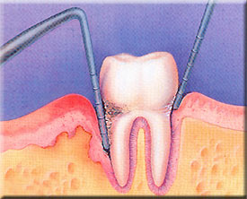
Chronic Periodontitis
This presentation will probably involve audience discussion, which will create action items. Use PowerPoint to keep track of these action items during your presentation
In Slide Show, click on the right mouse button
Select “Meeting Minder”
Select the “Action Items” tab
Type in action items as they come up
Click OK to dismiss this box
This will automatically create an Action Item slide at the end of your presentation with your points entered.
1

Slide 2
INDEX
Introduction
History
Classification
Clinical features
Histological & radiographical features
Mechanisms of destruction
Treatment
Conclusion

Slide 3
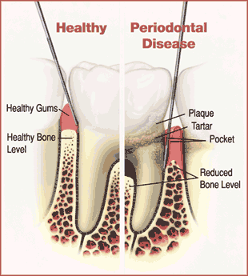
INTRODUCTION
Chronic periodontitis is defined as inflammation of the gingiva extending into the adjacent attachment apparatus.
The disease is characterized by loss of clinical attachment due to destruction of the periodontal ligament and loss of the adjacent supporting bone.⁽¹⁾

Slide 4
HISTORY
Based on clinical characteristics, G.V.Black (1886) classified periodontal disease into 5 types⁽²⁾:
Constitutional Gingivitis.
A painful form of gingivitis.
Simple gingivitis.
Calcific inflammation of the peridental membrane.
Phagedenic peri cementitis.

Slide 5
HISTORY Orban (1942) on the basis of etiology, clinical & pathologic features classified as⁽³⁾
Inflammation
-Gingivitis
-Periodontitis
- Simplex
- Complex
Degeneration
-Periodontosis
-Systemic disturbance
-Hereditary
-Idiopathic
Atrophy
-Periodontal atrophy
Hypertrophy
- Gingival hypertrophy
Traumatism
- Periodontal traumatism

Slide 6
Orban & Weinman– Periodontosis⁽⁴⁾
Three stages of the disease:
Stage I
Stage II
Stage III

Slide 7
HISTORY
“Pyorrhea Alveolaris”- Alphonse Toirac in 1823.
“Riggs Disease” – John W Riggs in mid 19th century.⁽⁴⁾
5 types of periodontitis- Page & Schroder in 1982 & AAP in 1986.⁽⁵⁾
“Chronic Periodontitis”- International workshop for classification of periodontal disease 1999

Slide 8
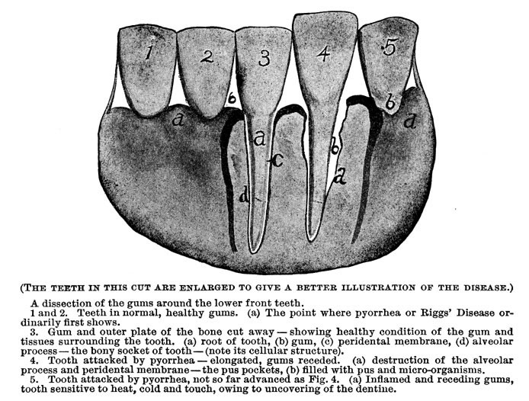
ADAPTED FROM
:www.householdphysicin.com.

Slide 9
Fleming in 1998 defined Chronic Periodontitis as:
“An infectious disease resulting from inflammation within the supporting tissue of the teeth, progressive attachment loss and bone loss”⁽⁶⁾

Slide 10
classification
Classification of periodontal diseases can be placed into three dominant paradigms primarily:
1870-1920: Based on clinical features of the disease.
1920-1970: Based on nature of pathologic changes.
1970-present: Based on the etiology of the disease.

Slide 11
The classification given by The Third World Workshop in Clinical Periodontitis (1989) included
adult periodontitis occurring ≥35 years.
The criteria of age and rate of progression were removed in the subsequent classifications given in 1996.

Slide 12
AAP (1999)- based on current clinical and scientific data.
Three general clinical manifestation of periodontitis.⁽⁷⁾
1. Chronic periodontitis
Localized
Generalized
2. Aggressive periodontitis
Localized
Generalized
3. Periodontitis as manifestation of systemic disease.
4. Two forms of necrotizing disease have been described:
NUG
NUP
Notes:
American academy of periodontology

Slide 13
Chronic periodontitis may be localized or generalized.
Localized periodontitis: When <30% of the sites assessed in the mouth demonstrate attachment and bone loss.
Generalized periodontitis: When >30% of the sites assessed in the mouth demonstrate attachment loss and bone loss.

Slide 14
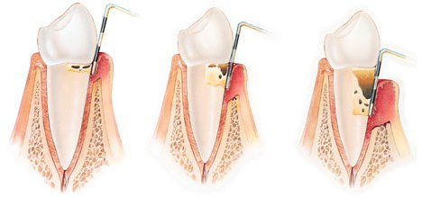
SUB - CLASSIFICATION
Mild: 1–2 mm of attachment loss
Moderate: 3–4 mm attachment loss
Severe: ≥ 5 mm attachment loss

Slide 15
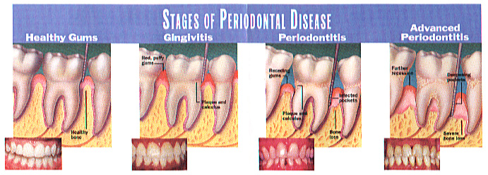
CHRONIC PERIODONTITIS
Most prevalent form of periodontitis.
It is generally considered to be a slowly progressing disease.
Although chronic periodontitis is most frequently observed in adults, it can occur in children and adolescents in response to chronic plaque and calculus accumulation.

Slide 16
CDC SURVEY 2010. Available at.www. http://www.cdc.gov/nchs/ppt/hp2010/focus_areas

Slide 17
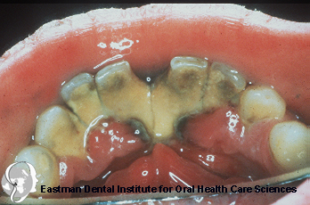
Clinical features
Alterations of the marginal gingiva.
Bleeding on probing .
Reduced resistance of the soft marginal tissues to probing (increased pocket depth or periodontal pocketing).
Loss of alveolar bone (even or angular pattern).
Root furcation exposure.
Increased tooth mobility.
Drifting and eventually exfoliation of teeth

Slide 18
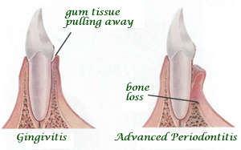
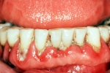
Symptoms
Usually painless.
Occasionally, pain may be present in the absence of caries due to exposed roots that are sensitive to heat, cold, or both.
Areas of localized dull pain, sometimes radiating deep into the jaw, have been associated with periodontitis.
The presence of areas of food impaction may add to the patient's discomfort.

Slide 19
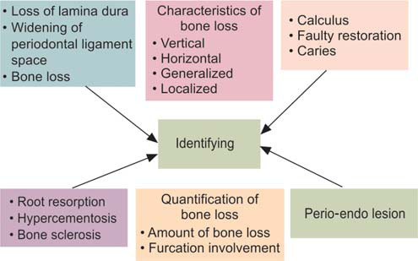
ROLE OF RADIOGRAPHS IN PERIODONTAL DISEASE
Raghavan V. Radiology in Periodontics. Journal of Indian Academy of Oral Medicine and Radiology, January-March 2013;25(1):24-29

Slide 20
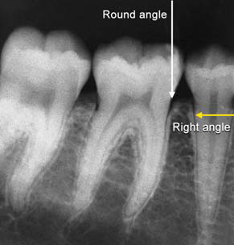
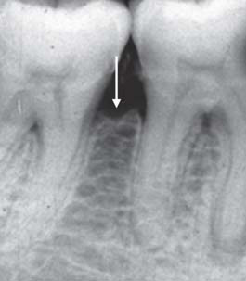
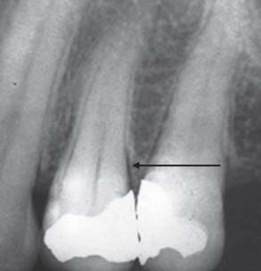
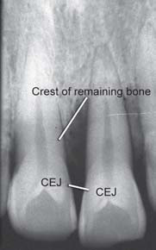
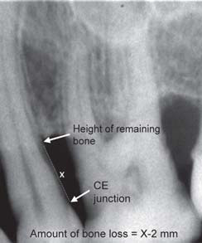
Junction of alveolar crest and lamina dura Crestal irregularities Widening of periodontal ligament space Evaluation of amount of bone loss Vertical bone loss

Slide 21
Disease distribution
Site specific disease.
The clinical signs of chronic periodontitis are considered to be due to direct, site specific effects of subgingival plaque accumulation.
As a result of this local effect, pocketing, attachment and bone loss may occur

Slide 22
Disease severity
The severity of destruction that occurs as a result of chronic periodontitis is generally considered a function of time.
With the increasing age, attachment loss and bone loss becomes more prevalent and more severe due to an accumulation of destruction.

Slide 23
Prevalence
Chronic periodontitis increases in prevalence and severity with age, generally affecting both sexes equally.
Periodontitis is an age-associated, not age-related, disease.
In other words,
It is not the age of the individual that causes the increase in disease prevalence, but rather the length of time that the periodontal tissues are challenged by chronic plaque accumulation.

Slide 24
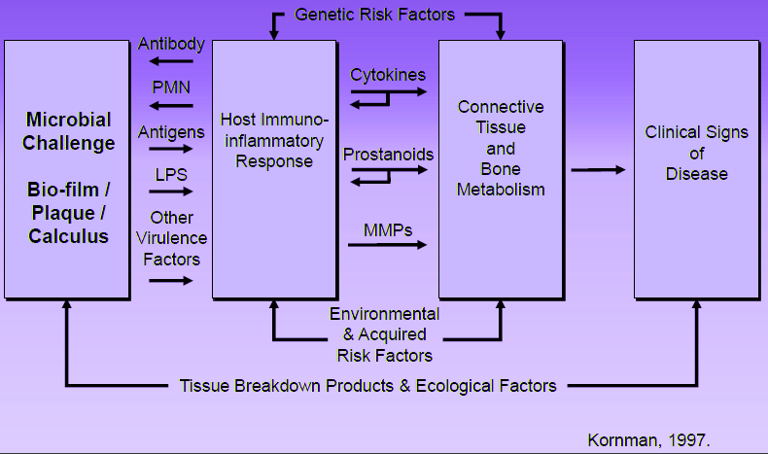
PATHOGENESIS
Kornman .1997.

Slide 25
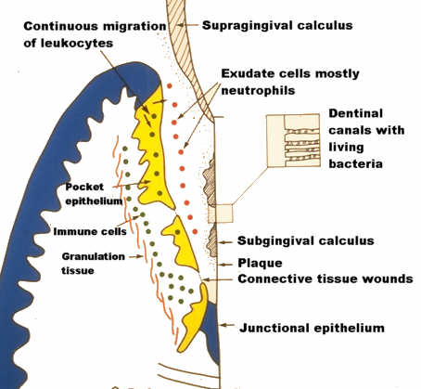
Disease progression
The rate of disease progression is usually slow but may be modified by systemic and/or environmental and behavioural factors.
More rapidly progressive lesions occur most frequently in interproximal areas and are usually associated with areas of greater plaque accumulation and inaccessibility to plaque control measures.⁽¹²⁾

Slide 26
MODELS OF DISEASE PROGRESSION
 | Slow, steady progressive disease process
Episodic burst theory | Irregular Continuous model Periods of exacerbation & remission
Synchronous burst theory | Periods of exacerbation & remission during a defined period
Epidemiologic model | Consistent with continuous disease aging process that depends only on duration of the process
Brownian motion or stochastic model⁽¹³⁾ | Random periods of sharp bursts and remission can occur, but underlying disease activity remains constant

Slide 27
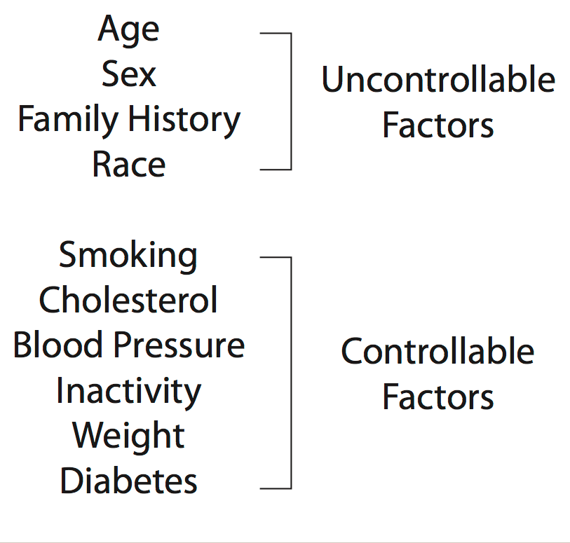
Risk factors for disease
The term “risk factor” means an aspect of lifestyle, or an environmental exposure, or an inborn or inherited characteristic, which on the basis of epidemiological evidence is known to be associated with a given disease.
Risk factors may be part of the causal chain of a disease and/or may predispose the host to develop a disease.

Slide 28
Local factors
Plaque accumulation on tooth and gingival surfaces
Specific plaque hypothesis - it is the presence of increased proportions of members of the red complex (P.gingivalis, T.forsythus, and Treponema denticola) that are frequently associated with ongoing attachment and bone loss in chronic periodontitis.

Slide 29
Plaque retentive factors –
Calculus
Subgingival and/or overhanging restorations
Carious lesions
Furcations
Malaligned teeth
Root grooves and concavities
Clasps of partial dentures
Traumatic occlusion
Microbial plaque (biofilm) is a crucial factor in inflammation of the periodontal tissues, but the progression of gingivitis to periodontitis is largely governed by host-based risk factors (Michalowicz 1994; Shapira et al 2005). ⁽¹⁵⁾

Slide 30
Systemic factors
A reduction in number or function of PMNs generally results in increased rate and severity of periodontal tissue destruction (Wilton et al. 1988). ⁽¹⁶⁾
Many drugs, such as phenytoin, nifedipine, and cyclosporine, predispose to gingival overgrowth in response to plaque and thus may modify pre-existing chronic periodontitis (Ellis et al. 1999). ⁽¹⁷⁾
Changes in circulating hormone levels may increase severity of plaque-induced gingival inflammation but typically do not result in any increased susceptibility to periodontitis.

Slide 31
Immunosuppressive drug therapy and any disease resulting in suppression of inflammatory and immune processes (such as HIV infection) may predispose the individual to exaggerated periodontal tissue destruction (Barr et al. 1992).⁽¹⁸⁾
Nutritional deficiencies in animals have been shown to affect the periodontal tissues.
Avitaminosis-C may also aggravate established chronic periodontitis.

Slide 32
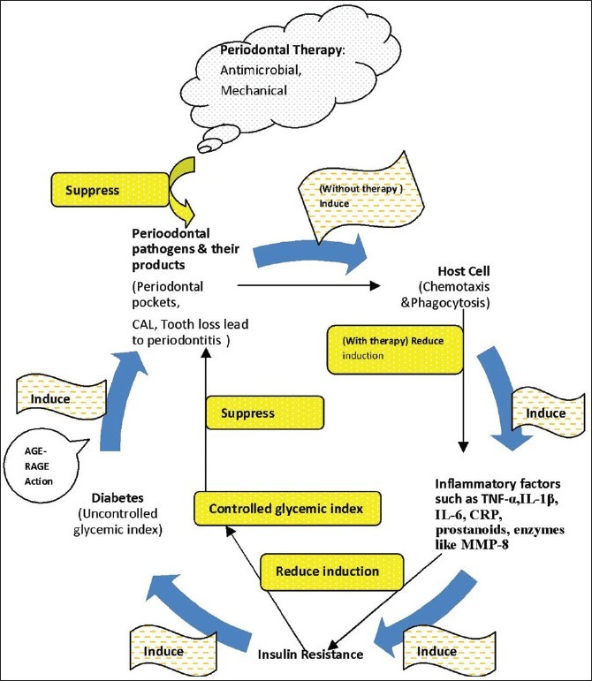
MODEL OF ASSOCIATION BETWEEN PERIODONTAL DISEASE AND DIABETES

Slide 33
Environmental factors
Kinane, Chestnutt (2000) suggested that risk attributable to tobacco for chronic periodontitis is between 2.5 and 7.0. ⁽²⁰⁾
Response to periodontal therapy is impaired in smokers.
Their signs and symptoms of both gingivitis and chronic periodontitis, are masked by dampening of inflammation.

Slide 34
Stress and other psychosomatic conditions may have direct anti-inflammatory and/or anti-immune effects on the body’s defenses.
The association between stress and disease is particularly strong for infectious diseases, inflammatory conditions, and impaired wound healing (Kiecolt-Glaser et al. 2002; LeResche & Dworkin 2002; Broadbent et al. 2003). ⁽²¹⁾
Chronic periodontitis has also been associated with psychosocial variables (Green et al. 1986; Linden et al. 1996; Genco et al. 1999; Wimmer et al. 2002; Pistorius et al. 2002).⁽²²⁾

Slide 35
Genetic factors
KORNMAN et at, 1998⁽²³⁾
Genetic variation or polymorphism in the genes encoding interleukin 1-α and interleukin 1-ß
An increased susceptibility to a more aggressive form of chronic periodontitis in subjects of Northern European origin.

Slide 36
There is a evidence from twin studies for a genetic predisposition to periodontal diseases
Mc Guire MK and Nunn ME (1999)⁽²⁴⁾
IL-1 genotype risk for tooth loss by 2.7 times.
Heavy smokers and IL-1 genotype negative increased the risk for tooth loss by 2.9 times.
Combined effect of the IL-1 genotype and smoking increased the risk of tooth loss by 7.7 times.

Slide 37
Diagnosis
Clinically
Presence of chronic inflammatory changes in marginal gingiva.
Presence of periodontal pockets
Attachment loss
Radiographically
Evidence of bone loss.
Based on the age of the patient, rate of disease progression over time, familial nature of aggressive disease, and relative absence of local factors in aggressive disease compared with the presence of abundant plaque and calculus in chronic periodontitis.

Slide 38
PROGNOSIS
Clinical attachment loss and bone loss are not very advanced (slight-to-moderate periodontitis), the prognosis is generally good, provided the inflammation can be controlled through good oral hygiene and the removal of local plaque-retentive factors
Severe disease… furcation involvement and increasing clinical mobility, or in patients who are noncompliant with oral hygiene practices, the prognosis …fair to poor.

Slide 39
Scientific basis of periodontal therapy
Low rates of tooth loss ( 0.1 tooth lost/year) in treated and well-maintained periodontitis patients (Lindhe & Nyman 1984, Nabers et al. 1988).
Patients who, following treatment, but were not complying with maintenance care had double the rate of tooth loss per year (0.2 teeth/year) (Becker et al. 1984),
Untreated patients lost approximately 0.6 teeth/year ( Becker et al. 1979). ⁽²⁵⁾

Slide 40
Essential therapeutic consideration for the clinician is to
control the infection
arrest the disease progression
correct anatomical defects
replace missing teeth
ultimately help the patient maintain periodontal health with frequent periodontal maintenance care.

Slide 41
Conventional non surgical periodontal therapy
It consists of patient education, oral hygiene improvement, scaling root planning and regular recall maintenance.
Badersten et al. (1984) demonstrated that chronic periodontitis can be treated successfully by intensive initial non-surgical periodontal therapy and this outcome can be maintained over time.⁽²⁶⁾

Slide 42
NON SURGICAL THERAPY
Local therapy
Elimination of plaque and calculus .
Relieve trauma from occlusion.
Abscess drainage .
Subgingival irrigation .
Supra and subgingival scaling & root planing.
Reduction in microorganisms.
(Philstrom et al 1983, Ramfjord et al 1987, Badersten et al 1987…. SRP is effective in reducing GI & PD)

Slide 43
Nonsurgical therapy
Antibiotics
Tetracyclines
Minocycline 200 mg/day for 1 week… spirochetes… Cianco & Slots et al.
Doxycycline. Subantimicrobial dose 20 mg twice daily…Caton et al .
Metronidazole…. 250mg tid/2weeks.
(Lekovic in 1983 & Loesche 1992)⁽²⁷⁾
Used in combination with ciprofloxacin, amoxicillin…

Slide 44
HOST MODULATION
Several agents have been used or evaluated to modify host response to disease.
The use of subantimicrobial-dose doxycycline (SSD) may help to prevent the destruction of the periodontal attachment by controlling the activation of MMPs, primarily collagenase and gelatinase, from both infiltrating cells and resident cells off the periodontium, primarily the neutrophils

Slide 45
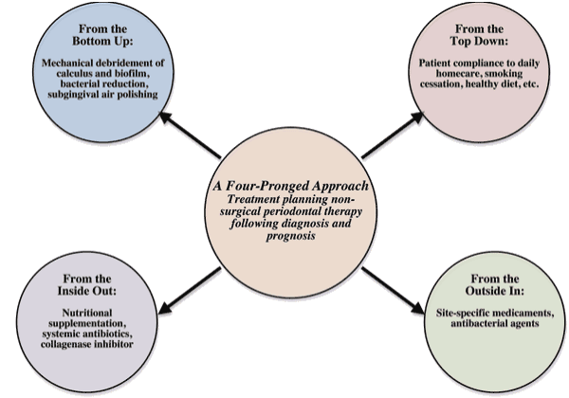
ADAPTED FROM:Kimberly R. Miller.Four Pronged Approach.RDH.2009:30(1).

Slide 46
LOCAL DELIVERY
The use of local delivery to administer antibiotics offers a novel approach to the management of periodontal “localized “infections.
The primary advantage of local therapy is that smaller total dosages of topical agents can be delivered inside the pocket, avoiding the side effects of systemic antimicrobial agents while increasing the exposure of the target microorganisms to higher concentrations.

Slide 47
Effect of surgical treatment
Surgical treatment permits visualization and access to the root surfaces and thus has clear advantages over a non-surgical approach for the cleaning of root surfaces.
Tissues may also be manipulated and lesions modified, or granulation tissue surgically removed.

Slide 48
Surgical therapy
NEW ATTACHMENT PROCEDURES
1. Grafts [Bone and alloplastic material].
2. Guided tissue regeneration.
Membrane
Coronal flap positioning
Chemicals
3. Root biomodification.

Slide 49
REGENERATIVE THERAPY
The use of regenerative materials, including bone graft, barrier membranes, and wound healing agents are well documented and often used.
Intrabony defects particularly vertical defects with multiple osseous walls are often amenable to regeneration with this technique.

Slide 50
LASER PERIOTHERAPY
Lasers can achieve excellent tissue ablation with strong bactericidal and detoxification effects.
Can reach sites that conventional mechanical instrumentation cannot.
Laser irradiation - bactericidal and detoxification effects without producing a smear layer.

Slide 51
VACCINES IN PERIODONTITIS
Porphyromonas gingivalis is considered to be the key pathogen in periodontitis.
Of all components, cysteine proteases have the greatest potential as a vaccine antigen.
Porphpain –2 purified from P. gingivalis is effective in inducing protection (Roy. C. page et al; 2000).
Since there is increase in evidence that periodontitis significantly increases the risk of potentially fatal diseases like coronary heart disease, stroke and complications from diabetes mellitus, a successful vaccine for periodontitis could have health benefits far exceeding the prevention of periodontitis.

Slide 52
CONCLUSION
Chronic periodontitis is an infectious disease characterized by generalized inflammation including tooth loss.
Proper maintenance and overall hygiene will lead to less occurrence and restoring good oral health

